Slide 1
AGIS: Towards Automatic Generation of Infection Signatures
Zhuowei Li^{1,3}, XiaoFeng Wang¹, Zhenkai Liang⁴ and Mike Reiter²
¹ Indiana University at Bloomington
² University of North Carolina at Chapel Hill
³ Center for Software Excellence, Microsoft
⁴ Carnegie Mellon University

Slide 2





Exploit signatures vs. infection signatures
Infection Signature
Exploit Signature

Slide 3

How to get infection signatures?
Manually analyze malware infections
Automated analysis
  Invariant extraction from replication code
  Checksum
  Invariance from network traffic
  ⇒ ☹ cannot handle even the simplest metamorphism

Slide 4
Our solution: AGIS
Automated malware analysis
  Run malware in a sandboxed environment
  Identify mal-behaviors using generalized polices
Automated infection signature generation
  From the code necessary for infections’ missions
  “vanilla” infections and regular-expression signatures
Certain resilience to obfuscated infections

Slide 5
Differences from prior work
Behavior-based malware detection
  Only analyze add-on based infections
  No signature generation
Panorama
  Finer-grained analysis, but very slow
  No signature generation

Slide 6
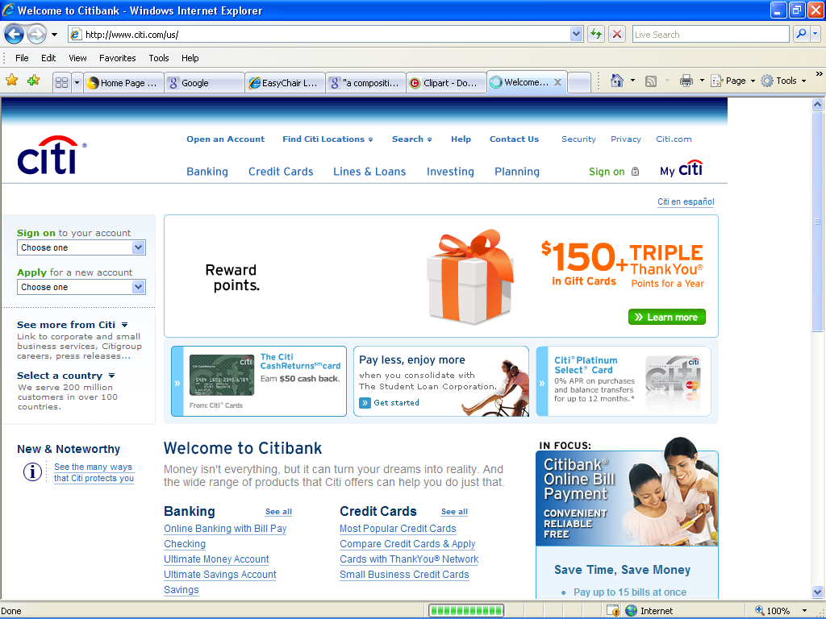








How does AGIS work?

Slide 7
Malicious behavior detection
Create an infection graph
Set detection policies
Detection and behavior extraction

Slide 8

Infection graph and back tracking
3. run
2. modify
keylogger process
downloader.exe
1. dowload
1. dowload
4. hook
5. save
hook.dll
run registry
keylogger.exe
key.log

Slide 9
Detection policies
Specifications for malicious behaviors
Keylogger rule
  syscall for hooking keyboard, and
  callback function ⇒ output syscalls (Writefiles, Sendto…)
Mass-mailing worm rule
  loop for searching directories to read file, and
  syscall ⇒ SMTP servers

Slide 10
Infection signature extraction
Dynamic analysis and static analysis
  Get instructions necessary for malicious behaviors
Build signatures
  from the instructions

Slide 11
Analyses
Dynamic analysis
  Find API calls for malicious behavior (M-calls)
  Identify their call sites through stack walking
Static analysis
  Instructions prepares for M-calls’ parameters (chops)

Slide 12
Obfuscated code
Metamorphism
  Junk-code injection: dealt by chops
  Code transposition: dealt by CFG
  register assignment, instruction replacement: left for scanner
Polymorphism
  Modify code ⇒ signature

Slide 13
Get signatures
Vanilla malware
  Chop
Regular-expression signature
  Blocks: consecutive instructions on a chop
  Conjunction of blocks

Slide 14
Implementation
Kernel driver
  Hook SSDT
Static analyzer
  Built upon Proview PVDASM

Slide 15
Evaluations
Malware
  Mydoom (D/L/Q/U)
  NetSky (B/X)
  Spyware. KidLogger
  Invisible KeyLogger
  Home Keylogger
Evaluations of detection and signature generation

Slide 16
Examples for detection
MyDoom
  Loop-read using NtReadFile
  Send messages through NtDeviceIOControlFile
  Violate the mass-mailing rule
Spyware.KidLogger
  Hook using NtUserSetWindowsHookEx
  Write through NtWriteFile
  Violate the keylogger rule
False positives
  Find none from 19 common applications (BiTorrent, browers, MS office, google desktop…)

Slide 17
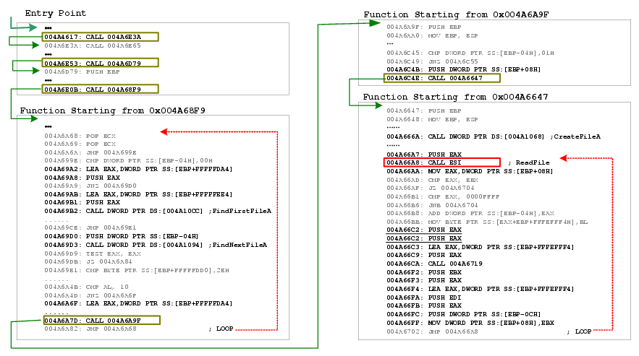
Chop for Mydoom.D

Slide 18
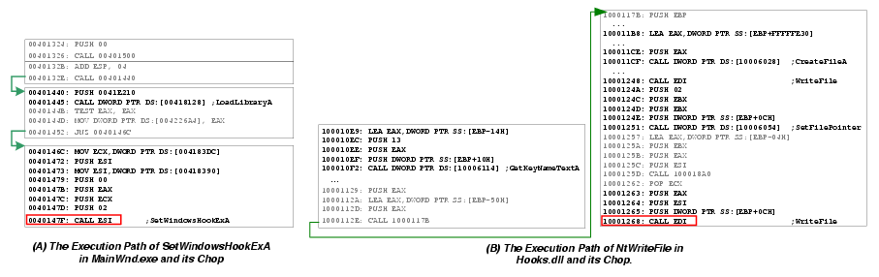
Chop for Spyware.KidLogger

Slide 19
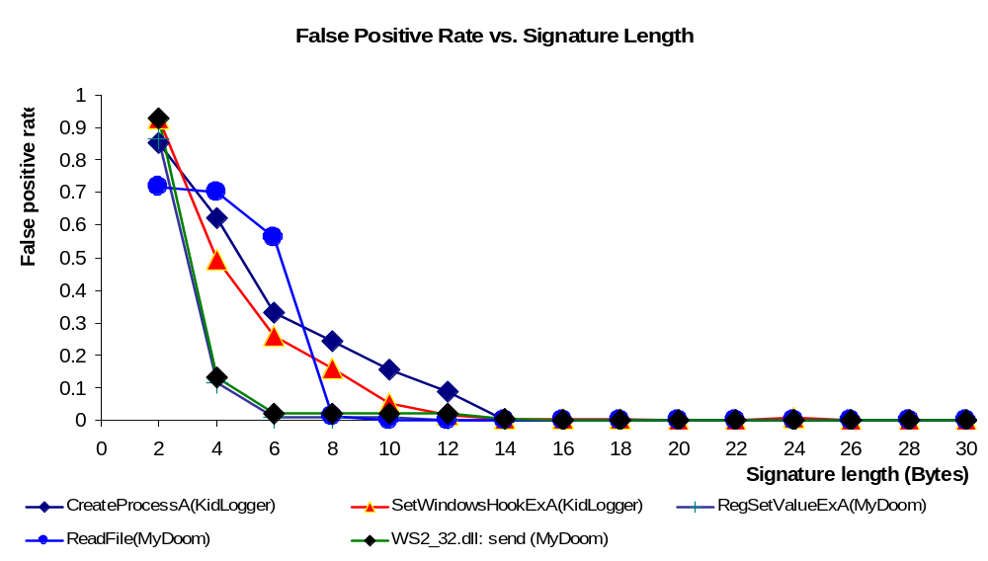
FP rate vs. sig length

Slide 20
Other evaluations
FP of vanilla signatures
  Statically checked 1378 normal programs, no match
Obfuscation
  Obfuscate code with RPME: extracted right chop
  Encode using UPX: found encoding loop
Performance
  Detection: around 1 minute
  Signature generation: less than 1 minute

Slide 21
Limitations
User-land infections only
Not for add-ons
Undecideabiblity of Static obfuscation analysis
Obfuscation of behaviors

Slide 22
Conclusions and future work
Achievements
  1st infection signature generation approach for host
  Work on today’s user-land infections
Future work
  Efficient dynamic analytic tools
  Better scanning techniques

