Slide 1
PRECIP: Towards Practical and Retrofittable Confidential Information Protection
XiaoFeng Wang (IUB), Zhuowei Li (IUB), Ninghui Li (Purdue) and Jong Youl Choi (IUB)

Slide 2

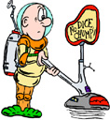

How to protect your information from spyware?
However…
However…
Prevent it !
Detect it !

Slide 3



The last defense line
Contain unauthorized surveillance

Slide 4
Spyware containment
Existing access control mechanisms are insufficient
  Spyware can watch authorized party’s access to a secret
Alternative: information flow security
  Track sensitive data
  Prevent them from flowing into unauthorized parties

Slide 5


Information flow security
The Bell-LaPadula model
highly
sensitive
sensitive
sensitive
public

Slide 6
However, this is insufficient for a modern OS
User input object
  keyboard, mouse…
  When does it become sensitive?
Other shared object
  screen, clipboard …
  sensitive? public?
Multitasked subject
  Work concurrently on public and sensitive data
  Which output is sensitive?

Slide 7
Requirements for a usable IF model
Work on a modern OS
Efficient enough for online operation
  Instruction-level tracking can be too slow
Retrofittable to legacy systems
  Avoid modifying the source code of app, of OS

Slide 8
PRECIP
A first step towards practical and retrofittable confidential information protection
Track an application’s input/output dependence
Model input object and shared object
Designed for online operations
Retrofittable to legacy applications and OS

Slide 9
The model
Subjects and objects
  Local objects (files, buffers, keyboard, screen,…)
  Remote objects (website…)
  User input objects (UIO): objects for transferring inputs (keyboard)
Channels
  Connect subject to subject, subject to object, object to subject
  A path is composed of multiple channels
Messages
  Information on a channel in the form of “messages”
  Examples: keyboard events, mouse events, data through a “read” call

Slide 10
The model (cont’d)
Dependency relation
  Output messages depend on some input messages
  An input to the PRECIP model
Sensitivity levels
  high: “sensitive”, low: “public”
Trusted and untrusted subjects
  Untrusted: unknown dependency relations
  Trusted: all dependency relations are known

Slide 11
Security objective
Information is sensitive if
  it depends (directly or transitively) upon a message from an sensitive object, or sensitive inputs from an UIO
Information leakage happens if
  Sensitive info gets into an untrusted subject or a remote public object
Objective: Sensitive information shouldn’t be leaked

Slide 12
Policies achieving the objective
Tracing rules
  Sensitive msg: either from a sensitive obj or dependent upon a sensitive msg
  Obj ⇒ sensitive if it receives a sensitive msg
  UIO ⇒ sensitive iff a path connects it to a sensitive obj
  Obj ⇒ public if it is cleaned
Control rules
  Block sensitive msg to public remote obj and untrusted sub
  Sensitive info to a local obj ⇒ block the msg or mark the obj sensitive

Slide 13
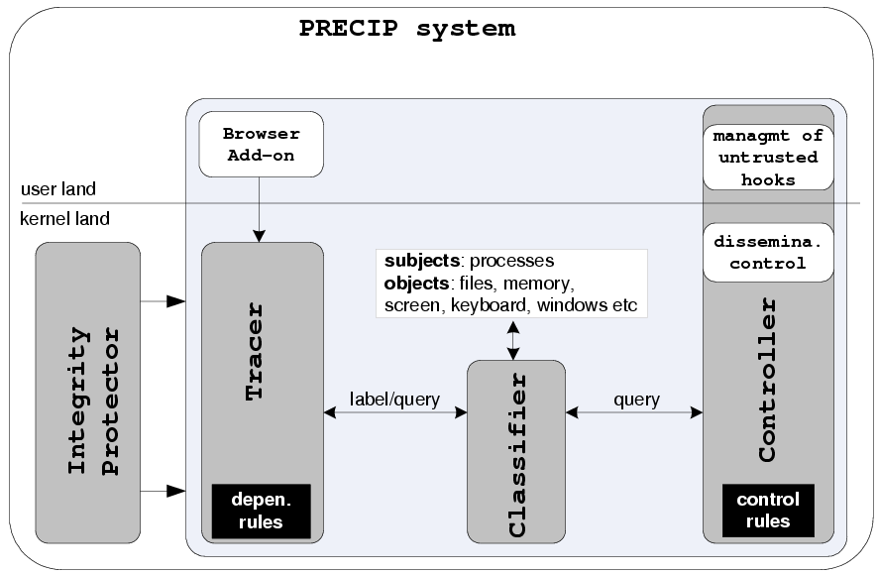
Application of PRECIP to Windows XP

Slide 14
Adversary model
Spyware is not inside the kernel when PRECIP is installed
  However, our integrity protector can preventspyware to be installed through system calls
PRECIP is not designed for preventing exploit of software vulnerabilities
  We use existing tools to do the job

Slide 15
Classification and labeling
Trust levels
  Classify applications according to dependency rules
  Mark an executable using its NTFS file stream
Sensitivity levels
  Automatic classification: using a file’s DAC

Slide 16
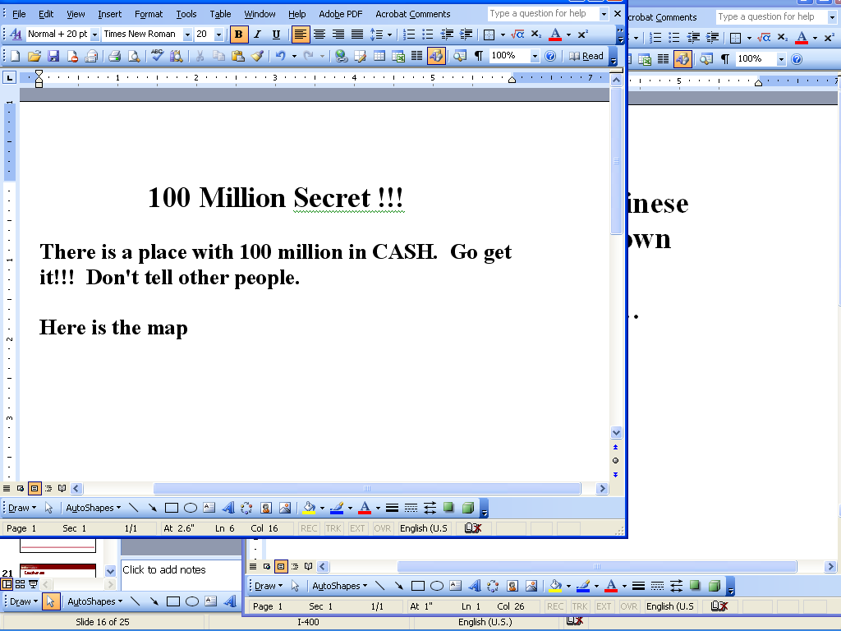
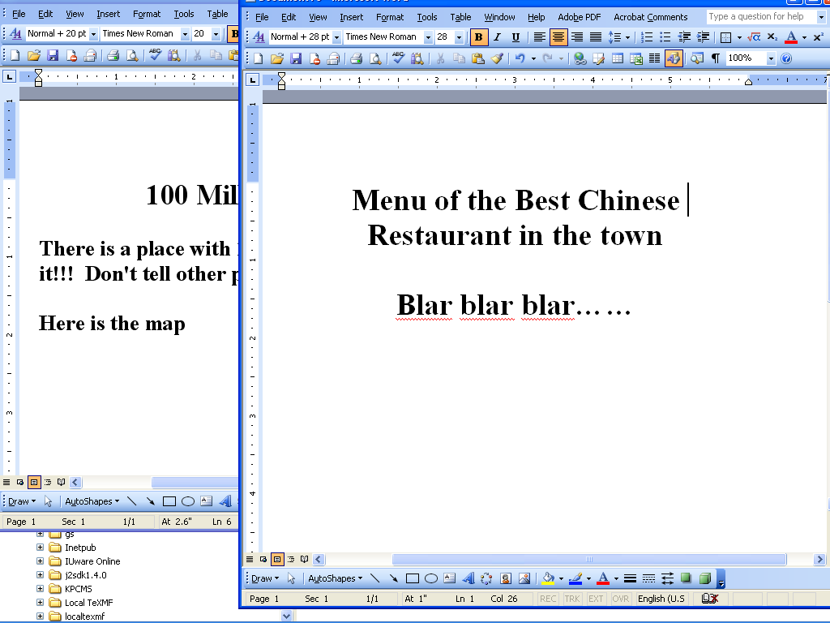
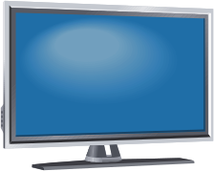




Dependency rules for editing/viewing App
Sensitive
Sensitive
Sensitive
Public
Sensitive
Public
Sensitive
Public
Sensitive
Public

Slide 17
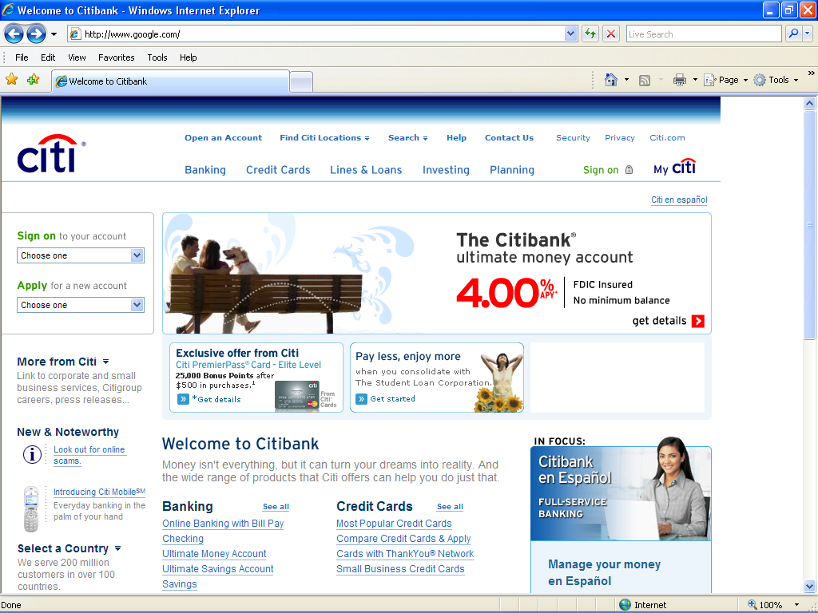
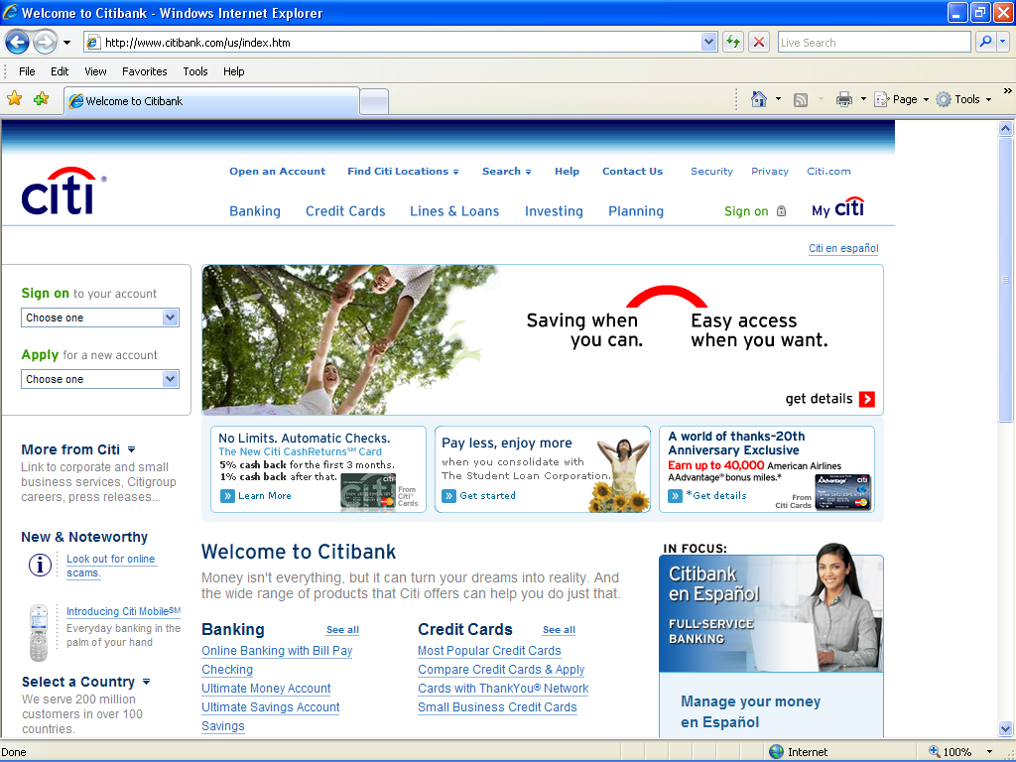
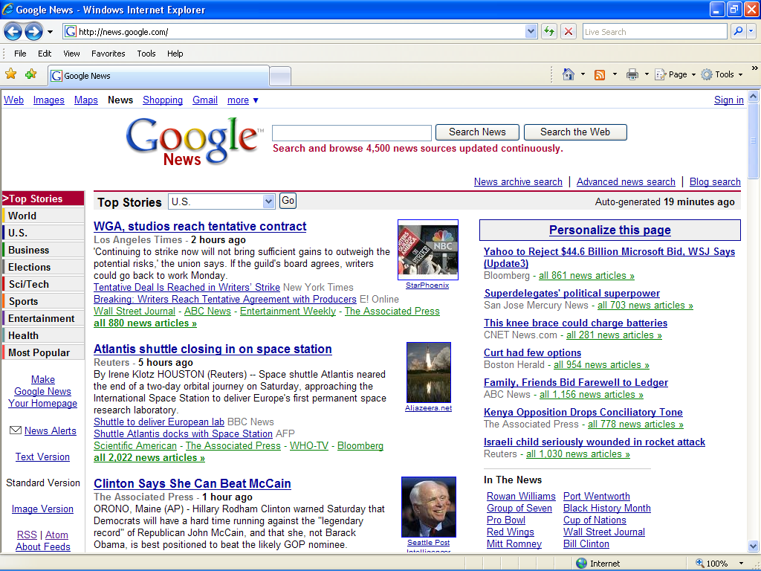
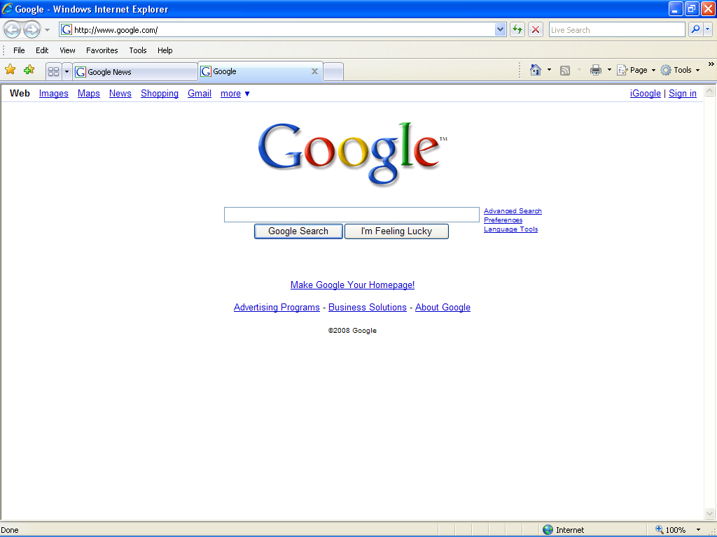
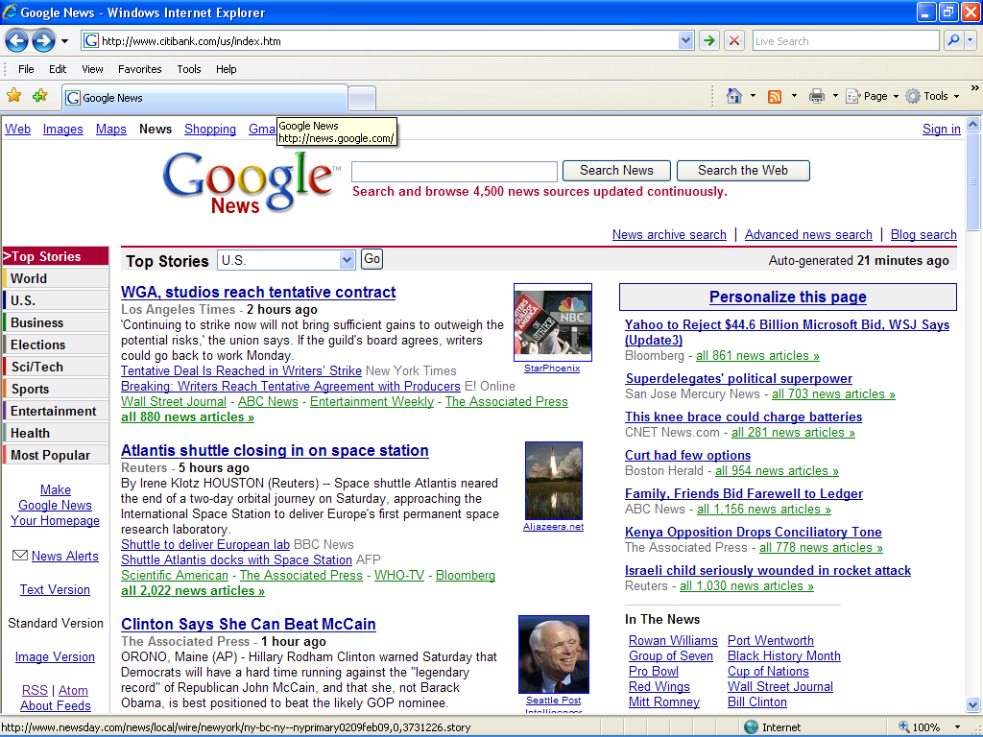
Dependency rules for web browsers

Slide 18
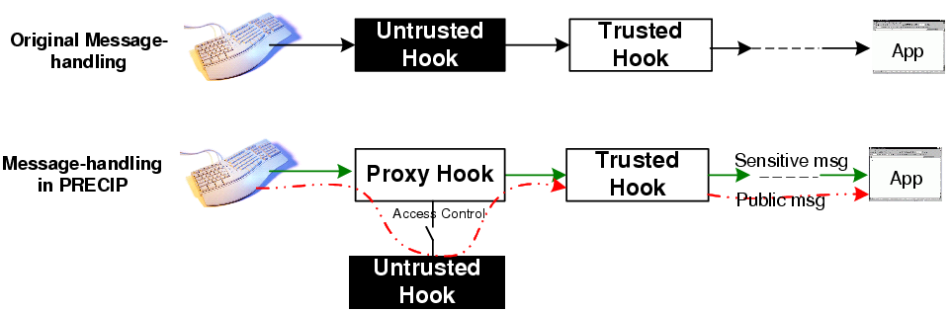
Management of hooks

Slide 19
Integrity protection
Prevent unauthorized access of subject’s and object’s labels, contents and PRECIP settings
  Regulate calls related to file system, auto-start extensibility points and process
Only allow signed kernel drivers to be loaded
  A policy also used in Windows Vista

Slide 20
Evaluation
Dependency rules
  Test dependency rules on Microsoft office, Adobe Acrobat and Notepad
  Quite effective in most cases
Effectiveness
Performance

Slide 21
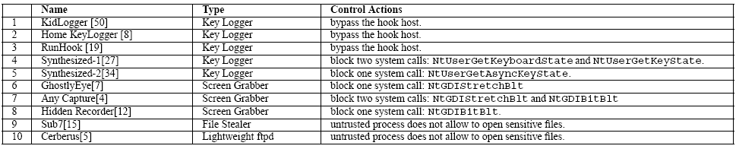
Effectiveness

Slide 22
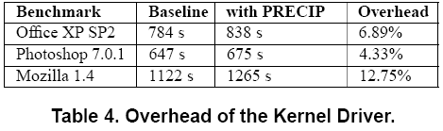
Performance
Performance of hook management
  Baseline (no proxy): 691.015 microseconds
  PRECIP: 784.809 microseconds
  Overhead: 13.57%
Performance of the kernel driver
  Evaluated using WorldBench 5.0

Slide 23
Limitations
Dependency rules are empirical
  Research: automatic analysis of an application to generate rules
Integrity model as a complementary
Model is incomplete
  Multiple sensitivity levels
  Compartmentalization

Slide 24
Related research
Language-based information flow security
  For design of a new program
Instruction-level tracking
  Hard to use online without hardware support
New systems such as Abestos, IX, Flume,…
  Need to modify OS
Sandboxing techniques
  Too coarse-grained

Slide 25
Conclusions
Propose a new confidentiality model for practical and retrofittable IF protection
Application of the model to Windows XP
Future research
  Improve the model
  Improve the techniques for enforcing the model

