Slide 1


Packet Vaccine: Black-box Exploit Detection and Signature Generation
XiaoFeng Wang, Zhuowei Li
Jun Xu, Mike Reiter
Chongkyung Kil and Jong Youl Choi

Slide 2
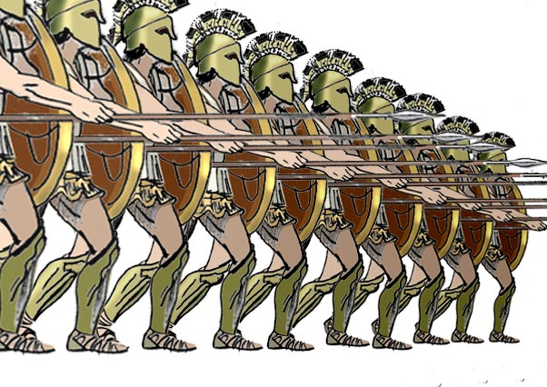


Automated Exploit Defense

Slide 3


Expectations for Automated Defense?
A perfect fix to vulnerable software?
A reasonably secure and fast-generated fix seems more realistic

Slide 4

Automatic Exploit Defense: the State of Art
Source code instrument
Static analysis of source code
Monitor an application’s execution
to the break point
Static analysis of binary code

Slide 5
Vaccine
Vaccine: a weakened viruses or bacteria for stimulating antibody production
How about a black-box “packet vaccine” ?

Slide 6


IDEAS
2. exception and analysis
1. scramble anomalous payload
3. Injection of vaccine variances

Slide 7
Properties
Fast Exploit Detection
Black-box Signature Generation
  Work on obfuscated code
Little or no modification to the protected system

Slide 8




Design
1. Vaccine Generation
2. Exploit Detection
4. Signature
Generation
3. Vulnerability
Analysis

Slide 9
Vaccine Generation
How to generate a weakened exploit?
Our approach
  Identify an address-like byte token on a packet
  Randomize it

Slide 10
Address-like Tokens
Use address range
  stack: 0xc0000000
  heap: 0x08048000
  entries of some libc functions
Where to get them?
  Linux: /proc/pid/maps
  Windows: debugging tools/memory monitoring tools

Slide 11
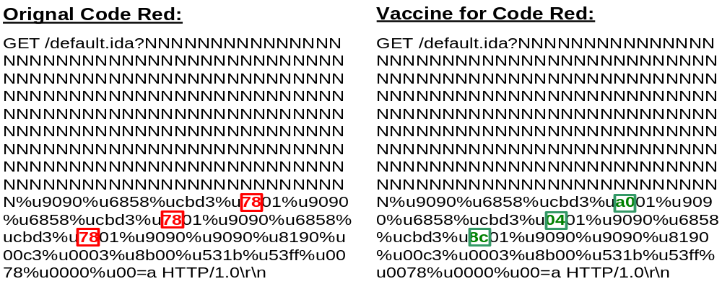
Example
Byte sequence `7801cbd3' falls in the address range of “msvcrt.dll”

Slide 12
Exploit Detection and Vuln. Diagnosis
Detection:
  Exception happens
Diagnosis
  Pickup the contents from CR2 and EIP
  Match them to the scrambled byte sequences
  Locate the corrupted pointer

Slide 13
Signature Generation (1)
App-independent Signatures
  Byte sequences
Byte-based Vaccine Injection (BVI)
  Modify one byte and the jump address
  Send to the application
  not crash ⇒ important byte

Slide 14
Signature Generation (2)
Application-level Signatures
  field length (buffer overrun)
  special symbols (e.g, “%n” for formate string)
App-based Vaccine Injection (AVI)
  the minimal field length ⇒ crash
  remove special tokens ⇒ no crash

Slide 15
Performance
BVI is parallelizable
  for multi-process application
AVI can be enhanced by binary search

Slide 16
Implementation
Intercept application-level dataflow to detect suspicious tokens
Scramble them to generate vaccines
Signature generation (RedHat Linux 7.3)
  Verifier: implemented using ptrace
  Prober: local/remote
  Prober and verifier: a persistent connection
  Verifier notifies Prober of exceptions

Slide 17
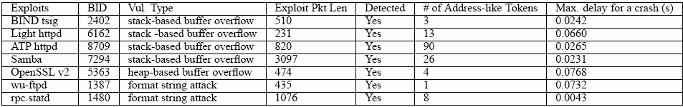
Experiment: Vaccine Effectiveness

Slide 18
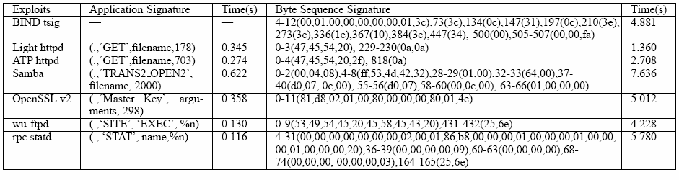
Experiment: Signature Generation

Slide 19
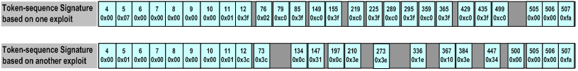
Signature Quality: BIND
Comparison between our signature and MEP (oakland 06)

Slide 20
Signature Quality: ATP http
MEP
  get “GET” and “HEAD”
  But specific tokens ‘/’ and ‘//’ and longer field length (812)
AVI:
  Only “GET”
  But more precise field length (703)
The real buffer size is 680

Slide 21
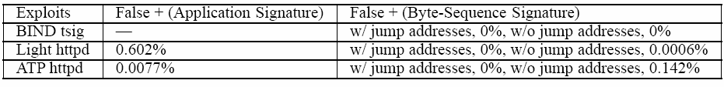
False positives

Slide 22
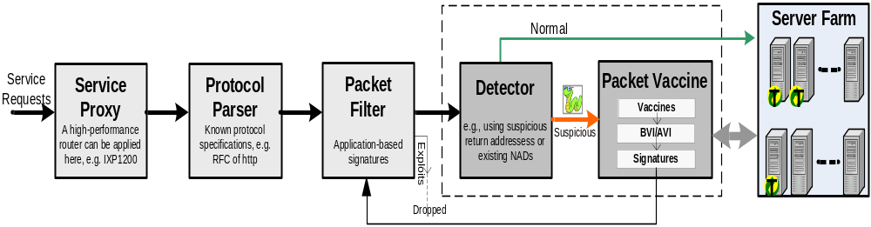
Application: Protecting Internet Servers

Slide 23
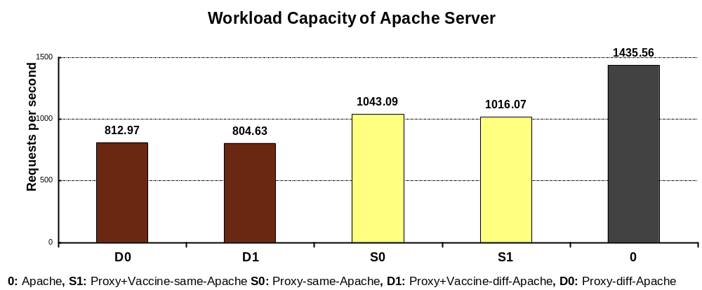
Server Workload
1043.09-1016.07=27.02
812.97-804.63=8.34

Slide 24
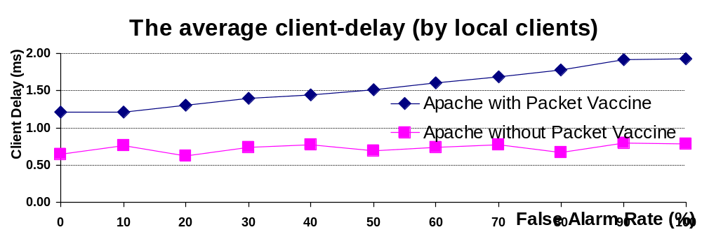
Local Client Delay

Slide 25
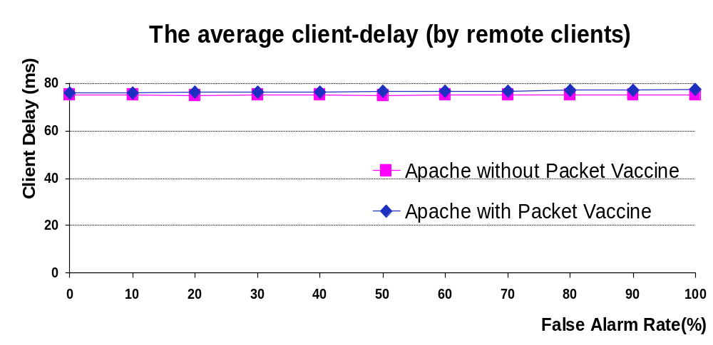
Remote Client Delay

Slide 26
Other Applications
Vulnerability Scanner
A lightweight replacement for Grey-box approaches
Proactive discovery and fix of vulnerabilities

Slide 27
Limitations
False negatives in exploit detection
Encrypted payload and checksums
Signature limitations in representation

Slide 28
Future Work
Generation of more accurate signatures
Proactive detection of software vulnerabilities

