Slide 1



Shuo Chen
Rui Wang, XiaoFeng Wang and Kehuan Zhang
IEEE Symposium on Security and Privacy
Oakland, California
May 17th, 2010

Slide 2





Traditional PC application
Web application
split between client and server
state transitions driven by network traffic
Worry about privacy? Let’s do encryption.

Slide 3

The eavesdropper cannot see the contents, but can observe :
  number of packets, timing/size of each packet
Previous research showed privacy issues in various domains:
  SSH, voice-over-IP, video-streaming, anonymity channels (e.g., Tor)
Our motivation and target domain:
  target: today’s web applications
  motivation: Software-as-a-Service (SaaS) becomes mainstream, and the web is the platform to deliver SaaS apps.

Slide 4

Surprisingly detailed user information is being leaked out from several high-profile web applications
  personal health data, family income, investment details, search queries
  (Anonymized app names per requests from related companies)
The root causes are some fundamental characteristics in today’s web apps
  stateful communication, low entropy input and significant traffic distinctions.
Defense is non-trivial
  effective defense needs to be application specific.
  calls for a disciplined web programming methodology.

Slide 5



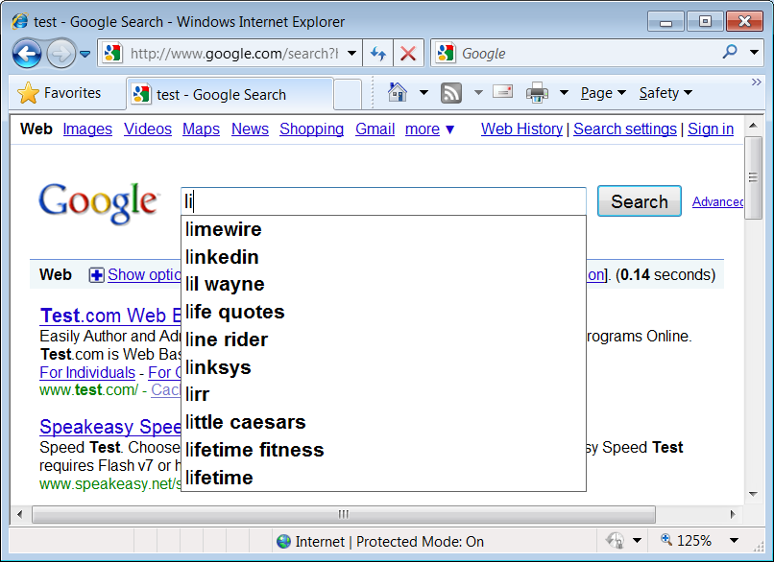
Scenario: search using encrypted Wi-Fi WPA/WPA2.
Example: user types “list” on a WPA2 laptop.
821➔
⬅ 910
822➔
Query suggestion
⬅ 931
823➔
⬅ 995
824➔
⬅ 1007
Attacker’s effort: linear, not exponential.
Consequence: Anybody on the street knows our search queries.

Slide 6

(“^{A}” denoting a pseudonym)
A web application by one of the most reputable companies of online services
Illness/medication/surgery information is leaked out, as well as the type of doctor being queried.
  Vulnerable designs
  Entering health records
    By typing – auto suggestion
    By mouse selecting – a tree-structure organization of elements
  Finding a doctor
    Using a dropdown list item as the search input

Slide 7

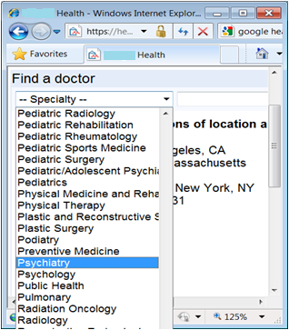
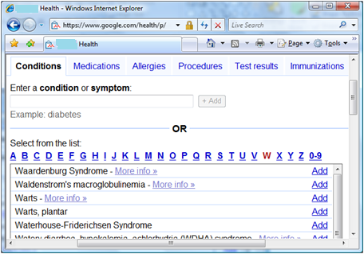
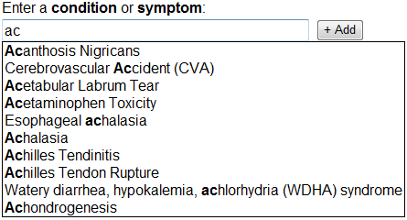
Entering health records: no matter keyboard typing or mouse selection, attacker has a 2000× ambiguity reduction power.
Find-A-Doctor: attacker can uniquely identify the specialty.
tabs
suggestions

Slide 8

It is the online version of one of the most widely used applications for the U.S. tax preparation.
Design: a wizard-style questionnaire
  Tailor the conversation based on user’s previous input.
  The forms that you work on tell a lot about your family
    Filing status
    Number of children
    Paid big medical bill
    The adjusted gross income (AGI)

Slide 9
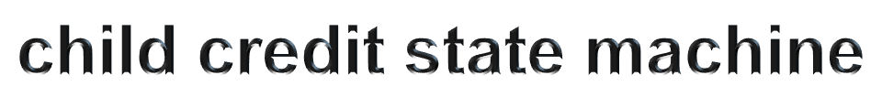

All transitions have unique traffic patterns.
Entry page of Deductions & Credits
Summary of Deductions & Credits
Not eligible
Full credit
Partial credit
Consult the IRS instruction:
  $1000 for each child
  Phase-out starting from $110,000. For every $1000 income, lose $50 credit.
$0
Full credit
Partial credit
Not eligible
$110000
$150000
(two children scenario)

Slide 10
$0
Even worse, most decision procedures for credits/deductions have asymmetric paths.
  Eligible – more questions
  Not eligible – no more question
Full credit
Partial credit
Not eligible
$115000
$145000
Entry page of Deductions & Credits
Summary of Deductions & Credits
Not eligible
Enter your paid interest
Full credit
Partial credit

Slide 11
$0
Disabled Credit
$24999
Earned Income Credit
$41646
Retirement Savings
$53000
College Expense
$116000
IRA Contribution
$85000
$105000
Student Loan Interest
$115000
$145000
Child credit *
$110000
$130000 or $150000 or $170000 …
First-time Homebuyer credit
$150000
$170000
Adoption expense
$174730
$214780
We are not tax experts.
OnlineTax^{A} can find more than 350 credits/deductions.

Slide 12

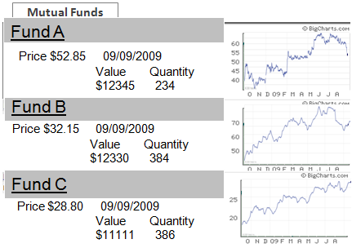
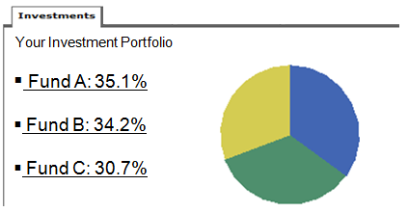

A major financial institution in the U.S.
Which funds you invest?
No secret.
Each price history curve is a GIF image from MarketWatch.
Everybody in the world can obtain the images from MarketWatch.
Just compare the image sizes!
3346 B
3312 B
3294 B
Your investment allocation
Given only the size of the pie chart, can we recover it?
Challenge: hundreds of pie-charts collide on a same size.

Slide 13

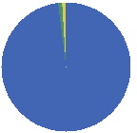
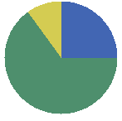
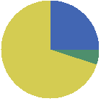
Inference based on the evolution of the pie-chart size in 4-or-5 days
The financial institution updates the pie chart every day after the market is closed.
The mutual fund prices are public knowledge.
≅ 80000 charts
Size of day 1
Size of day 2;
Prices of the day
Size of day 3;
Prices of the day
Size of day 4;
Prices of the day
≅ 800 charts
≅ 80 charts
≅ 8 charts
1 chart

Slide 14
Root causes: some fundamental characteristics of today’s web applications

Slide 15
Fundamental characteristics of web apps
Significant traffic distinctions
  The chance of two different user actions having the same traffic pattern is really small.
  Distinctions are everywhere in web app traffic. It’s the norm.
Low entropy input
  Eavesdropper can obtain a non-negligible amount of information
Stateful communication
  Many pieces of non-negligible information can be correlated to infer more substantial information
  Often, multiplicative ambiguity reduction power!

Slide 16
Challenges in Mitigating the Side Channel Threat

Slide 17

Traffic differences are everywhere. Which ones result in serious data leaks?
  Need to analyze the application semantics, the availability of domain knowledge, etc.
  Hard.
Is there a vulnerability-agnostic defense to fix the vulnerabilities without finding them?
  Obviously, padding is a must-do strategy.
    Packet size rounding: pad to the next multiple of Δ
    Random-padding: pad x bytes, and x ∈ [0, Δ)
  We found that even for the discussed apps, the defense policies have to be case-by-case.

Slide 18
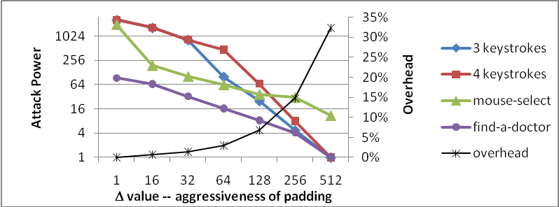
OK to use rounding or random-padding
32.3% network overhead (i.e., 1/3 bandwidth on side-channel info hiding)

Slide 19
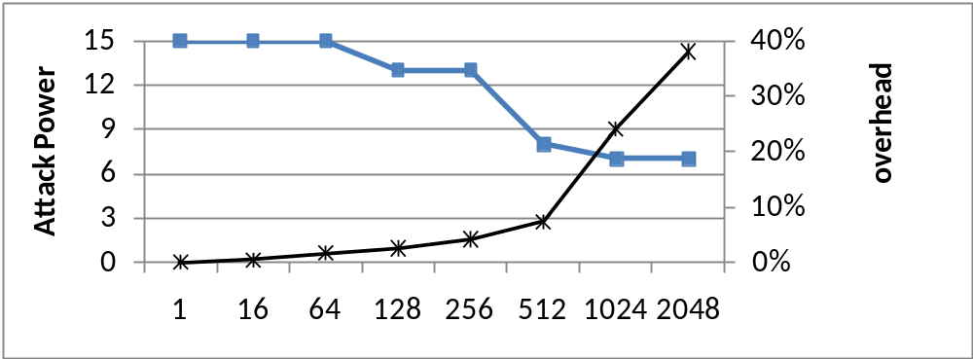
Neither rounding nor random-padding can solve the problem.
  Because of the asymmetric path situation

Slide 20
Rounding is not appropriate, because
  Google’s responses are compressed.
  The destination networks may or may not uncompress the responses
    E.g., Microsoft gateways uncompress and inspect web traffic, but Indiana University does not.
    rounding before the compression ➔Indiana Univ. still sees distinguishable sizes;
    rounding after the compression ➔ Microsoft still sees distinguishable sizes

Slide 21
Random padding is not appropriate, because
  Repeatedly applying a random padding policy to the same responses will quickly degrade the effectiveness.
    Suppose the user checks the mutual fund page for 7 times, then
      96% probability that the randomness shrinks to Δ/2.
OnlineInvest^{A} cannot do the padding by itself
  Because the browser loads the images from MarketWatch.

Slide 22


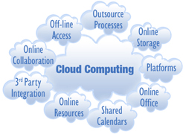
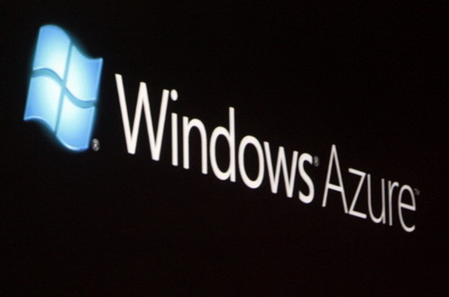
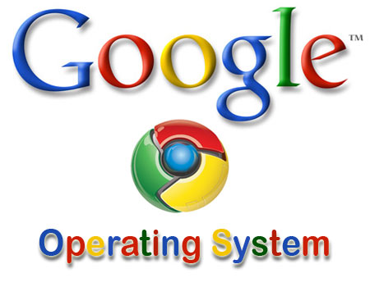
Need to develop a disciplined methodology for side-channel-info hiding

Slide 23

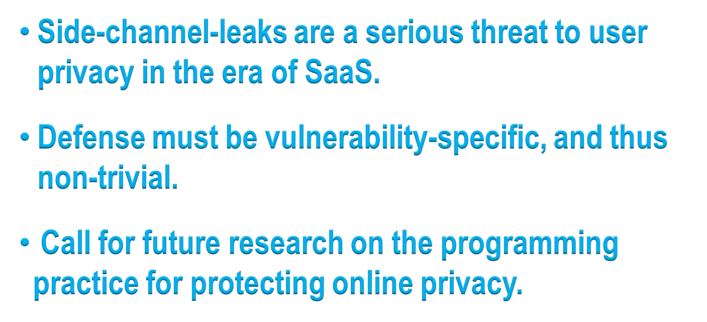

Slide 24
Reviews: What need to be covered
What the paper talks about
  Summarize your understanding of the paper
Strength of the paper
  Novelty, soundness, practicality, evaluation and presentation
Weakness of the paper
Your decision and justifications
Suggestion for improvement

Slide 25
Example of a decent review
===== Summary of the paper =====
This paper explores the space of side channel leaks in web applications. Specifically, the paper explores attacks on inferring private data by observing HTTP / HTTPS traffic. The main idea is to infer the application space by using the size of the HTTPS traffic -- an attacker armed with knowledge about how an application works can infer the nature of the interaction and therefore infer private information about the user. The paper constructs several real world scenarios in which highly sensitive information about users is uncovered. Some mitigation strategies are proposed.
===== Recommendation =====
Best Argument for:
This is clearly interesting work. These attacks are novel, and the amount of information uncovered from popular web sites is impressive.
This is also a timely topic.
Against:
The paper discussion of defenses is not very comprehensive.
The writing could improve.

Slide 26
Example of a decent review
===== Comments for authors =====
I like the paper. The attacks is simple but effective, the amount of information gleaned is impressive, and there is good real-world experimental data to support these claims!
Would these attacks be more difficult if the attacker didn't know the web site the user was visiting? Perhaps it will be. For example, a user may use an trusted third party anonymizer over HTTPS which does not reveal any information about the web site being visited. In this case, can a side channel attack also needs to identify the web site. (can a side channel be used to identify a web site in the above scenario?) If the web site isn't identified, how useful is this attack?
The attack on Investments secrets is also impressive, and shows how gradually over a period of time, the search space for the attacker reduces.
It would have helped if the paper addressed a related question: Given some specifications of what kind of sensitive data is handled by an arbitrary site, is there a systematic methodology to uncover side channel leaks in this site? I'd have been thrilled about this work had it started out with a general methodology to answer this question, that is specialized by the custom analysis of the individual sites. (Some of the work in answering the question is already there in the paper). Without such an analysis section upfront, the paper reads as a collection of novel attacks on a bunch of sites, without developing further science. Something for the authors to think about.

Slide 27
Example of a bad review
This paper discusses the fact that well-known side channels (e.g., the result of efficiency requirements in the case of encrypted communication) are neglected in many of today's products.
(The reviewer does not even realize the scope of the research)
This is an important problem to look into. My only concern related to this paper is the fact that there seems to be little novelty in the way of actual research nuggets. Remedies come to mind, yet the proposed techniques are well known and straightforward (e.g., padding, or variants thereof etc).
(Is the paper all about remedy?)
This would be a great article for the IEEE S&P Magazine or similar. (Why?)
Is there something wrong with the formatting style ? It seems to not be the required Oakland IEEE format.

Slide 28
How to write a good review
Read a paper carefully
  What is it about? Is it on a right topic? Do you understand the techniques? Do you know related research?
Compare its merits to the state of the art
  Marginal? Incremental? a surprise?
Evaluate its practical impacts
  Do you believe it works? Is the evaluation part convincing? Any chance for its adoption?
Comment on its presentation
  Is the paper well organized? Are the main idea and technical details clearly and adequately stated? Any writing problems?
Help the authors improve their paper

Slide 29
Homework: read the following papers
Signing Me onto Your Accounts through Facebook and Google: a Traffic-Guided Security Study of Commercially Deployed Single-Sign-On Web Services
How to Shop for Free Online – Security Analysis of Cashier-as-a-Service Based Web Stores
Soundcomber: A Stealthy and Context-Aware Sound Trojan for Smartphones

