Slide 1


To Release or Not to Release: Evaluating Information Leaks in Aggregate Human-Genome Data
Xiaoyong Zhou, Bo Peng, Yong Li, Yangyi Chen, Haixu Tang and XiaoFeng Wang
Indiana University, Bloomington
ESORICS 2011, Leuven, Belgium

Slide 2
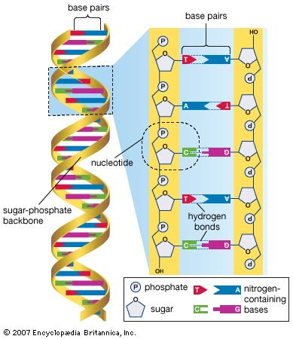

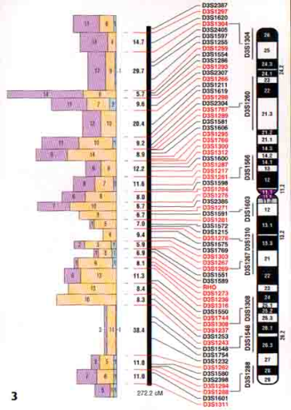
Backgrounds Human Genome Project
The Development of Human Genome Study
In 1953, Francis Crick and James Watson discovered the double helical structure of the DNA molecule
In the mid-1970s, Frederick Sanger developed techniques to sequence DNA.[1]
In June 2000, the majority of the human genome had in fact been sequenced.[1]
2010, the cost of genotyping one person is also small. Estimated less than $1000.
In 2008, President Bush signed into law S.1858 which allows the federal government to screen the DNA of all newborn babies in the U.S.

Slide 3
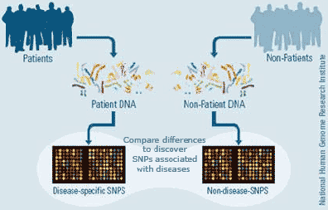
GWAS Study
Genome-Wide Association Study
An examination of all or most of the genes of different individuals of a particular species to see how much the genes vary from individual to individual. Different variations are then associated with different traits, such as diseases.

Slide 4
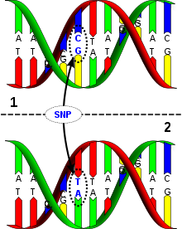
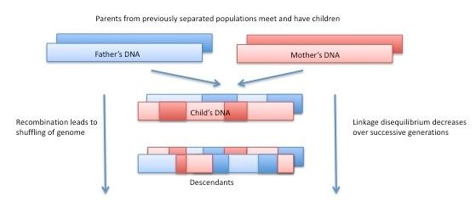
Terminologies in this Paper
Polymorphism: The occurrence of two or more genetic forms (e.g. alleles of SNPs) among individuals in the population of a species.
Single Nucleotide Polymorphism (SNP): The smallest possible polymorphism, which involves two types of nucleotides out of four (A, T, C, G) at a single nucleotide site in the genome.
Haplotype: Haplotype, also referred to as SNP sequence, is the specific combination of alleles across multiple neighboring SNP sites in a locus.
Linkage disequilibrium(LD): Non-random association of alleles among multiple neighboring SNP sites.

Slide 5
Typical Data Released
Raw Data
Raw DNA (genotype) data is too risky to be released. De-anonymization could happen by looking at the genetic markers related to observable features. NIH’s guidelines for data releasing expressed their concern about genotype to phenotype deanonymization.[2]
Aggregate Data
Single Allele frequencies
Pairwise Allele frequencies
Statistics (r-square, p-value)

Slide 6
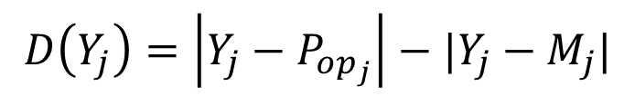



Homer’s Attack
Reference Group ($P_{op}$)
Case Group ($M$)
•
•
•
•
•
•
•
•
•
|Y_{i} – Pop_{i}|
Y_{j} : 1
|Y_{i} – M_{i}|
M_{j} : 0.8
Pop_{j} : 0.3
Y_{j+1} : 0
M_{j+1} : 0.2
Pop_{j+1} : 0.6
Y_{j+2} : 1
M_{j+2} : 0.6
Pop_{j+2} : 0.3
•
•
•
•
•
•
•
•
•
$H_{0}$ Not in $M$
$$D\left(Y_{j}\right)=\left|Y_{j}−P_{op_{j}}\right|−|Y_{j}−M_{j}|$$
ΣD

Slide 7
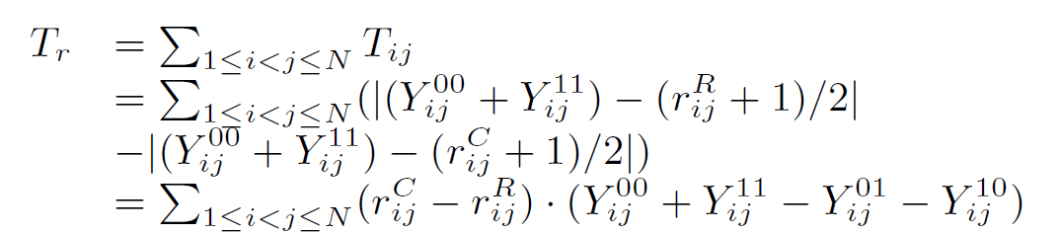

The Attack in our previous paper
Pairwise allele frequencies are other popular published data. Such data contains more information about an individual given the same amount of SNPs.
$T_{r}$ is used to measure the distance of an individual to case group and reference group, 20 times more powerful
Pairwise allele frequencies can also be used to fully recover the matrix.

Slide 8
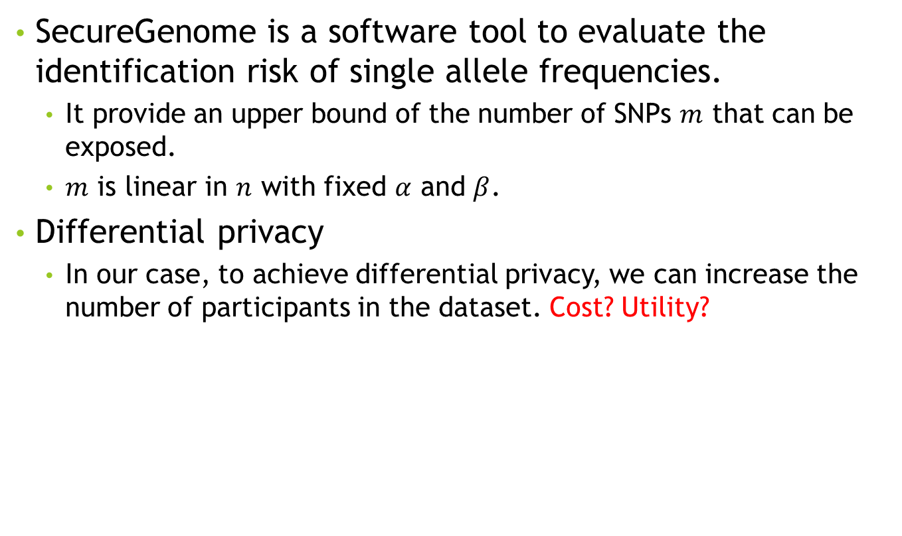
Related works
SecureGenome is a software tool to evaluate the identification risk of single allele frequencies.
It provide an upper bound of the number of SNPs $m$ that can be exposed.
$m$ is linear in $n$ with fixed $α$ and $β$.
Differential privacy
In our case, to achieve differential privacy, we can increase the number of participants in the dataset. Cost? Utility?

Slide 9
Goals of our work
The feasibility and complexity of the two attacks on the two types of datasets? We also proposed a preliminary risk scale system to measure the risk of releasing data.
Fundamental understanding of the problem of aggregate data releasing in GWAS study.
Provide a guideline for releasing data.

Slide 10
Threat Models
We consider an adversary who can not accomplish the task that needs exponential computing power.
The attacker can not sampling an exponential space to determine a probability distribution over this space.
The attacker can do anything else:
Getting a perfect reference group
Have access to the victims DNA profile.

Slide 11
Identification Threat to Allele Frequencies
Attack Allele Frequencies. Given single allele frequencies, an attacker tries determine if an individual is in the case group or not.
Assuming the attacker have the SNPs profile of the victim.
A perfect reference group.
Defense: Make sure the identification power can not exceed a predefined threshold.
Secure Genome
More detail in our technique report

Slide 12
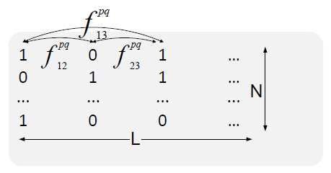
Recovery attack for Pairwise Allele Frequencies
Given pairwise allele frequencies, it is feasible to completely recover the SNP sequences.

Slide 13
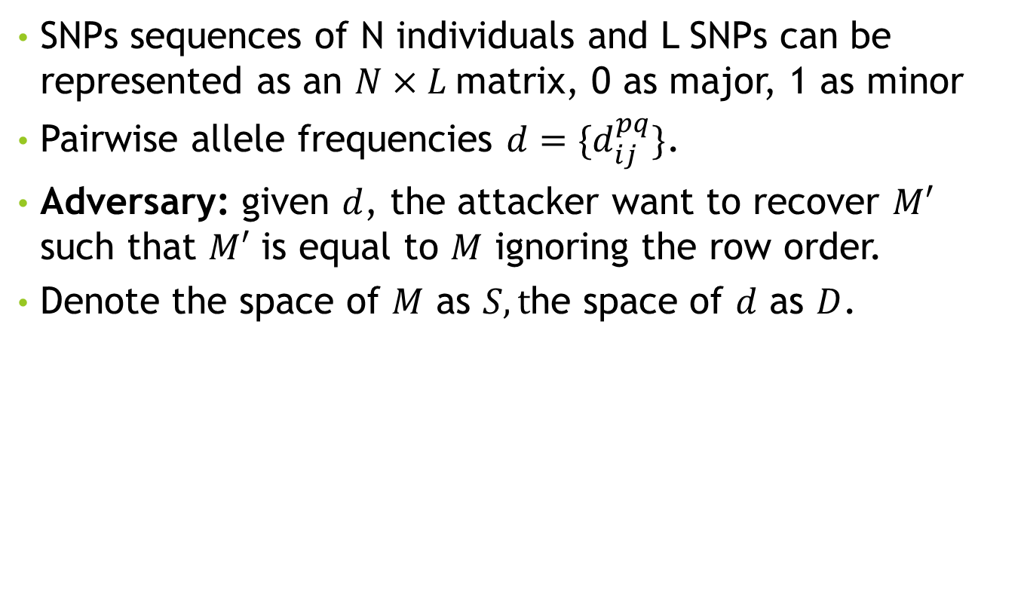

Formalization of the problem
SNPs sequences of N individuals and L SNPs can be represented as an $N×L$matrix, 0 as major, 1 as minor
Pairwise allele frequencies $d=\{d_{ij}^{pq}\}$.
Adversary: given $d$, the attacker want to recover $M′$ such that $M′$ is equal to $M$ ignoring the row order.
Denote the space of $M$ as $S, t$he space of $d$ as $D$.
$$\left|S\right|:|D|$$
Notes:
Intuitively, when $\left|S\right|≫|D|$, there will be multiple matrices $M$ for a given $d$. If the attacker have difficulty to determine which one is the correct one, the risk of releasing such data is low.

Slide 14
Challenges in risk classification
Theorem 1: Determining if there is a haplotype matrix for a given pairwise allele frequency set is NP-complete.
Corollary 2: Determining the number of haplotype matrices for a given pairwise allele frequency set is NP-hard.
Corollary 4: Recovering one haplotype matrix for a given pairwise allele frequency set is NP-hard.

Slide 15
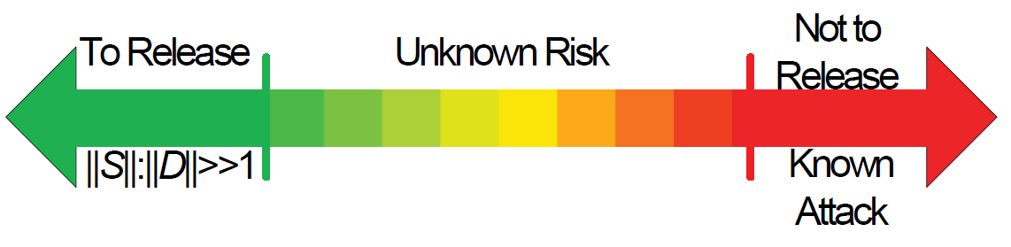

A risk scale system
The ratio of $\left|S\right|:\left|D\right|$.
If $\left|S\right|:\left|D\right|≫1$, it is likely that there are multiple solutions exists for a given $d$. Lower risk.
If $\left|S\right|:\left|D\right|≪1$, it is likely to have a unique solution for a given $d$, if there exist one.

Slide 16

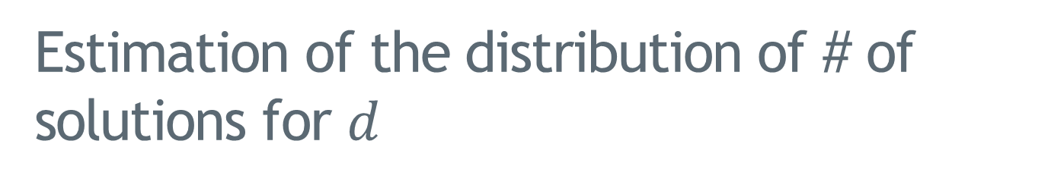
Estimation of the distribution of # of solutions for $d$
It’s difficult to rigorously define the distribution of solutions over $d$.
Estimation of the distribution using Cplex ($N=40, L=7)$

Slide 17
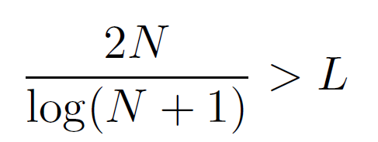
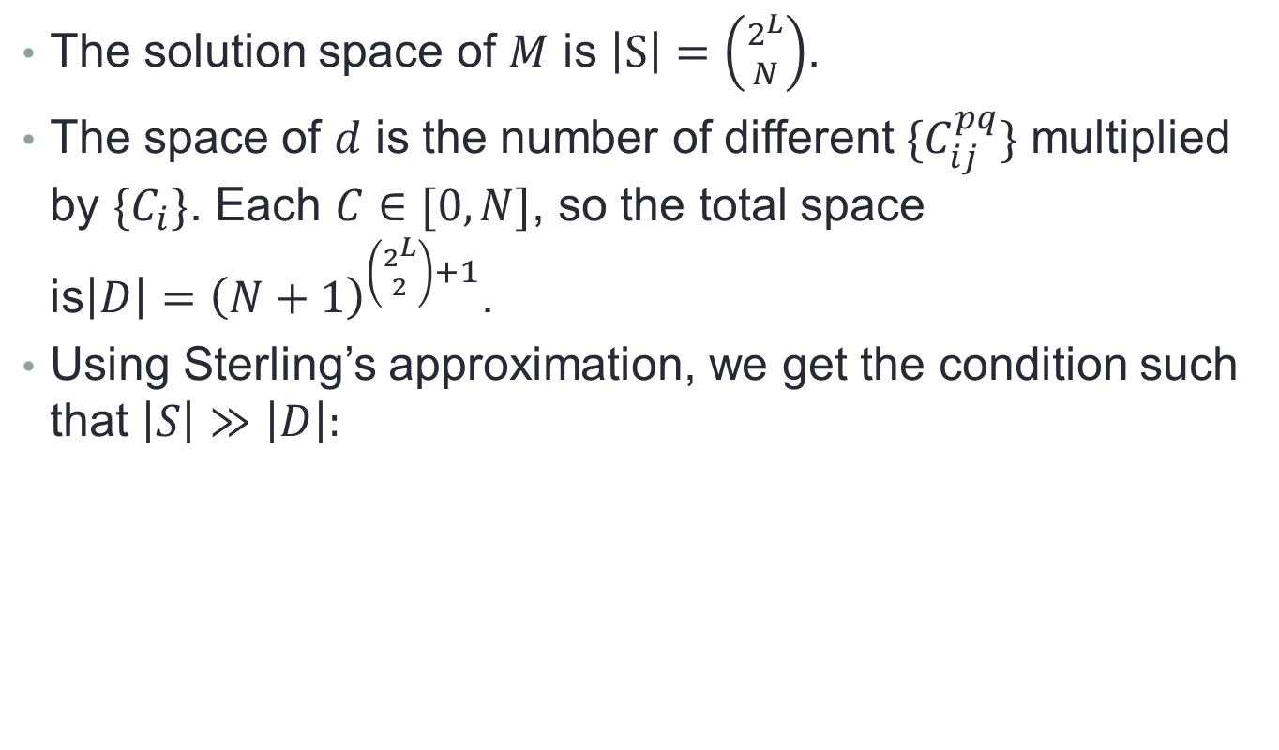
Approximate the number of solution
The solution space of $M$ is $\left|S\right|=\left({2^{L} \atop N}\right)$.
The space of $d$ is the number of different $\{C_{ij}^{pq}\}$ multiplied by $\{C_{i}\}$. Each $C∈[0, N]$, so the total space is${\left|D\right|=\left(N+1\right)}^{\left({2^{L} \atop 2}\right)+1}$.
Using Sterling’s approximation, we get the condition such that $\left|S\right|≫\left|D\right|:$
S
D

Slide 18
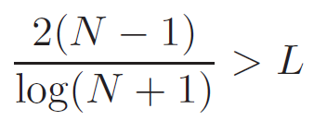
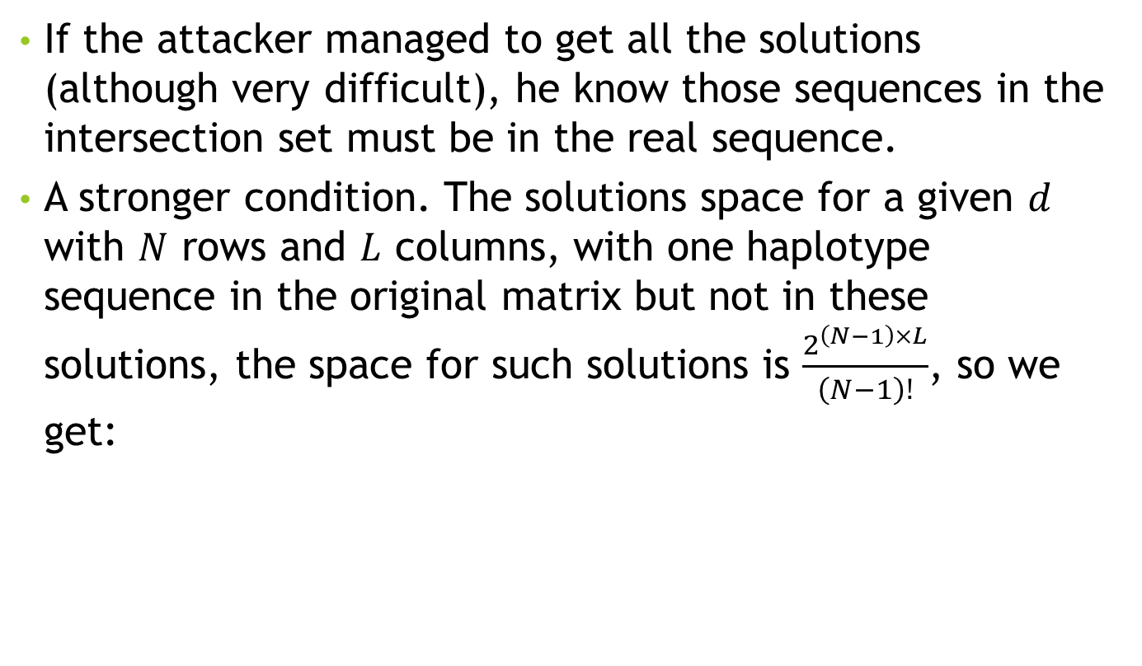
Partial recovery of haplotype matrix
If the attacker managed to get all the solutions (although very difficult), he know those sequences in the intersection set must be in the real sequence.
A stronger condition. The solutions space for a given $d$ with $N$ rows and $L$ columns, with one haplotype sequence in the original matrix but not in these solutions, the space for such solutions is $\frac{2^{\left(N−1\right)×L}}{\left(N−1\right)!}$, so we get:

Slide 19
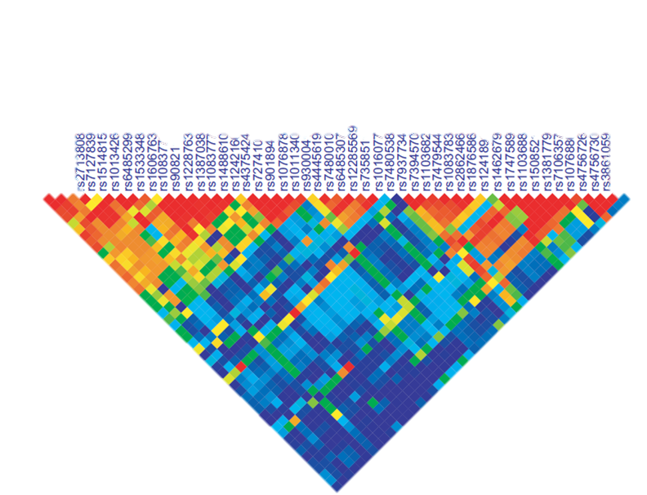
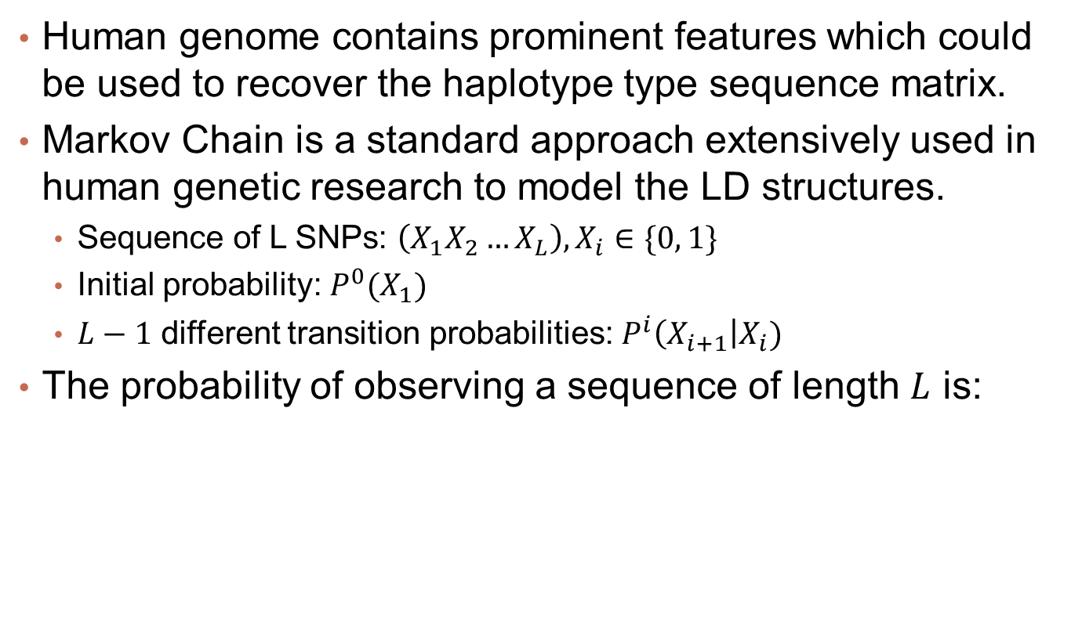
The impact of human genome
Human genome contains prominent features which could be used to recover the haplotype type sequence matrix.
Markov Chain is a standard approach extensively used in human genetic research to model the LD structures.
Sequence of L SNPs: $\left(X_{1}X_{2}…X_{L}\right), X_{i}∈\{0, 1\}$
Initial probability: $P^{0}(X_{1})$
$L−1$ different transition probabilities: $P^{i}\left(X_{i+1}\right|X_{i})$
The probability of observing a sequence of length $L$ is:

Slide 20
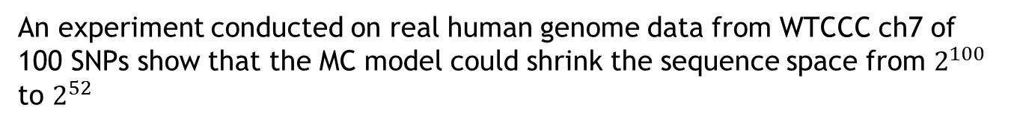
The impact of human genome structure
An experiment conducted on real human genome data from WTCCC ch7 of 100 SNPs show that the MC model could shrink the sequence space from $2^{100}$ to $2^{52}$

Slide 21
When to release

Slide 22
When not to release
Those frequency set that can not be put in a green zone, the solutions is likely to be unique and the risk of releasing these data is unknown.
For those data can be successfully recovered by existing attacks, we put them in the red zone.

Slide 23
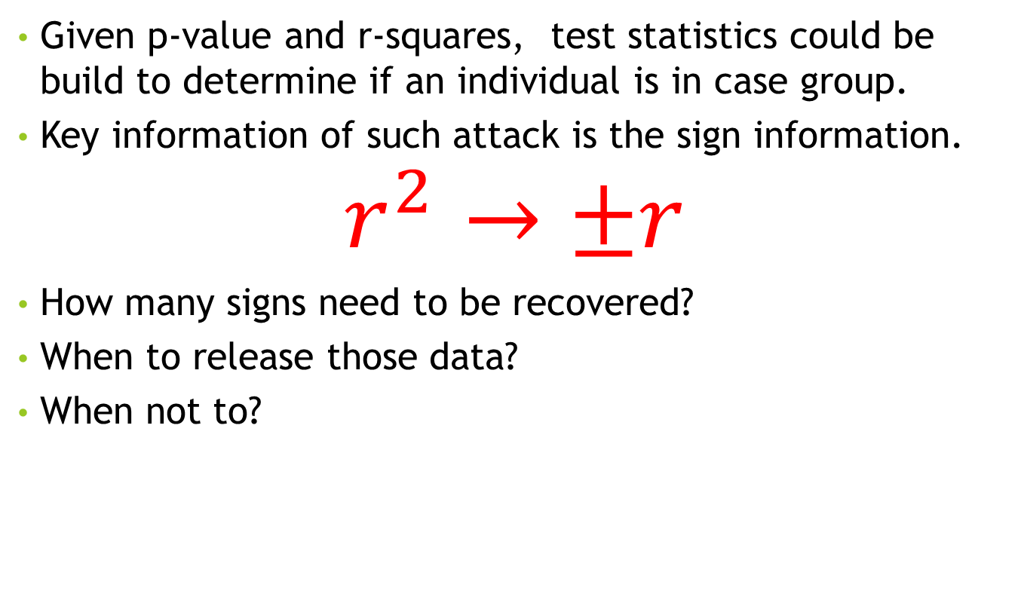
Identification Threat to Test Statistics
Given p-value and r-squares, test statistics could be build to determine if an individual is in case group.
Key information of such attack is the sign information.
$$r^{2}→±r$$
How many signs need to be recovered?
When to release those data?
When not to?

Slide 24
How many signs need to be recovered?
Easy case, why not assume the attacker can recover all the signs?
Analyze the relationship between sign recover rate and identification power.

Slide 25
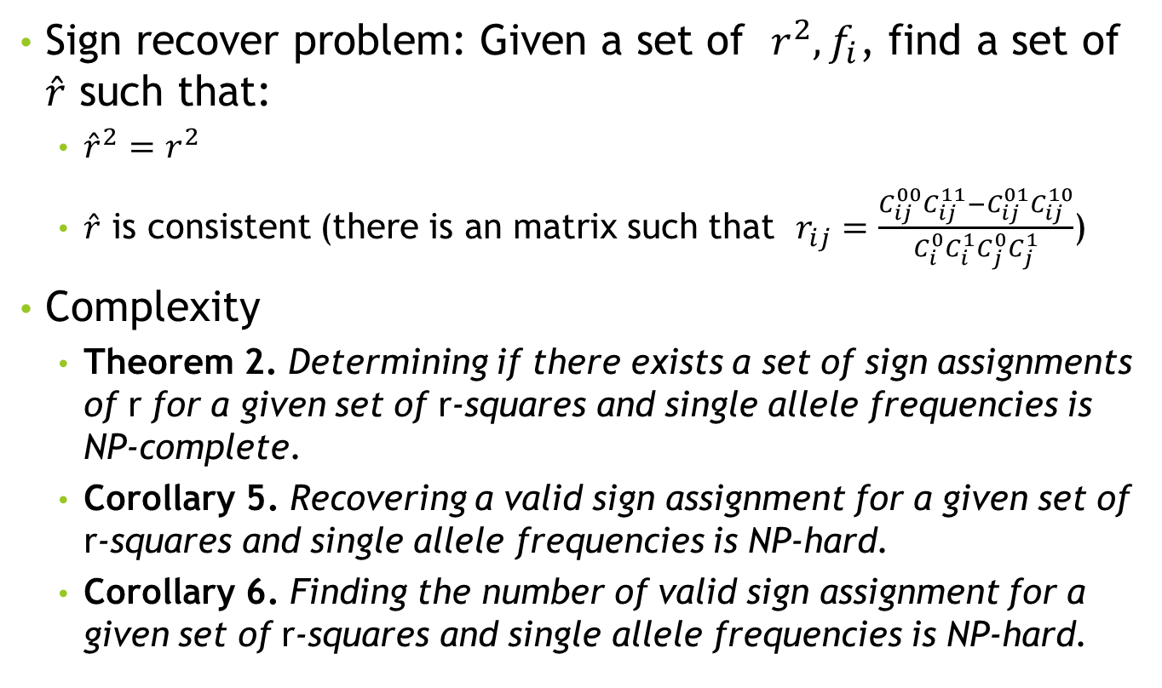
Complexity of releasing statistics
Sign recover problem: Given a set of $r^{2}, f_{i}$, find a set of $\hat{r}$ such that:
${\hat{r}}^{2}=r^{2}$
$\hat{r}$ is consistent (there is an matrix such that $r_{ij}=\frac{C_{ij}^{00}C_{ij}^{11}−C_{ij}^{01}C_{ij}^{10}}{C_{i}^{0}C_{i}^{1}C_{j}^{0}C_{j}^{1}}$)
Complexity
Theorem 2. Determining if there exists a set of sign assignments of r for a given set of r-squares and single allele frequencies is NP-complete.
Corollary 5. Recovering a valid sign assignment for a given set of r-squares and single allele frequencies is NP-hard.
Corollary 6. Finding the number of valid sign assignment for a given set of r-squares and single allele frequencies is NP-hard.

Slide 26
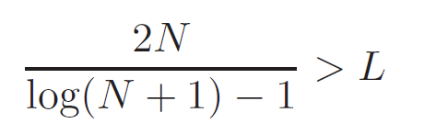
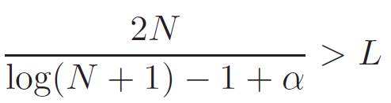
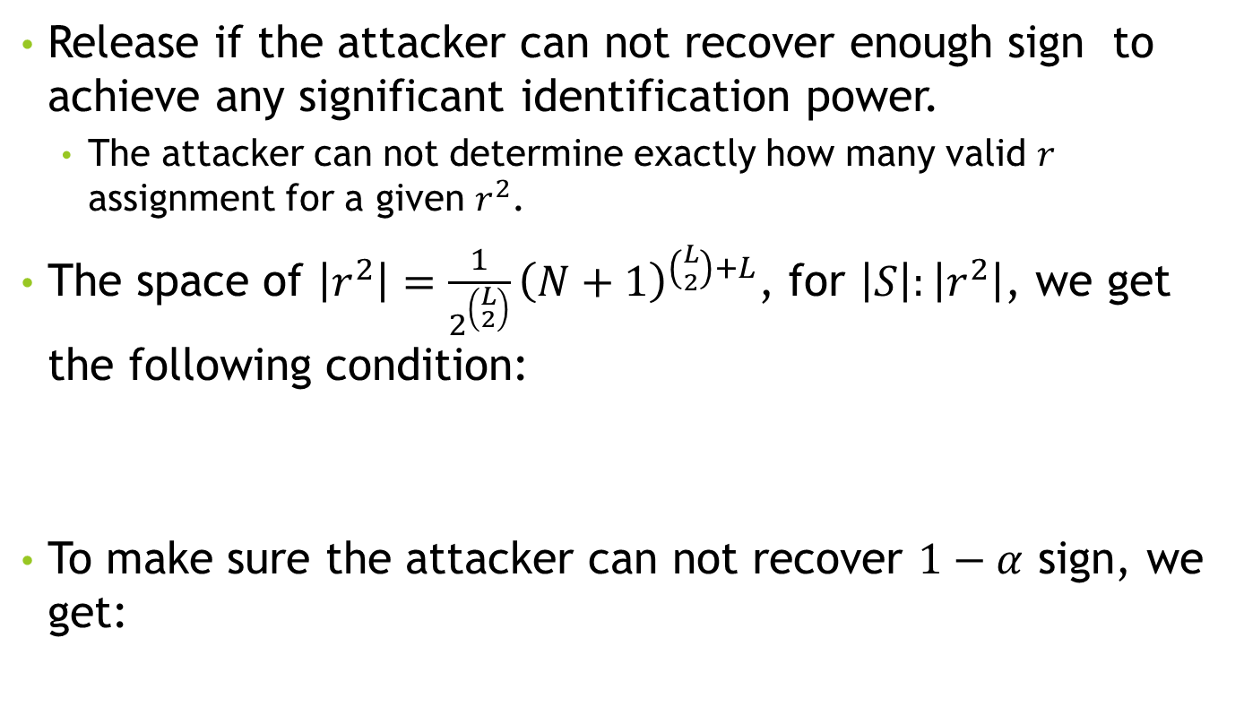
When to release
Release if the attacker can not recover enough sign to achieve any significant identification power.
The attacker can not determine exactly how many valid $r$ assignment for a given $r^{2}$.
The space of $\left|r^{2}\right|=\frac{1}{2^{\left({L \atop 2}\right)}}{\left(N+1\right)}^{\left({L \atop 2}\right)+L}$, for $\left|S\right|:\left|r^{2}\right|$, we get the following condition:
To make sure the attacker can not recover $1−α$ sign, we get:

Slide 27
A case study
L=100

Slide 28
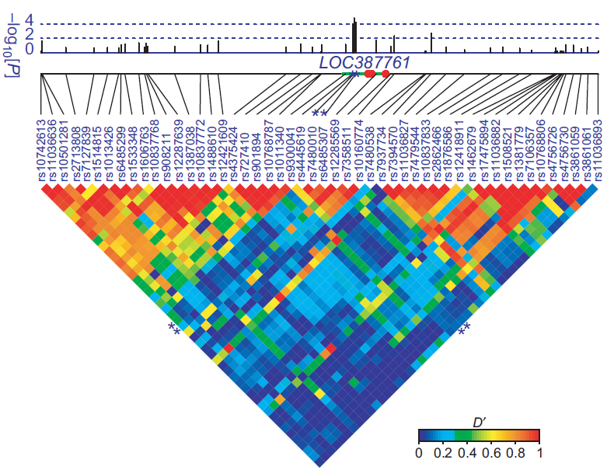
When not to release: a new attack
A new attack serves as a lower bound to put data into red-zone. The new attack leverage the LD disequilibrium structure of haplotype and recombine the haplotype blocks

Slide 29
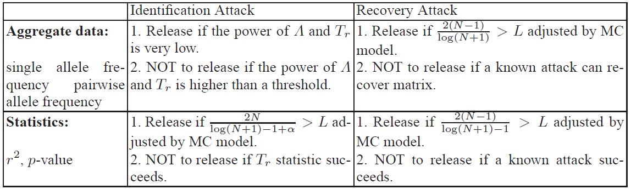
Summary

Slide 30
Future work
1. Differential privacy with low cost.
2. More study on the data put in the yellow zone and a more strict bound classifying the data.
3. Privacy preserving genome data computation

Slide 31
Questions

