Slide 1


Screenmilker: How to Milk Your Android Screen for Secrets
Chia-Chi Lin, Hongyang Li¹,
Xiaoyong Zhou², and XiaoFeng Wang²
¹University of Illinois at Urbana-Champaign
²Indiana University at Bloomington
INDIANA UNIVERSITY
Bloomington

Slide 2


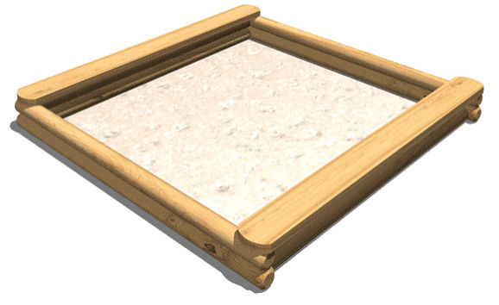

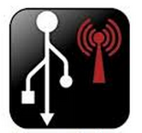
Android Security VS. App Demands
Android security design
No Direct access system resources
No Reading/Writing outside it’s own directory
No installing/uninstalling other apps
User’s/developer’s demands
Capture screen
Backup
USB Tethering
Notes:
Android is designed with security in mind which runs each application in a sand box and application need to ask for permissions to access system resources.
Android need such security mechanism to protect individual app and sensitive data.
But such security design prevent third party developers from implementing server highly demanded apps.
For example, Screen shots application need access system framebuffer, backup up app need to access the data of other applications, SMS messages. USB tethering app to allow laptop sharing internet connection of the phone.

Slide 3

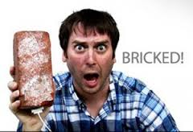

One Solution: Root the phone
#
Notes:
Applications with root privileges can do anything on the phone such as accessing sensitive data or install malicious apps.

Slide 4
An Legitimate Alternative: ADB Proxy
Android Debug Bridge (ADB)
A versatile command line tool that lets user communicate with his device
A set of capabilities
Install/Uninstall
Pull/Push data
Take screenshots / Record screen
…
How app can use ADB? -- proxy
Notes:
Most developers turns to an legitimate alternatives ADB proxy.
Android provides user with a debugging bridge.
http://events.linuxfoundation.org/images/stories/pdf/lf_abs12_kobayashi.pdf

Slide 5
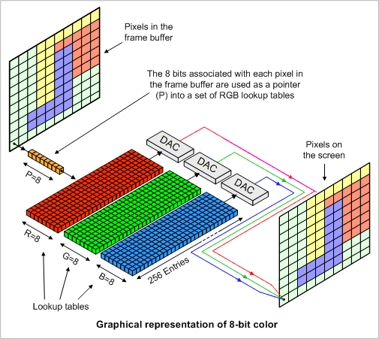
ADB Proxy
An native executable implemented by developer
Runs on the phone as shell user to provide privileged services to other apps
ADB proxy is legitimate
Apps using this approach have tens of millions of downloads
No objections from Google
App
Screenshot
command
ADB Proxy
Access
framebuffer
Notes:
Once ADB Proxy is started, it receives commands from other app and execute those commands on behalf of the app.

Slide 6
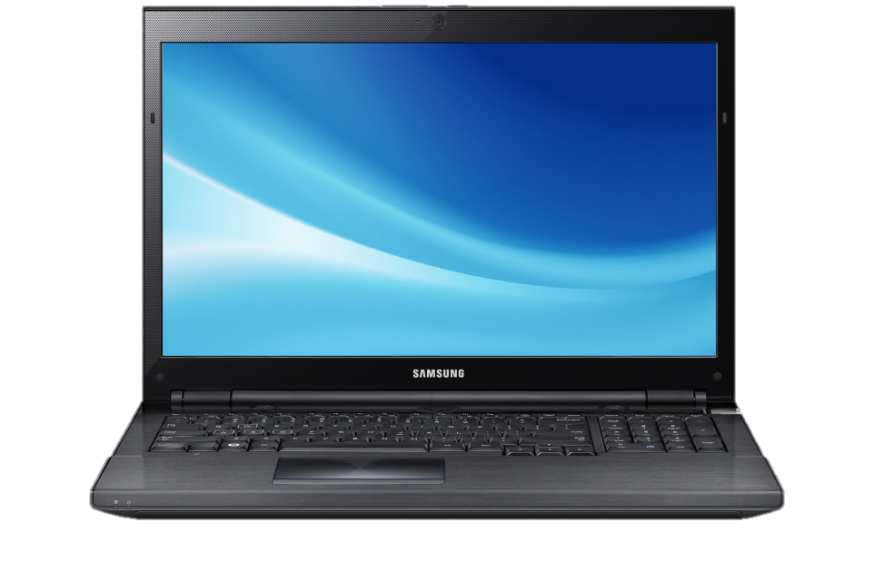
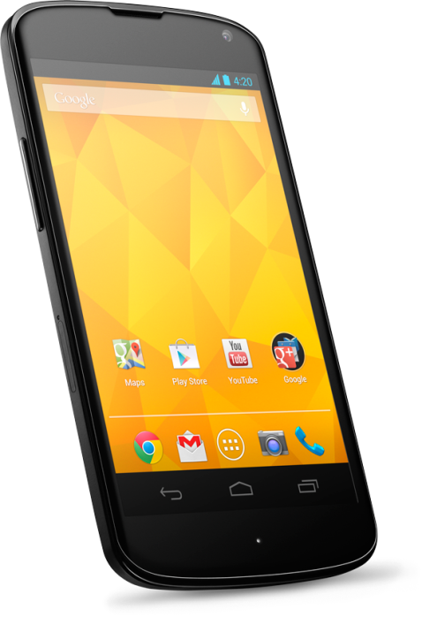

1. Turn on USB Debugging and Connect Android to a PC

Slide 7
2. Run a Script on the PC to Install a ADB Proxy on Android
#! /bin/bash
ADB Proxy
ADB Proxy has the same capabilities as ADB

Slide 8
3. Disconnect Android from the PC
ADB Proxy
Notes:
Now the application can connect to ADB proxy to use some of the privileged capabilities.

Slide 9
Apps Using ADB proxy
Screenshot apps
Very popular on Google Play
USB Tethering Apps
Sync and Backup Apps
App Name | Total Installs
Screen Capture – No Rooting 2.2 | 1,000,000 – 5,000,000
Screenshot Free | 1,000,000 – 5,000,000
Screenshot UX Trail | 1,000,000 – 5,000,000
No Root Screenshot It | 100,000 – 500,000
Screenshot and Draw Trail | 100,000 – 500,000
Screenshot Ultimate | 100,000 – 500,000
ShakeShot Trail | 100,000 – 500,000
NoRoot Screenshot Lite | 50,000 – 100,000
Notes:
Due to the simplicity of ADB proxy installation, many apps uses ADB proxy.

Slide 10
Security Implications
No Access Control
Local socket
Any apps with the INTERNET permission can connect to ADB proxy
A malicious app could command ADB proxy to
Take screenshots
Install applications
App
Malicious App
socket
ADB Proxy
Notes:
With the popularity of ADB proxy, no one studied the security implications of ADB Proxy.
We know Android does not provide IPC calls for native executable. The question is how apps connect to ADB proxy
We found that apps usually use local socket to connect to ADB proxy.
Unfortunately, there are no access control for local socket and developers have to manually implement access control to protect the ADB proxy. Surprisingly, our survey study show that non of those apps implemented sufficient protection.
In this paper I will use screenshots proxy as an example to demonstrate the security risk of ADB proxy.

Slide 11
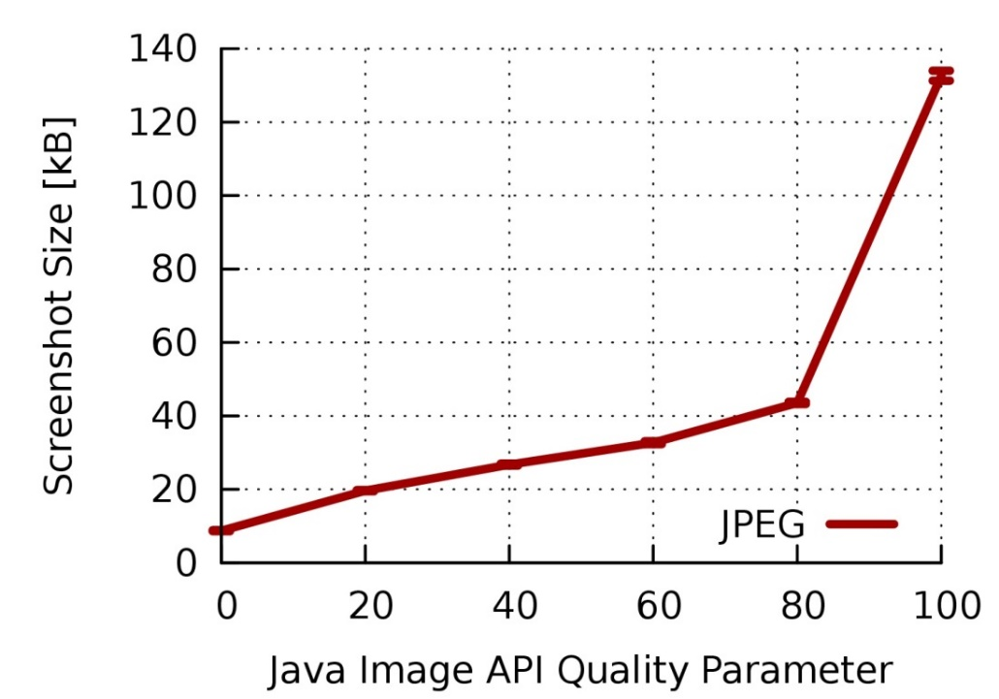
Naïve attacks are not stealthy
Streaming pictures to adversary consumes too much bandwidth
Running OCR locally uses too much CPU and memory
For a 2-Mbps Upload Bandwidth, Only 2 Screenshots Can Be Sent Out Every Second
Notes:
Naïve attack does not work well. It is non-trivial to extract valuable information from those screenshots without being detected by the user.
We need to know when to take screenshots and how to efficiently extract sensitive information.

Slide 12
Our Attack
Screenmilker App
Runtime Situation Detection
/proc/[pid]/stat
Attacker
Screenshot ADB Proxy
Real-Time Data Extraction
Internet
Notes:
To do so, we designed and implemented an malicious app Screenmilker capable of extracting passwords of banking apps and other sensitive information such as contact list.
On high level, screenmilker leverage the /proc file system to detect the target app’s activities and we use those information to determine when to take screenshots. This help to reduce the footprint of screenmilker.
After getting the screenshot, we use a lightweight checksum algorithm to extract sensitive data from the screenshots and then send the information to the attacker.

Slide 13

Detect Screenshot Proxy
Build a database of screenshot apps
Use call PackageManager to get the list of apps on the device
Alternatively, scan TCP ports ADB proxies use
Notes:
Now we go to details of how screenmilker is built. The first thing we need to do is determining if ADB proxy is available on the phone.

Slide 14
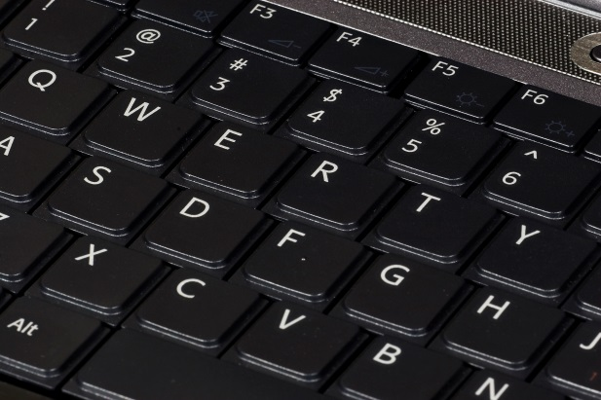
Runtime Situation Detection
Detect target apps (e.g., banking apps) through PackageManager
Probe /proc/[pid]/stat to monitor apps’ activities
Check the cpu utime change of target app
Monitor the soft keyboard app to identify whether user is typing on the soft keyboard
com.google.android.inputmethod.latin
Notes:
After we know screenshots proxy is running, we need to know if a valuable target app is running and when to take screenshots.

Slide 15
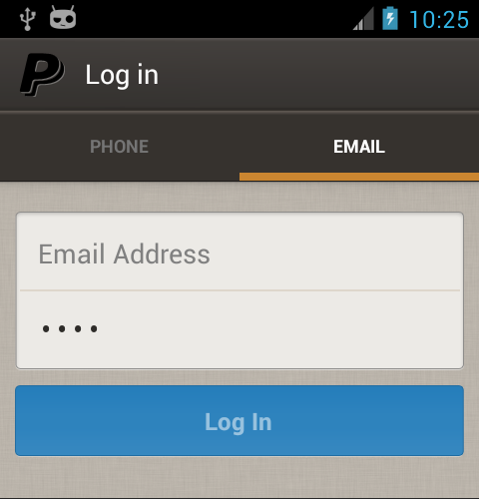
Detecting Application States
Get Screen Orientation
Take screenshots
Extract title bar
Match the title bar against app state database
Notes:
Once the target apps is running, we need to detect the state of the applications, specifically, we need to detect when the user is on the login screen and entering his username and passwords..
However the passwords is usually masked by dots and at most shows the last character for a very short period of time. We turn our attention to soft keyboard it self.

Slide 16
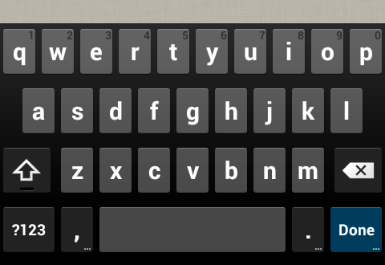
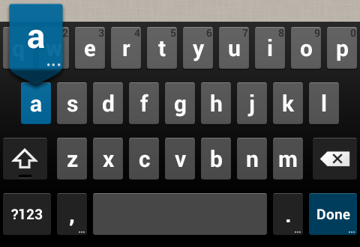
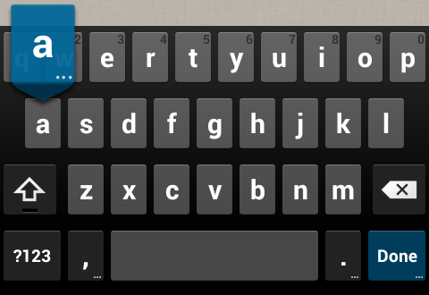
Real-Time Keystroke Analysis
Notes:
Here is a screenshot series when a key is pressed on soft keyboard. First the pressed key is highlighted and a bubble pops up, then the key highlights fade away and the bubble disappears. The bubble last longer than the key high light. The bubble is a more stable feature.

Slide 17
Fingerprinting the Soft Keyboard
Notes:
So we want use those bubbles to fingerprint the typing activity.
The most indicative area showing which key is pressed is the 4 strips above the keys. So crops those 4 strips to determine which key is pressed. In additions, we capture the SHIFT key state for two purposes: first, we use it to determine weather the user is entering capitalized letter. Second, whenever the user switches to a number keyboard, the SHIFT key will turn into another symbol, so that we are capturing non-letter characters.

Slide 18

Determining the Keystroke
CRC32 Value | Keystroke
222054093 | a
8599545 | b
4181574192 | c
… | …
222054093
Notes:
After cropping the image, we use a lightweight hash algorithm aka CRC32 to calculate a hash value for each image. Then we look up the hash value in the pre-calculated hash table to find out which key is pressed. By doing so we successfully extracted the password of high profile banking apps as we show in the evaluation section.

Slide 19
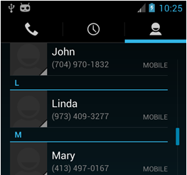
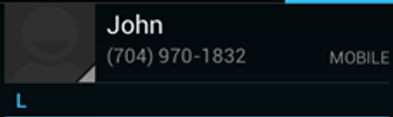
Real-Time Contact Collection
CRC
Notes:
Not only we can extract password, we can also extract information from contact applications. We use the same approach to determine weather the contact application is running and capture screenshots whenever the user viewing the contact list. We use a two step approach to extract the information from the contact list.
We first extract a individual contact item from the list, to do so, we scan the along the vertical bar on the contact list. Use the color of the horizontal blue line as the edge.
Then we extract the name and phone number from each item. We scan top-down, left to right detect the edge of the character.
We use the same hash method to recognize the character.

Slide 20
Evaluations
Notes:
We first evaluate the effectiveness of Screenmilker and then we show the stealthness of it.

Slide 21
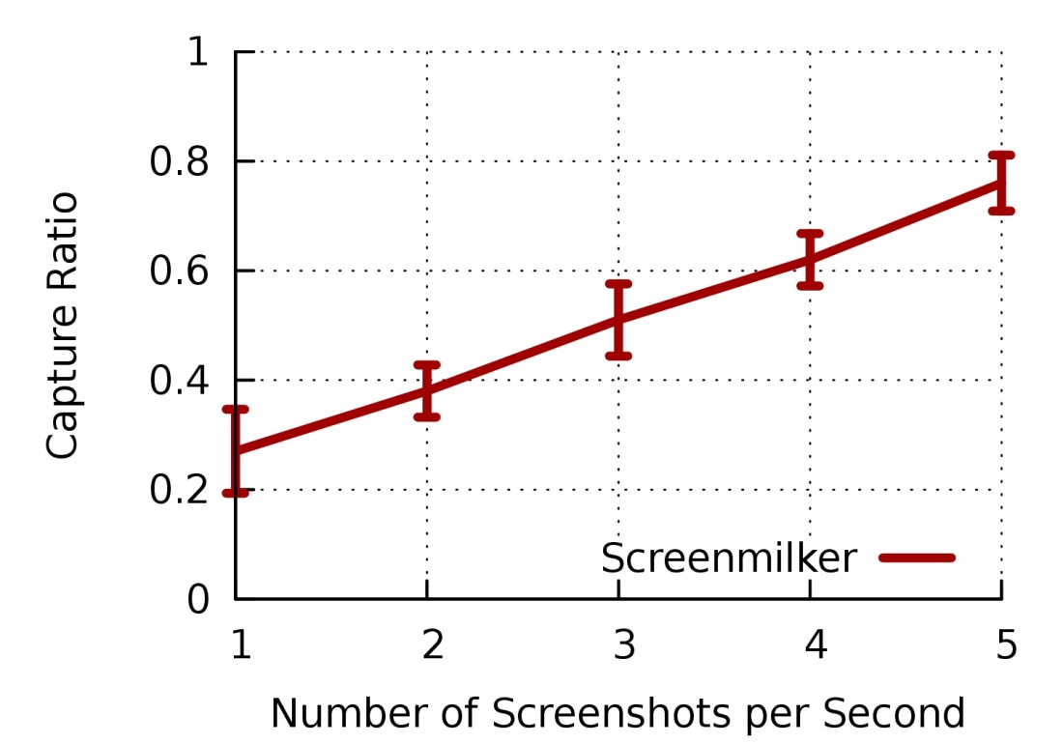
Effectiveness: Single Key Stroke Capture Ratio
Capture Ratio Increases From 27% to 76% as the Screenshot Rate Increases
Notes:
We use two approaches to demonstrate the effectiveness of screenmilk, we first evaluate the capture ratio of screenmilk. The percentage of single keystrokes that we can be reliably determined by screenmilk.
We further evaluate the effectiveness of extracting real password from real applications.

Slide 22
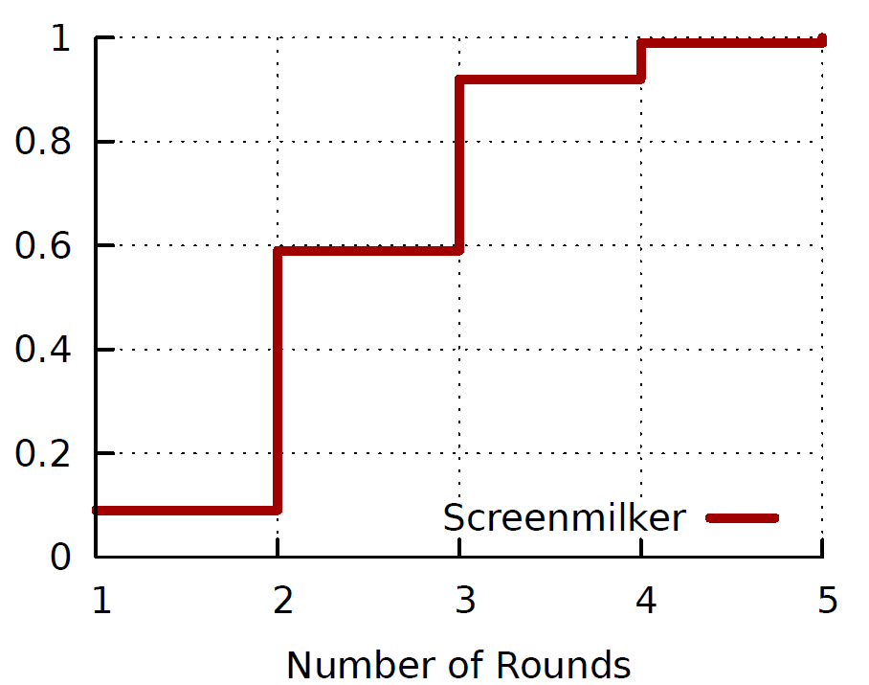
Password Extraction
Experiment setup
10-character passwords
5 banking apps [American Express, Chase, Citi, PayPal and Wells Fargo]
40 password entering for each app
How many rounds to recover a password?
Screenmilker may miss the moment for some keystrokes
Notes:
As we know, screenmilk can not capture every single key strokes, however for most high profile banking apps, that does not store passwords on the device, screenmilker has multiple chances to extract password.
With 5 round, we can fully recover the password for sure.
With 3 rounds, we can fully recover the password 90% of the time.

Slide 23
Rounds to Extract Entire Password
App | Average Number of Rounds
American Express US | 2.625
Citi Mobile | 2.525
Chase Mobile | 2.325
PayPal | 2.75
Wells Fargo Mobile | 2.45
Notes:
Here is the breakdown of each application, as you can see, we can fully recover the password in under 3 rounds on average.

Slide 24
CPU run time
 | Extraction Function | Time [ms]
General | Initialize Hash Table [one time] | 1.389
 | Take a Screenshot [not controllable by Screenmilker] | 161.314
Keystroke Extraction | Fingerprint the Image Features | 0.388
 | Lookup Hash Table | 0.220
Contact Collection | Obtain Position of Text | 3.018
 | Segment and Map Text | 2.916
Notes:
We then evaluate the stealthness of screenmilker. We first measure the CPU usage of screenmilker. Except the time used to take screenshot, which screenmiler can not control, the cpu run time is low, under 10 milliseconds which is very efficient.

Slide 25
Memory Consumption
App | Memory [Kbytes]
Screenmilker [situation detection] | 286.308
Clock | 294.072
Screenmilker [contact collection] | 295.279
Screenmilker [keystroke extraction] | 295.364
Calculator | 295.464
Google Talk | 310.844
Instagram | 326.244
Pandora Internet Radio | 356.332
Facebook | 365.384
Browser | 391.912
Temple Run 2 | 436.712
Notes:
Our application does not use too much memory and can easily mimic other legitimate screenshot applications.

Slide 26
Power Consumption
App | Power [mW]
Screenmilker [situation detection] | 4.1
Screenmilker [contact collection] | 8.3
Google Talk | 47.8
Clock | 52.1
Calculator | 91.8
Screenmilker [keystroke extraction] | 101.6
Instagram | 155.8
Pandora Internet Radio | 213.5
Facebook | 252.1
Browser | 374.8
Temple Run 2 | 529.2
Notes:
We further estimated the power consumption of screenmilker.

Slide 27
Mitigations: Access Control on ADB Proxy
Utilize iptables to control local-socket communication
Users need to explicitly grant apps permission to communicate with local servers
We build a service to add iptables rules accordingly
Notes:
We use iptables to control connections to local socket. By default, we don’t allow any application to communicate with any local servers. We let the user’s explicitly determine which app can connect to which local server. We then add iptables rules according to the user’s choice.
In addiction to our solution, other approaches are also worth investigation such as SE Android rules or Google can provide

Slide 28
Conclusions
ADB proxy is a popular workarounds that grant privileged capabilities to 3rd party apps
Without proper protection, ADB proxy could be exploited by malicious apps to extract sensitive information from the phone as demonstrated by Screenmilker
From our evaluation, we show that malicious app can effectively and stealthily extract information from screenshots
Notes:
The UI elements of mobile apps UI are highly predictable and simple image analysis can extract sensitive information.

Slide 29
Thank You! Questions?
Notes:
Does user still use such technologies? The have millions downloads and from the most recent comment about rooted screen capture devices, people still complains why the need to root their phones.

