Slide 1
LEAD QUALITY ANALYSIS
Aarki Analyst Take-Home Assignment
Dataset: 3,021 leads | Apr – Sep 2009
Baseline quality rate: 13.0% | Target: 15.6% (×1.2)
Xiaoai Zhu
Fiona.zhu0906@gmail.com
All analysis and visualization were conducted using Python (Pandas, numpy, matplotlib, plotly, scipy). Full code and all plot see in my github link: https://github.com/xzhu411/Aarki.git

Slide 2
Table of Contents
01
Q1 — Time Trend Analysis
p. 3
Is lead quality improving or declining over time?
02
Q2 — Driver Analysis
p. 4–12
Widget & Creative · Publisher Zone & Campaign · Partner & Traffic
Debt Level · Phone Score · Address Score · Debt × Phone Score
Marketing Campaign · Geographic Distribution
03
Q3 — CPL Increase Opportunity
p. 13
Filter strategies to reach the 15.6% quality target
04
Future Work & Conclusions
p. 14-15
Actionable next steps ranked by impact and feasibility
2

Slide 3
Summary
13.0%
15.6%
393
44.6%
Baseline Quality Rate
Target (Baseline ×1.2)
Good Leads (of 3,021)
Good / (Good+Bad)
KEY FINDINGS
Q1
No significant time trend (Apr–Sep 2009, p=0.61). Quality fluctuates but is stable overall.
Q2
Search traffic (15.3%) significantly outperforms Content/AdSense (9.7%), p=0.0004. Phone Score 5 leads are best at 16.2% (p=0.0007).
Q2
Debt level shows an inverted-U pattern — only the two extremes ($7.5k-10k: 7.0% and >$100k: 6.8%) are significantly below average (chi²=44.82, p<0.0001).
Q3
Recommended strategy: exclude extreme debt + Search traffic only → 16.9% quality, retaining 1,186 leads, exceeding the 15.6% target.
All code of analysis and visualization can be found here
https://github.com/xzhu411/Aarki.git
2
2

Slide 4
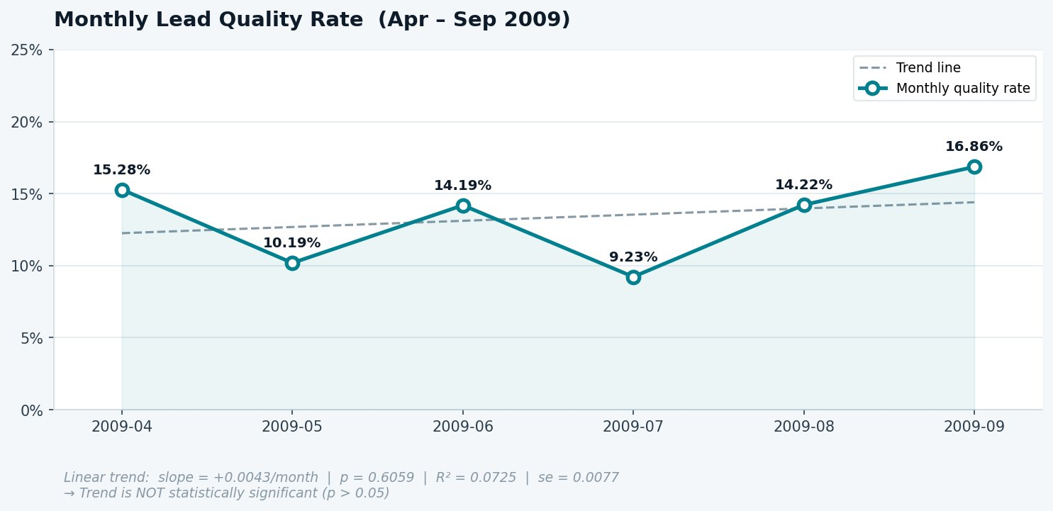
Q1 — Is Lead Quality Improving Over Time?
TREND ANALYSIS
To assess whether lead quality is changing over time, we plotted monthly quality rates across the six-month campaign window and fitted a linear regression to test for a directional trend. While the most recent month (Sep 2009) shows the highest rate at 16.9%, a single strong month is insufficient to conclude improvement, and the regression slope is near zero and statistically insignificant (p = 0.61), meaning the observed fluctuations are consistent with random variation around a stable mean.
Interpretation
Quality rate fluctuates between 9.2% (Jul) and 16.9% (Sep) with no consistent upward or downward direction.
Linear regression: slope = +0.43%/month, but p = 0.61, not statistically significant.
Conclusion: quality is stable, not systematically improving or declining during this period.
3
3

Slide 5
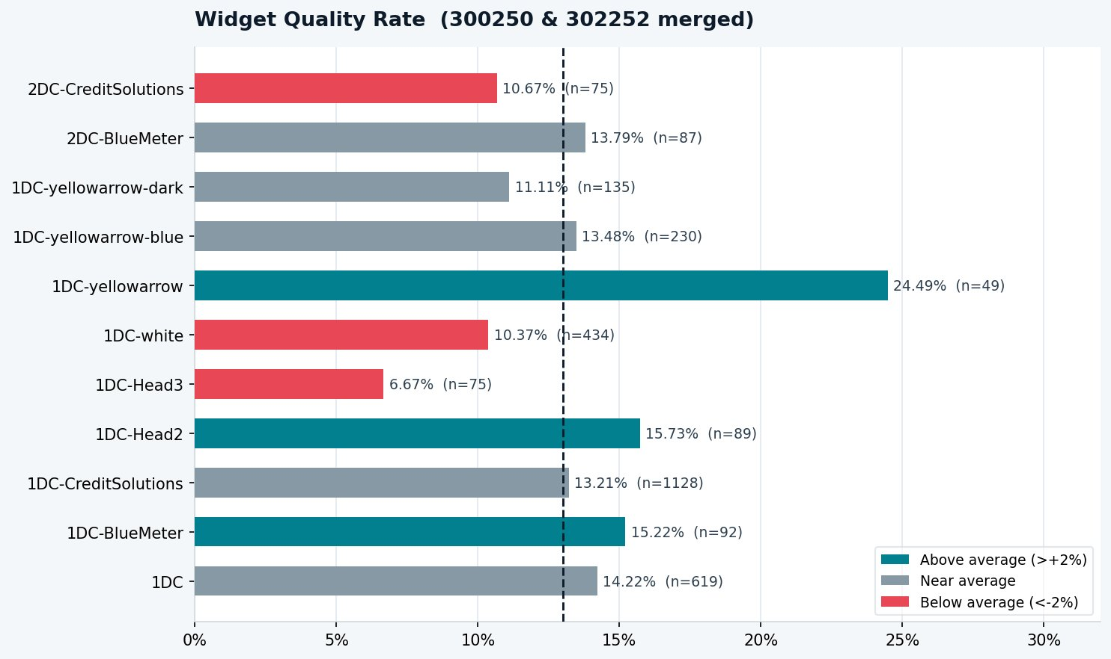
Q2 — Driver Analysis: Widget Performance
WIDGET / CREATIVE
We first examined the creative dimension. Note that widgets 300250 and 302252 share identical naming conventions and were treated as the same widget family after merging. We also tested whether 1DC (single-page) vs. 2DC (two-page) forms drive quality differences, but the gap was minimal (12.8% vs. 12.3%) with limited 2DC sample size (n=162), so the more informative breakdown is at the individual widget variant level.
1DC-yellowarrow (n=49) achieves 24.5% quality — the highest, but small sample warrants caution.
1DC-Head3 (n=75) is the worst performer at 6.7%, well below average — a strong exclusion candidate.
High-volume widgets (1DC-CreditSolutions, n=1,128) are near average at 13.2%, limiting upside.
1DC forms (12.8%) slightly outperform 2DC (12.3%), (table below) but the difference is small and the sample for 2DC is limited (n=162), not a strong enough signal to act on alone.
Key Takeaways
Form Type | Leads | Quality Rate
1DC | 2,232 | 12.8%
2DC | 162 | 12.3%
4
4

Slide 6
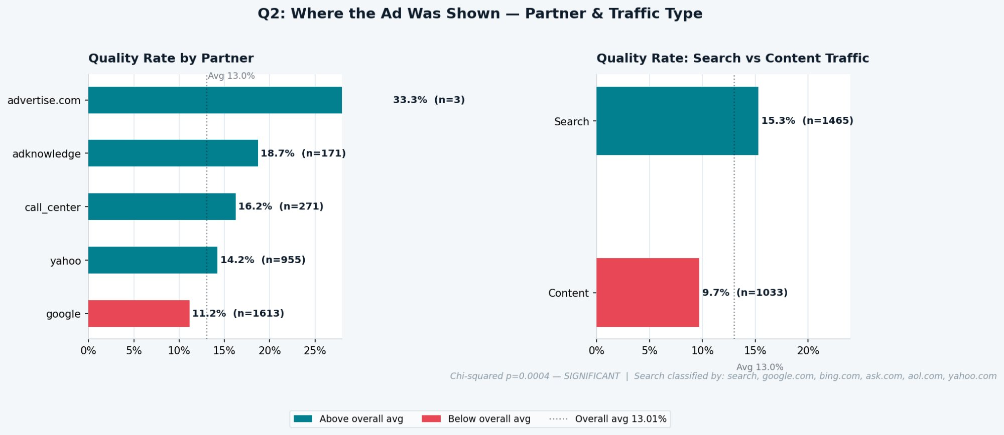
Q2 — Driver Analysis: Partner & Traffic Type
PARTNER / TRAFFIC
For distribution channels, we separated two distinct questions. Partner was taken directly from the dataset field, but required a case-sensitivity correction.
"google" and "Google" appeared as separate entries and were merged before analysis.
Traffic type, however, cannot be read from the Partner field alone: a partner like Google delivers both paid search and display/content inventory. We therefore derived traffic type independently from the ReferralDomain field, classifying any domain containing keywords such as "search", "google.com", "bing.com", "yahoo.com", "ask.com", ”search", or "aol.com" as Search, and everything else as Content. Both dimensions were then tested with chi-squared to assess statistical significance.
Key Takeaways
Partner case-sensitivity corrected (google + Google merged). Google (n=1,613) performs below average at 11.2%.
AdKnowledge leads quality at 18.7%, followed by Call Center (16.2%) and Yahoo (14.2%).
advertise.com shows 33.3% but n=3, which is statistically negligible.
Search traffic (15.3%) significantly outperforms Content/AdSense (9.7%), chi²=12.36, p=0.0004.
5
5

Slide 7
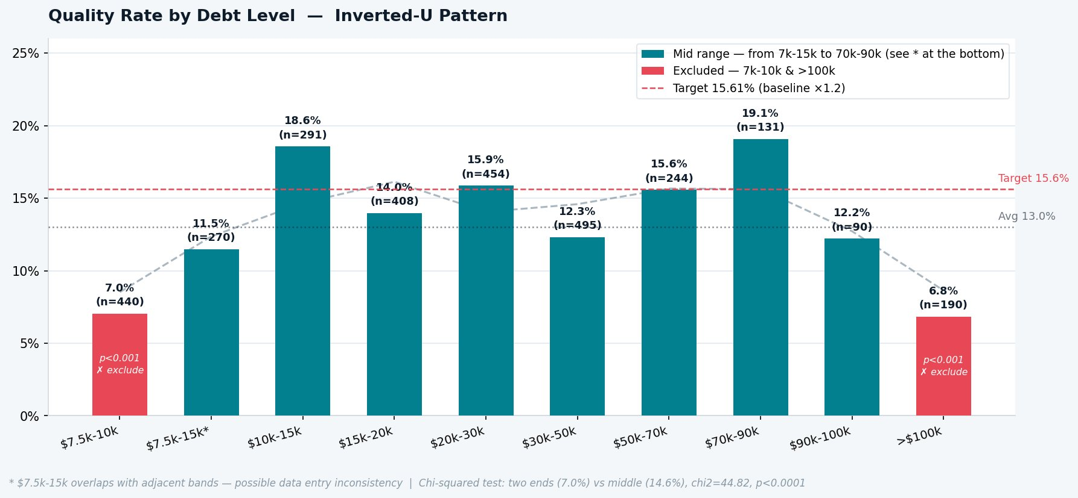
Q2 — Driver Analysis: Debt Level
DEBT LEVEL
For applicant profile, we ordered all 10 debt bands from lowest to highest and compared quality rates across them, rather than collapsing into a simple low/mid/high grouping upfront. This revealed an inverted-U pattern: mid-range debt bands consistently outperform both extremes.
We also flagged the $7.5k–$15k band as a data quality concern: it overlaps with two adjacent bands and has zero PhoneScore coverage, suggesting it may come from a different data source.
For the statistical test, rather than running adjacent-band comparisons (which would answer the wrong question), we grouped the two extreme ends together and tested them against all middle bands as a single chi-squared — directly validating the exclusion decision.
Key Takeaways
Inverted-U pattern: middle debt bands ($10k–$90k) consistently outperform the two extremes.
Only the two ends are statistically significant: $7.5k-10k (7.0%) and >$100k (6.8%) vs. middle (14.6%), chi²=44.82, p<0.0001.
Note: $7.5k–$15k band has 0% PhoneScore coverage — possible data entry inconsistency; treat with caution.
6
6

Slide 8
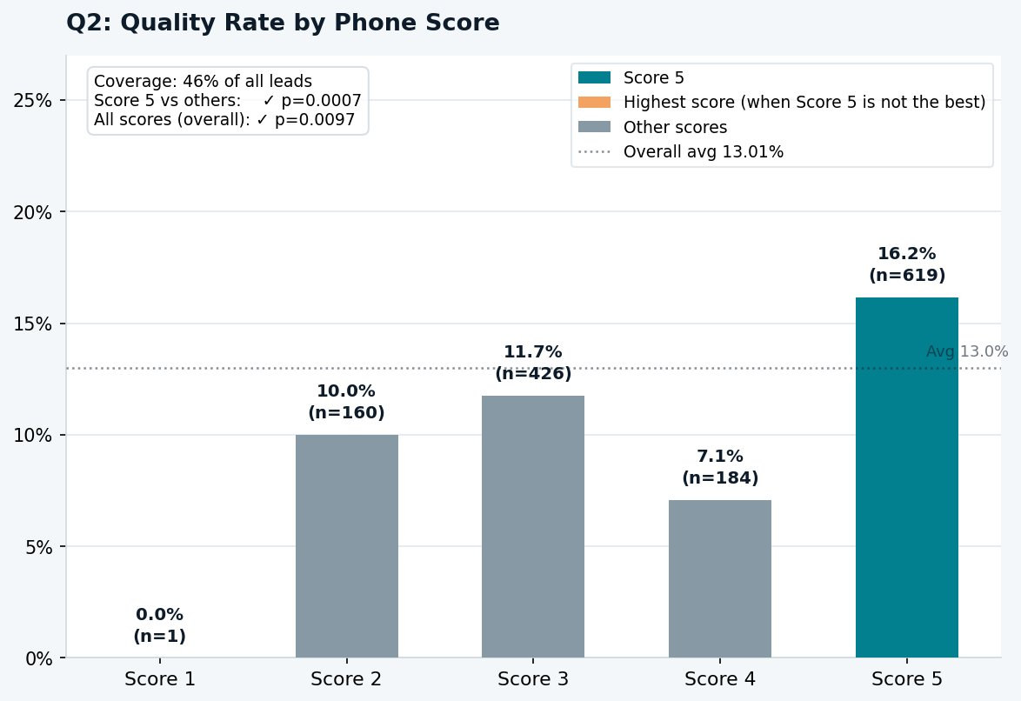
Q2 — Driver Analysis: Phone Score
VERIFICATION SCORES
PhoneScore is a third-party lead verification signal that is only populated for 46% of leads, meaning any filter based on it immediately discards the other 54% regardless of their actual quality. We focused on whether Score 5 is a reliable positive signal by running a chi-squared test of Score 5 vs. all other scores, rather than testing the full score distribution, since the non-monotonic pattern (Score 4 dips below Score 2 and 3) suggests the intermediate scores carry no consistent directional meaning.
Key Takeaways
Score 5 leads achieve 16.2% quality, clearly the best. Score 5 vs. others: p=0.0007 (highly significant).
Pattern is non-monotonic (Score 4 dips to 7.1%), suggesting Score 5 is the only reliable positive signal.
Coverage caveat: PhoneScore is only available for 46% of leads, which limits direct use as a filter.
7
7

Slide 9
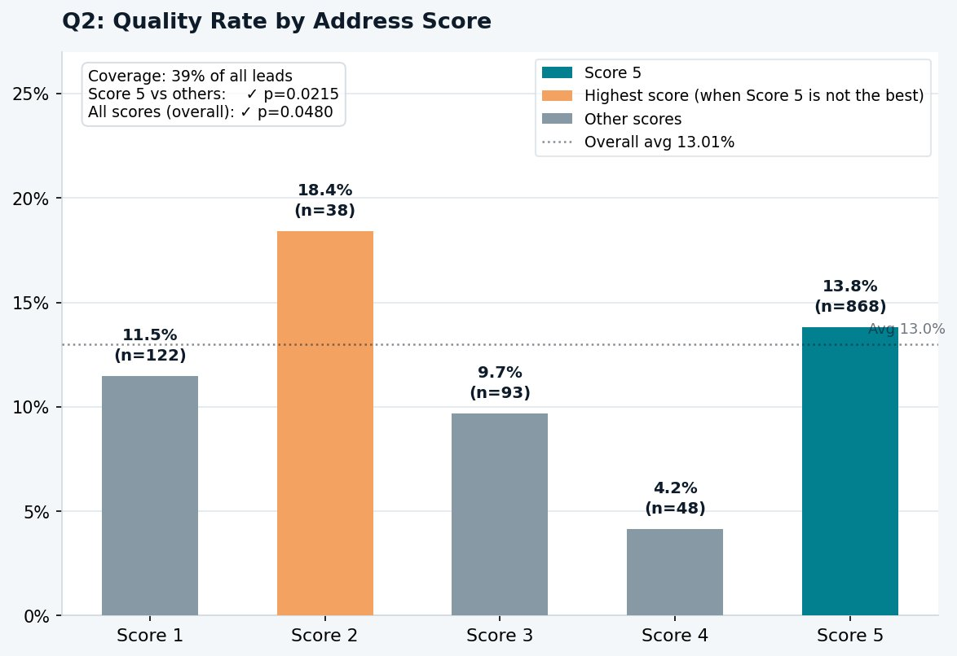
Q2 — Driver Analysis: Address Score
VERIFICATION SCORES
We applied the same Score 5 vs. others chi-squared framework to AddressScore for consistency. The test is technically significant (p=0.0215), but the pattern tells a different story from PhoneScore: Score 5 (n=868) sits at only 13.8%, barely above the overall average, while Score 2 appears highest at 18.4% but with only n=38, too small to be reliable.
This illustrates why we evaluate statistical significance alongside effect size and sample stability before recommending a variable as a filter.
Key Takeaways
Unlike PhoneScore, AddressScore is non-monotonic: Score 2 is highest (18.4%) but n=38 — unreliable.
Score 5 (n=868) achieves only 13.8%, barely above the overall average — limited predictive value.
Coverage is only 39%. Combined with the irregular pattern, AddressScore is not recommended as a standalone filter.
8
8

Slide 10
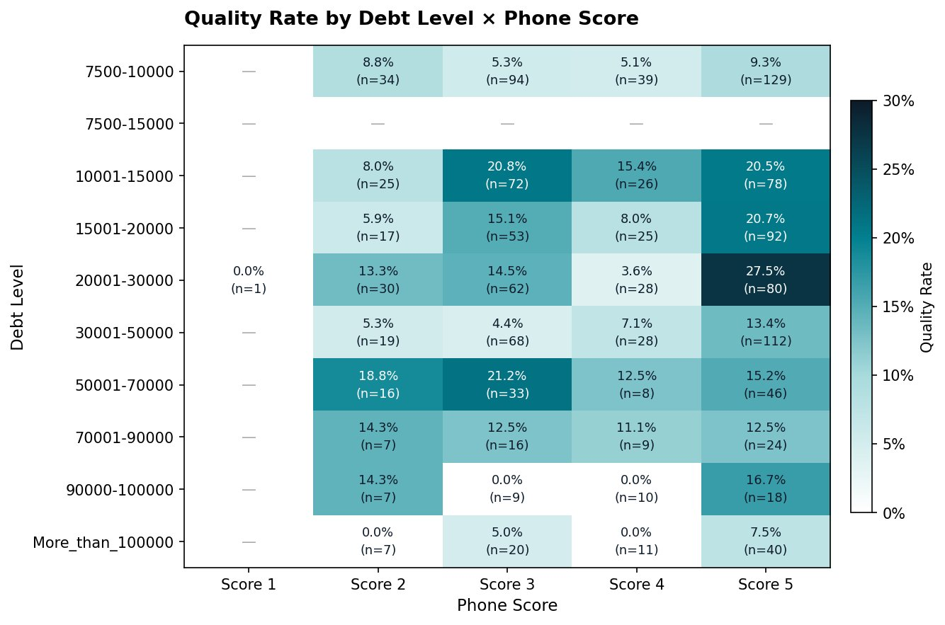
Q2 — Driver Analysis: Debt Level × Phone Score
INTERACTION EFFECT
Having identified both debt level and PhoneScore as independently significant drivers, the natural next question is whether they interact, i.e., whether the benefit of a high PhoneScore is consistent across all debt bands, or whether certain debt + score combinations are disproportionately better or worse.
To explore this, we built a two-dimensional pivot table with debt level on one axis and PhoneScore on the other, computing quality rate and sample size for each cell. This allows us to spot interaction effects that would be invisible when looking at either variable alone, and also serves as a cross-validation: if the two variables are truly independent signals, we would expect Score 5 to outperform within most debt bands, which the heatmap broadly confirms, while also revealing the $7.5k–$15k anomaly more clearly (the entire row is blank, reinforcing the data quality concern raised earlier).
Key Takeaways
$7.5k–$15k has no PhoneScore data at all, which confirms this band is an anomaly in the dataset.
Best cell: $20k–$30k + Score 5 = 27.5% (n=80), a strong signal when both filters apply simultaneously.
9
9

Slide 11
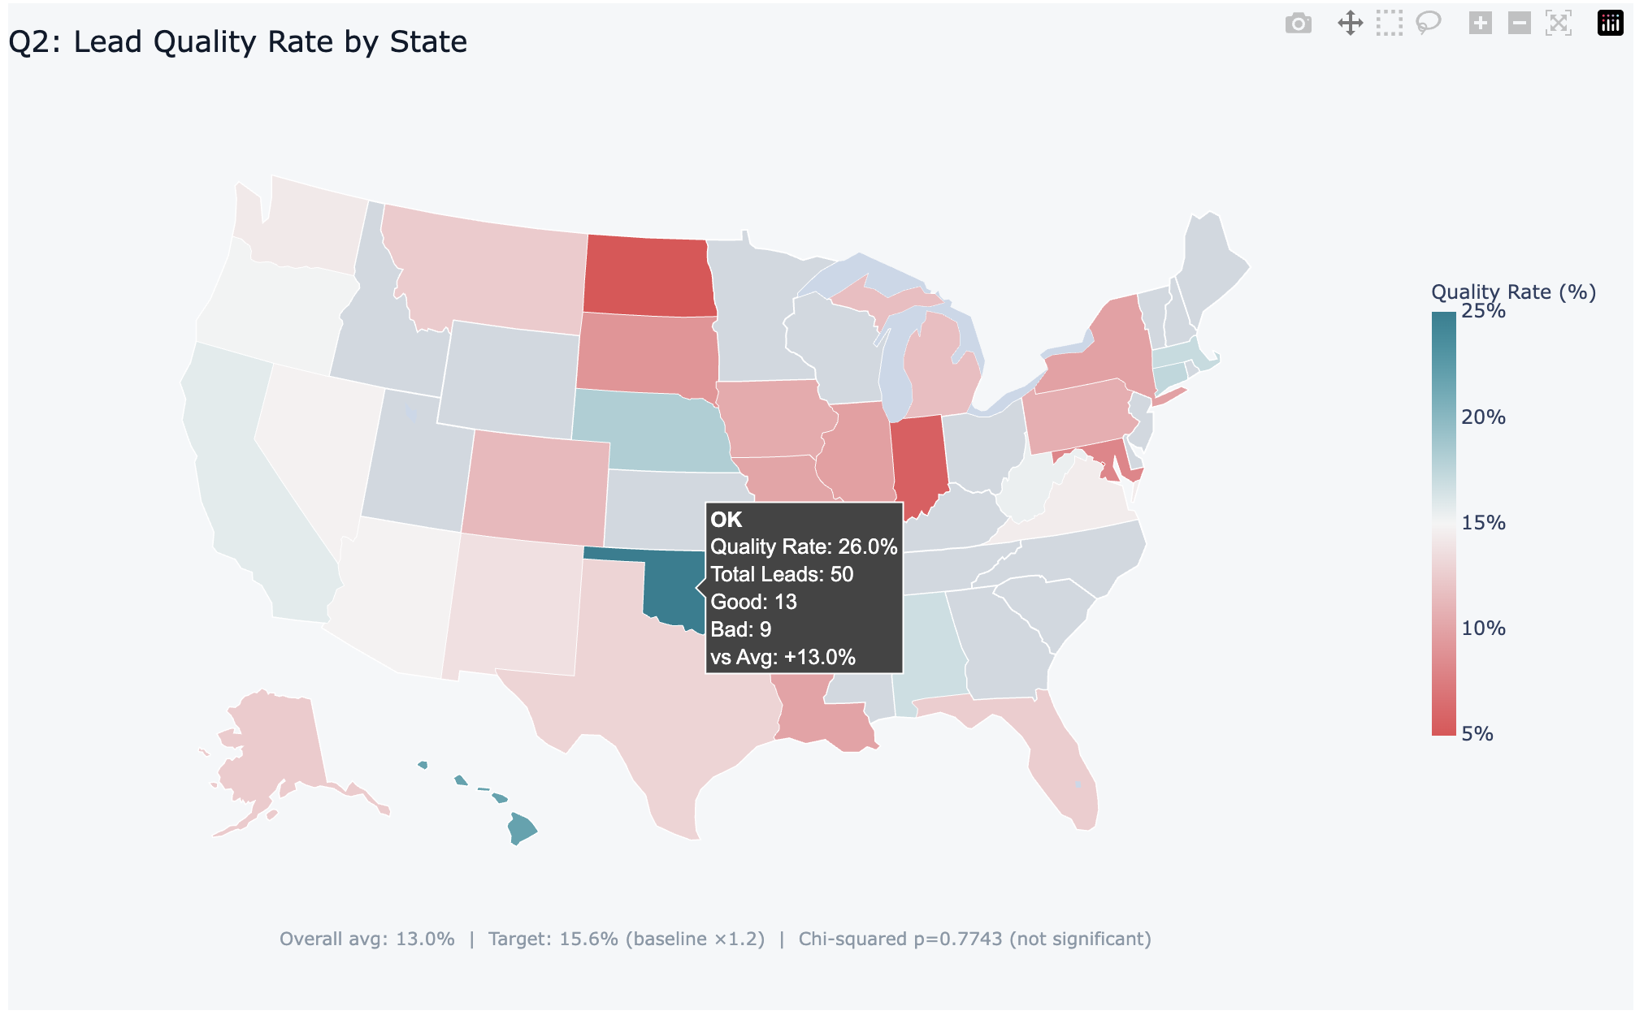
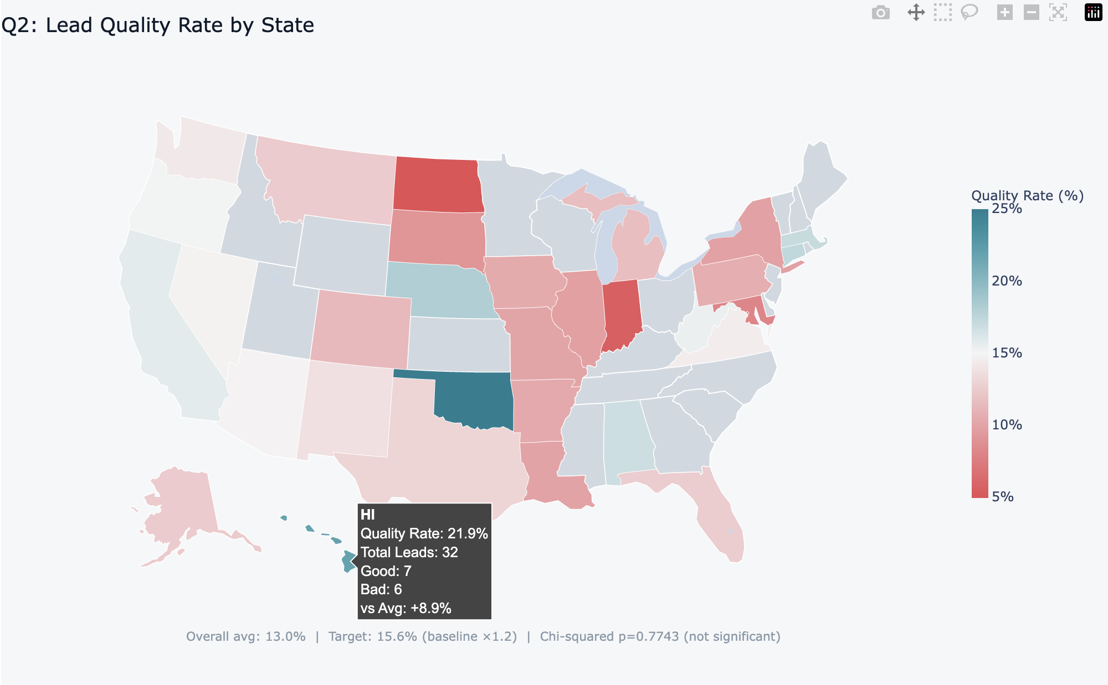
Q2 — Driver Analysis: States & Map
States
To explore whether geography plays a role in lead quality, we grouped leads by U.S. state and computed quality rates for all states with at least 30 leads (22 states met this threshold, covering the majority of lead volume).
Rather than treating each state as an independent test, we ran a single chi-squared test across all qualifying states to assess whether the distribution of quality outcomes is independent of geography — this avoids the multiple comparison problem that would arise from testing each state individually.
Please see the complete interactive plot here: https://xzhu411.github.io/Aarki/state_quality_map.html
Key Takeaways
State-level quality differences are not statistically significant overall (chi²=15.92, p=0.77) — observed variation is consistent with random chance at current sample sizes.
Oklahoma (26.0%, n=50) and Hawaii (21.9%, n=32) show the highest rates among qualifying states, but both have relatively small samples and should not be acted on without further data.
Indiana (5.6%, n=36) and Maryland (8.2%, n=98) are the weakest performers among states with meaningful volume.
Conclusion: state is not a recommended filter at this stage, but geographic patterns should be monitored as volume grows, state-level targeting could become actionable with 6–12 more months of data.
9
10

Slide 12
Q2 — Driver Analysis: Publisher Zone & Campaign Type
PLACEMENT
We examined two placement-level variables: PublisherZoneName (which ad slot the creative appeared in) and PublisherCampaignName (the campaign it was served under). Notably, these two variables map 1-to-1 in this dataset, "Top Right-300x250" corresponds exactly to "DebtReductionCallCenter", and "TopLeft-302252" to "DebtReductionInc”, meaning they capture the same underlying split from two different angles.
We also looked at AdvertiserCampaignName to check whether branded vs. generic demand-side targeting drives any quality difference.
Publisher Zone / Campaign Type
Zone / Campaign | Leads | Good | Bad | Quality Rate
Top Right-300x250 (DebtReductionCallCenter) | 271 | 44 | 66 | 16.2%
TopLeft-302252 (DebtReductionInc) | 2,742 | 349 | 422 | 12.7%
Advertiser Campaign (Demand-Side)
Campaign | Leads | Good | Bad | Quality Rate
Debt Settlement1 Master | 1,810 | 236 | 298 | 13.0%
creditsolutions-branded-shortform | 1,203 | 157 | 190 | 13.1%
Key Takeaways
Top Right-300x250 (16.2%) outperforms TopLeft-302252 (12.7%) by ~3.5pp. No chi-squared was run as there are only two groups, the directional difference is clear but should be interpreted alongside other variables, since this split also aligns with the Call Center vs. organic traffic split.
Advertiser campaign shows virtually no quality difference (13.0% vs. 13.1%), branded vs. generic demand-side targeting does not appear to affect lead quality in this dataset.
The 1-to-1 mapping between PublisherZoneName and PublisherCampaignName means these two fields are redundant. The meaningful driver is likely the underlying traffic source (Call Center vs. organic), which is better captured by the Partner and TrafficType analysis.
11

Slide 13
Q2 — Driver Analysis: Marketing Campaign
CAMPAIGN
MarketingCampaign represents the search or advertising campaign label associated with each lead (e.g., AdWords campaign groups). These labels likely reflect differences in keyword targeting, traffic routing, or advertising channel configuration on the demand side.
To evaluate whether campaign segmentation is associated with lead quality, we grouped leads by campaign name and filtered to campaigns with at least 30 leads to ensure stable estimates. We then compared quality rates across campaigns and conducted a chi-squared test to assess whether differences across campaign groups are statistically significant.
Quality Rate by Marketing Campaign (n ≥ 30)
Marketing Campaign | Leads | Good | Bad | Quality Rate
Financial Services | 171 | 32 | 23 | 18.7%
Debt Holding Tank | 337 | 61 | 33 | 18.1%
Debt Volume | 143 | 23 | 18 | 16.1%
Credit | 100 | 14 | 15 | 14.0%
state | 97 | 12 | 11 | 12.4%
Debt Consolidation | 34 | 4 | 7 | 11.8%
DebtReductionInc | 1,468 | 166 | 227 | 11.3%
Debt General | 328 | 29 | 75 | 8.8%
Chi-squared test (all campaigns, n≥30): chi² = 35.26, p < 0.0001 → SIGNIFICANT
Key Takeaways
Campaign group is significantly associated with lead quality (chi²=35.26, p<0.0001), suggesting that different search campaigns or keyword groups generate leads with different quality profiles.
"Financial Services" (18.7%) and "Debt Holding Tank" (18.1%) are the top performers, both well above the 15.6% target. "Debt General" (8.8%) is the worst, nearly 4pp below the overall average.
"DebtReductionInc" (11.3%) accounts for the largest share of leads (n=1,468) but underperforms — its high volume makes it a meaningful drag on overall quality.
12

Slide 14
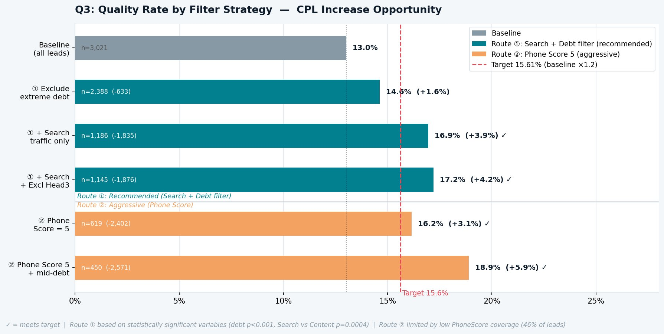
Q3 — CPL Increase Opportunity
STRATEGY
The Q2 findings identified three statistically significant variables: debt level (p<0.001), traffic type (p=0.0004), and PhoneScore (p=0.0007). Rather than applying all three filters at once, which would stack volume losses multiplicatively, we structured the analysis as two sequential routes, each adding one filter at a time so the quality and volume impact of each step is transparent.
Route ① builds from the broadest, most coverage-friendly filters first (exclude extreme debt → Search only → exclude Head3), reaching the 15.6% target at step two while retaining 1,186 leads.
Route ② starts from PhoneScore = 5, which by itself already meets the target but immediately discards 54% of leads where the score is missing, making it a fundamentally different risk profile from Route ①, not just a more aggressive version of the same approach
Route ① — Recommended
Route ② — Aggressive
Exclude $7.5k-10k & >$100k debt
+ Search traffic only
+ Exclude Head3 widget
→ 17.2% quality, n=1,145 leads retained
Phone Score = 5 + mid-range debt
→ 18.9% quality, but only n=450 leads
→ Loses 85% of volume
→ Not viable until PhoneScore coverage improves
10
13

Slide 15
Future Work
STRATEGY
Expand PhoneScore / AddressScore coverage Verification signals currently cover only part of the dataset (PhoneScore ~46%, AddressScore ~39%). As coverage improves over time, PhoneScore, particularly Score 5, can be used as a scalable quality filter rather than an aggressive or niche segmentation strategy.
Keyword-level NLP analysis of search intent Columns containing the referring keyword string and search queries provide an opportunity to analyze user intent. Applying NLP techniques (e.g., keyword clustering or embedding-based similarity) could reveal related high-intent terms and expand the set of queries that trigger high-quality ads.
Multivariate modeling of lead quality Current analysis evaluates drivers individually or at most consider two at a time. Future work could build a multivariate model (e.g., logistic regression or gradient boosting) to estimate the marginal impact of each variable while controlling for others, allowing more precise optimization of lead acquisition.
Cost-efficiency optimization The current strategy optimizes for quality rate. A next step would be to optimize for expected profit by combining quality probability, CPL, and conversion value, identifying segments that maximize expected ROI rather than quality alone.
10
14

Slide 16
Conclusions
IMPLEMENT
Exclude low-quality debt segments
Remove $7.5k–$10k and >$100k leads. Statistically validated (chi²=44.82, p<0.0001). Low volume loss (633 leads).
IMPLEMENT
Prioritise Search traffic over Content
Search delivers 15.3% vs Content's 9.7% (p=0.0004). Reduce or stop buying AdSense/content-network leads.
IMPLEMENT
Exclude Head3 widget
Head3 (6.7%) is 6 pp below average. Removing it adds marginal quality lift with minimal volume impact (n=75).
MONITOR
Improve PhoneScore coverage
Score 5 is the strongest individual signal (16.2%, p=0.0007) but covers only 46% of leads. Expanding coverage would unlock Route ② at scale.
INVESTIGATE
Investigate $7.5k–$15k anomaly
Zero PhoneScore coverage in this band suggests a data collection or vendor issue. Worth investigating before using this segment.
15

