Slide 1
Airport: Dolly and Tractor preliminary trial version

Slide 2
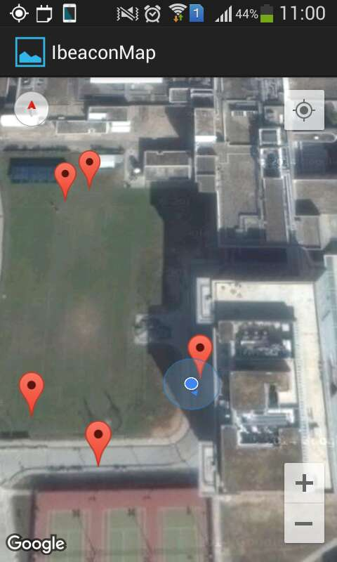
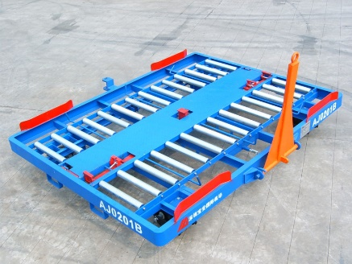
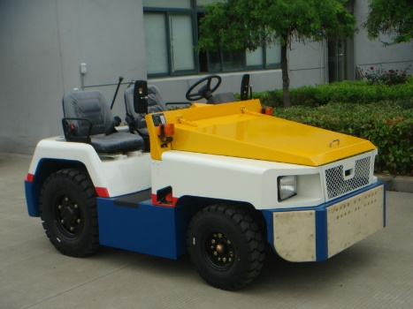
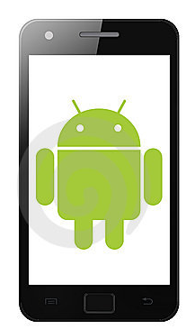
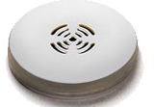
System Design
Equip with iBeacon
Equip with a detector (Android Device)
Cloud based server
Tracking application

Slide 3
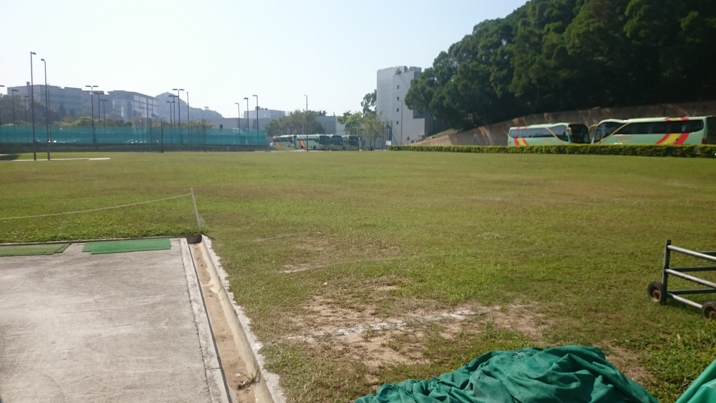
Testing Area

Slide 4
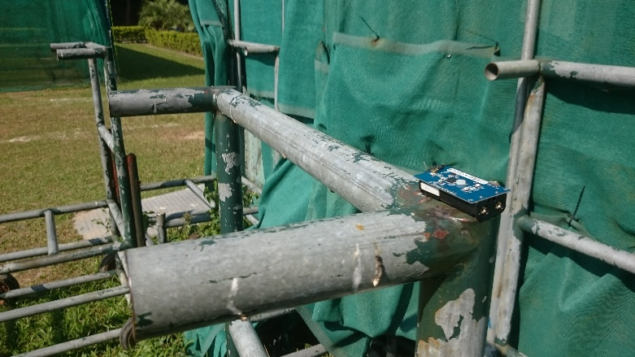
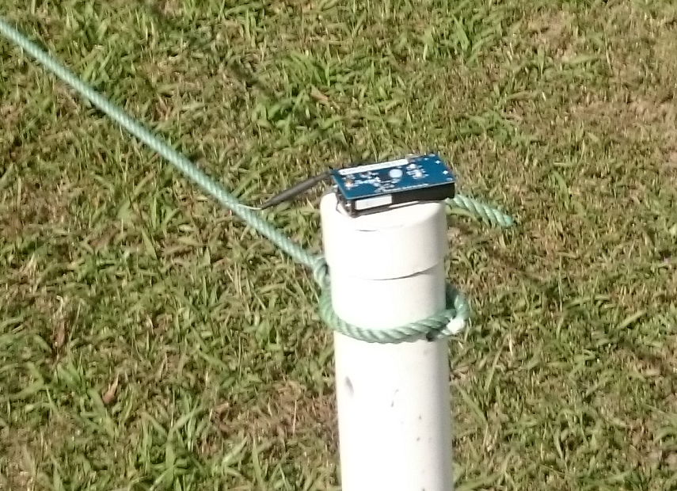
Testing
We walk around with 5 iBeacons like a tractor pulling a few dollies
An detector device is placed in our pocket
We drop and pick-up iBeacons, like the tractor drop and pick-up the dollies
Observe the tracking application over the process

Slide 5
Testing result
The location of the dollies (iBeacons) are exactly shown in the tracking application
The error is about 5m in outdoor area
The location of iBeacons dropped
Our last location

