Slide 1
Dynamic Pd cluster growth on CeO₂(111)
07/06/2018

Slide 2
Cluster Expansion for Pd dynamics
Goals – use the current cluster energy to predict larger cluster energy without doing more DFT calculation
Action plans
Use 2D Pd clusters to test cluster expansion techniques and understanding
Include 3D Pd clusters
Include the configurations with CO adsorbed and introducing coverage effect
Produce energetics input files for Zacros

Slide 3

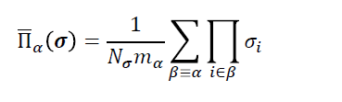

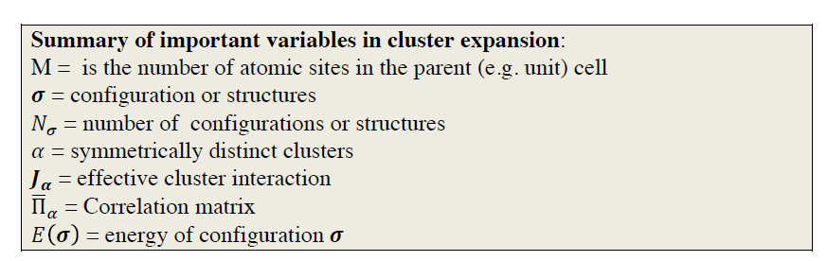
Cluster Expansion Theory
Energy of a configuration
Correlation matrix
Goal is to minimalize mean square error

Slide 4
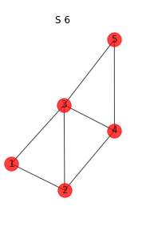
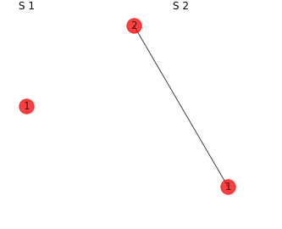
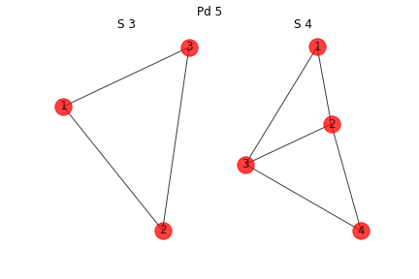
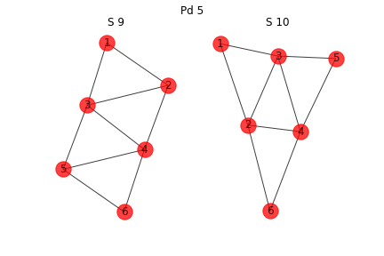
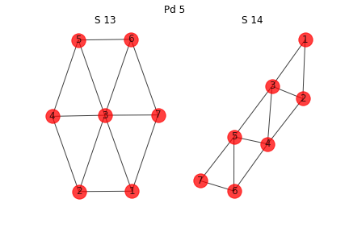
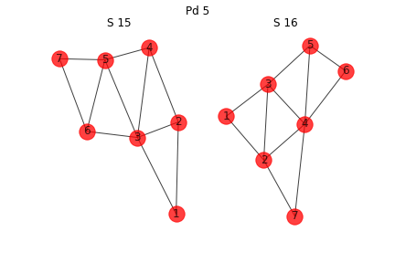
Configurations considered
Only 12 2D configurations up to Pd7 are considered now
Ece in eV
Pd1 (T) | 0
Pd2 | -0.45
Pd3 | -1.5
Pd4 | -2.56
Pd5 | -3.41
Pd6_1 | -4.49
Pd6_2 | -4.38
Pd6_3 | -4.32
Pd7_1 | -6.07
Pd7_2 | -4.9
Pd7_3 | -5.11
Pd7_4 | -5.12

Slide 5
Lattice
Fit the 12 configurations to one lattice
Grey denotes the site is empty
Red denotes the site is occupied

Slide 6






Clusters
Single body
1NN two-body interaction
2NN two-body interaction
3NN two-body interaction
Triangular triplet three-body interaction
Linear triplet three-body interaction
bend triplet three-body interaction
Adopted from:
Piccinin, S. and Stamatakis, M. “Steady-State CO Oxidation on Pd ( 111 ): First-Principles Kinetic Monte Carlo Simulations and Microkinetic Analysis” Topics in Catalysis 60, no. 1 (2017): 141–151. doi:10.1007/s11244-016-0725-5

