Slide 1

Improving Bank-Level Parallelism for
Irregular Applications
Xulong Tang, Mahmut Kandemir,
Praveen Yedlapalli, Jagadish Kotra
MICRO ‘49

Slide 2
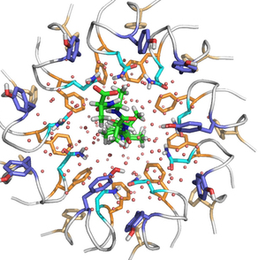
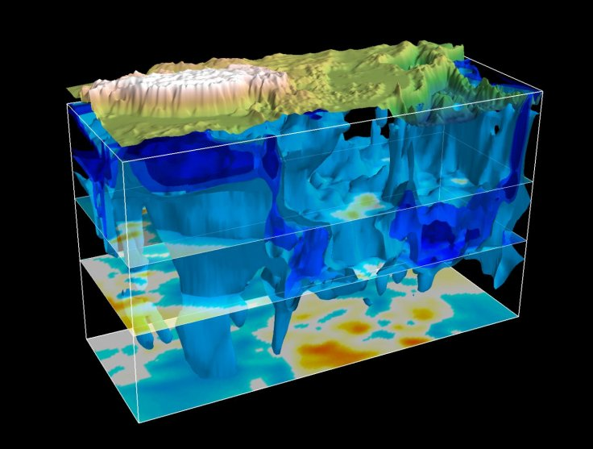


Irregularity of Applications
Irregular applications
Molecular dynamics
Earthquake simulation
Weather simulations
Economics science
Most of the applications are running on
Multicores/Manycore platforms.
Image source:
http://www.nature.com/nature/journal/v516/n7530/fig_tab/nature13768_SF5.html
https://en.wikipedia.org/wiki/Weather_Research_and_Forecasting_Model
http://www.tibetnature.net/en/massive-fast-moving-structure-seen-beneath-tibetan-plateau-in-earthquake-simulation-study/
https://hgchicago.org/courses/advanced-courses/economic-science/

Slide 3
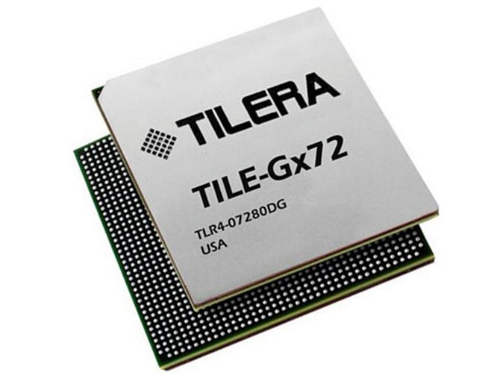
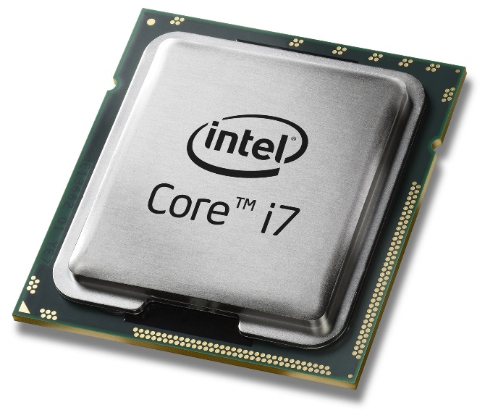
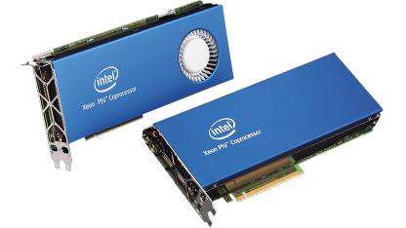
Era of Multicore/Manycore Systems
Are we using the memory system efficiently?
4 cores, 4.0GHz
MemB: 21 GB/s
72 cores, 1.2GHz
MemB: 60 GB/s
68 cores, 1.40 GHz
MemB: 480 GB/s
Image source:
http://www.intel.com/
https://en.wikipedia.org/wiki/Tilera

Slide 4
Executive Summary
End-to-end data access performance is crucial to multithreaded applications running on multicores/manycores.
Maximizing LLC hit rate is not enough.
Off-chip accesses are expensive.
Off-chip accesses latencies are not uniform
Bank-level parallelism
Row-buffer locality
Memory scheduling
Software works targeting off-chip accesses are still in their infancy.
Our proposal: Software approach to improve BOTH bank-level parallelism and bank-reuse for irregular applications running on manycore platforms.

Slide 5
Outline
Executive Summary
Background
Challenges and Motivation
Our Proposal
Simulation Setup and Evaluation
Conclusions

Slide 6
Background
Bank-Level Parallelism (BLP)
The average number of requests being served in parallel by all the banks in the DRAM when at least one request is being served by any bank.
The importance of BLP
Maximizing memory parallelism at a finer granularity.
Improving memory bank utilization.
Core-1
Core-2
BLP=1
BLP=2
Bank1
Bank2
Idle

Slide 7
Background
Bank-reuse (BR)
Subsequent accesses to the same memory bank.
Is it really important?
Expose opportunities to improve row-buffer locality.
Core-1
1
2
3
4
3
2
Bank1
Bank2

Slide 8
Outline
Executive Summary
Background
Challenges and Motivation
Our Proposal
Simulation Setup and Evaluation
Conclusions

Slide 9
Memory Access Pattern
Core-1
Core-2
Core-3
Core-4
1
2
3
4
5
6
7
8
9
10
11
12
13
14
15
16
Original
Idle
Idle
Idle
Bank-1
Bank-2
Bank-3
Bank-4
Group of loop iterations
Notes:
If there are dependencies among different groups
We are scheduling subject to the dependency group.

Slide 10
BLP
Core-1
Core-2
Core-3
Core-4
1
2
3
4
5
6
7
8
9
10
11
12
13
14
15
16
Original
Bank-1
Bank-2
Bank-3
Bank-4
Core-1
Core-2
Core-3
Core-4
1
2
3
4
6
7
8
5
11
12
9
10
16
13
14
15
BLP optimized
Bank-1
Bank-2
Bank-3
Bank-4
Group of loop iterations

Slide 11
Bank reuse
Core-1
For each core, bring iteration groups back to back if they access to the same bank.
Expose more row-buffer locality opportunities.
1
2
3
4
Bank-1
Bank-2
Bank-3
Bank-4
Core-1
1
2
3
4
Bank-1
Bank-2
Bank-3
Bank-4
Group of loop iterations
Notes:
Although access to the same bank does not mean access to the same row. However, the principle of locality in
Loops together with FRFCFS memory scheduling together can explore more row-buffer locality once we bring the accesses
To the same bank back to back

Slide 12
Opportunities
In the BLP Ideal scenario
BLP improvement: 69.8%
Execution time reduction: 27.8%
Notes:
Ideal definition:
To show what the potential of an ideal scheme that max-
imizes BLP (as opposed to MLP) would be, we performed
another set of experiments. It needs to be observed that,
at any given period of time, there could be two reasons
why an application can experience less than maximum BLP.
First, there may not be enough number of off-chip memory
references (e.g., if we have only 16 outstanding memory
references in a period of execution, we can have a maximum
BLP value of 16). Second, even if we have enough off-chip
accesses, those accesses may not get distributed evenly across
available memory banks. In our implementation of the ideal
scheme, we ensured that, if there are sufficient number of off-
chip accesses, they are always distributed across the banks
evenly. Therefore, the only reason this ideal scheme could not
achieve maximum BLP is the lack of sufficient number of
memory accesses. The results with this ideal scheme (called
BLP Ideal) are given as the last bar for each application, in
Figures 4 and 5. As compared to the original execution, this
ideal scheme brings an average BLP improvement of 69.8%,
resulting in an average execution time saving of 27.8%.

Slide 13
Our goal
Loop iterations scheduling targeting improving bank-level parallelism. (horizontal dimension)
Achieving bank-ruse as long as it does not hurt BLP. (vertical dimension)
Core-1
Core-2
Core-3
Group of loop iterations

Slide 14
Outline
Executive Summary
Background
Challenges and Motivation
Our Proposal
Simulation Setup and Evaluation
Conclusions

Slide 15
Formalization
loop:
X[…] ← …
Y[…] ← …
parallel-loop:
…← A[X[…]] + B[X[…]]
…← C[Y[…]] + D[Y[…]]
X[…] ← …
Y[…] ← …
parallel-loop:
… ← A[X[…]] + E[Y[…]]
… ← F[Y[…]] + D[X[…]]
goto loop
Parallel region
Granularity applying our approach.
Slab
Bank-map
BLP
Bank-reuse
C₁
C₂

Slide 16
Formalization
parallel-loop:
…← A[X[…]] + B[X[…]]
…← C[Y[…]] + D[Y[…]]
Parallel region
Slab
Scheduling unit in our approach.
Bank-map
BLP
Bank-reuse
slab
C₁
Core-1
Core-2
Core-3
Core-4

Slide 17
Formalization
Parallel region
Slab
Bank-map
Memory banks accessed by a specific slab.
E.g. C1 (1001), C2 (1000), C3(0010), C4 (0011)
BLP
“OR” op on bank-maps from the slabs scheduled at the same time.
E.g. 1011
Bank-reuse
Core-1
Core-2
Core-3
Core-4
slab
slab
slab
slab
Bank-1
Bank-2
Bank-3
Bank-4
Notes:
Horizontal

Slide 18
Formalization
Parallel region
Slab
Bank-map
BLP
Bank-reuse
Slabs accessing same bank from one core.
“XNOR” op on subsequent slabs.
E.g. slab 1 and slab 4
Bank-1
Bank-map
1000
4
0010
3
Bank-2
0100
2
1001
1
Bank-3
Core-1
Bank-4
Notes:
Vertical

Slide 19
Built-in Inspector
BLP shows repetitive patterns over execution.
Inspector-executor paradigm.
Each parallel region, right after the index array are assigned.
Inspector invoked at runtime.
X[…] ← …
Y[…] ← …
parallel-loop:
…← A[X[…]] + B[X[…]]
…← C[Y[…]] + D[Y[…]]
X[…] ← …
Y[…] ← …
Sch ← BLP-scheduling()
/* Algorithm I */
parallel-loop using Sch:
… ← A[X[…]] + B[X[…]]
… ← C[Y[…]] + D[Y[…]]
C₁
Inspector
Executor

Slide 20
Algorithm
Greedy algorithm working on slide window.
Window size (25 slabs)
BLP is primary goal.
Bank-reuse is taken into account only when there are multiple schedulable slabs with the same BLP.

Slide 21
Example
Core-1
Core-2
Core-3
Core-4
Slab
1
2
3
4
5
6
7
8
9
10
11
12
13
14
15
16
Bank-1
Bank-2
Bank-3
Bank-4
0001
1000
1010
1000
0100
0011
0101
0100
1000
0001
1001
0010
1001
1001
0100
0110

Slide 22
Example
Core-1
Core-2
Core-3
Core-4
0001
1000
1010
1000
T1
0100
0011
0101
0100
BLP:
0000
0001
1001
1011
1111
1000
0001
1001
0010
1001
1001
0100
0110
1000
T2
0100
0011
0101
BLP:
0000
1000
0001
1001
0010
1001
1001
0100
0110

Slide 23
Example
Core-1
Core-2
Core-3
Core-4
0001
1000
1010
1000
T1
0100
0011
0101
0100
BLP:
1111
1000
0001
1001
0010
1001
1001
0100
0110
1000
T2
0100
0011
0101
BLP:
1001
1011
1111
0000
1000
0001
1001
0010
1001
1001
0100
0110

Slide 24
Example
Core-1
Core-2
Core-3
Core-4
0001
1000
1010
1000
T1
0100
0011
0101
0100
BLP:
1111
1000
0001
1001
0010
1001
1001
0100
0110
1000
T2
0100
0011
0101
BLP:
1111
1000
0001
1001
0010
1001
1001
0100
0110
Violate BLP
1000
T3
0100
0000
1000
1001
1101
BLP:
1111
1000
0001
1001
0010
1001
0100

Slide 25
Outline
Executive Summary
Background
Challenges and Motivation
Our Proposal
Evaluation
Conclusions

Slide 26
Evaluation Methodology
LLVM 3.5
Simulator
gem5, 12 Xeon E5 (3.4GHz)
Cache configuration (32KB private L1, 256KB private L2, 10MB shared LLC)
Memory configuration (4 DDR4-2933 MCs, 32GB)
8 ranks/DIMM, 2 banks/rank, 2KB row size.

Slide 27
Evaluation
BLP improvement: 46.8%
Execution time reduction: 18.3%

Slide 28
Comparison to Different Schemes
More results and discussions are
present in the paper

Slide 29
Conclusions
Improving end-to-end data access performance is important to irregular applications running on multicore platforms.
Propose loop iteration scheduling to improve memory bank-level parallelism for irregular applications.
Bank-reuse is also considered in an attempt to improve row-buffer locality.
Our approach outperforms most hardware and software based approaches, and significantly improves both BLP (46.8% on average) and execution times (18.3% on average).
Notes:
Propose loop iteration scheduling to improve memory bank-level parallelism for irregular applications.
Bank reuse is also considered in an attempted to improve row-buffer locality.
Results

Slide 30
Questions?
Improving Bank-Level Parallelism for
Irregular Applications
Xulong Tang, Mahmut Kandemir,
Praveen Yedlapalli, Jagadish Kotra
MICRO ‘49

Slide 31
Backup Slides

Slide 32
DRAM Basics
Notes:
DRAM in modern systems is composed of various compo-
nents like ranks, banks, and sub-arrays. Cores in a multicore
access the data from off-chip DRAM through a component
called Memory Controller (MC). Upon a last-level cache
(LLC) miss, read/write requests are mapped to a specific
MC based on the address mapping which we describe below.
Requests to a DRAM are queued in a buffer at the MC,
and are issued to the DRAM by MC. Figure 1 shows the
basic organization of a DRAM and how it is connected
to a multicore. Each MC manages a DRAM module also
referred to as DIMM by issuing commands over address/data
buses, also referred to as channel. Internally, each module
is organized hierarchically as ranks, banks, and sub-arrays.
We do not consider sub-arrays in our hierarchy as they are
less common. Each DIMM is made up of multiple ranks.
Each rank consists of multiple banks and all the banks in
a rank share the timing circuitry. Each bank consists of a
set of sense-amplifiers, referred to as row-buffer, where the
memory row is loaded to before the data corresponding to the
request is sent back over the channel. In an open-row policy,
the row previously accessed is left open in the row-buffer.
Consequently, if there is a request to the same row in the
row-buffer, it need not be activated again, and hence incurs
low latency resulting in a row-buffer hit. If there is a request
to a different row, the current row in the row-buffer needs
to be precharged and the new row has to be activated before
the data is accessed and such a scenario is widely referred
to as row-buffer conflict. Many works in the past proposed
hardware-based schedulers that take advantage of the open-
row policy. One such scheduler, FR-FCFS [8], [9], prioritizes
accesses that target the current row in the row-buffer over other
accesses.

Slide 33
Address Mapping
Page offset (12 bits for 4KB page)
4 MCs (bits 12 and 13)
4 ranks (bits 14 and 15)
8 banks (bits 16, 17 and 18)
47
18
15
13
11
5
0
Mem
Bank
Mem
Rank
Mem Channel
Page offset
Notes:
Address mapping, also referred to as interleaving, governs
how data are distributed across various components in the
DRAM. This mapping (from physical addresses to memory
banks) is decided statically (at hardware design time), and
depending on the mapping scheme employed by the hardware,
a request to a physical address can result in an access to a
channel/rank and bank. Various interleavings are possible at
each level in the memory hierarchy like caches, channels and
banks. Two widely-employed interleavings are cache line level
and page level. Address mapping plays an important role in
determining the performance of the system as it effects both
the locality and parallelism in the memory hierarchy. Figure 2
shows how a physical address is mapped to a channel/rank and
bank based on page-level interleaving. The least significant
12-bits represent the page offset for a 4KB page. Assuming
there are 4 MCs, the next 2 bits (bits 12 and 13) represent
the channel id where this physical address is mapped. In a
corresponding channel, assuming there are 4 ranks, the next
2 bits (bits 14 and 15) represent the rank where this physical
address is mapped. Once the rank is determined, assuming
there are 8 banks in a rank, the next 3 bits (bits 16, 17 and
18) are the bank bits and determine which bank this physical
address is mapped to.

Slide 34
Formalization
Parallel region
Slab
Scheduling unit in our approach.
Bank-map
BLP
Row-buffer locality
4
4
4
X[…] ← …
Y[…] ← …
parallel-loop:
…← A[X[…]] + B[X[…]]
…← C[Y[…]] + D[Y[…]]
X[…] ← …
Y[…] ← …
parallel-loop:
…← A[X[…]] + B[X[…]]
…← C[Y[…]] + D[Y[…]]
X[…] ← …
Y[…] ← …
parallel-loop:
…← A[X[…]] + B[X[…]]
…← C[Y[…]] + D[Y[…]]
X[…] ← …
Y[…] ← …
parallel-loop:
…← A[X[…]] + B[X[…]]
…← C[Y[…]] + D[Y[…]]
4
3
3
3
3
X[…] ← …
Y[…] ← …
parallel-loop:
…← A[X[…]] + B[X[…]]
…← C[Y[…]] + D[Y[…]]
2
X[…] ← …
Y[…] ← …
parallel-loop:
…← A[X[…]] + B[X[…]]
…← C[Y[…]] + D[Y[…]]
2
X[…] ← …
Y[…] ← …
parallel-loop:
…← A[X[…]] + B[X[…]]
…← C[Y[…]] + D[Y[…]]
2
X[…] ← …
Y[…] ← …
parallel-loop:
…← A[X[…]] + B[X[…]]
…← C[Y[…]] + D[Y[…]]
2
1
1
1
1
Core-1
Core-2
Core-3
Core-4
Notes:
Amination needed (the whole scheduling amination for different cores)

Slide 35
BLP over Time
Repetitive BLP pattern
Inspector-Executor paradigm.

Slide 36
Simulation results
optimized
original

Slide 37
Hardware results

