Slide 1
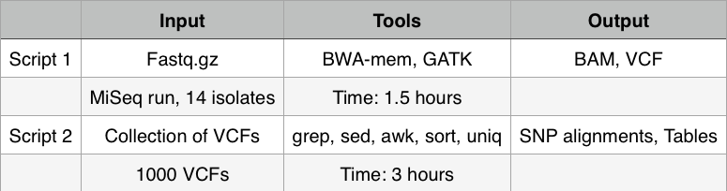
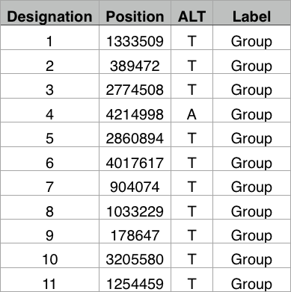
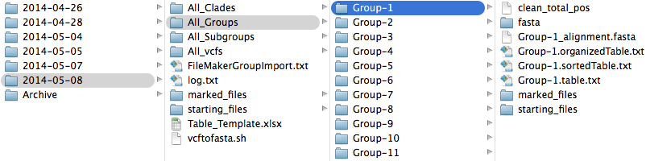
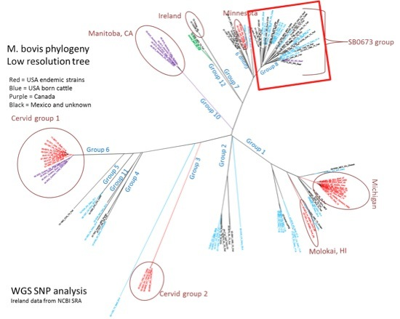
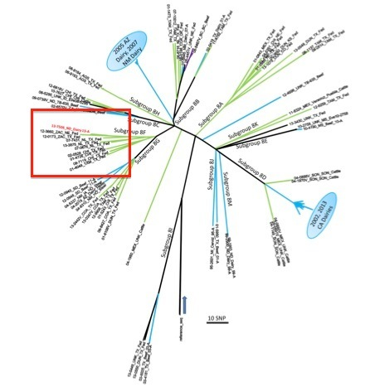
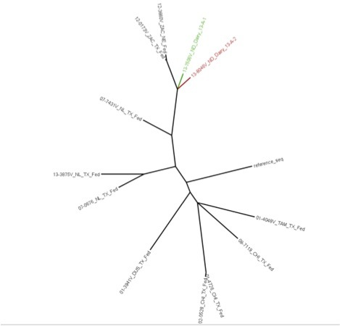




A high-resolution, routine diagnostic, genotyping method for Mycobacterium bovis and Brucella abortus using single nucleotide polymorphisms from whole genome sequencing data. Tod P. Stuberª, Suelee Robbe-Austermanª, Tyler Thacker^{b}, Patrick M. Campª, David T. Farrellª, Christine R. Quanceª, Matthew M. Erdmanª ªUnited States Department of Agriculture, Animal & Plant Health Services, National Veterinary Services Laboratories (NVSL), Diagnostic Bacteriology Laboratory, Ames, Iowa, USA Corresponding authors (515) 337-7388. (Tod.P.Stuber@aphis.usda.gov, Suelee.Robbe-Austerman@aphis.usda.gov, Matthew.M.Erdman@aphis.usda.gov, Patrick.M.Camp@aphis.usda.gov, David.T.Farrell@aphis.usda.gov, Christine.R.Quance@aphis.usda.gov) ^{b}United States Department of Agriculture, National Animal Disease Center, Ames, Iowa, USA. (Tyler.Thacker@ars.usda.gov)
OBJECTIVE
A robust genotyping method is needed to provide low and high-resolution comparisons for diseases of high consequence. Here we describe NVSL’s pipeline for the real time reporting of WGS SNP data to identify the source of brucellosis and bovine tuberculosis disease outbreaks. We describe the method used to sequence, identify and verify SNPs, identify phylogenetic relationships, and report the results. SNP comparisons are reported with an accurate, transparent and in an easy to understand format. SNP analysis from WGS of Mycobacterium bovis and Brucella abortus shows improved epidemilogical resolution when compared to past methods; spoligotyping, MIRU-VNTR-24 and MLVA. We show SNPs discriminate herd-to-herd transmission and discuss how unique SNPs seen in single isolates are interpreted differently than SNPs seen in multiple isolates.
PIPELINE SUMMARY
DEFINING SNPS
METHODS
DNA library preparations were done using Illumina’s NexteraXT kit with 1ng of input DNA from primary cultures. Routine diagnostic preparations were indexed and multiple samples were ran on a single MiSeq chip using 2 X 250 paired-end chemistry. Two scripts were used to complete SNP analysis. Script 1 used BWA, Picard and Broad Institute’s GATK, to align reads to a reference and output SNPs relative to the reference for each isolate in VCF. Script 2 used common Unix programs to output, easy to interpret, SNP comparisons from multiple VCF as both phylogenetic trees and SNP tables. Finally, by viewing BAM and VCF, SNPs were validated by visually verifying in IGV.
Pipeline available at: https://github.com/stuber/SNP_analysis
OUTPUT FILE STRUCTURE
Pipeline summary, partial list of defining SNPs showing positions that categorize isolates into groups, and file structure output.
REPORTING
Reports are provided in real time to epidemiologists and field staff. After isolating bacteria a completed genotyping report is released within one week. The report visually shows the relationship of the current outbreak isolate to isolates in the database by providing low and high resolution phylogenetic trees of SNPs. A high resolution SNP table is also provided showing isolate relationships. The intuitive interpretation of results provided by trees and tables, the reliability of WGS SNP data compared to previous genotyping methods, and ability to quickly communicate results provides actionable reporting to all interested personnel.
INTERPRETATION OF RESULTS
• Group, subgroup and clade only show informative SNPs for the isolates within that cluster
• Once a SNP occurs and establishes in a population it does not revert back
• Observations of homoplasy are rare
• SNPs observed in a single isolate are less informative than SNPs seen in multiple isolates and therefore established in a population
• The rate of an established SNP change appears to be highly variable and indistinguishable between Brucella sp. and M. bovis ranging from 0.1 to 0.7 with a median of 0.3 per year
CONCLUSIONS
This method has been effective for providing low and high resolution genotyping results using a workflow that can be done in a diagnostic laboratory and giving comparisons in real-time to epidemiologist and field staff in an easy to interpret format. The data analysis can be accomplished cost effectively using a desktop computer running Unix. Output provides lucid comparisons indicating strain relatedness. Comparisons demonstrate transmission from outbreak-to-outbreak and even herd-to-herd in diseases of high consequence. WGS and SNP analysis is a robust method for genotyping bacteria. This will aid veterinarians and other health officials to make decisions leading to control and elimination of disease in the United States.
CASE EXAMPLE
Low resolution phylogenetic tree of Group 8. USA origin cattle are blue, and Mexican origin cattle are in green. The isolates from the 2013 ND Dairy are located in subgroup 8F. Isolate shown in red font.
High resolution tree of subgroup 8F. Both isolates recovered from the 2013 ND Dairy-A contain 7 additional SNPs from the common ancestor which is located at the junction of the red and green branches. The Zacatecas isolates are 10- 12 SNPs from this node.
Low resolution tree of M. bovis isolates. The isolate of interest is located in group 8 which is within the red box.
SNP Table detailing the SNP differences between the Zacatecas originating isolates and the ND Dairy isolates.

