Slide 1
Building a Distributed Data Warehouse Pipeline Using Hadoop Ecosystem
---User Log Information Analysis
Ziyang Xu
DS5110

Slide 2
Introduction
The Big Data Rvolution
Project Objective
Tools and Technologies

Slide 3
Motivation: Why This Project?
Why not docker?

Slide 4
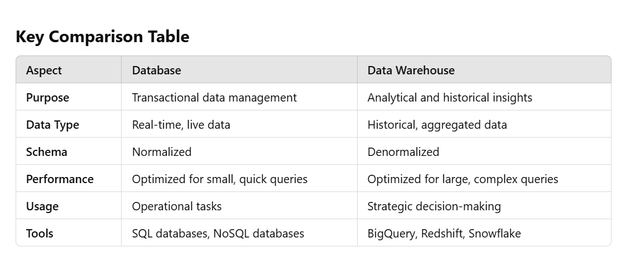
Data Warehouse VS Database?

Slide 5
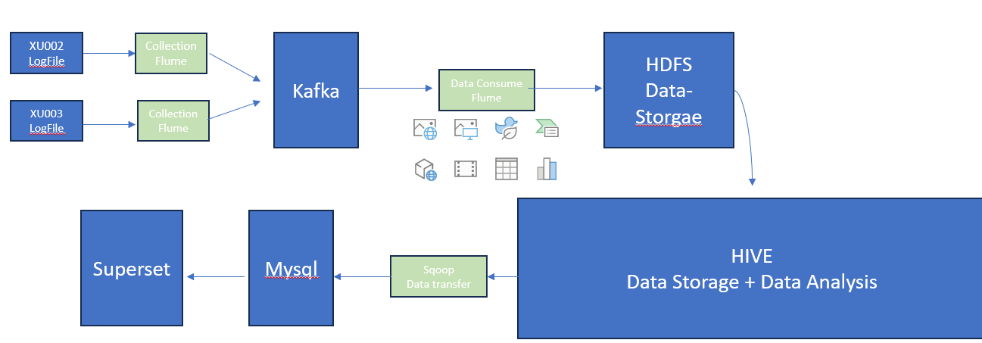
Model(Pipeline)

Slide 6
Mock Data
Data Type: Jason (common, actions, displays,error,ts)
Example(structure and “common”):
"common": { // Environment Information
"ar": "15", // Province ID
"ba": "iPhone", // Phone Brand
"ch": "Appstore", // Channel
"is_new": "1", // Whether the user is new
"md": "iPhone 8", // Phone Model
"mid": "YXfhjAYH6As2z9Iq", // Device ID
"os": "iOS 13.2.9", // Operating System
"sid": "3981c171-558a-437c-be10-da6d2553c517", // Session ID
"uid": "485", // User ID
"vc": "v2.1.134" // App Version Number }
{
“common”:{…},
“actions”:{…},
“display”:{…},
“error”:{…},
“ts”:{…}
}

Slide 7
HDFS:The Backbone of Distributed Data Storage
What is HDFS?
A distributed file system designed for storing large datasets across multiple nodes.
Ensures high availability, scalability, and fault tolerance.
Key Features:
Distributed Storage: Splits data into blocks and stores them across multiple nodes.
Fault Tolerance: Automatically replicates data blocks to handle node failures.
Scalability: Easily adds nodes to scale storage and processing capabilities.
Write Once, Read Many: Optimized for batch processing and analytics.
Role in the Project:
Central repository for storing raw and processed data.
Partitioned log data by date for efficient querying with Hive.
Ensured data accessibility across the pipeline components.

Slide 8
Hive:Querying Big Data with SQL
What is Hive?
A data warehouse tool built on Hadoop for querying and managing large datasets using SQL-like syntax.
Converts SQL queries into MapReduce jobs for execution.
Key Features:
SQL-Like Query Language (HiveQL): Makes it accessible for users familiar with traditional databases.
Supports Structured and Semi-Structured Data: Easily handles nested JSON formats.
Partitioning and Bucketing: Enhances query performance by reducing the data scanned.
Role in the Project:
Processed and analyzed log data stored in HDFS.
Created tables using nested structures (STRUCT, ARRAY) to preserve data hierarchy.
Automated daily data loading into Hive partitions using bash scripts.

Slide 9
Superset: Visualizing Insights from Big Data
What is Superset?
An open-source business intelligence (BI) tool for creating interactive dashboards and visualizations.
Connects to various data sources, including Hive and MySQL.
Key Features:
Ease of Use: Drag-and-drop interface for dashboard creation.
Interactive Dashboards: Filters, drill-downs, and real-time updates.
Custom Visualizations: Supports a variety of chart types and formats.
Role in the Project:
Connected to Hive and MySQL to visualize analytical results.
Created dashboards to explore user behavior and app performance.

Slide 10
Demo

Slide 11
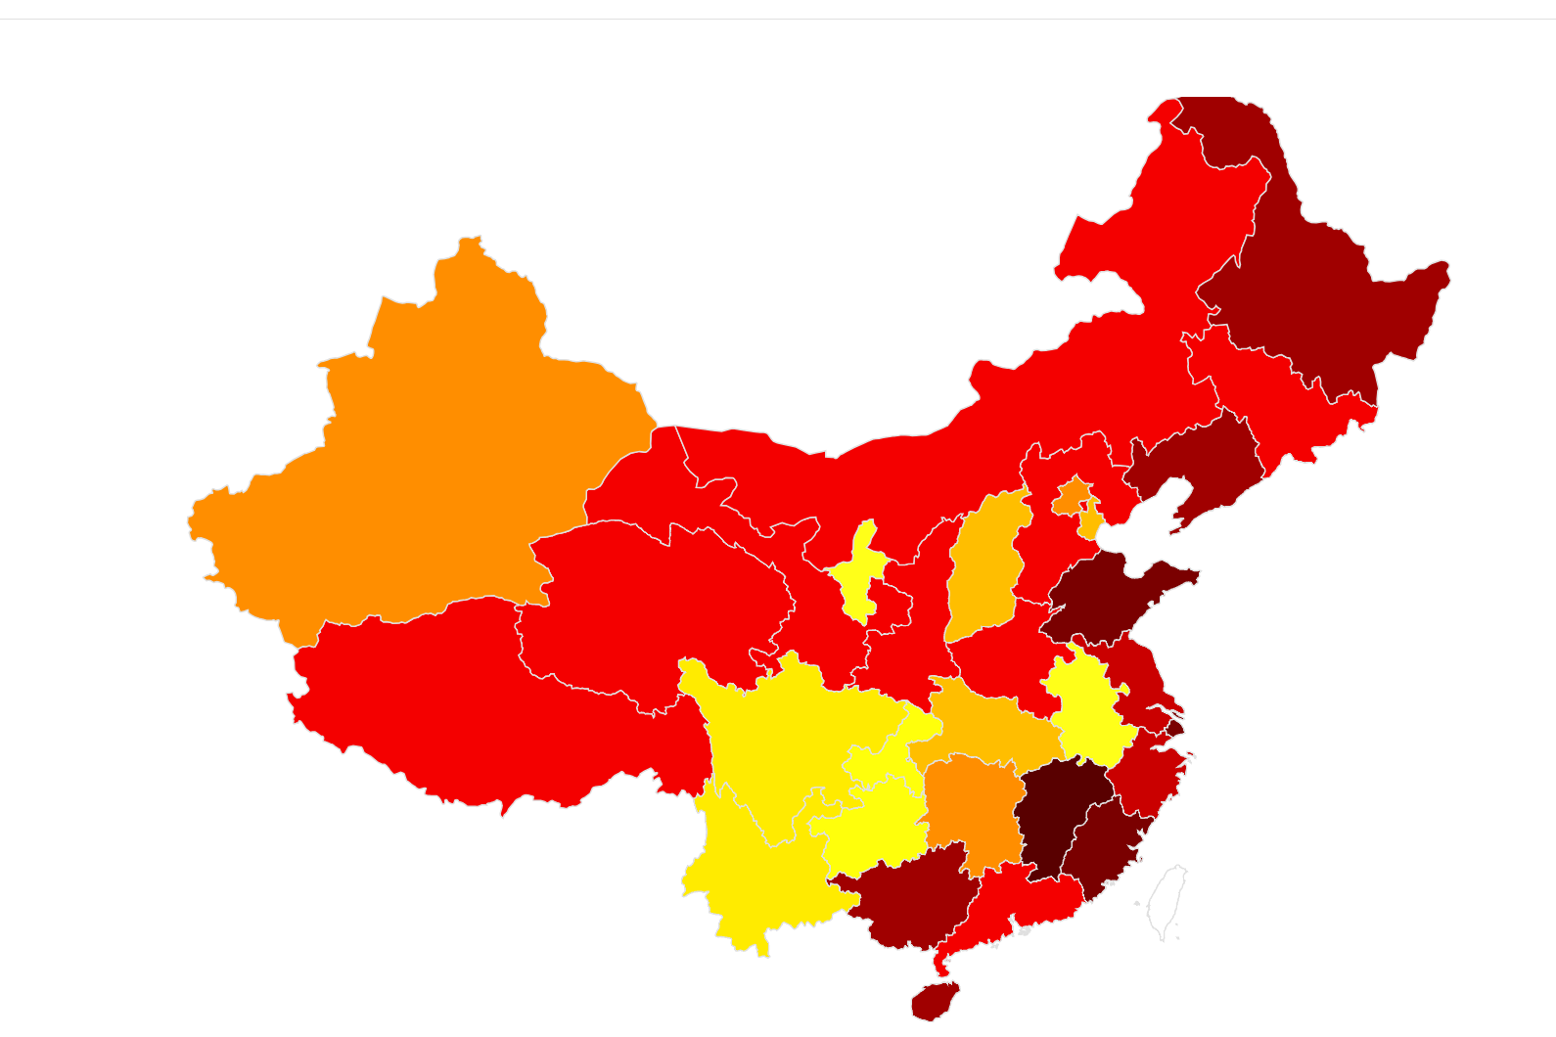
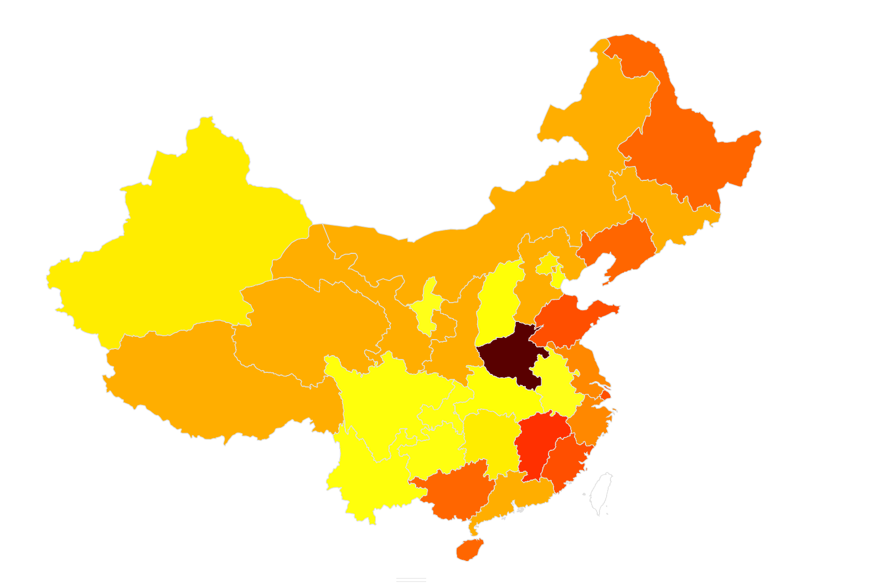
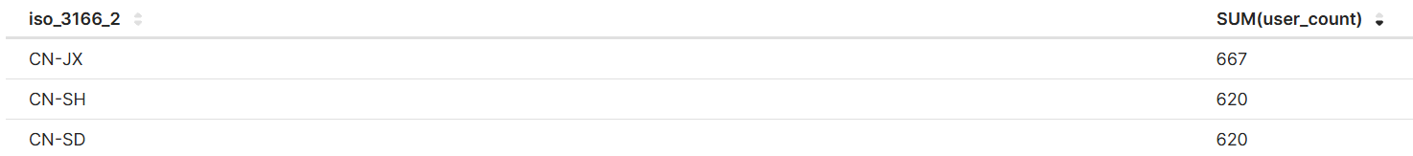
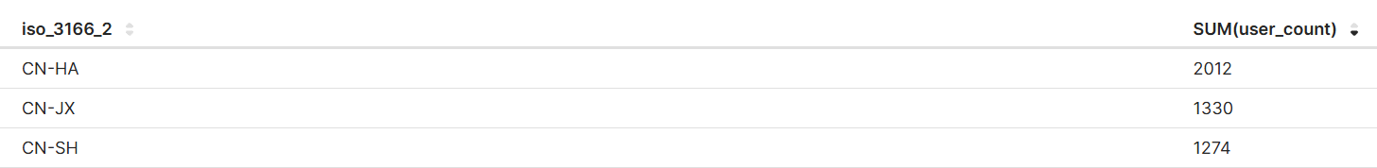
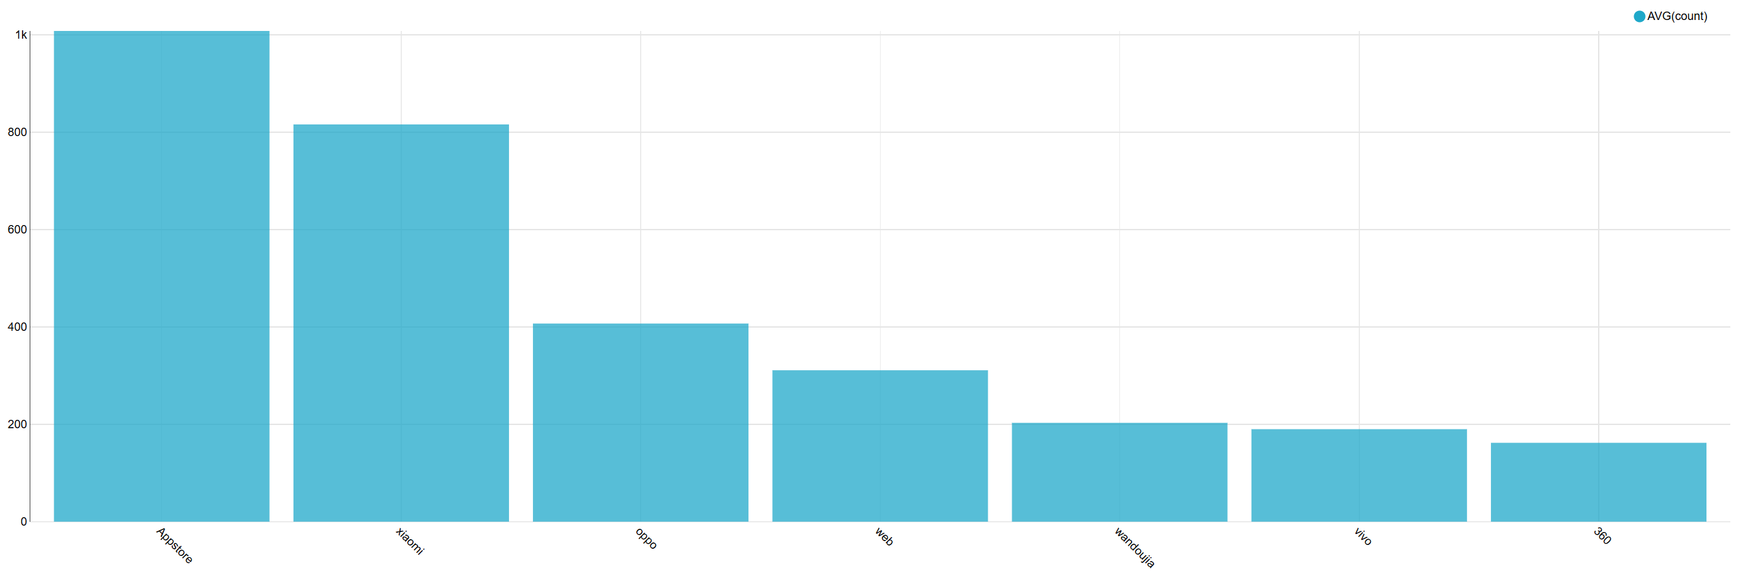
Results and Visualizations

Slide 12
Conclusion and Future Work
Cloud Migration:
Move the pipeline to a cloud platform like AWS or GCP for better scalability and reliability.
Automation and Scalability:
Automate more ETL processes to streamline operations.

Slide 13
Thanks! Have a nice winter break!

