Slide 1
VendorLog
Team 25(Ziyang Xu)

Slide 2
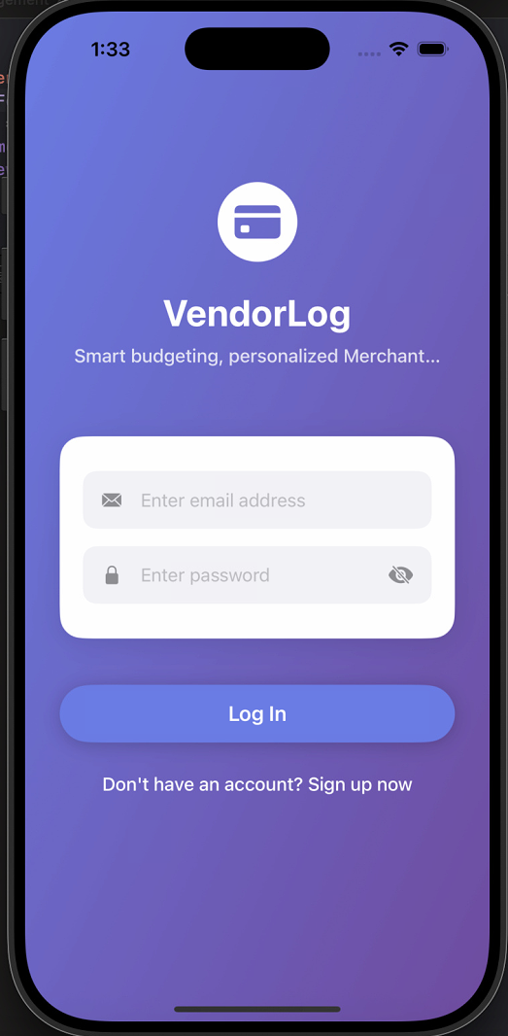
LogIn Page:
This screen is the login page of the VendorLog application. Users can:
Enter their email address
Use their registered email to sign in.
Enter their password
Input the corresponding account password to complete authentication.
Tap the “Log In” button to access the system
Once authenticated, users will enter VendorLog’s main interface and begin using features such as budgeting, expense tracking, and merchant insights.
Access the sign-up option for new users
If they don’t have an account yet, users can tap “Sign up now” at the bottom to navigate to the registration page and create a new account.

Slide 3
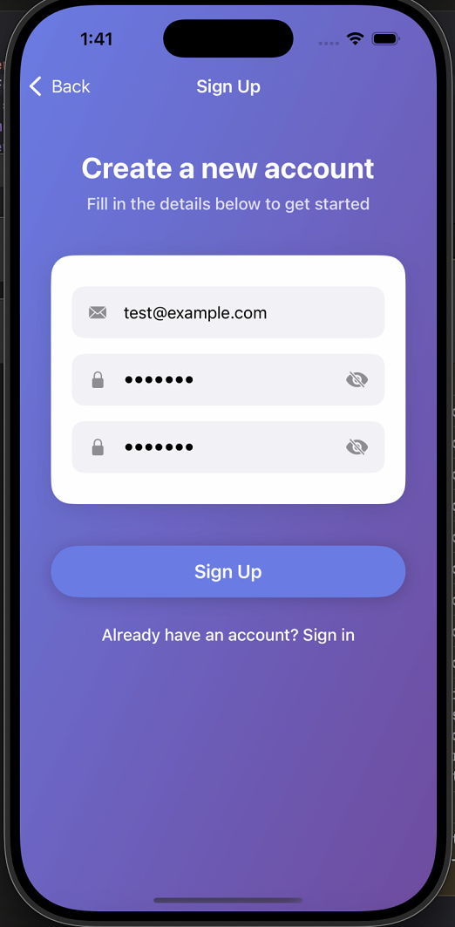
Create Account Page:
This screen is the VendorLog user registration page, designed for new users to create an account. Users can complete all registration steps here, including:
Entering an email address
This will be used as the login account and for receiving verification or notification emails.
Setting a password
The password must be at least 6 characters long to ensure account security.
Confirming the password
Enter the password again to make sure there are no mistakes.
Tapping “Sign Up” to complete registration
After submitting, a new VendorLog account will be created.
Navigation for existing users
If the user already has an account, they can tap “Sign in” at the bottom to return to the login page.

Slide 4
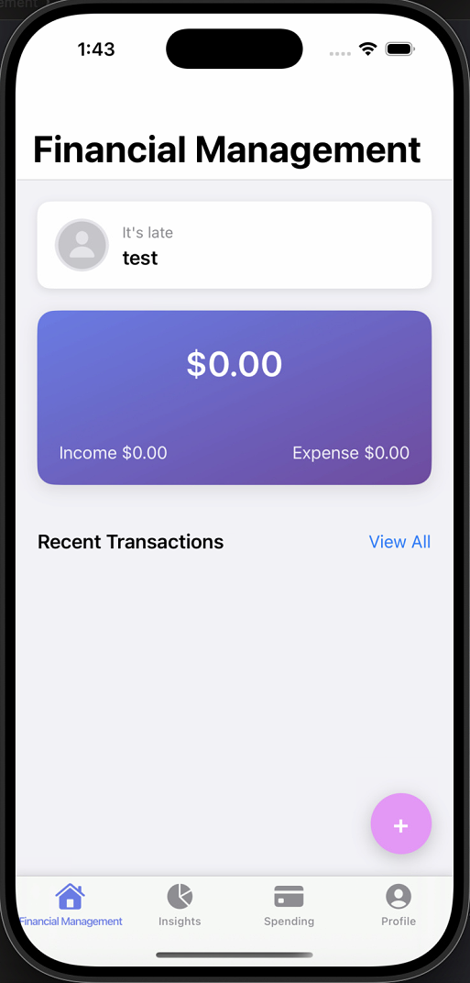
Home Page:
User Info Card
At the top, the user’s avatar and username (e.g., test) are displayed.
This serves as a personal welcome area and indicates which account is currently signed in.
Balance Summary
The purple card in the center shows the user’s current financial overview:
Total Balance ($0.00)
Income ($0.00)
Expense ($0.00)
These values update in real time as users add new transactions.
Recent Transactions
This section displays the user’s most recent income or expense records.
Users can tap View All to see the full transaction history.

Slide 5
Home Page:
Add Transaction Button
The purple + button in the bottom-right corner is a quick action button for adding new income or expense entries.
Tapping it opens the Add Transaction screen.
Bottom Navigation Bar
Financial Management: Current screen showing the financial overview
Insights: Charts, analytics, and financial insights
Spending: Detailed spending view by merchant or category
Profile: User profile and settings

Slide 6
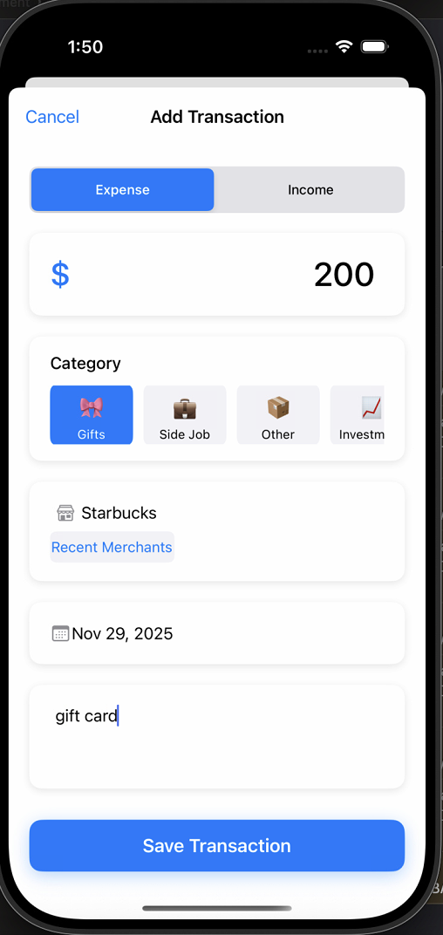
Add Transaction Page:
This screen is the Add Transaction page, designed to let users quickly record a new expense or income. Users can select the transaction type (Expense or Income) at the top, enter the amount, choose a category (such as Gifts, Side Job, or Other), fill in or select a merchant (e.g., Starbucks), set the transaction date, and add optional notes (such as “gift card”). Once all information is entered, tapping the Save Transaction button saves the record to the system and updates the financial overview and transaction history.

Slide 7
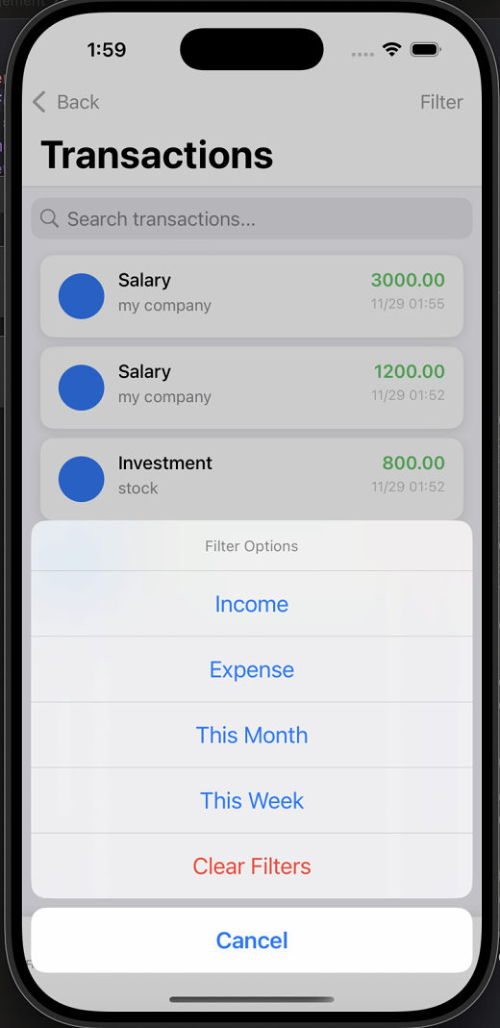
Transactions Page:
This screen is the Transactions page, where users can view all recorded income and expenses. Users can search for specific transactions using the search bar at the top, or tap the Filter button in the upper-right corner to refine the results. Filter options include viewing only Income (displayed in green), only Expense (displayed in red), transactions from this month, transactions from this week, or clearing all filters. Each transaction entry shows the name, merchant, amount (green for income, red for expense), and the date and time, allowing users to clearly and efficiently manage their financial activity.

Slide 8
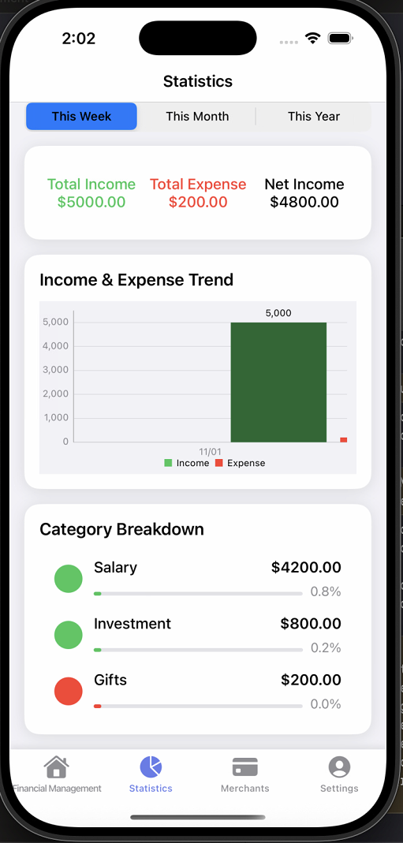
Statistics Page:
This screen is the Statistics page of the application. It is designed to display the user’s income and expense trends, category breakdowns, and overall financial performance across different time periods. Users can quickly understand their financial health and spending patterns.
Time Range Selection
The top of the page provides three selectable time periods—This Week, This Month, and This Year—allowing users to switch between different ranges and view the corresponding financial statistics.
Income & Expense Summary
The summary section displays three key metrics for the selected timeframe: Total Income (shown in green), Total Expense (shown in red), and Net Income (income minus expense). These values give users an at-a-glance understanding of their financial balance.
Income & Expense Trend
The trend chart visualizes how income and expenses change over time, using green bars for income and red bars for expenses, enabling users to clearly compare financial inflows and outflows.
Category Breakdown
The category breakdown section lists the amount and percentage for each transaction category—such as Salary, Investment, and Gifts—helping users identify which categories contribute most to their income or spending.

Slide 9
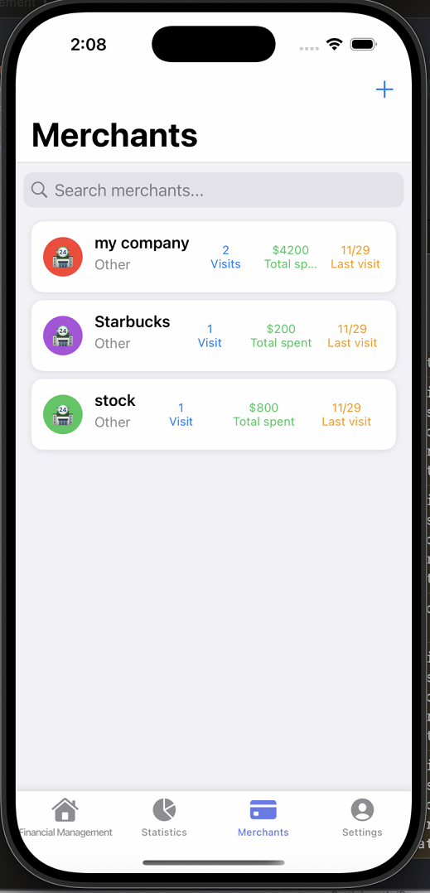
Merchants Page:
This screen is the Merchants page, where users can view all merchants they have interacted with through their transactions. It provides a clear summary of spending habits tied to each merchant.
Search Function
At the top, users can search for specific merchants using the search bar, making it easy to quickly locate transaction history for a particular store or vendor.
Merchant List
Each merchant entry displays key information including the merchant name, category, number of visits, total amount spent, and the date of the most recent visit. This helps users understand how often they visit each merchant and how much they typically spend there.
Add Merchant Button
In the upper-right corner, users can tap the + icon to add a new merchant manually if needed.

Slide 10
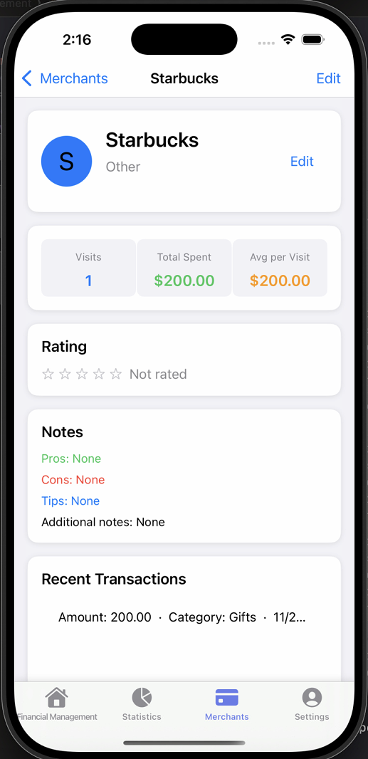
Merchant Details Page:
This screen is the Merchant Details page, providing an in-depth look at a specific merchant. It shows the merchant’s name, category, and a quick link to edit its information.
Visit & Spending Summary
The summary section displays key statistics related to the user’s interactions with this merchant, including the number of visits, the total amount spent (in green), and the average spending per visit (in orange).
Rating
Users can view or assign a star rating for the merchant. If no rating has been set, it appears as “Not rated.”
Notes
The notes section allows users to record pros, cons, tips, and any additional notes about the merchant. This helps users track personal impressions or important reminders.
Recent Transactions
At the bottom, users can see a list of recent transactions associated with this merchant, including the transaction amount, category, and date, making it easy to review past spending behavior with this vendor.

Slide 11
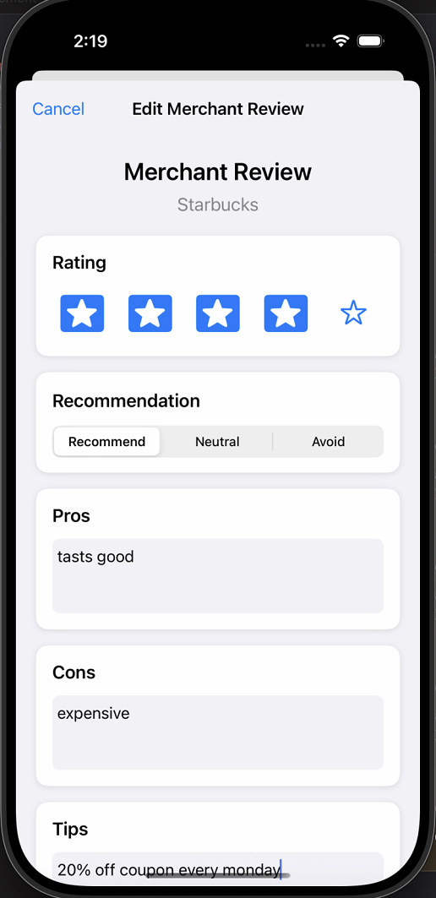
Merchant Edit Page:
This screen is the Edit Merchant Review page, where users can add or update their personal review of a specific merchant. It provides a structured way to record impressions, feedback, and useful notes about the merchant.
Rating
Users can select a star rating to reflect their overall experience with the merchant. This rating visually represents satisfaction level.
Recommendation
The page includes three recommendation options—Recommend, Neutral, and Avoid—allowing users to categorize how strongly they would suggest this merchant to others.
Pros and Cons
Users can fill in the Pros and Cons fields to highlight what they liked or disliked about the merchant. These notes help capture both strengths and weaknesses based on past visits.
Tips
The Tips section allows users to add helpful insights for future reference, such as deals, discounts, or useful reminders (e.g., “20% off coupon every Monday”).

Slide 12
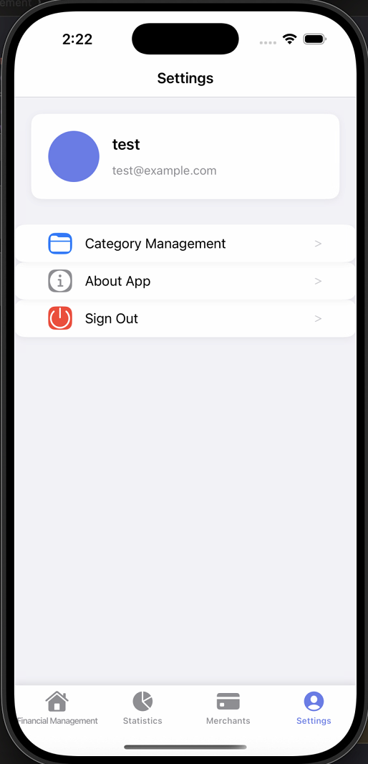
Setting Page:
This screen is the Settings page, where users can view their account information and manage various app-related preferences. It provides easy access to key configuration options.
User Profile
At the top, the page displays the user’s profile information, including their name and email address, serving as a quick reference to the currently signed-in account.
Category Management
Users can navigate to Category Management to customize, add, or update transaction categories, allowing for more personalized financial tracking.
About App
This section provides information about the application, such as version details or general app info, giving users insight into the product they are using.
Sign Out
The Sign Out option allows users to securely log out of their account, ensuring privacy and safety when switching devices or accounts.

Slide 13
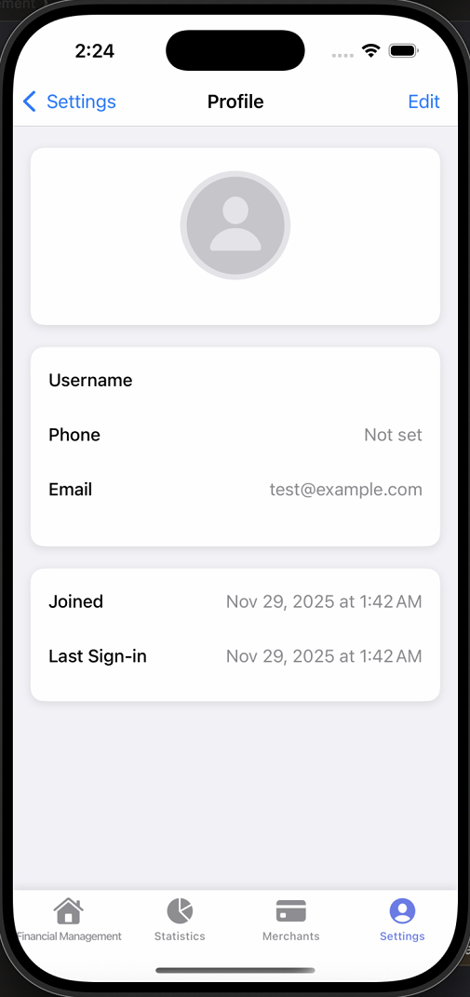
Profile Page:
This screen is the Profile page, where users can view and manage their personal account information. It provides a clear summary of key account details in a structured layout.
Profile Photo
At the top, users can tap the profile photo area to open the photo library or camera, allowing them to upload or take a picture to set a custom avatar.
Account Information
The page displays essential details including the username, phone number, and email address associated with the account. If certain information has not been set, it will appear as “Not set.”
Account Activity
Users can also view their account creation date (Joined) and their most recent login time (Last Sign-in), offering useful context about account usage history.
Edit Option
An Edit button in the top-right corner allows users to update their username and phone number.

Slide 14
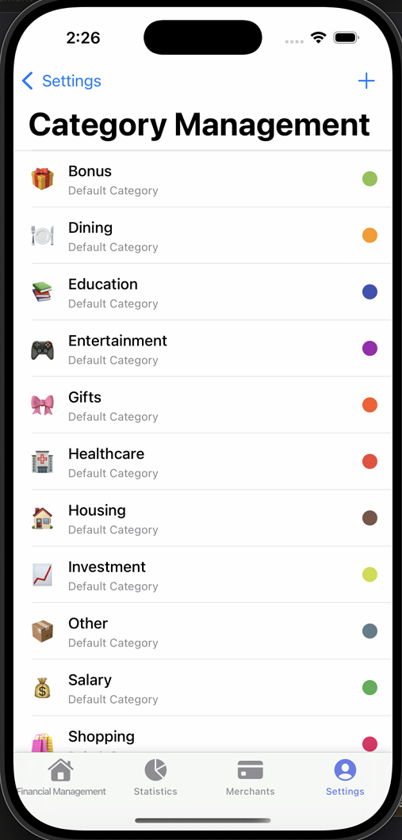
Category Management Page:
This screen is the Category Management page, where users can view and organize all transaction categories used throughout the app. It provides a clear list of both income and expense categories.
Default Categories
Each category in the list is labeled as a “Default Category,” indicating that it comes preloaded with the app. Examples include Bonus, Dining, Education, Entertainment, Gifts, Healthcare, Housing, Investment, Salary, Shopping, and more.
Visual Indicators
Every category is accompanied by an icon and a color marker on the right side, making it easier for users to quickly recognize and differentiate categories during transaction entry.
Add Category
In the top-right corner, users can tap the + icon to create and customize new categories, allowing for more personalized expense or income tracking.

Slide 15
Github Link:
https://github.com/xzy95024/financial-management-app

Slide 16
Thanks!

