Slide 1
Invitation to Python Section 3. Tools Installation
Lectured by: Dr. Xinzhi ZHANG
Research Assistant Professor, Department of Journalism
Hong Kong Baptist University
24 Nov 2018@CVA AI Lab

Slide 2
Fundamental tools
Talking to your computer: Command line interface (CLI)
Text Editor: Atom, or Sublime Text, or others
Platform for publishing and socializing: Git and GitHub, and Markdown language
Python 3.x and Jupyter Notebook

Slide 3
Command Line Interface (CLI) basics
Open CLI: spotlight search – “terminal”
An interesting tutorial
Basic commands of CLI:
pwd
date
mkdir
echo
ls
cd
touch
cp
rm
mv
clear

Slide 4
Git
Git is a “version control system”: records changes to a file or set of files over time and users can recall specific versions later.
Useful for collaboration project
Git: Linux, a popular version control system
Download and install Git
Setting up your Git account
git config --global user.email "your@email.com"
git config --global user.name "your name"

Slide 5
GitHub
GitHub is a web-based hosting service for software development projects that use Git version control system.” (Wiki)
Push and pull
Public repositories
The social aspects of GitHub (share, fork, star)
A profile that shows your portfolio

Slide 6
GitHub
Creating your GitHub repository (“repo”)
Creating your own repo (with a Readme file)
“Fork” another user’s repository
Creating a local copy
Clone the Repo
Pull request and collaborative projects

Slide 7
Git and GitHub Tutorials
Official help page
A good tutorial on Git version control in general
Tutorial: Setting up your own webpage on GitHub
Tutorial: Git and GitHub for personal usage

Slide 8
Text Editor
Atom (A very cool trailer)
Sublime Text
Notepad ++

Slide 9
Markdown language
filename.md
Markdown language quick guide [Link]
Work with markdown language
Atom Preview
A small example [cucn DDJ workshop]
A much more professional one [Tour to Python]

Slide 10
Installing Python and Jupyter Notebook
Python 3.x
Python downloading
Jupyter Notebook (based on Anaconda)
Anaconda
Jupyter Notebook documents

Slide 11
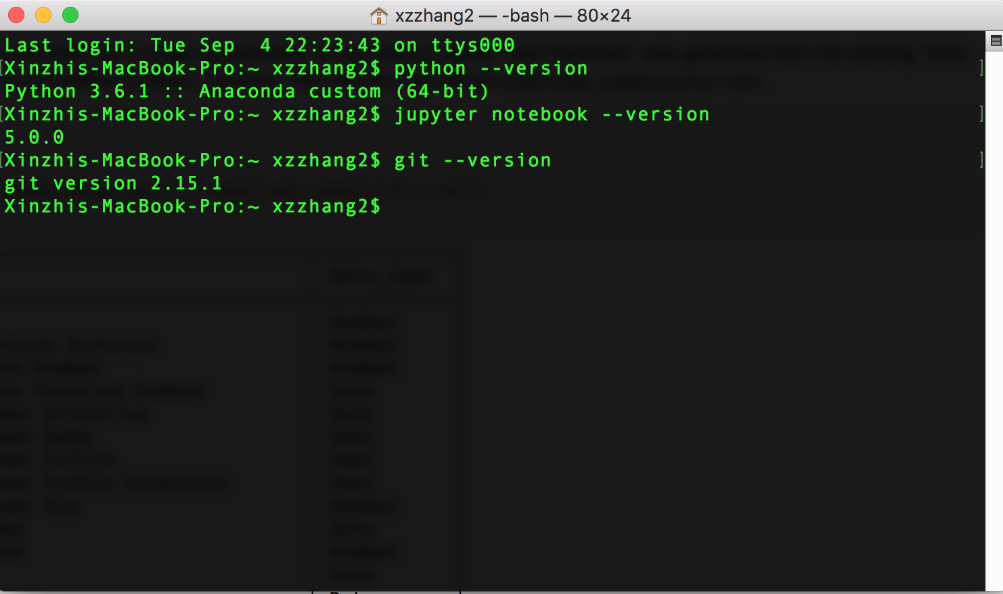
check your existing versions (for Mac users)

Slide 12
Your first Python program
Two ways of printing “Hello World!”
via CLI
via Jupyter Notebook
import this
import antigravity
Notes:
URL: https://www.eversql.com/top-5-python-easter-eggs-and-hidden-features/

Slide 13
Tips: How to ask for help?
“Hacking skills:” Asking questions and finding answers
Key characteristics of hackers
willing to find answer on their own
knowledgeable about where to find answers on their own
unintimidated by new data types or packages
not being afraid of saying that they don't know the answer
polite but relentless
Reference: Eric Steven Raymond: How To Ask Questions The Smart Way [Must read, URL here]

Slide 14
Tips: How to ask for help?
Asking reproducible questions (other can understand your question and rework it on their own machines)
What is the question you are going to answer?
What steps did you use to find out the answer?
What is the expected output?
What do you see instead?
What version and operating system are you using?
What are the data analytical tools/functions you are using?
What other solutions have your thought about?

Slide 15
Tips: How to ask for help?
Be polite: others do not have the obligations to help you
Be explicit: Try to be as specific and detailed as you can! Don't ask too general questions
Following up and post solutions - helping others, knowledge increments

Slide 16
Tips: Where to look for help?
Ready-made:
Software’s manuals and helping documents
Official tutorials
Online sources:
Stack overflow
GitHub pages
Google and Google scholar
Course forums
WeChat or Twitter public accounts
Online courses
Offline sources
A skilled friend?
Workshops, seminars, hackathons, meetups

Slide 17
Tips: Practice, practice, practice!
Get your hands dirty!
https://www.digitaling.com/articles/39588.html

Slide 18
References: Academic journals
Journal of Computer-Mediated Communication
Computers in Human Behaviors
Cyberpsychology, Behavior, and Social Networking
New Media & Society
Information, Communication, & Society
Digital Journalism
…

Slide 19
References: Public Twitter accounts and blog platforms
High-quality Twitter accounts to follow (must read):
https://twitter.com/FiveThirtyEight
https://twitter.com/paulbradshaw
https://twitter.com/ProPublica
https://twitter.com/pewjournalism
https://twitter.com/GuardianData
https://twitter.com/ftdata
https://twitter.com/WSJGraphics
https://twitter.com/PostGraphics
https://twitter.com/BBC_News_Labs
https://twitter.com/BBGVisualData
https://twitter.com/ReutersGraphics
https://twitter.com/LATimesGraphics
https://twitter.com/UpshotNYT
https://twitter.com/GlobeSpotlight
Professional organizations and blog communities
https://medium.com
Global Investigative Journalism Network
ICA Computation Methods Interest Group
DT Data
The Data and News Society @ HKBU

Slide 20
References: A batch of GitHub “Repos”
# “Repos” on general data science
Data-X@Berkerly
Computational Sociology @ Duke
SICSS [2018]
# data science based on python
WhirlwindTourofPython
PythonDataScienceHandbook
# Courses offered by other institutions
COM5507 @ CityU
webscraping tutorial
JOUR7080 @HKBU
Big data course @NJU

