Slide 1
Invitation to Python Section 4: Python in Action: Python in a notebook
Lectured by: Dr. Xinzhi ZHANG
Research Assistant Professor, Department of Journalism
Hong Kong Baptist University
24 Nov 2018 @ CVA AI Lab

Slide 2
Agenda
Computational thinking
Python as a computer programming language
Program execution
Program steps and flow
Errors and debugging
Vocabulary/Words
Variables & expressions
Data Structures
Functions
Sentences & Paragraphs
Control flow statements
Conditions
Loops and iterators

Slide 3
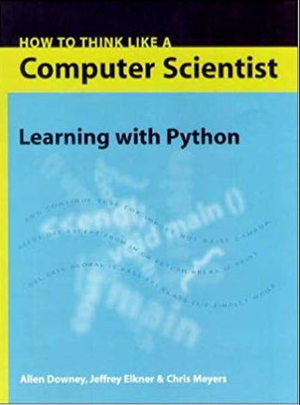
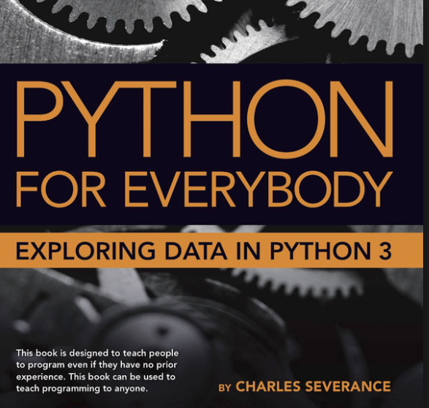
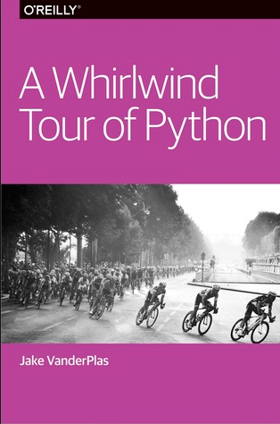
https://github.com/jakevdp/WhirlwindTourOfPython
https://www.py4e.com/book.php
http://interactivepython.org/runestone/static/thinkcspy/index.html

Slide 4
The Python Tutorial
https://docs.python.org/3.7/tutorial/index.html

Slide 5
“Computational thinking”
To think like a computer scientist = mathematics, engineering, and natural science.
Like mathematicians, computer scientists use formal languages to denote ideas (specifically computations).
Like engineers, they design things, assembling components into systems and evaluating tradeoffs among alternatives.
Like scientists, they observe the behavior of complex systems, form hypotheses, and test predictions.
The single most important skill for a computer scientist is problem solving. Problem solving means the ability to formulate problems, think creatively about solutions, and express a solution clearly and accurately.
-- Allen B. Downey, How to think like a computer scientist: Learning with Python

Slide 6
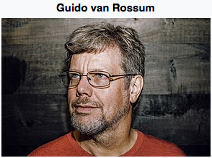
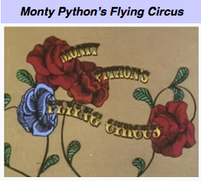
Guido van Rossum is a Dutch programmer best known as the author of the Python programming language, for which he was the "Benevolent Dictator For Life" (BDFL) until he stepped down from the position in July 2018.

Slide 7
Tips to learn a programming language
Read and write
Pay attention to the details
Discover and compare the differences
--- Zed Shaw: learn python the hard way
Notes:
sooner or later you will understand how important these three tips are. even perhaps not now.

Slide 8
A commend-liner

Slide 9
Executing (“running”) the program
A “command liner.”
A Notebook
01_print.py

Slide 10
Program steps or program flow
input: Get data from the "outside world". This might be reading data from a file, or even some kind of sensor like a microphone or GPS. In our initial programs, our input will come from the user typing data on the keyboard.
output: Display the results of the program on a screen or store them in a file or perhaps write them to a device like a speaker to play music or speak text.
sequential execution: Perform statements one after another in the order they are encountered in the script.
conditional execution: Check for certain conditions and then execute or skip a sequence of statements.
repeated execution: Perform some set of statements repeatedly, usually with some variation.
reuse: Write a set of instructions once and give them a name and then reuse those instructions as needed throughout your program.

Slide 11
Program flow: input
We can instruct Python to pause and read data from the user using the input() function
The input() function returns a string
We can also input a file (more on file inputs later)
02a_input.py
02_count.py
03_countall.py

Slide 12
Program flow: Sequential steps
x = 2
Program:
x = 2
print(x)
x = x + 2
print(x)
Output:
2
4
print(x)
x = x + 2
print(x)
When a program is running, it flows from one step to the next. As programmers, we set up “paths” for the program to follow.
Source: https://www.py4e.com/html3/

Slide 13
Program flow: Conditional steps
x = 5
x < 10 ?
Yes
Program:
x = 5
if x < 10:
print('Smaller')
if x > 20:
print('Bigger')
print('Finish')
print('Smaller')
Output:
Smaller
Finis
No
x > 20 ?
Yes
No
print('Bigger')
print('Finis')
Source: https://www.py4e.com/html3/

Slide 14
Program flow: Repeated steps
n = 5
No
n > 0 ?
Yes
Program:
n = 5
while n > 0 :
print(n)
n = n – 1
print('Blastoff!')
Output:
5
4
3
2
1
Blastoff!
print(n)
n = n -1
print('Blastoff')
Loops (repeated steps) have iteration variables that change each time through a loop.
Source: https://www.py4e.com/html3/

Slide 15
Errors and debugging
Programming errors are called bugs and the process of tracking them down and correcting them is called debugging.
These kinds of errors can occur in a program:
syntax errors,
runtime errors,
semantic errors,
There might be other errors

Slide 16
Errors and debugging
Syntax errors. These are the first errors you will make and the easiest to fix. A syntax error means that you have violated the "grammar" rules of Python. The line and character that Python indicates in a syntax error may just be a starting point for your investigation.
Runtime error. The error does not appear until you run the program. These errors are also called exceptions because they usually indicate that something exceptional (and bad) has happened.
Semantic errors. A semantic error is when your description of the steps to take is syntactically perfect and in the right order, but there is simply a mistake in the program. The program is perfectly correct but it does not do what you intended for it to do.
Debugging
Test (more will be covered in later sections)
Google the error message.
“Asking the reproducible questions” (week 1) on the Forum

Slide 17
Variables and expressions
Constants
fixed values. Can be both numeric or string (with a quote)
Variables: a named place in the memory where a programmer can store data and later retrieve the data using the variable “name”
Programmers get to choose the names of the variables
You can change the contents of a variable in a later statement
Assignments: In Python, we assign a value to a variable using the assignment statement (=)

Slide 18
How to name a variable?
Must start with a letter or underscore _
Must consist of letters, numbers, and underscores
Case Sensitive
Cannot use reserved words

Slide 19
Reserved words
You cannot use reserved words as variable names / identifiers
False class return is finally
None if for lambda continue
True def from while nonlocal
and del global not with
as elif try or yield
assert else import pass break
except in raise

Slide 20
Numeric expressions
Because of the lack of mathematical symbols on computer keyboards - we use “computer-speak” to express the classic math operations
Asterisk is multiplication
Exponentiation (raise to a power) looks different than in math.
04_var.py
Operator | Operation
+ | Addition
- | Subtraction
* | Multiplication
/ | Division
** | Power
% | Remainder

Slide 21
Operator precedence rules
Highest precedence rule to lowest precedence rule:
Parentheses are always respected
Exponentiation (raise to a power)
Multiplication, Division, and Remainder
Addition and Subtraction
Left to right

Slide 22
Data structures in Python
All Python objects have type information attached.
Built-in data types
Built-in data structures. A data structure is a particular way of organizing data in a computer.

Slide 23
“Simple” data types
Type | Example | Description
int | x = 1 | integers (i.e., whole numbers)
float | x = 1.0 | floating-point numbers (i.e., real numbers)
complex | x = 1 + 2j | Complex numbers (i.e., numbers with real and imaginary part)
bool | x = True | Boolean: True/False values
str | X = “abc” | String: characters or text. A string is a sequence of characters.
NoneType | X = None | Special object indicating nulls
This table is revised and modified from: https://github.com/jakevdp/WhirlwindTourOfPython/blob/master/05-Built-in-Scalar-Types.ipynb

Slide 24
“Simple” data structures
Type | Example | Description | Can we change the content within this collection? | Are the items in the collection ordered?
list | [1, 2, 3] | List: an mutable, ordered collection | Yes – mutable | Yes – ordered
tuple | (1, 2, 3) | Tuple: an immutable, ordered collection | No – immutable | Yes – ordered
set | {1, 2, 3} | Set: Unordered collection of unique values | Yes – mutable | No – unordered
dict | {'a':1, 'b':2, 'c':3} | Dictionary: Unordered (key, value) mapping | Yes – mutable | No – unordered
Table compiled by Xinzhi Zhang on 20180912 – for educational purposes only

Slide 25
Lists
A list is a kind of collection, a sequence of values.
Lists: integers, strings, empty, and nested lists
Lists are mutable
Checking the list
how many elements?
something in the list?
Working on lists
traversing
indexing (zero-based, and -1 from right to left)
concatenating and slicing
05_ds_list.py

Slide 26
Tuples
Tuples are in many ways similar to lists, but they are defined with parentheses rather than square brackets.
Both lists and tuples have elements which are indexed starting at 0.
Tuples are immutable.
Tuples are efficient in making some temporary variables, especially if we have multiple value outputs.

Slide 27
Dictionaries
Dictionaries are flexible mappings of keys to values, and form the basis of much of Python's internal implementation.
They can be created via a comma-separated list of key:value pairs within curly braces.

Slide 28
Lists vs dictionaries
Dictionaries are like lists except that they use keys instead of numbers to look up values
>>> ddd = dict()
>>> ddd['age'] = 21
>>> ddd['course'] = 182
>>> print(ddd)
{'course': 182, 'age': 21}
>>> ddd['age'] = 23
>>> print(ddd)
{'course': 182, 'age': 23}
>>> lst = list()
>>> lst.append(21)
>>> lst.append(183)
>>> print(lst)
[21, 183]
>>> lst[0] = 23
>>> print(lst)
[23, 183]

Slide 29
Sets
Sets contains unordered collections of unique items. They are defined much like lists and tuples, except they use the curly brackets of dictionaries.

Slide 30
Control flow ***
Control flow is where “the rubber really meets the road in programming.”
With control flow, you can execute certain code blocks conditionally and/or repeatedly: these basic building blocks can be combined to create sophisticated programs.
conditional statements (“if”, “elif”, and “else”)
loop statements (“for” and “while” plus the accompanying “break”, “continue”, and “pass”)

Slide 31
Comparison operators
Boolean expressions ask a question and produce a Yes or No result which we use to control program flow
Boolean expressions using comparison operators evaluate to True / False or Yes / No
Python | Meaning
< | Less than
<= | Less than or Equal to
== | Equal to
>= | Greater than or Equal to
> | Greater than
!= | Not equal
Remember: “=” is used for assignment.

Slide 32
One-way decisions
x = 5
print('Before 5')
if x == 5 :
print('Is 5')
print('Is Still 5')
print('Third 5')
print(’the next step')
Yes
x == 5 ?
No
print('Is 5’)
print('Still 5')
print('Third 5')
print(‘the next step’)

Slide 33
more one-way decisions
x = 5
x < 10 ?
Yes
Program:
x = 5
if x < 10:
print('Smaller')
if x > 20:
print('Bigger')
print('Finis')
No
print('Smaller')
Output:
Smaller
Finis
x > 20 ?
Yes
No
print('Bigger')
print('Finis')

Slide 34
Nested decisions
x > 1
yes
no
print('More than one’)
x = 42
if x > 1 :
print('More than one')
if x < 100 :
print('Less than 100')
print('All done')
x < 100
yes
no
print('Less than 100')
print('All Done')

Slide 35
Two-way decisions (alternative execution)
Sometimes we want to do one thing if a logical expression is true and something else if the expression is false
It is like a fork in the road - we must choose one or the other path but not both.
x = 4
no
x > 2
yes
print('Not bigger')
print('Bigger')
print('All Done')

Slide 36
Conditional statements
to be or not to be…

Slide 37
Two-way decisions: else
x = 4
no
x > 2
yes
x = 4
if x > 2 :
print('Bigger')
else :
print('Smaller')
print('All done')
print('Not bigger')
print('Bigger')
print('All Done')

Slide 38
Multi-way decisions: elif
x = 0
yes
x < 2
print('small')
x = 0
if x < 2 :
print('small')
elif x < 10 :
print('Medium')
else :
print('LARGE')
print('All done')
no
yes
x < 10
print('Medium')
no
print('LARGE')
print('All Done')

Slide 39
Multi-way decisions: elif
There is no limit on the number of elif statements. If there is an else clause, it has to be at the end, but there doesn’t have to be one.

Slide 40
The try/except structure
In some tutorials (such as the Whirlwind tour Python), “try/except” is regarded a method for debugging, i.e., catching exceptions
If the code in the try works - the except is skipped
If the code in the try fails - it jumps to the except section

Slide 41
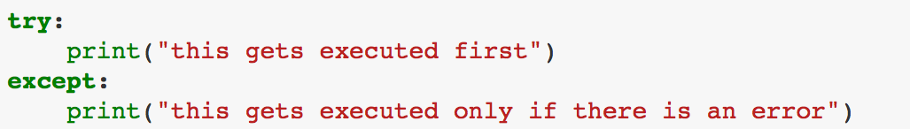
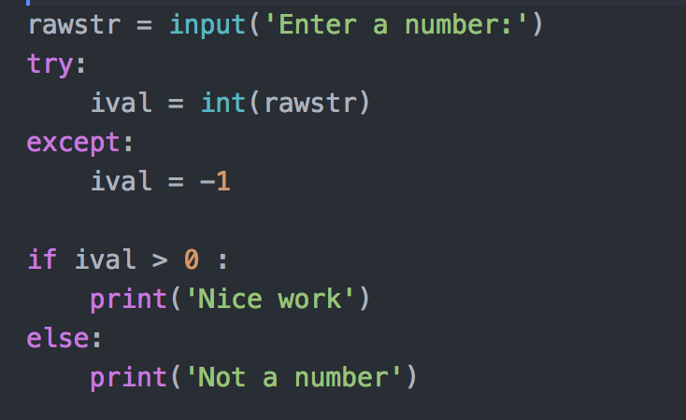
The try/except structure

Slide 42
Loops & Iterations
Computers are good at doing repetitive work.
“for loops”
“while loops”
“break” and “continue”

Slide 43
For loops
Sometimes we want to loop through a set of things such as a list of words, the lines in a file, or a list of numbers. When we have a list of things to loop through, we can construct a definite loop using a for statement.

Slide 44
For loops
for variable in collection: do things with variable
07_flow_loop.py

Slide 45
While loops
A while statement is executed in the following sequence:
Evaluate the condition, yielding True or False.
If the condition is false, exit the while statement and continue execution at the next statement.
If the condition is true, execute the body and then go back to step 1.

Slide 46
While loops
n = 5
Program:
n = 5
while n > 0 :
print(n)
n = n – 1
print('Blastoff!')
print(n)
Output:
5
4
3
2
1
Blastoff!
0
No
n > 0 ?
Yes
print(n)
n = n -1
print('Blastoff')

Slide 47
Break
The break statement ends the current loop and jumps to the statement immediately following the loop.

Slide 48
while True:
line = input('> ')
if line == 'done' :
break
print(line)
print('Done!')
No
True ?
Yes
....
break
...
print('Done')

Slide 49
Continue
The continue statement ends the current iteration and jumps to the top of the loop and starts the next iteration.
Sometimes you are in an iteration of a loop and want to finish the current iteration and immediately jump to the next iteration.
In that case you can use the continue statement to skip to the next iteration without finishing the body of the loop for the current iteration.

Slide 50
No
True ?
Yes
while True:
line = raw_input('> ')
if line[0] == '#' :
continue
if line == 'done' :
break
print(line)
print('Done!')
....
continue
...
print('Done')

Slide 51
pass
The “pass” statement does nothing.
It can be used when a statement is required syntactically but the program requires no action.

Slide 52
Functions
A function is a named sequence of statements that performs a computation.
When you define a function, you specify the name and the sequence of statements.
Later, you can “call” the function by its name.
Issues on functions include:
define
call
parameters

Slide 53
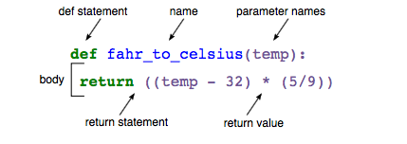
https://swcarpentry.github.io/python-novice-inflammation/06-func/index.html

Slide 54
Python in a notebook

Slide 55
Agenda
Jupyter Notebook
A new way of research presentation
Three Foremost Data Science Packages (*)
Numpy
Pandas (*)
Matplotlib

Slide 56
Jupyter Notebook
Installation (please refer to week 1)
Tips: use Anaconda
A new way of presentation
A gallery of interesting Jupyter Notebooks

Slide 57

Acknowledgements / Contributions
Some of the slides used in this lecture are Copyright 2010- Charles R. Severance (www.dr-chuck.com) of the University of Michigan School of Information and made available under a Creative Commons Attribution 4.0 License. Please maintain this last slide in all copies of the document to comply with the attribution requirements of the license. If you make a change, feel free to add your name and organization to the list of contributors on this page as you republish the materials.
Initial Development: Charles Severance, University of Michigan School of Information
Compiled and revised by Dr. Xinzhi Zhang

Slide 58
References
https://swcarpentry.github.io/python-novice-inflammation/
https://www.py4e.com/html3/05-iterations
https://github.com/jakevdp/WhirlwindTourOfPython/blob/master/07-Control-Flow-Statements.ipynb

