Slide 1

Data & Media Hack 2019 Workshop Python for data processing and visualization
Dr. Xinzhi ZHANG
Research Assistant Professor, Department of Journalism
Hong Kong Baptist University

Slide 2
Agenda
Data processing & its five steps
Python 101: a baby step
Data exploration, and visualization

Slide 3
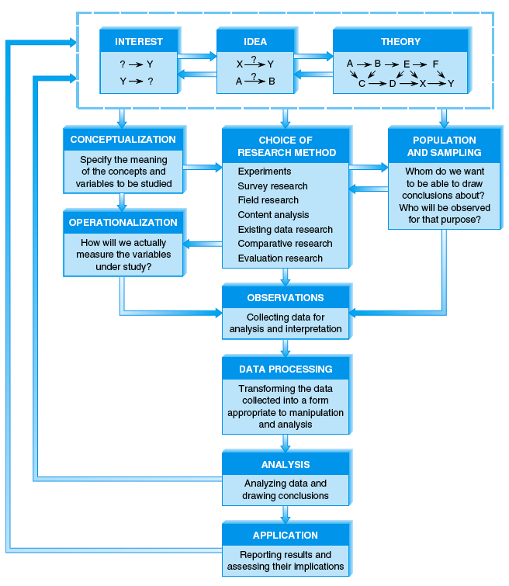

Slide 4
Data Processing
The purpose of data processing is to transfer collected data (data from web scraping, downloading, or fieldworks) into machine-readable form and ready for data analysis.
After that, one can use mathematics and statistics to analyze the data with statistical packages.

Slide 5
Data Processing
Data processing is also called “data preparation:” cleaning the data, normalizing it, and putting it a form that it can be useful for data analysis work.
It is also called pre-processing (预处理) or coding (coding here in Chinese should be translated as 编码, not 编程, whereas the latter is expressed as programming).

Slide 6
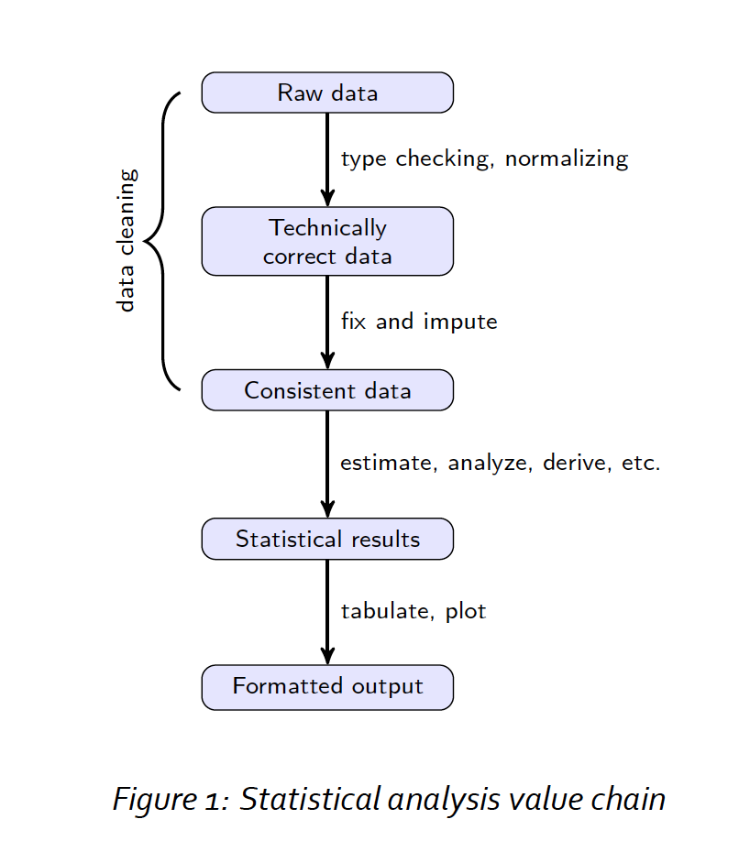
Raw data files may lack headers, contain wrong data types (e.g. numbers stored as strings), wrong category labels, unknown or unexpected character encoding and so on.
Source of figure 1: Edwin de Jonge and Mark van der Loo

Slide 7
Technically correct data is that, in this state data can be read into a data frame, with correct names, types, and labels, without further trouble.
Source of figure 1: Edwin de Jonge and Mark van der Loo

Slide 8
Consistent data is the stage where data is ready for statistical inference. It is the data that most statistical theories (or data analytical methods) use as a starting point.
Source of figure 1: Edwin de Jonge and Mark van der Loo

Slide 9
Web scraping
Data processing
Data analytics
Source of figure 1: Edwin de Jonge and Mark van der Loo

Slide 10
Data Processing
Our goal is to produce consistent data.

Slide 11
Machine-readable Data File
In the field of data and media communication, we work on “Spreadsheet” or “Data Frame” (Python Pandas or R)
Case: a collection of values that belong to a unique subject (unit) in the data file.
Example: a person, a news article, a country…
Variable: a logical grouping of attributes, which describe characteristics or qualities of an object.
Example: Age, race, weight, name, scores on a test, and time measured….
Value: represents the observed attribute of a specific variable of a case
Example: 25 years old, Asian, 120 pounds, A..
Scale: The possible values the variable can assume form the scale for measuring the variable.

Slide 12
Key issues in data processing
At “dataset level”
Compiling a codebook
Examine the shape (dimension)
Keeping or dropping variables
Merge
Join
Concatenate
At “case” level
Indexing (“numbering”)
At “variable” level
Data type (string? integer? date?)
Renaming, creating, recoding
Missing values
Normalization (“USA” vs “US” vs “U.S.A.”…)

Slide 13
Coding: Codebook
In the data processing, one needs to create a codebook first.
A codebook is a document that describes the locations of variables and lists the assignments of codes to the attributes composing those variables.
A codebook is the primary guide used in the coding process.
A codebook is the guide for locating variables and interpreting codes in the data file during analysis.
Notes:
Codebook: the coding scheme that we develop usually comprises two components. One is variable name, and the other is value. Variable name describe the location of variables, and value refers to each attribute for that variable. We usually put variable name and values in a systematic way in a book. That book is called codebook. To produce the codebook, we usually use our original questionnaire. On the questionnaire, we will put down the variable names and the values.

Slide 14
Codebook
A codebook at least includes the followings:
variable name
variable label: the description of the variable, usually the question on the questionnaire
value definition: you assign a number to each value of the variable: exclusive and exhaustive
Define missing values

Slide 15
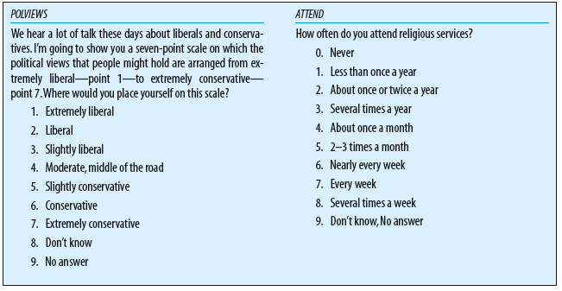
Codebook: An example

Slide 16
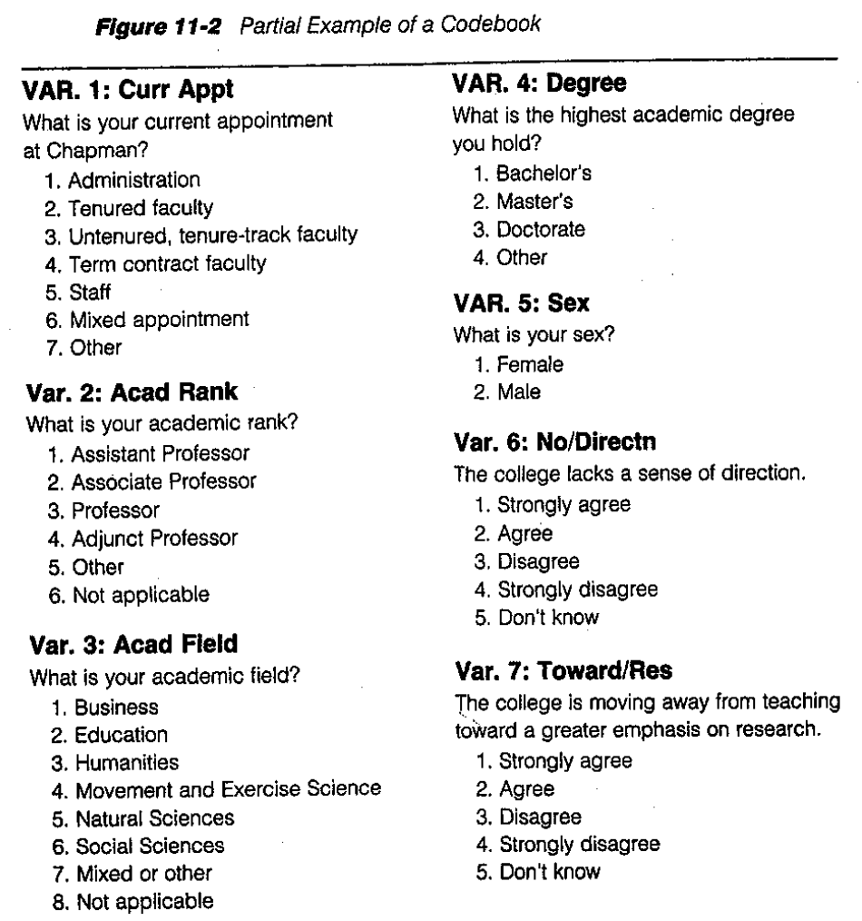
Codebook: Another example

Slide 17
Dataset-level processing
https://pandas.pydata.org/pandas-docs/stable/merging.html

Slide 18
Case and variable processing
A demonstration of Python Pandas data cleaning for numerical and string data

Slide 19
Python Installation

Slide 20
Installing Python and Jupyter Notebook
Python 3.x
Python downloading
Jupyter Notebook (based on Anaconda)
Anaconda
Jupyter Notebook documents

Slide 21
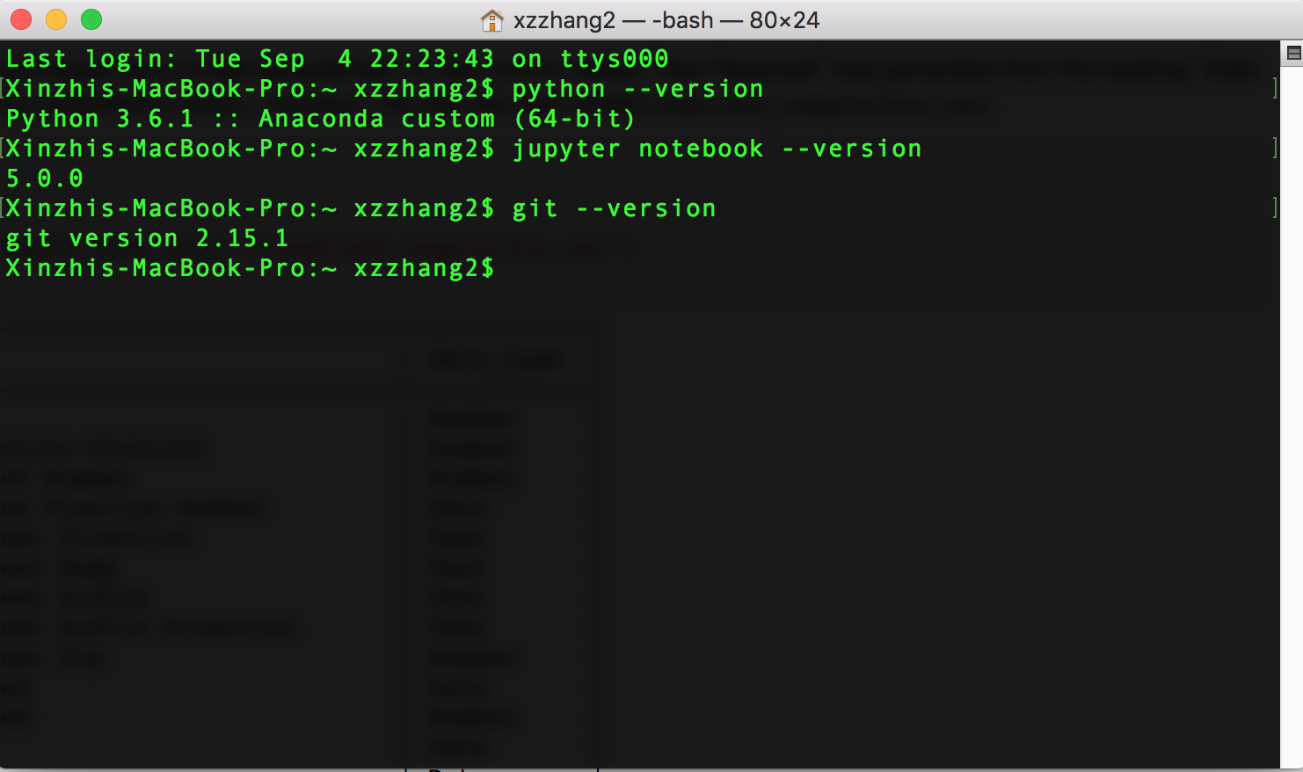
check your existing versions (for Mac users)

Slide 22
A Python 101 tutorial
“Invitation to Python” (DMC @ HKBU, Nov 2018) – a baby step
https://github.com/xzzhang2/201811_budmc_Invitation2Py

Slide 23
Tips: How to ask for help?
“Hacking skills:” Asking questions and finding answers
Key characteristics of hackers
willing to find answer on their own
knowledgeable about where to find answers on their own
unintimidated by new data types or packages
not being afraid of saying that they don't know the answer
polite but relentless
Reference: Eric Steven Raymond: How To Ask Questions The Smart Way [Must read, URL here]

Slide 24
Tips: How to ask for help?
Asking reproducible questions (other can understand your question and rework it on their own machines)
What is the question you are going to answer?
What steps did you use to find out the answer?
What is the expected output?
What do you see instead?
What version and operating system are you using?
What are the data analytical tools/functions you are using?
What other solutions have your thought about?

Slide 25
Tips: How to ask for help?
Be polite: others do not have the obligations to help you
Be explicit: Try to be as specific and detailed as you can! Don't ask too general questions
Following up and post solutions - helping others, knowledge increments

Slide 26
Tips: Where to look for help?
Ready-made:
Software’s manuals and helping documents
Official tutorials
Online sources:
Stack overflow
GitHub pages
Google and Google scholar
Course forums
WeChat or Twitter public accounts
Online courses
Offline sources
A skilled friend?
Workshops, seminars, hackathons, meetups

Slide 27
References: Public Twitter accounts and blog platforms
High-quality Twitter accounts to follow (must read):
https://twitter.com/FiveThirtyEight
https://twitter.com/paulbradshaw
https://twitter.com/ProPublica
https://twitter.com/pewjournalism
https://twitter.com/GuardianData
https://twitter.com/ftdata
https://twitter.com/WSJGraphics
https://twitter.com/PostGraphics
https://twitter.com/BBC_News_Labs
https://twitter.com/BBGVisualData
https://twitter.com/ReutersGraphics
https://twitter.com/LATimesGraphics
https://twitter.com/UpshotNYT
https://twitter.com/GlobeSpotlight
Professional organizations and blog communities
https://medium.com
Global Investigative Journalism Network
ICA Computation Methods Interest Group
DT Data
The Data and News Society @ HKBU

Slide 28
References: A batch of GitHub “Repos”
# “Repos” on general data science
Data-X@Berkerly
Computational Sociology @ Duke
SICSS [2018]
# data science based on python
WhirlwindTourofPython
PythonDataScienceHandbook
# Courses offered by several universities
COM5507 @ CityU
webscraping tutorial
JOUR7080 @HKBU
Big data course @NJU

