Slide 1
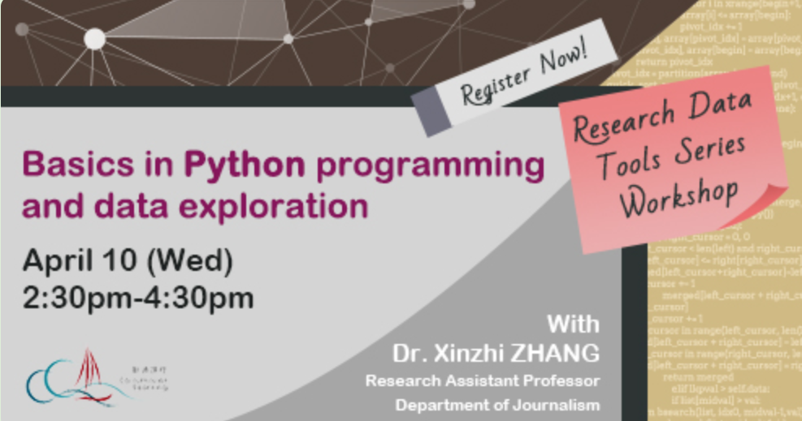
HKBU Library Workshop Python for data exploration
Dr. Xinzhi ZHANG
Department of Journalism
Hong Kong Baptist University

Slide 2
Xinzhi ZHANG [張昕之], Ph.D.
M.A., Ph.D. (City University of Hong Kong)
www.drxinzhizhang.com
https://scholar.google.com/citations?user=iOFeIDIAAAAJ&hl=en
@xin_zhi_zhang
https://github.com/xzzhang2
Research Assistant Professor, Department of Journalism, Hong Kong Baptist University
Director, BSSc in Communication, Journalism Major, Data and Media Communication Concentration (DMC)
Director, MSc in AI and Digital Media (AIDM) [Link]

Slide 3
Agenda
Python and its involvement with data science
Data processing
Data exploration and visualization
Python: a baby step

Slide 4
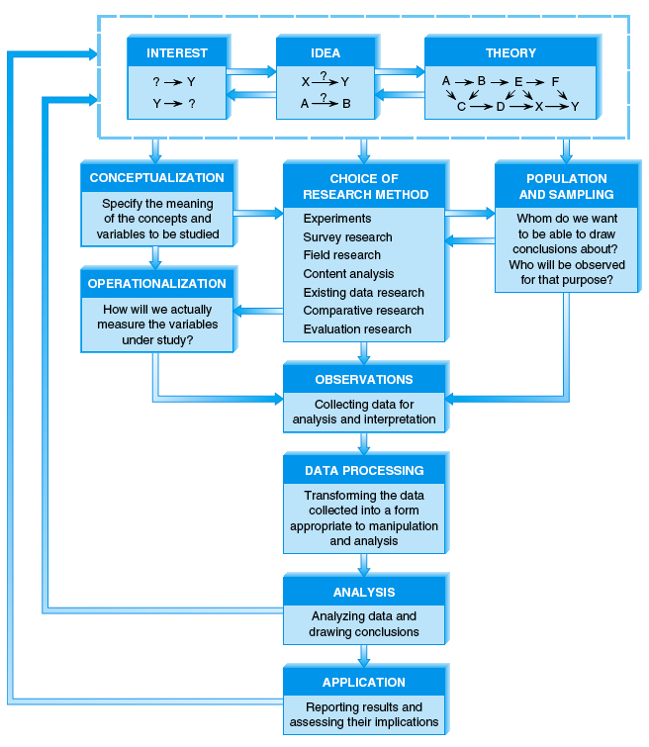

Slide 5
Python and “data life cycle”
Guide at the HKBU library: https://hkbu.libguides.com/data-analytics

Slide 6
Python and “data life cycle”
Data life cycle | Major tasks | “Non-coding-based” | The role of Python
1. Data creation | Data collection (via fieldworks or simulation) | Netlogo | Data simulation Web scraping
2. Data processing | Data cleaning | OpenRefine | Python programming
3. Data analysis | Various types of data analysis (data exploration, data visualization, statistical analysis…) | SPSS, STATA, EXCEL, Gephi | Python, Numpy, Scipy, Pandas, Matplotlib
4. Data storage | Data archiving and version control | Git
5. Data sharing | Open data via data repositories | GitHub | /
6. Data re-use | Re-using the data | / | /

Slide 7
Python and “data life cycle”
Data life cycle | Major tasks | “Non-coding-based” | The role of Python
1. Data creation | Data collection (via fieldworks or simulation) | Netlogo | Data simulation Web scraping
2. Data processing | Data cleaning | OpenRefine | Python programming
3. Data analysis | Various types of data analysis (data exploration, data visualization, statistical analysis…) | SPSS, STATA, EXCEL, Gephi | Python, Numpy, Scipy, Pandas, Matplotlib
4. Data storage | Data archiving and version control | Git
5. Data sharing | Open data via data repositories | GitHub | /
6. Data re-use | Re-using the data | / | /

Slide 8
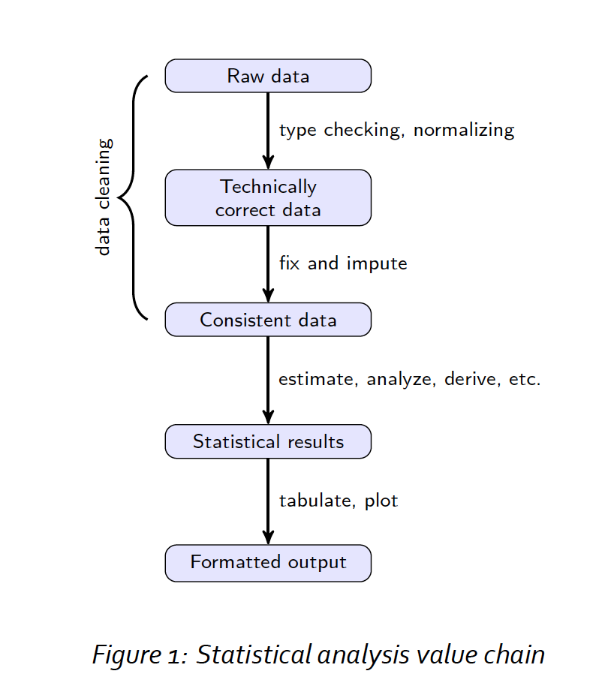
Data creation
Data processing
Data analysis
Source of figure 1: Edwin de Jonge and Mark van der Loo

Slide 9
Data processing
The purpose of data processing is to transfer collected data (data from web scraping, downloading, or fieldworks) into machine-readable form and ready for data analysis.
After that, one can use mathematics and statistics to analyze the data with statistical packages.

Slide 10
Note: Machine-readable File
In the field of data and media communication, we work on “Spreadsheet” or “Data Frame” (Python Pandas or R)
Case: a collection of values that belong to a unique subject (unit) in the data file.
Example: a person, a news article, a country…
Variable: a logical grouping of attributes, which describe characteristics or qualities of an object.
Example: Age, race, weight, name, scores on a test, and time measured….
Value: represents the observed attribute of a specific variable of a case
Example: 25 years old, Asian, 120 pounds, A..
Scale: The possible values the variable can assume form the scale for measuring the variable.

Slide 11
Data processing
Data processing is also called “data preparation:” cleaning the data, normalizing it, and putting it a form that it can be useful for data analysis work.
It is also called pre-processing (预处理) or coding (coding here in Chinese should be translated as 编码, not 编程, whereas the latter is expressed as programming).

Slide 12
Raw data files may lack headers, contain wrong data types (e.g. numbers stored as strings), wrong category labels, unknown or unexpected character encoding and so on.
Source of figure 1: Edwin de Jonge and Mark van der Loo

Slide 13
Technically correct data is that, in this state data can be read into a data frame, with correct names, types, and labels, without further trouble.
Source of figure 1: Edwin de Jonge and Mark van der Loo

Slide 14
Consistent data is the stage where data is ready for statistical inference. It is the data that most statistical theories (or data analytical methods) use as a starting point.
Source of figure 1: Edwin de Jonge and Mark van der Loo

Slide 15
Data processing
Our goal is to produce consistent data.
Code example: 20190410_HKBULib01_processing.ipynb

Slide 16
Data analysis
Exploratory vs. confirmatory
Exploratory data analysis: exploratory data analysis (EDA) is an approach to analyzing data sets to summarize their main characteristics, often with visual methods
Confirmatory data analysis or hypothesis testing: a hypothesis that is testable on the basis of observing a process that is modelled via a set of random variables.
Quantitative vs. qualitative
Statistical analysis, machine learning, visualization,…
Code example: 20190410_HKBULib02_exp.ipynb

Slide 17
Python: a baby step

Slide 18
Installing Python and Jupyter Notebook
Python 3.x
Python downloading
Jupyter Notebook (based on Anaconda)
Anaconda
Jupyter Notebook documents

Slide 19
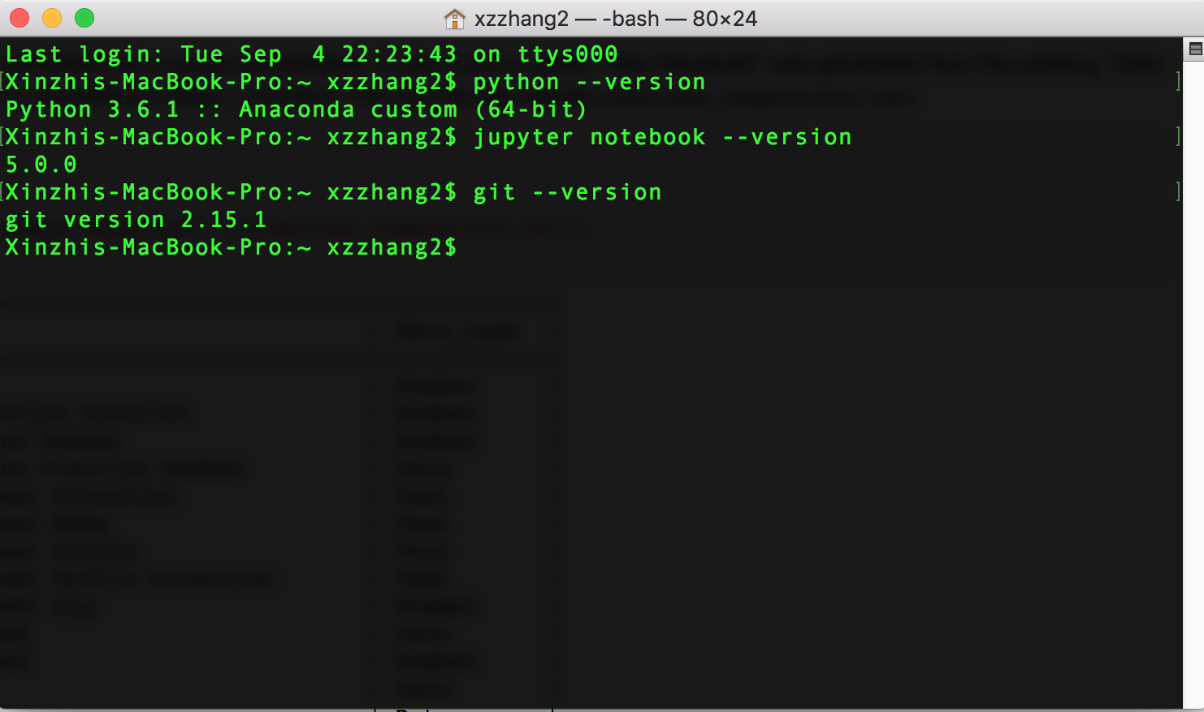
check your existing versions (for Mac users)

Slide 20
Your first Python program
Two ways of printing “Hello World!”
via CLI
via Jupyter Notebook
import this
import antigravity

Slide 21
Basics in Python programming
Python as a computer programming language
Program execution
Program steps and flow
Errors and debugging
Vocabulary/Words
Variables & expressions
Data Structures
Functions
Sentences & Paragraphs
Control flow statements
Conditions
Loops and iterators

Slide 22
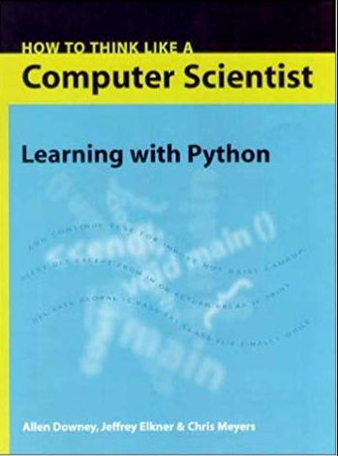
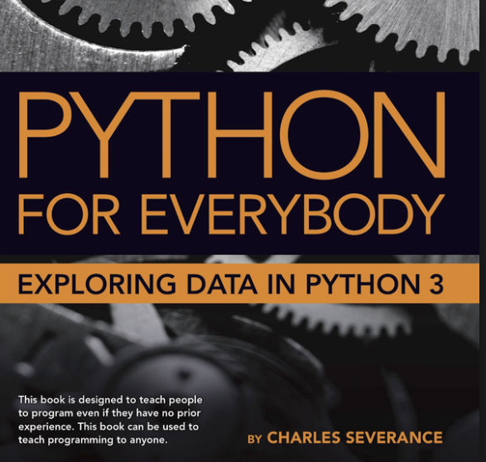

https://github.com/jakevdp/WhirlwindTourOfPython
https://www.py4e.com/book.php
http://interactivepython.org/runestone/static/thinkcspy/index.html

Slide 23
The ”official” Python tutorial
https://docs.python.org/3.7/tutorial/index.html

Slide 24
A Python 101 tutorial
“Hello world!”
“Invitation to Python” (DMC @ HKBU, Nov 2018) – a baby step
https://github.com/xzzhang2/201811_budmc_Invitation2Py

Slide 25
Tips: How to ask for help?
“Hacking skills:” Asking questions and finding answers
Key characteristics of hackers
willing to find answer on their own
knowledgeable about where to find answers on their own
unintimidated by new data types or packages
not being afraid of saying that they don't know the answer
polite but relentless
Reference: Eric Steven Raymond: How To Ask Questions The Smart Way [Must read, URL here]

Slide 26
Tips: How to ask for help?
Asking reproducible questions (other can understand your question and rework it on their own machines)
What is the question you are going to answer?
What steps did you use to find out the answer?
What is the expected output?
What do you see instead?
What version and operating system are you using?
What are the data analytical tools/functions you are using?
What other solutions have your thought about?

Slide 27
Tips: How to ask for help?
Be polite: others do not have the obligations to help you
Be explicit: Try to be as specific and detailed as you can! Don't ask too general questions
Following up and post solutions - helping others, knowledge increments

Slide 28
Tips: Where to look for help?
Ready-made:
Software’s manuals and helping documents
Official tutorials
Online sources:
Stack overflow
GitHub pages
Google and Google scholar
Course forums
WeChat or Twitter public accounts
Online courses
Offline sources
A skilled friend?
Workshops, seminars, hackathons, meetups

Slide 29
References: Twitter accounts
High-quality Twitter accounts to follow (must read):
https://twitter.com/FiveThirtyEight
https://twitter.com/paulbradshaw
https://twitter.com/ProPublica
https://twitter.com/pewjournalism
https://twitter.com/GuardianData
https://twitter.com/ftdata
https://twitter.com/WSJGraphics
https://twitter.com/PostGraphics
https://twitter.com/BBC_News_Labs
https://twitter.com/BBGVisualData
https://twitter.com/ReutersGraphics
https://twitter.com/LATimesGraphics
https://twitter.com/UpshotNYT
https://twitter.com/GlobeSpotlight
Professional organizations and blog communities
https://medium.com
Global Investigative Journalism Network
ICA Computation Methods Interest Group
DT Data
The Data and News Society @ HKBU

Slide 30
References: A batch of GitHub “Repos”
# “Repos” on general data science
Data-X@Berkerly
Computational Sociology @ Duke
SICSS [2018]
# data science based on python
WhirlwindTourofPython
PythonDataScienceHandbook
# Courses offered by several universities
COM5507 @ CityU
webscraping tutorial
JOUR7080 @HKBU
Big data course @NJU

