Slide 1
FBLA Business Ethics 2023
Shippensburg Area Senior High School
Owen Dobson

Slide 2
AGENDA
Introduction
Topic
Areas of ethics/Overview
Responses and Solutions
Summary/ Conclusion/final decision
Wrap up

Slide 3
INTRODUCTION (About me and the project)

Slide 4
2023 HS Business ethics topic overview
Ethical Dilemma with jake and ANNETEE actions and how it combats transparency and integrity of the business as well as its overall ethical practices. His boss doesn’t agree with him and he is deciding whether to bring his concerns to the board with or without his direct supervisors approval. He boss is looking to have no warning to the customers that it is not a real person.

Slide 5
ANNETEE ETHICAL OVERVIEW

Slide 6
Integrity & Transparency
Jake is responblie for building and developing ANNETEE and therefore he is liable if anything goes wrong.
There a several integrity and transparency issues that involves this non human entity, artificial intelligence chatting with customers.
Not in the customers best interest, only in favor of the company
Possibly for bias or inaccurate answers or harmful responses
The integrity and honesty of the company as well as key values can be altered in the publics eye

Slide 7
Marginal Benefits / Marginal Costs
MB (marginal Benefits) | MC (Marginal Costs)
Better sales and improved customer service | Not a real person, communication with customers should be done by a real person. If they are expecting a real person, they should have one.
More resources and less requirement and employee needs/respobilties | Not warning the customers about the issue can be cartographic when the inaccurate or biases information comes out. Leading a customer to possible sue you over something you offered but did not in deed have as the AI made it up. Everything you generate which the AI is your fault just as how whoever shoots the gun, it is there fault not the gun; as it is a tool.
Time Saver

Slide 8
Other concerns
Labeling and notice of ANNETEE and other chatbots in all operations if use persists elsewhere
Legal concerns, the use of ANETEE for customer relations should be transparent and, therefore should be put in terms and conditions as well as your privacy policy and website footer, as well as included in your business plan and all advertisements and pitches.
Possibly of bias and inaccurate information creating legal and ethical concerns while potentially hurting company sales; doing more bad than good. Creating nonconstancy's.

Slide 9
Responses and SOULTIONS

Slide 10
Interviews
For this project you had to interview at least three local business owners for further research. I did a couple more to ensure compliance.
Name | Business & Role | Connection to me | Notes
Jordan Smith | Founder of Ocean Busters | Founder of a nonprofit that includes me on the executive board | Incredible leader of our organization.
Richard Cordero | HACC Business Teacher | Took a dual enrollment class at HACC for Internship Planning which included business ethics | His class helped me wright a business plan that I will use to start a venture.
Edward Drikorn lll | Owner of Studio 32 Johnstown | My step-grandfathers son. | Sparked and guided my interest in photography.
John Ruane | President at the Giant Company | I work at my local grocery store and reached out to him. | Cannot be included in the project due to late interview but I will still go through with it
Bryan Dobson | Owner at UPS store York, PA | My uncle. | Always been there for me.

Slide 11
Richard CORODARO
Harrisburg Community College Business Teacher

Slide 12
Q/A VIA Google meet with RICHARD CORODARO HIGHLIGHTS
His thoughts on the project
As an educator. How do you cultivate or leave Lee practical leadership qualities Among Us students in business real upgraded courses?
“…but it's your ethical decision making to disclose that that is really the Crux of that whole case study…that's going to be sticky issue with that boss of yours because clearly she or he is not ethical in asking that question steering you to not disclose that in itself is not being transparent. And let's take it the other way. If you did not disclose that it will come back to haunt you. Because your boss will not back you up. Your boss I didn't know he didn't tell me he will not have your back and you will be pinned against the wall. That if you play the scenarios out. six months a year, whatever you had a meeting with your board of directors and you never said anything. About what's happening? And your boss kept it a secret and then all of a sudden everything hits the fan. and then they goes back to your boss and your boss says I would never told me that meanwhile you did but you never told the board of directors. So they don't know that you knew that either or you didn't disclose it. That's where you're at the decision process. that's where it should be...”
“…So in those lessons, there's a right way and there's a wrong way but conveying that message in a way that students can learn. And students are different Learners. Some are auditory some are visual, whatever it might be. But conveying the message that everybody can learn maybe repeatedly in a different type of method, but my job is to convey a message. Some are auditory some are visual, whatever it might be. But conveying the message that everybody can learn maybe repeatedly in a different type of method, but my job is to convey a message. And I can explain a little bit more in-depth as to maybe why we're learning so certain things for example…”

Slide 13
Jordan Smith
Ocean Busters Founder – Student Owner

Slide 14
Q/A VIA Google meet with Jordan Smith HIGHLIGHTS
As a student nonprofit owner, how do you even seal a sense of accountability you have to go responsibility in your team and volunteers?
How do you ensure fair treatment and ethical engagement of volunteers within your nonprofit organization?
“a good way to do this is talking to them again with communication making sure they understand kind of what's expected and to keep that standard just like to talk to them and kind of review all your members making sure everyone's being respectful…”
Okay, so I feel like they're fair treatment. It's kind of hard to make sure that everyone's feeling heard because especially being online. It's kind of hard for that. But I think the best really is to try to check in with everyone checking all the teams checking with all the board members. And making sure everyone's okay and beginning especially on meeting just me. what do you think I'd struggle with that sometimes but I feel like that's important, too. to make sure

Slide 15
Edward Drikorn iii
Studio 32 Johnstown owner

Slide 16
Q/A VIA Google meet with Edward Drikorn iii HIGHLIGHTS
how does Studio 32 collect and Implement feedback from clients?
an you provide an example of a scenario where a studio 32 faced an ethical dilemma in a photography project and how It was resolved?
“what I do again, it's my interface with my clients. Did you have a good experience here today? what did we do that you liked? How can I improve the studio? what are your needs? For example when I'm speaking to photographers that ran out my studio. Do I have what you need are What was the process of running the studio easy where you happy with the tools that I had here? where you're in customers happy being here. Did I have a nice environment that they feel safe? Did they feel that it was clean where the restroom facilities? Okay. things like that Is the lighting sufficient outside the property that can feel safe coming to the studio in the evening things like that?”
“I've never really had an ethical dilemma, but I would be concerned. As far as when clients bring in let's say models to do product shoots. there's a question of the content of What the shoot entails? for example is something more of an adult theme and there are Individuals involved that might not be of legal consent age minors and they would be involved and they would be involved in something. That's Maybe not age appropriate. So when I have someone call would call up to rent the studio space out. I would ask various questions to kind of probe. What the intent of the photo shoot is? And who's involved with the photo shoot? And so that kind of alleviates any kind of legal or ethical dilemmas that may occur.”

Slide 17
John RAUNE
The Giant Company President

Slide 18
BRYAN DOBSON
Owner of multiple UPS stores around York, PA

Slide 19
Q/A VIA GOOGLE MEET with BRYAN DOBSON HIGHLIGHTS
Are you sure this isn't a scam I said, there's a lot of the scamming that goes on. Are you sure? You want this person to have what's in this package dudes, and she's just kind of went on and on don't you open that package, she was kind of scolding me and making sure that I gave it to this guy when he came into the store. And unfortunately, I'm Bound by the law. I can't like opening that package would be essentially violating all kinds of federal interstate commerce and…all kinds of different laws. So I can't open it the police even though I called the police kind of after the fact. They couldn't have opened the package either. They couldn't have done anything about it. I guess what I could have done was returned it I could have had it returned to the sender. But again, she was vehemently opposed to me doing anything and wouldn't listen to me about it being a scam. And sure enough this guy came in and he was shady. And I don't have cameras in the other store. They probably knew that. He Had his name matched his driver's license. That was the name on the package. So by law I have to give it to have no choice. So then I don't know about. Three four days later we get the police call from Florida. I know what I did after the lady called me before I gave the package.”
Once I overheard you and Dad talking once, and you told the story of you had to deal with scams that were sent to through the mail so you can tell me a more little bit about that?
“We had the one that stands out is the one that I'm aware of. I mean, there's probably been scams that have gone through the store that we aren't even aware of the one I was made aware of and couldn't do anything about which was really frustrating. Was I don't know I guess it was about a year and a half ago probably now. Where we took we're an overnight package To the store and it was to be picked up by a third party. And they shipped it to our store. Really without telling us usually we know when something's being shipped to our store. And we generally don't accept packages that we're not aware of that are coming into our store this one we ended up accepting and I don't remember why but we did I think maybe because the lady actually called me. So this elderly woman from Florida called my store and told me about this package and told me to make sure that this person gets the package and she wouldn't tell me what was in it. And right away I said ma'am.

Slide 20
Q/A VIA GOOGLE MEET with BRYAN DOBSON HIGHLIGHTS Continued
You expect to get what you expect. So same thing goes with the UPS store that continuity if you go into a store in Pennsylvania, it's going to be very if not identical to the store you go into in, California. As far as how you're treated as a customer and what the protocols are or how you ship products or the things that we offer. pricing is flexible for the most part but not on UPS sets the pricing for shipping. For what we send. so I'm not sure what other ethical considerations, we have a lot of customers that come into the store. And they will email us documents all kinds of different documents to everything from your car registration to legal documents to they want to print a shipping label that they got from a company that they need to return something to showed do a lot of that. : we do a lot of that. And so what we do is we usually end up band up in our downloads folder on our customer PC. At least every day. If we don't delete them at the time we were there with the customer. We delete the emails but if any downloaded files have been loaded onto our PC we delete those.”
can you provide examples where ethical considerations were pivotal in managing that in privacy concerns within shipping and delivering in industry?
“I mean as a franchisee. We have a very sat French or data protection policy from UPS So it's very lengthy and wordy and we do not share or sell data. For any of our customers or any data that we collect is kept completely confidential. And then it's deleted after it seems like customers fall out of our system if they don't ship anything. For somewhere around it's more than six months but less than a year they seem to fall out of our system. So it's automatically purged. From our system if they're inactive for a period of time for I would say eight months. take as far as really ethical choices on my part nothing really comes up. I mean, we don't really have any issues because again as a
franchise we're governed by the franchise agreement that we have with UPS. so really all of those legal and data privacy considerations are covered. By our corporate umbrella. So even though we're independently owned business. we fall under a franchise agreement, which is Which makes us effectively part of? The corporation if you will as far as the rules that we follow in continuity, one store can't decide to do something that another store. Doesn't do everybody's got to be consistent. it's no different than if you had a McDonald's or a Burger King or any kind of franchise, You expect to get the same food at a McDonald's in Illinois that you get in, Texas, You want to walk into a McDonald's and they have completely different menu than the McDonald's in your town, right?

Slide 21
CONCLUSIONS AND FINAL SOUTLIONS

Slide 22
Conclusions and soULItons to this ETHICAL issue
Jake should try to reason with his manager to come up with a solution.
If no agreement is reached then he should attend the board meeting and explain his thoughts thoroughly.
He should explain the ethical issues of using ANETEE for customers relationship management in his timeslot for debrief which includes how transparency and integrity play a pivotal part in this role.

Slide 23
WRAP UP

Slide 24
SOURCES/work cited 1
Smith, Jordan. Interview by Owen Dobson. Founder, Ocean Busters. 28 Nov. 2023.
Cordaro, Richard. Interview by Owen Dobson. Business Teacher, Harrisburg Area Community College. 25 Nov. 2023.
Dreikorn III, Edward L. Interview by Owen Dobson. Owner, Studio 32. 1 Dec. 2023.
Morley, Jessica, et al. “Ethics as a Service: A Pragmatic Operationalisation of AI Ethics.” Minds & Machines, vol. 31, no. 2, June
2021, pp. 239–56. EBSCOhost, https://doi.org/10.1007/s11023-021-09563-w.
Anshari, Muhammad, et al. “Financial Technology with AI-Enabled and Ethical Challenges.” Society, vol. 58, no. 3, June 2021,
pp. 189–95. EBSCOhost, https://doi.org/10.1007/s12115-021-00592-w.

Slide 25
SOURCES/work cited 2
Johnson, Deborah G. “Computer ethics.” Stanford Encyclopedia of Philosophy, Stanford University, 14 Mar. 2022,
plato.stanford.edu/entries/ethics-computer/.
Wallach, Wendell, and Colin Allen. Moral Machines: Teaching Robots Right from Wrong. Oxford University Press, 2008.
Faria, Jorge J., and John E. Richardson. “Business Ethics: Ethical Decision Making in a Global Economy.” McGraw-Hill
Education,
Van den Hoven, Jeroen, et al. “The Ethics of Artificial Intelligence: An Open Discussion.” AI Magazine, vol. 38, no. 4, 2017, pp.
20–36.
Bostrom, Nick. “The Ethics of Artificial Intelligence.” The Cambridge Handbook of Artificial Intelligence, edited by Keith
Frankish and William M. Ramsey, Cambridge University Press, 2014, pp. 316–334.

Slide 26
SOURCES/work cited 2
Winfield, Alan F.T. “Ethical Principles for Robotics and Autonomous Systems.” Journal of Robotics and Autonomous Systems,
vol. 79, 2016, pp. 1–6.
Gunkel, David J. “The Machine Question: Critical Perspectives on AI, Robots, and Ethics.” MIT Press, 2012.
Wallach, Wendell, and Colin Allen. Moral Machines: Teaching Robots Right from Wrong. Oxford University Press, 2008.
Faria, Jorge J., and John E. Richardson. “Business Ethics: Ethical Decision Making in a Global Economy.” McGraw-Hill
Education, 2018.
Tavani, Herman T. “Ethics and Technology: Ethical Issues in an Age of Information and Communication Technology.” John
Wiley & Sons, 2016.

Slide 27
SOURCES/work cited 2
Cordaro, Richard. "Chapter 2: Integrity, Ethics, and Social Responsibility." ENTR-221-V00 - Entrepreneurial Planning.
Harrisburg Area Community College, Harrisburg, PA. Lecture.
Balino, John. "Business Ethics." PA FBLA Conference 2023, Hershey Lodge, Pennsylvania, 17 Apr. 2023. Speech.
Dobson, Bryan. Interview by Owen Dobson. Franchise Owner, UPS. 1 Dec. 2023.

Slide 28
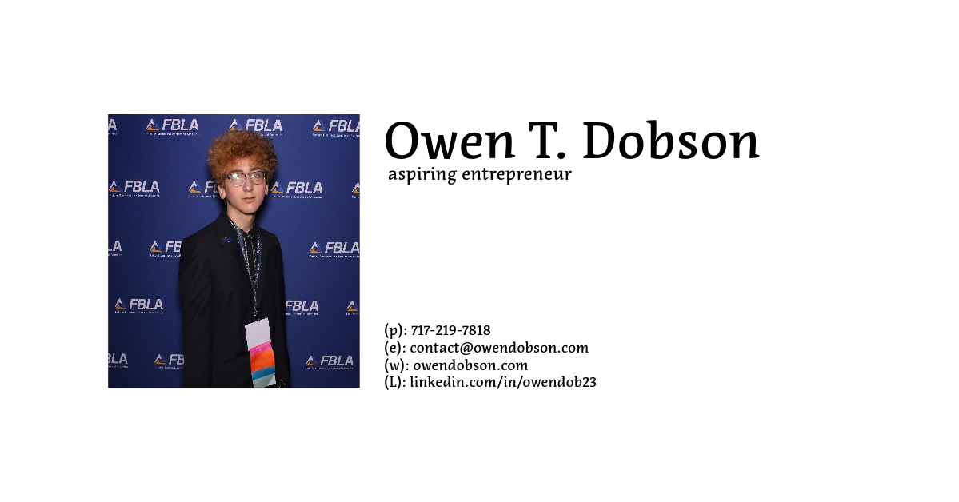
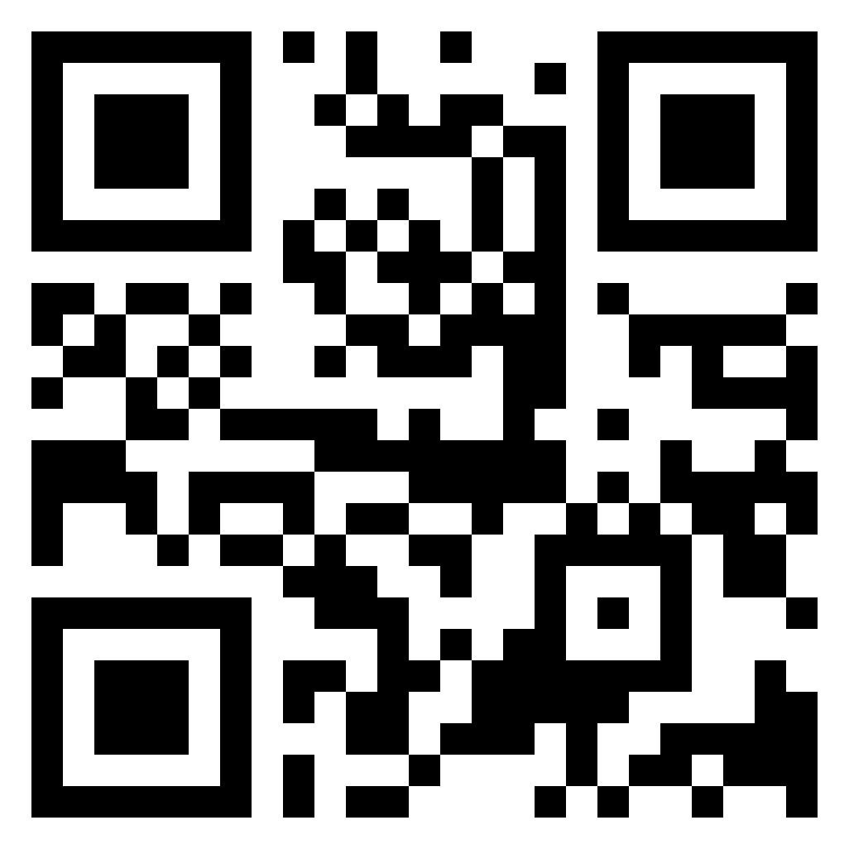
Thank you!
FBLA Business Ethics 2023

