Slide 1
FLASK-PRAETORIAN
By Yohannes Berhane

Slide 2
WHAT IS IT?
Flask-Praetorian is a flask extension for API security
Using Json-Web-Tokens, flask-praetorian uses a simple interface to make sure that users accessing your API endpoints have the correct access roles
Heavily influenced by Flask-Security
But doesn’t know focus on Security as a whole, but the security of API endpoints for the most part.

Slide 3
Functionalities
Encrypt (hash) passwords for storing in your database
Verify plaintext passwords against the encrypted, stored versions
Generate authorization tokens upon verification of passwords
Check requests to secured endpoints for authorized tokens
Ensure that the users associated with tokens have necessary roles for access
Parse user information from request headers for use in client route handlers

Slide 4
STEPS TO USE
Make sure to pip install flask-praetorian or if planning to clone the project straight from github:
- $ git clone https://github.com/dusktreader/flask-praetorian.git

Slide 5
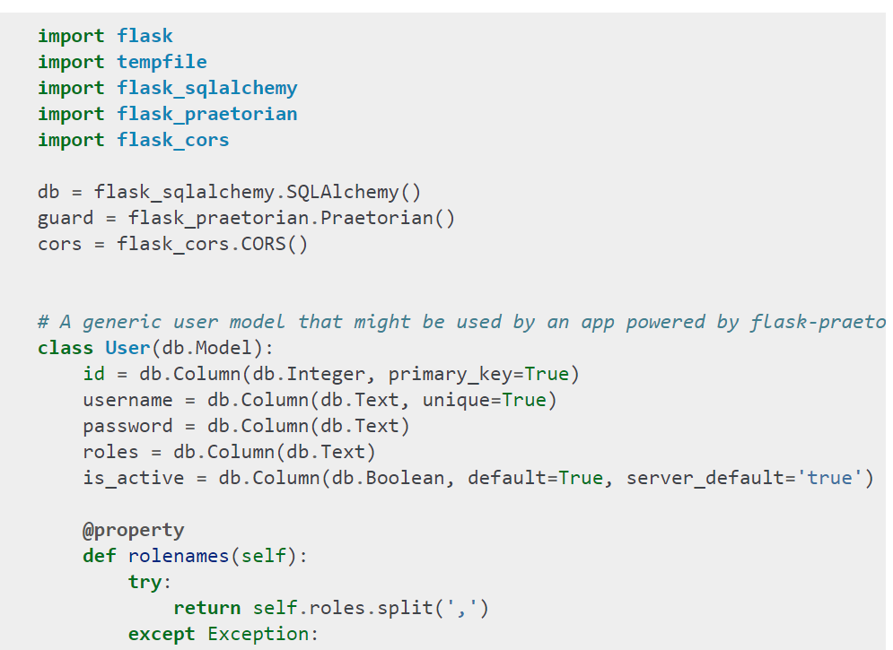
IMPORT and Initialize the Praetorian Instance

Slide 6
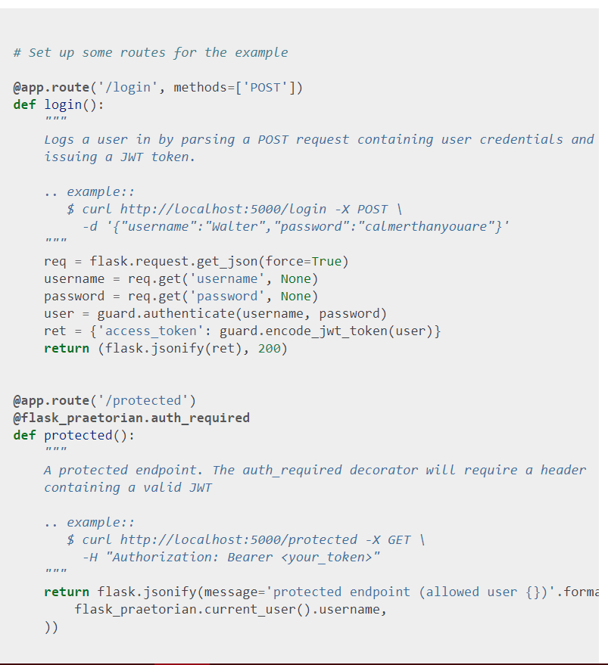
Quick Example

Slide 7
References
https://flask-praetorian.readthedocs.io/en/latest/

