Slide 1
Y-Board Mini
Learning to Solder

Slide 2
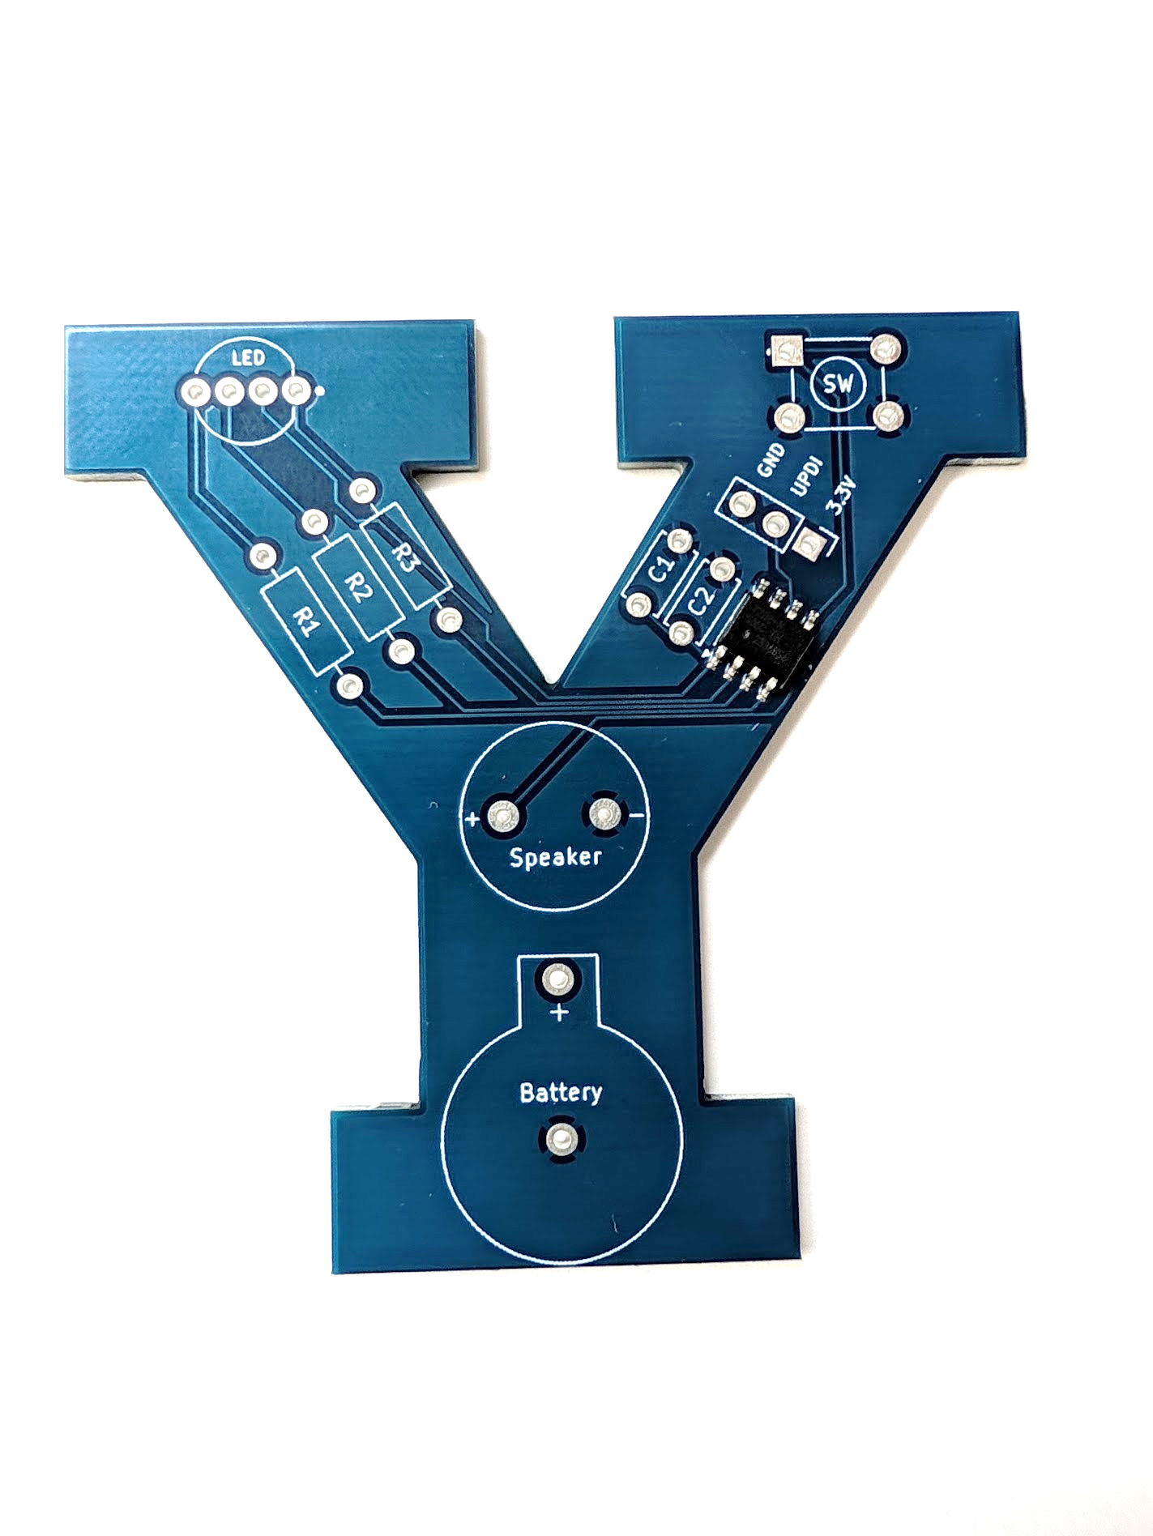
The Microcontroller
A microprocessor is a computer chip that runs software code.
It is the brains of this system
Once all the components are soldered onto the board, the microcontroller will play the BYU fight song when the button is pressed.

Slide 3
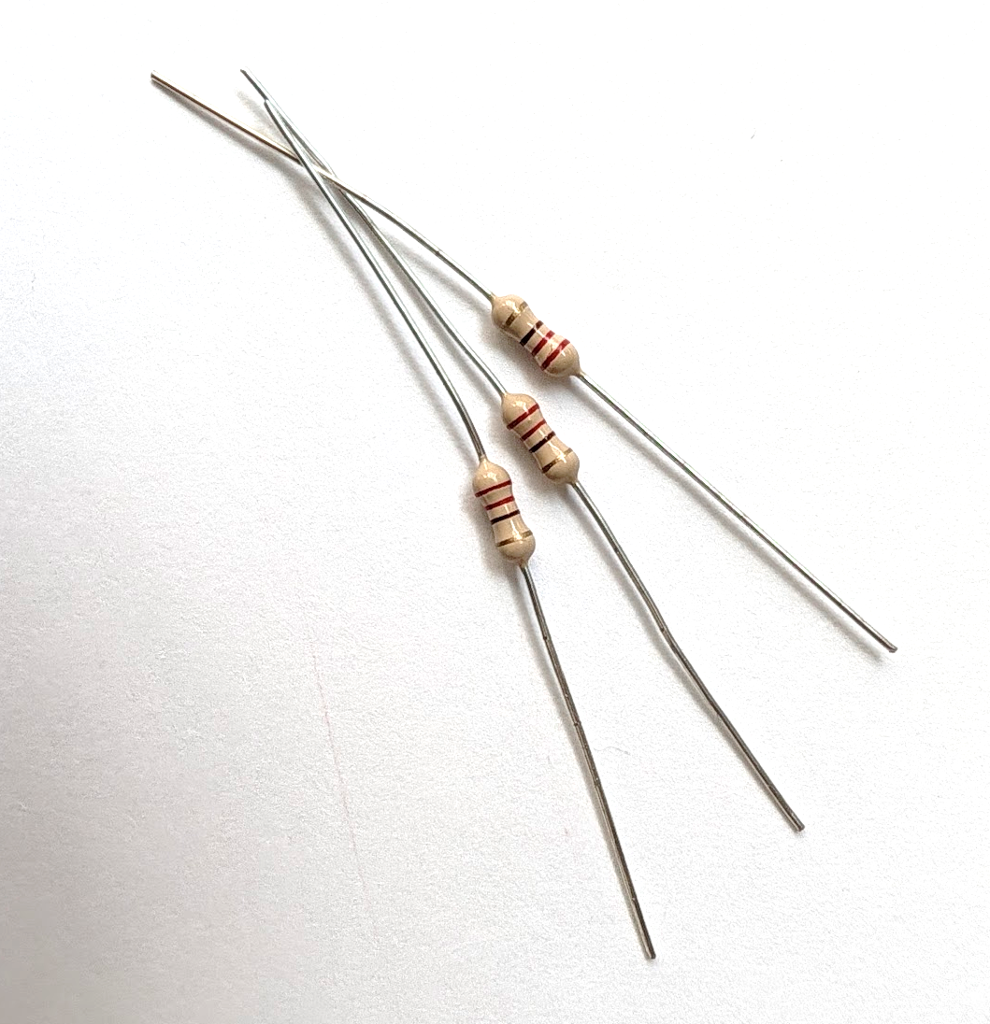
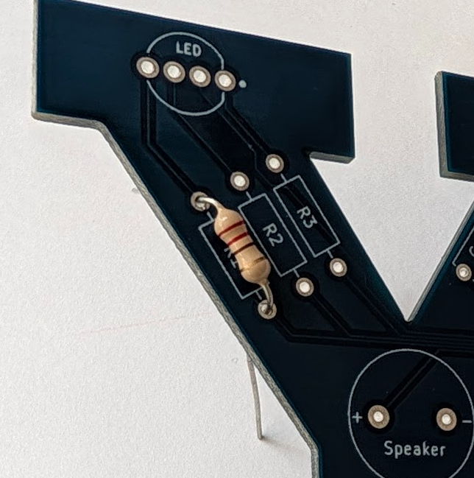
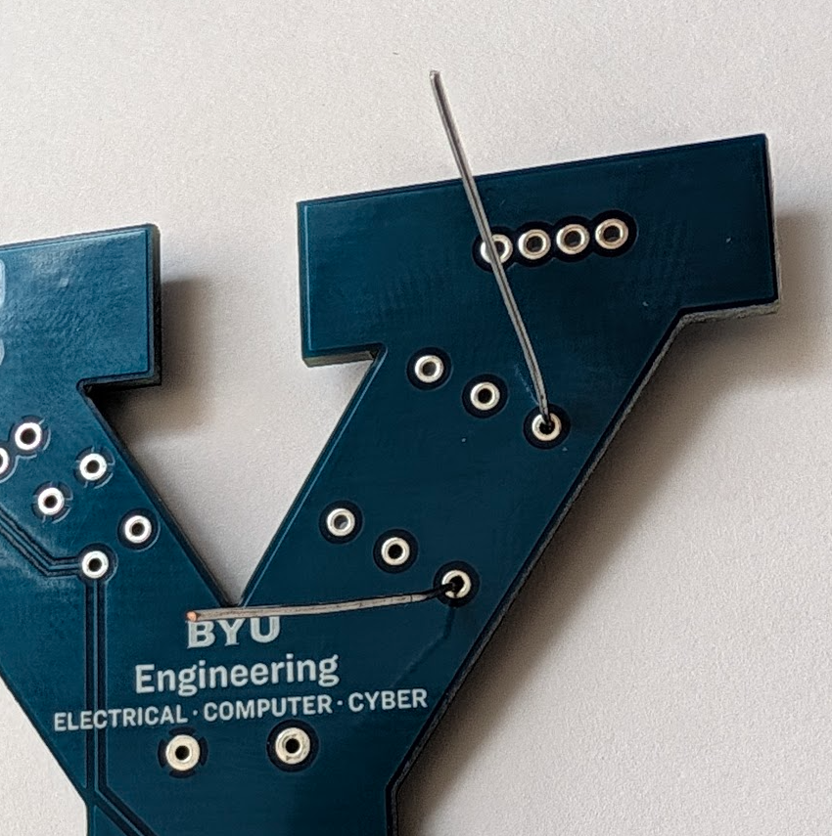
Resistors
A resistor resists and limits current flow in a circuit
This will make sure that the right amount of current goes to our LED
Solder the 3 resistors in R1, R2, R3
You can put them in any of the three spots, and either direction

Slide 4
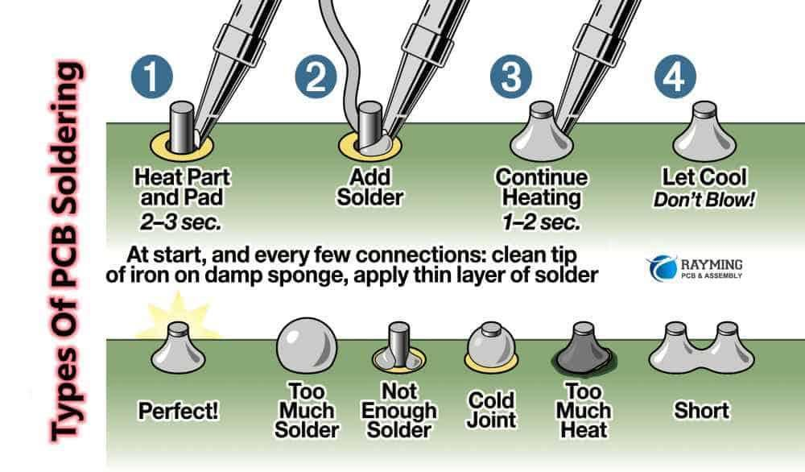
Soldering

Slide 5
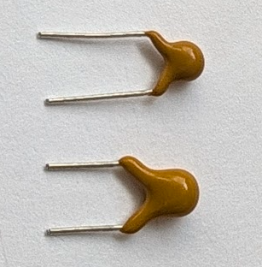
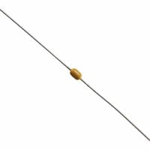
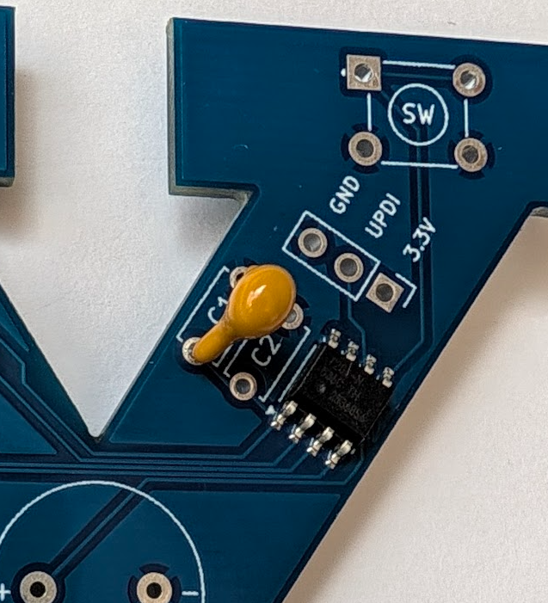
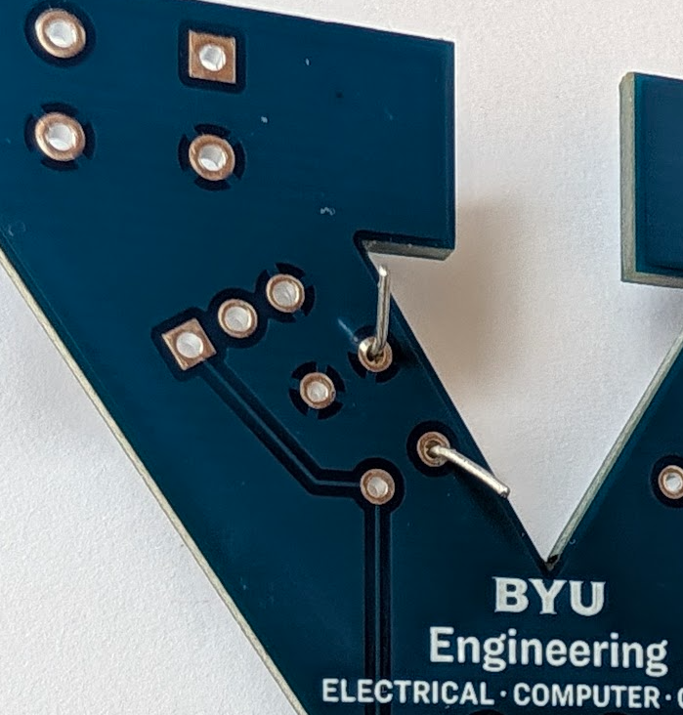
Capacitors
A capacitor is like a micro battery
The two capacitors will make sure the microcontroller gets smooth power from the battery
Solder the 2 capacitors in C1 and C2
You can put them in either spot, and either direction

Slide 6
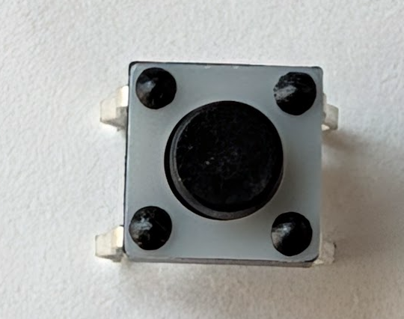
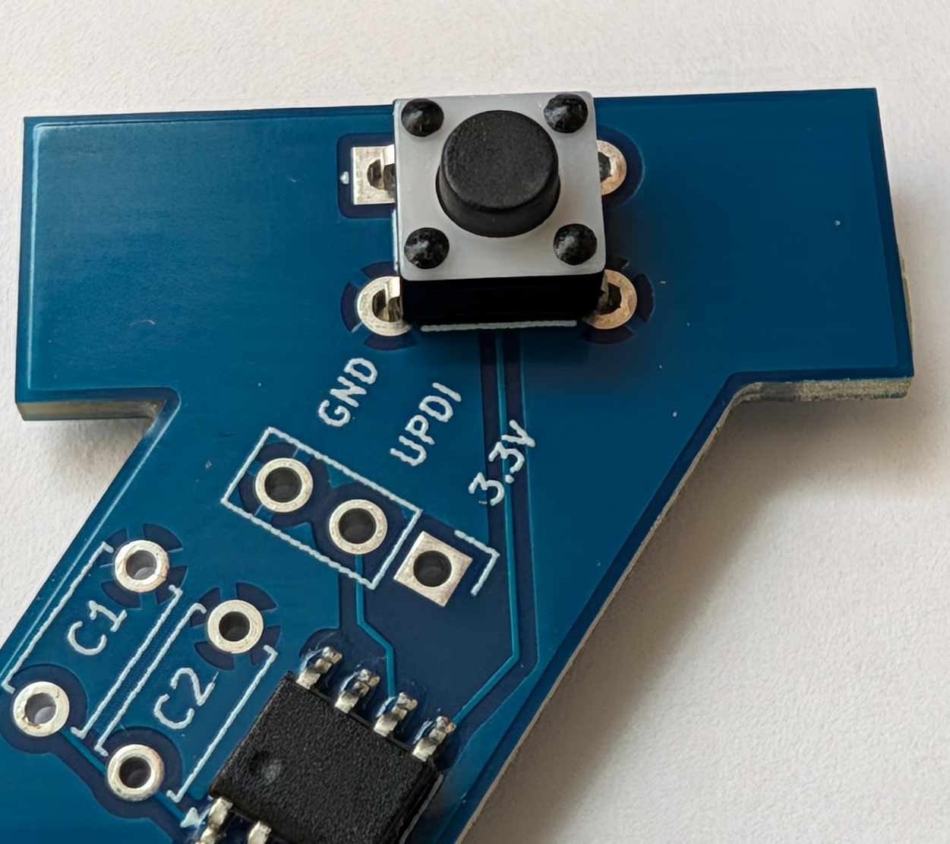
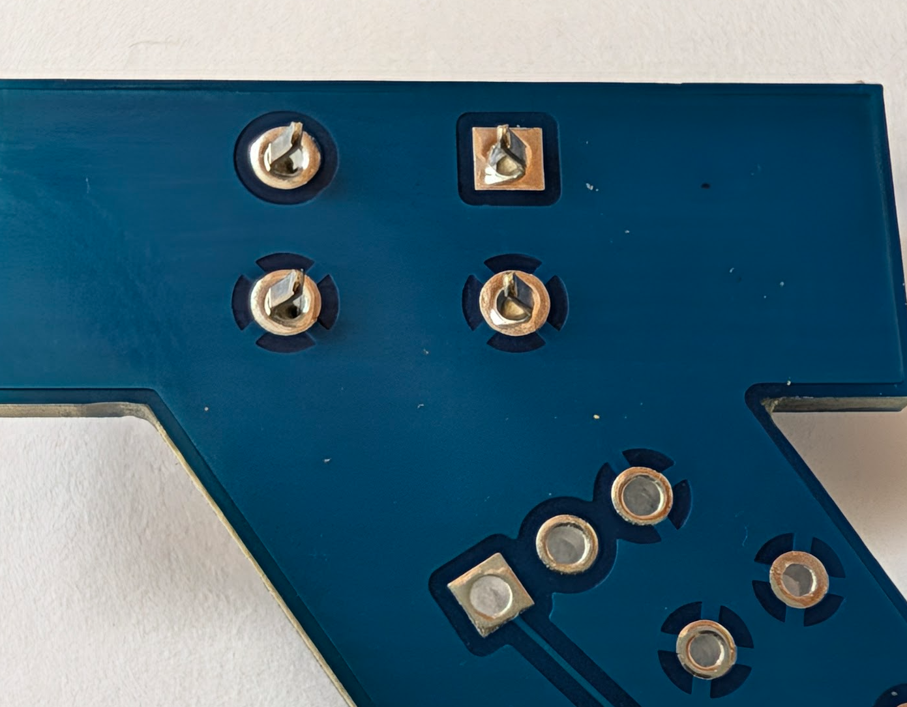
Button
A button or switch makes a connection between two electrical paths
The microcontroller will detect when we press the button
Pop the button into the SW place
It’s rectangular, so orient it correctly, but either direction is fine
Solder it!

Slide 7
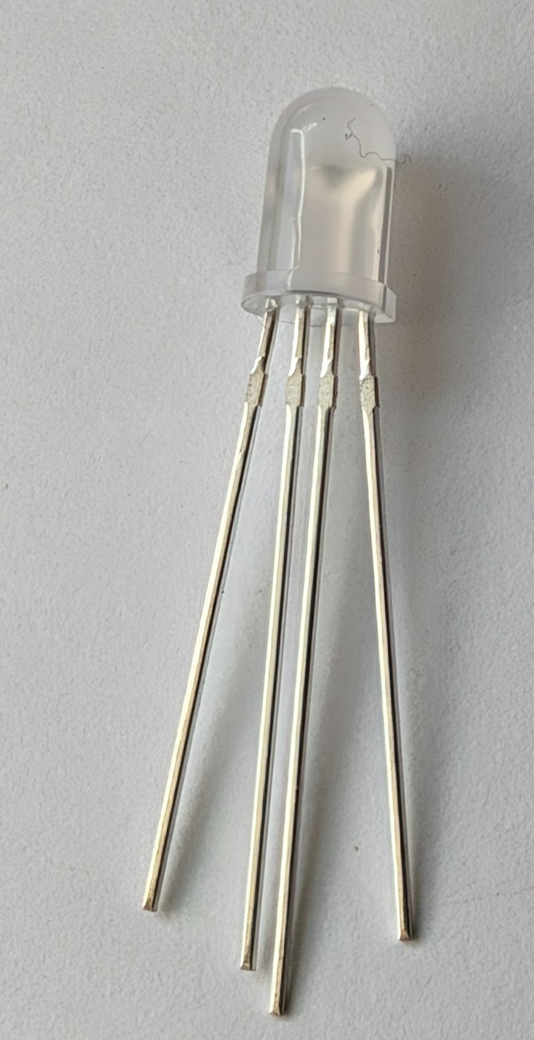
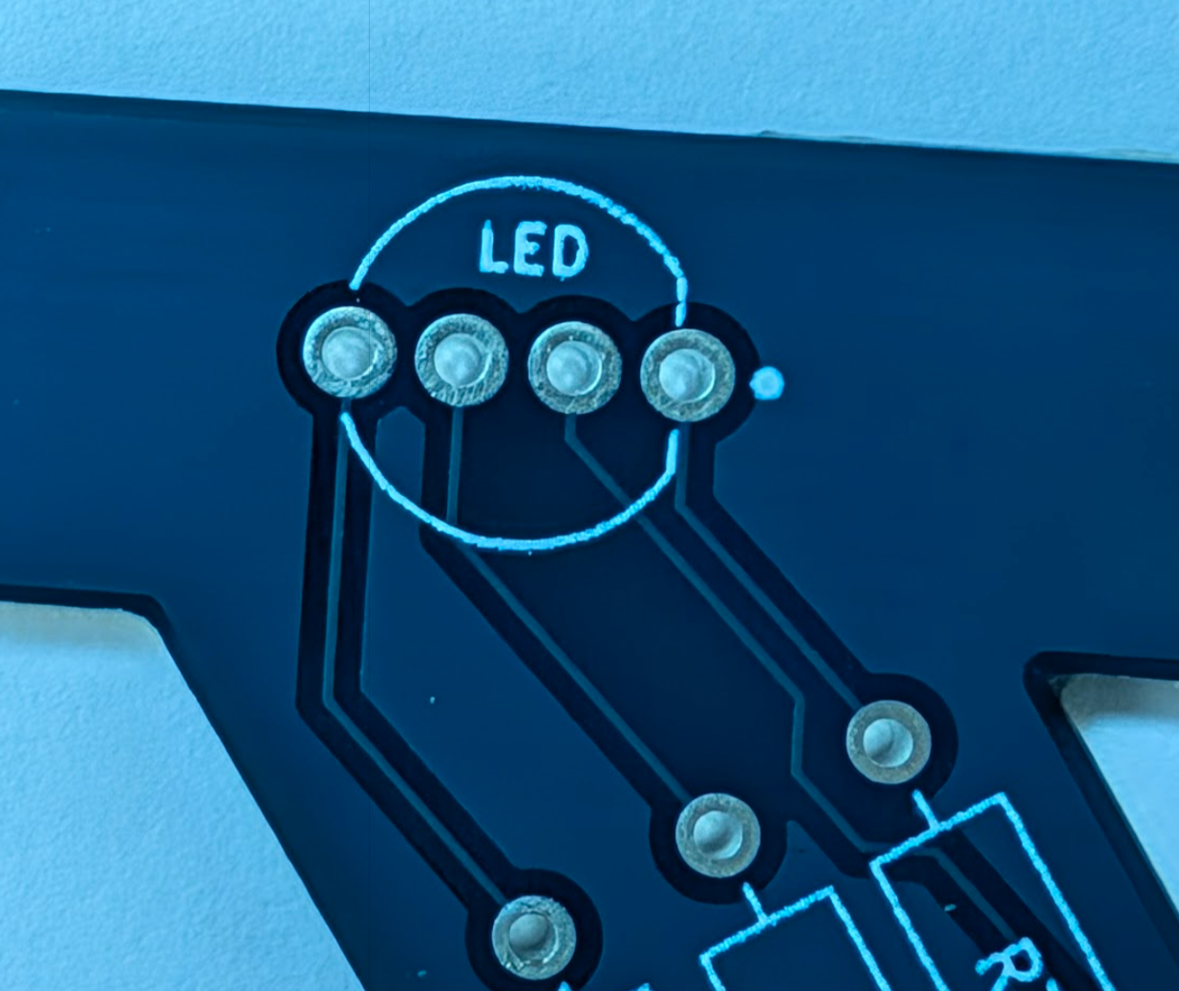
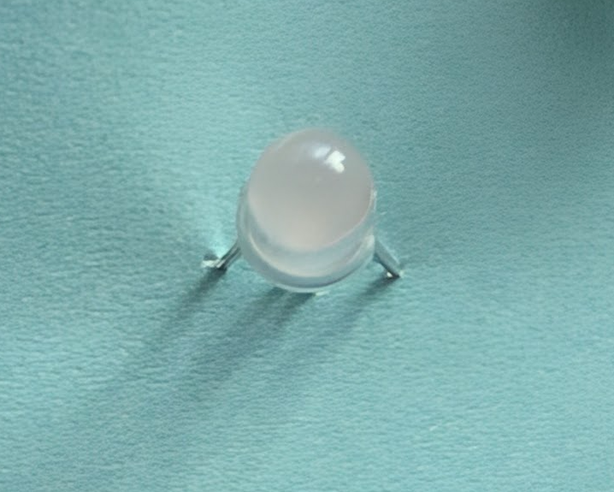
LED
An LED is a light emitting diode.
Diode: a circuit component that only allows current to flow one direction.
(We must get the direction correct)
This light is a RGB (red, green, blue) LED: lights in one
We can make different colors by turning each color light on and off
Flat Edge
Flat Edge
Don’t create a short!

Slide 8
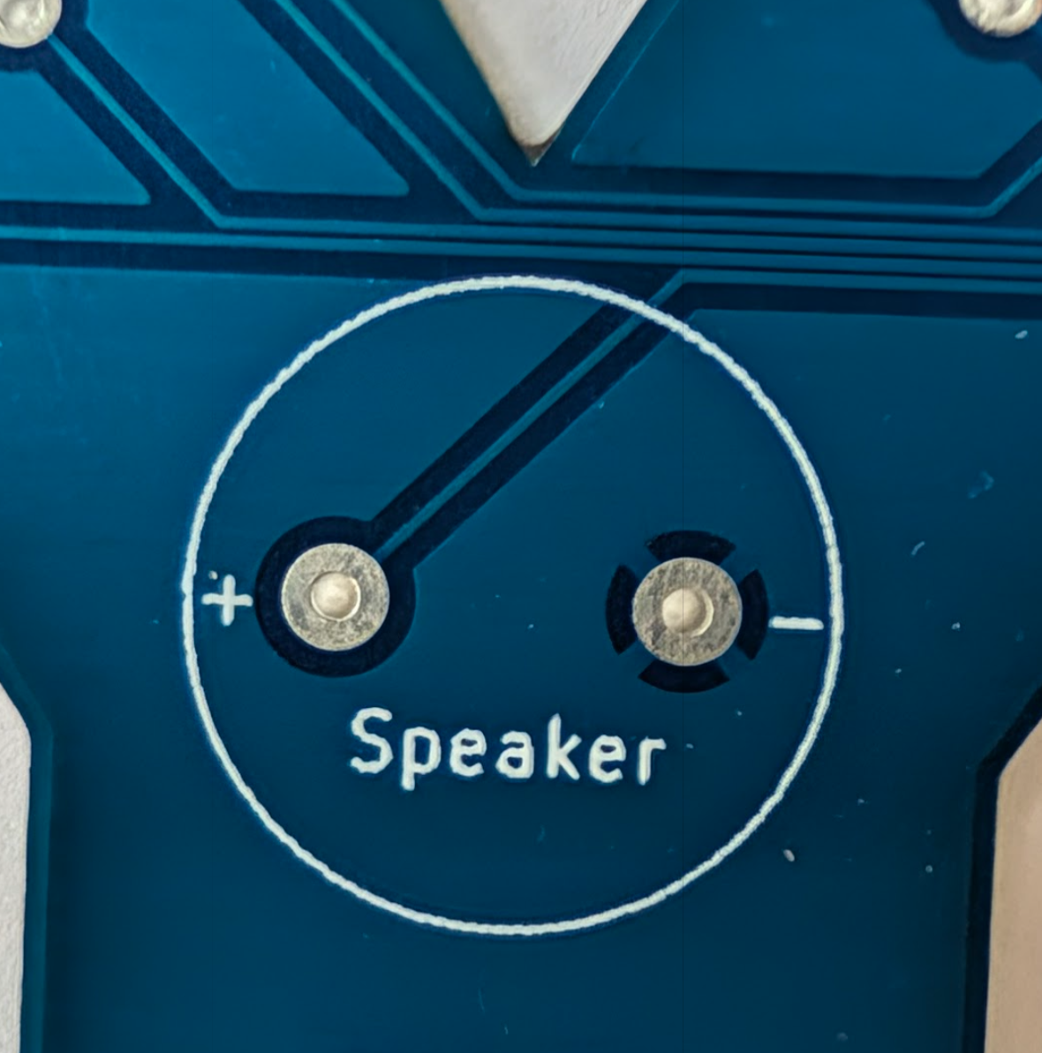
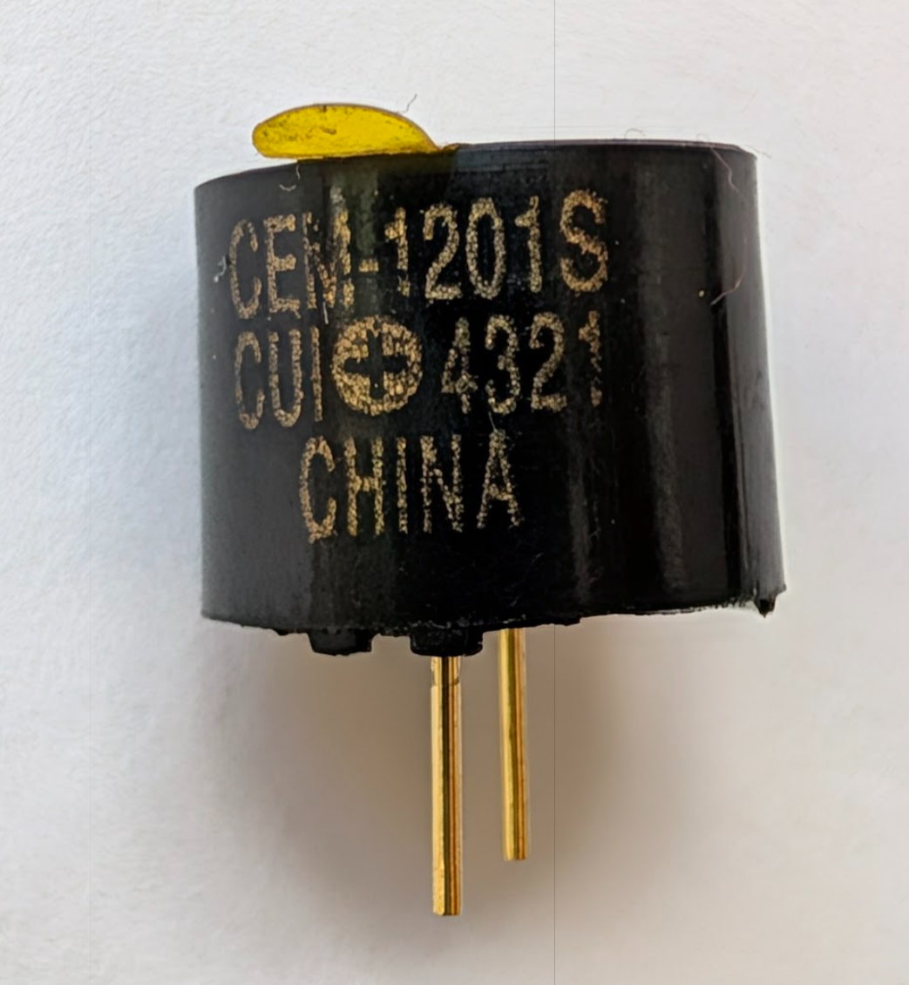
Speaker
It makes noise ☺
This pins are bigger, so it will take more time to heat them up
Make sure the solder joins to the pins and the board
Positive terminal

Slide 9
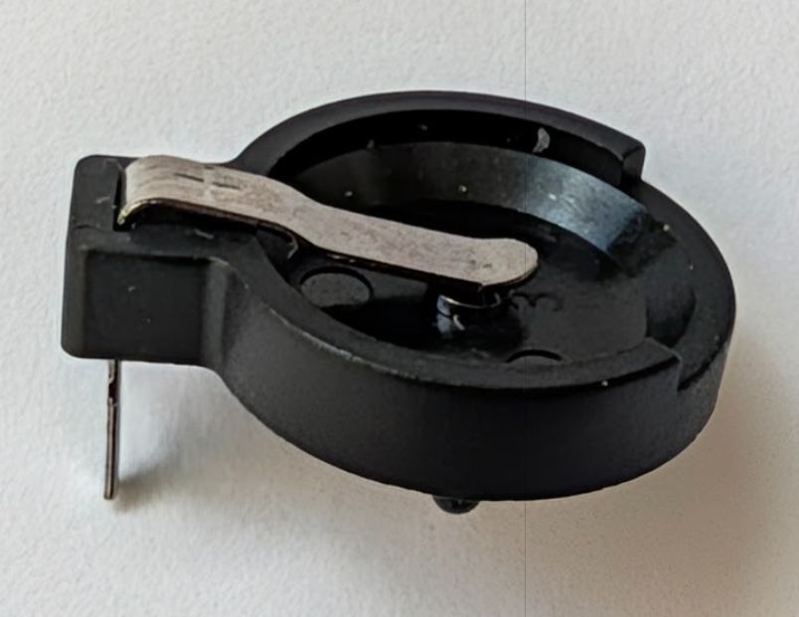
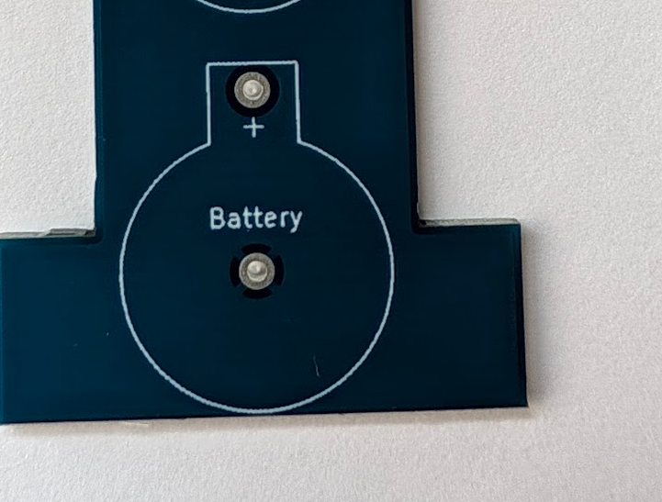
Batter Holder
Don’t put the battery in until after you solder
This pins are bigger, so it will take more time to heat them up
Make sure the solder joins to the pins and the board
Positive terminal

