Slide 1

Coding workshop - Stata
Yue Chu
SGSA Research Committee
Mar. 25, 2022, OSU

Slide 2

Topics for today
Good coding practices
Efficient coding
macros
tempfile, tempvar
loops
Useful commands
Data processing: merge, fuzzy match
Missingness: mdesc, mvpatterns, mcartest, mi
Output formatting
eststo, esttab
Q&A

Slide 3
Good coding practice
Principles | Do | Don’t
Clean and clear | Clean directories | Everything in root folder
 | Outline and ”chunk” like a paper | No paragraphs or sections
 | Wrap long commands (#delimit, ///) | Looong commands
 | Shell files (include “x.do”, do “x.do”) | Looong files, or maaany individual files
Efficient coding | Simplify codes (e.g. recode, loops, macros, tempfiles) | Repetitive codes
Flexible | Consider possible future changes | Manually search and update
Avoid hard code | Rely on your logic and programming (e.g. replace x=0 if missing(x)) | Write fixed solution / manually assign values (e.g. replace x=0 in 123)
Well-documented | Always comment! | No comments or notes
 | Version control | Save updated output as the same file
Notes:
For change delimiter, see https://www.stata.com/manuals/pdelimit.pdf
For /// as line breakers, make sure there’s space (“ “) before ///

Slide 4
Good coding practice
Clean and clear
Clean directories
Outline and divide up your codes like a paper
Wrap long commands
Shell files and call for do files
Efficient coding
Flexible
Consider possible future changes
Avoid hard code
Rely on your logic and programming
Well-documented
Comment! Comment! Comment!
Version control

Slide 5
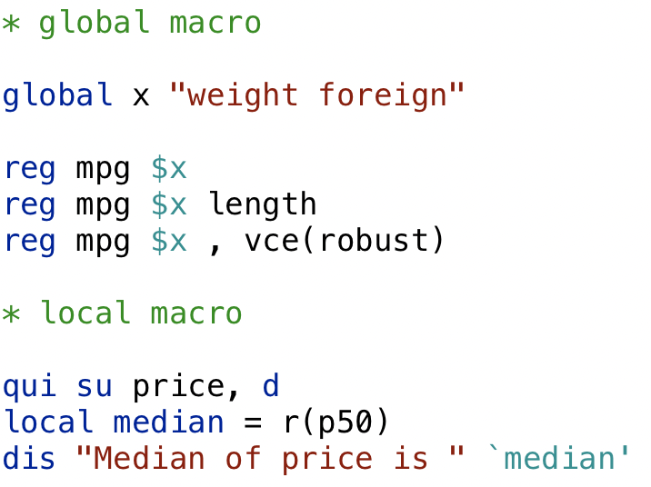
Macros
Reusable item (string, number, etc.)
Super easy for updating / version control
Efficient coding
Two types of macros
Global macro: Stata remembers the value
Local macro: Only works locally
Use with caution
Conflicts across do-files / ado-files
Notes:
https://www.stata.com/manuals/pmacro.pdf

Slide 6
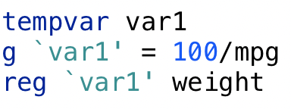
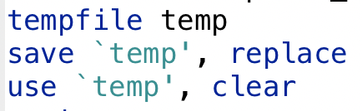
tempvar and tempfile
A variable or file only defined for current session
Use for intermediate files or variables you don’t want to save
Keep dataset and directories clean
Note
Only need to define once in one session
need “replace” if assigning same name to variable/file

Slide 7
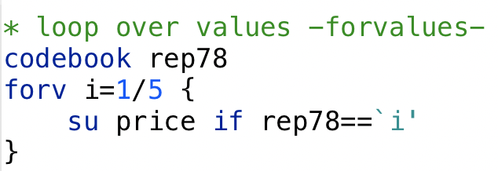
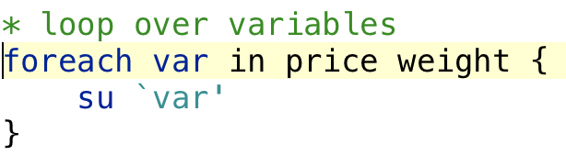
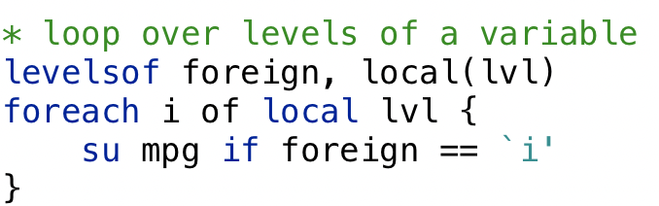
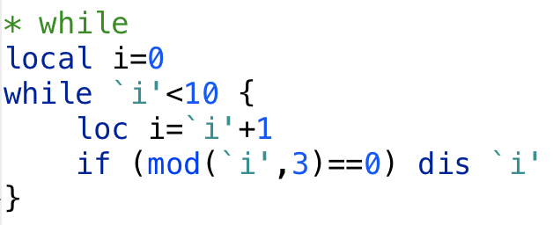
Loops
Use loops as much as you can
forvalues (forv)
foreach
loop over strings, variables, list of numbers/variables
levels of a variables
while

Slide 8
Merge
merge
Avoid m:m merge! if you want every possible matches for observations with the same key, try joinby
Fuzzy match
Mainly relaxing matching for string variables
matchit: more flexible, column matches, work for long strings
reclink: simpler, faster
Notes:
When you want to use m:m merge, think twice! Maybe you are trying to accomplish is what joinby, a different command, does: create in the output dataset every possible combination of an observation from the first dataset and an observation from the second dataset, both having the same key.
See: https://www.stata.com/manuals/u23.pdf and https://www.statalist.org/forums/forum/general-stata-discussion/general/1551609-merge-m-m-vs-joinby
For difference between matchit and reclink, see https://www.statalist.org/forums/forum/general-stata-discussion/general/1338206-what-are-the-differences-between-matchit-and-reclink

Slide 9
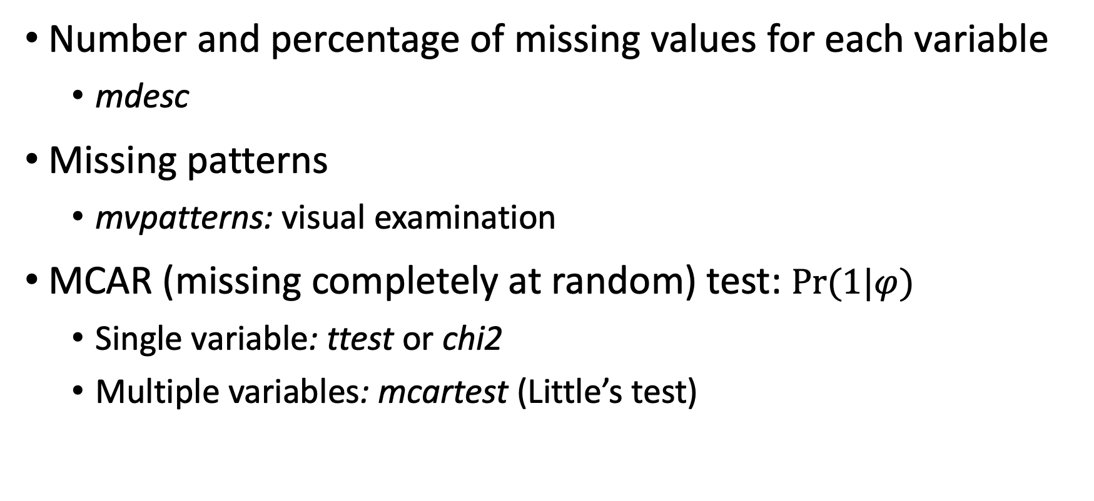
Missingness investigation
Number and percentage of missing values for each variable
mdesc
Missing patterns
mvpatterns: visual examination
MCAR (missing completely at random) test: $Pr(1|φ)$
Single variable: ttest or chi2
Multiple variables: mcartest (Little’s test)

Slide 10
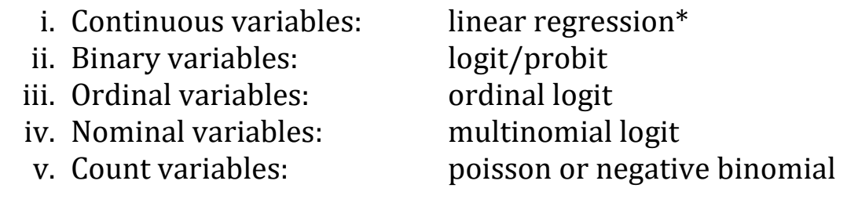
Missing imputation
Regression imputation
Stochastic regression: add random noise to predicted value
MICE (multiple imputation by chained equations)
mi
Specify separate regression for each variable to be imputed

Slide 11
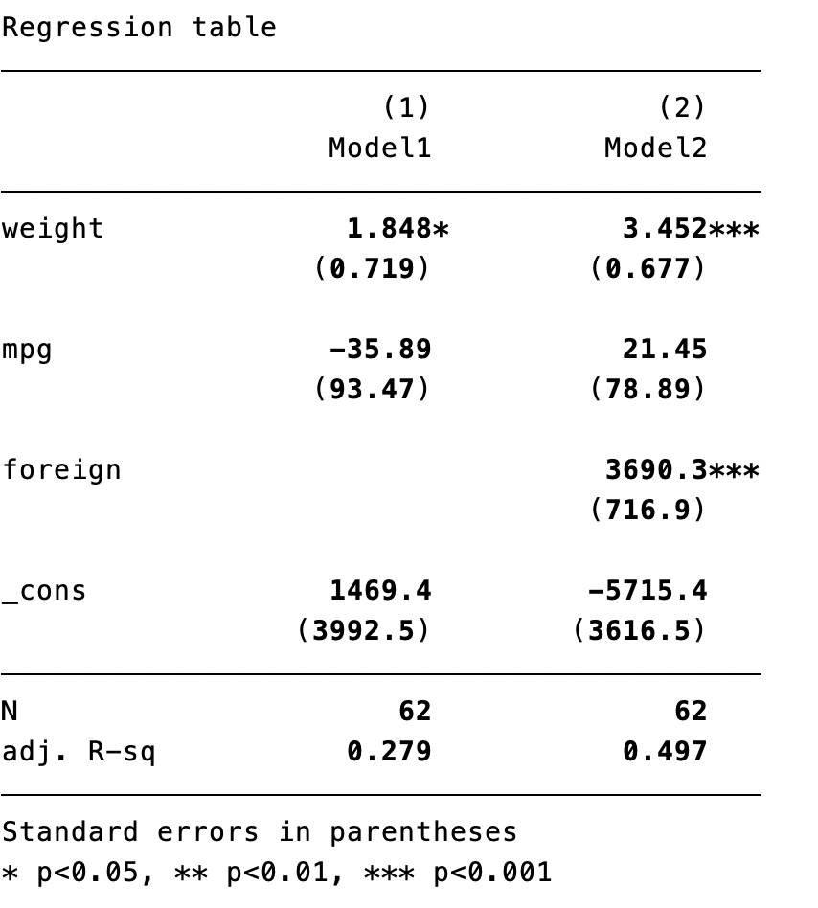
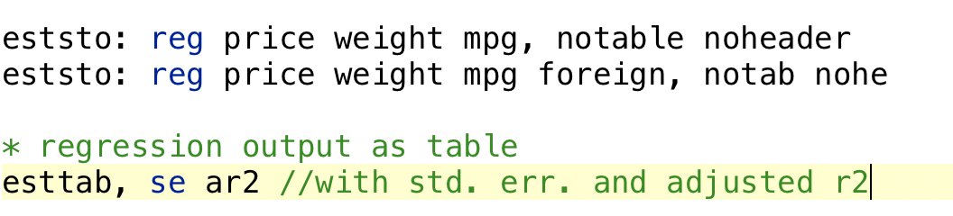
Output formatting
Store regression estimates
eststo
Publication style regression tables
esttab

Slide 12

Thank you! Contact info: Yue Chu chu.282@osu.edu
Codes in Stata can be found on Github
This repository have list of resources, cheatsheets, books, codes etc.
References and useful resources:
Gentzkow and Shapiro, Code and Data for the Social Sciences: A Practitioner’s Guide
Mize Best Practices for Analyzing Incomplete Data
Publication style regression tables
Useful Stata code
Gillespie and Lovelace, Efficient R programming
(ILLUSTRATIONS BY MICHELE PERRY @LOKFUNG, ISTOCK)

Slide 13
Computing resources on campus
 | What it is | Pro | Con
Soc-C1 | Department cluster service | User friendly Own space with memories Stop and revise anytime | Not much faster
Unity | University supercomputer environment | Fast Push and wait | Comfortable living in a 0-1 world Error-free codes Wait in line

