Slide 1

Energy Demand Forecasting
24 hour demand

Slide 2
OUTLINE
Motivation
The Datasets
EDA Insights
Statistical Tests
Prediction Models

Slide 3
Motivation - Personal
1. Climate change – Efficient use of energy
2. Use of personal engineering knowledge

Slide 4
Motivation - Society
“Accurate energy predictions is better for all of humanity”
How, you ask?

Slide 5
Over Supply
-1. Choke supply grid
- Hours of power cuts
- Safety Concerns
Under Supply
1. Power Cuts
2.
2. Lower energy prices
-Difficult to maintain and operate energy sources long term
3. Lost energy if cannot store

Slide 7
Who would be interested?

Slide 8
The Datasets
1. Energy Data
2. Weather Data

Slide 9
Why those cities?
1. Top 5 populated cities in Spain (30% of populatin)
2. Evenly Spaced out

Slide 10
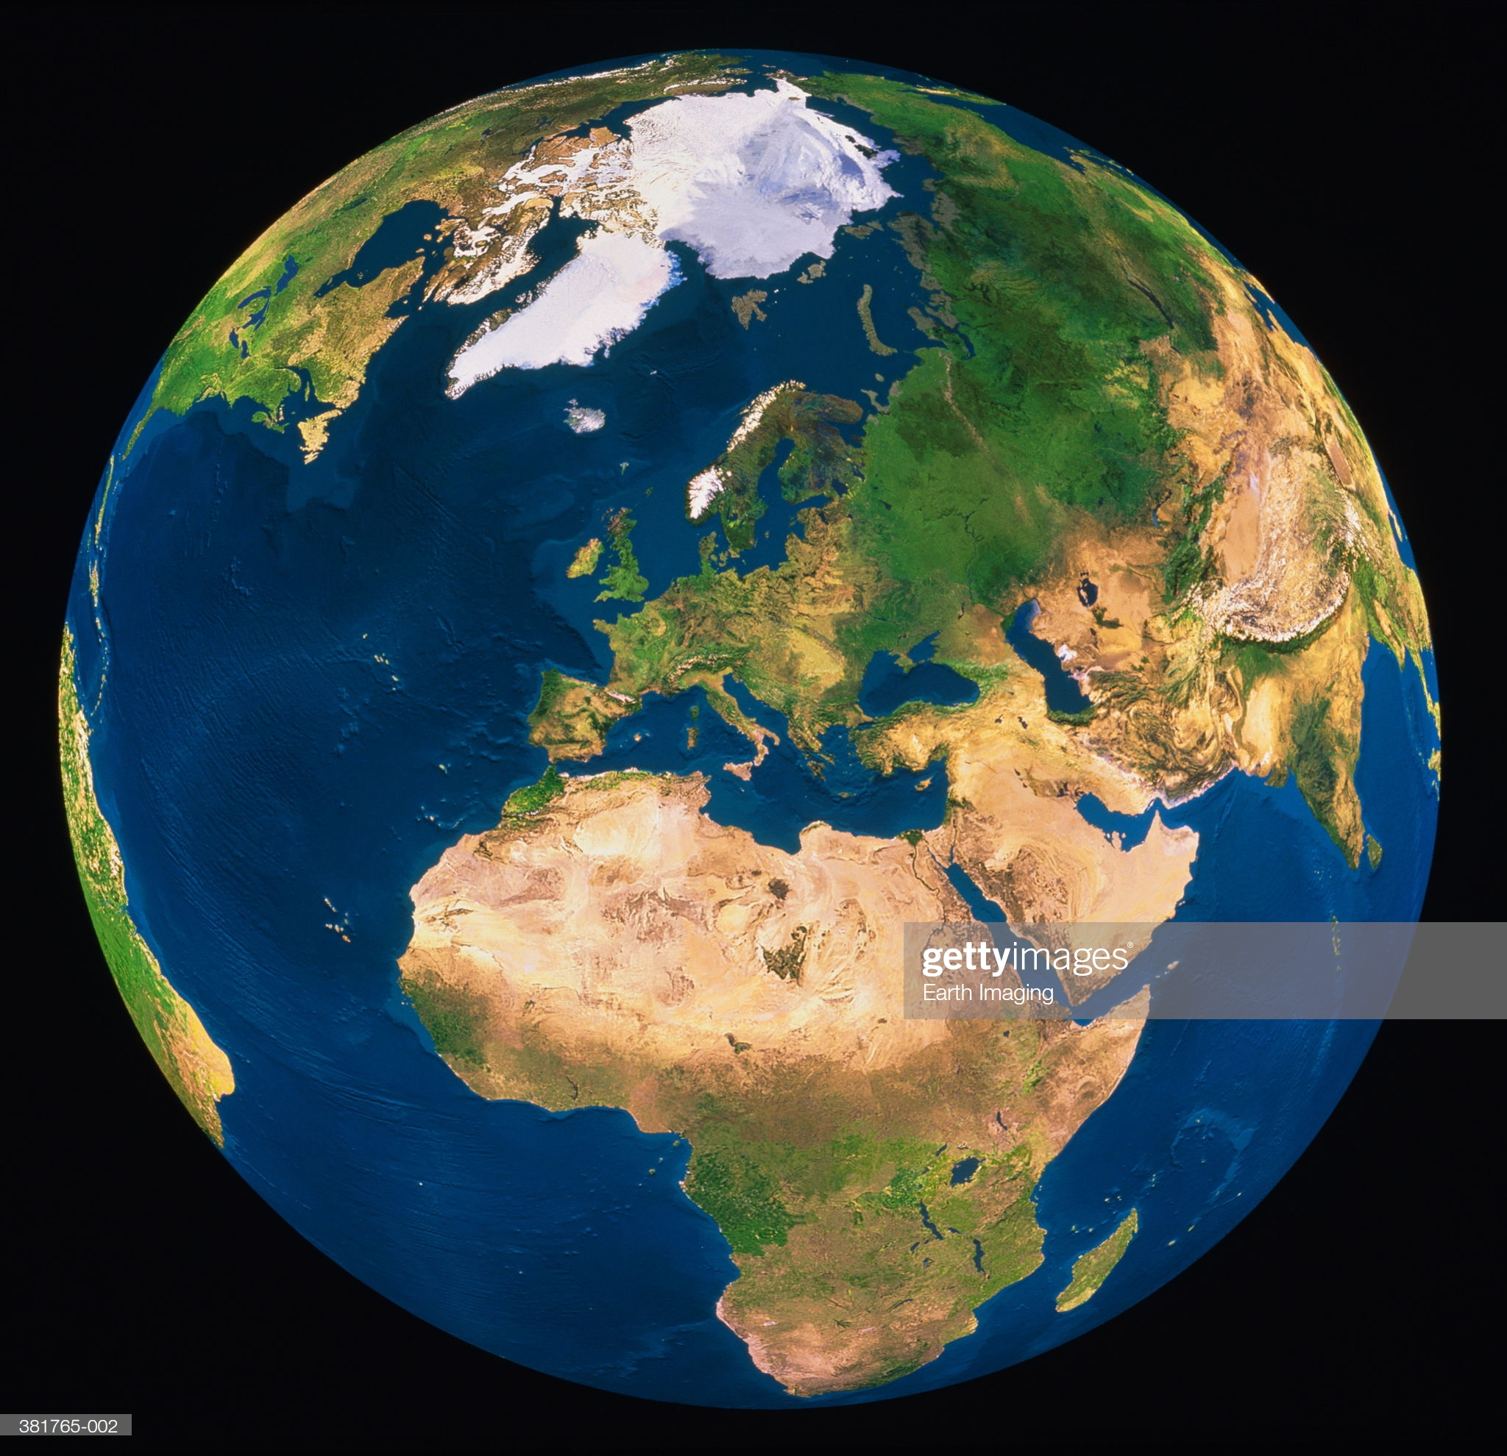

Our Population - Earth
Our Sample - Spain
Our Sample’s Samples
3.1.
3.2
3.3.
3.4.
3.5.

