Slide 1
LabelForest: Non-Parametric Semi-supervised Learning for Activity Recognition
Yuchao Ma and Hassan Ghasemzadeh
Embedded & Pervasive Systems Lab
Washington State University
{yuchao.ma, hassan.ghasemzadeh}@wsu.edu

Slide 2
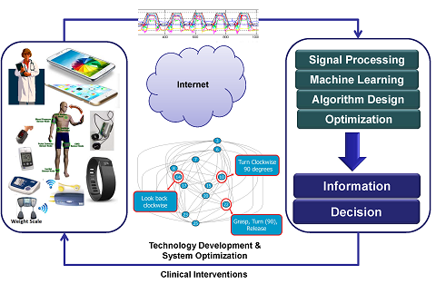
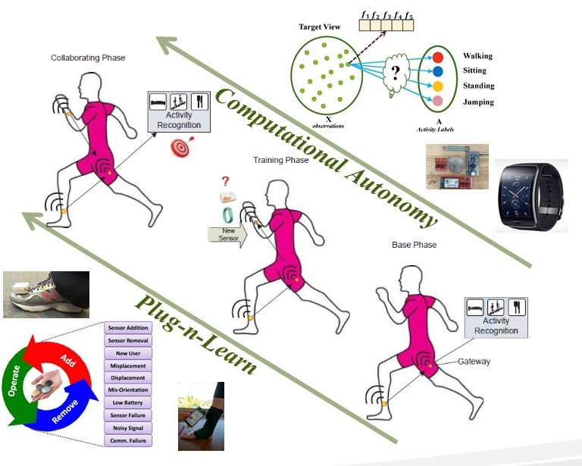
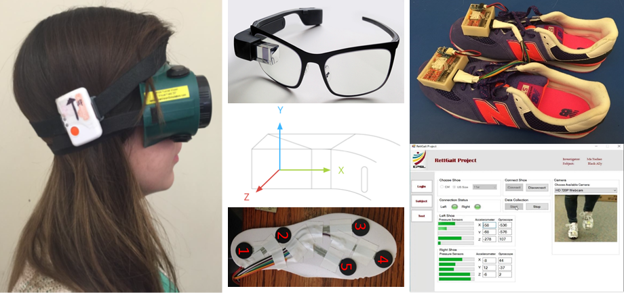
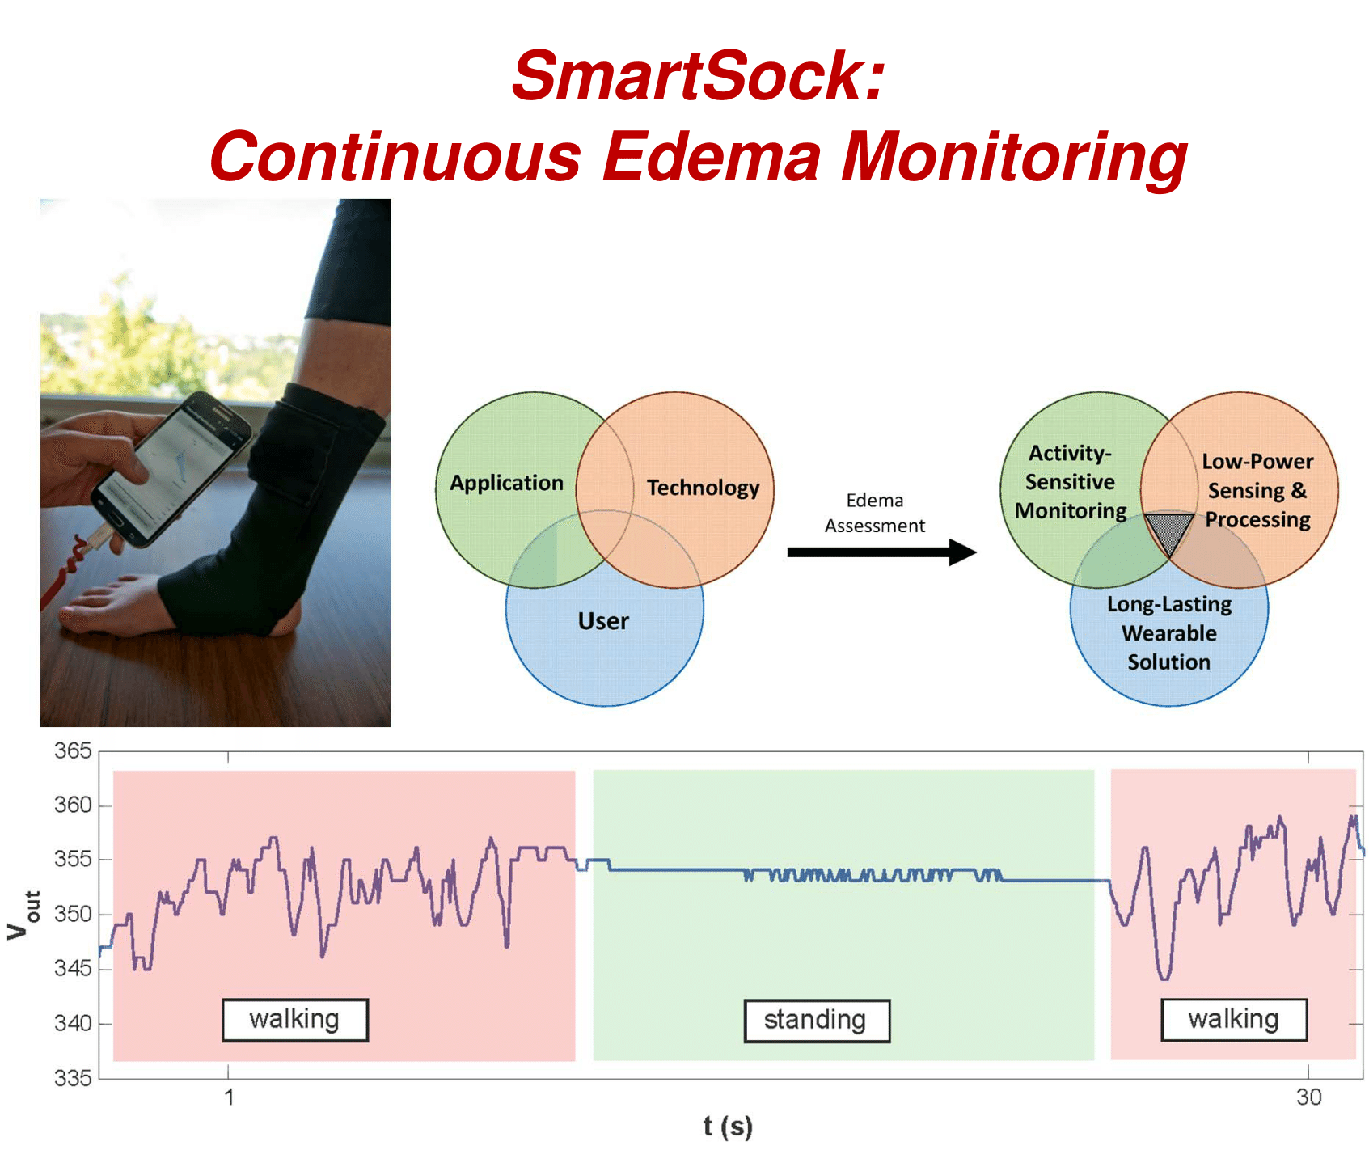
Research in EPSL @ WSU

Slide 3
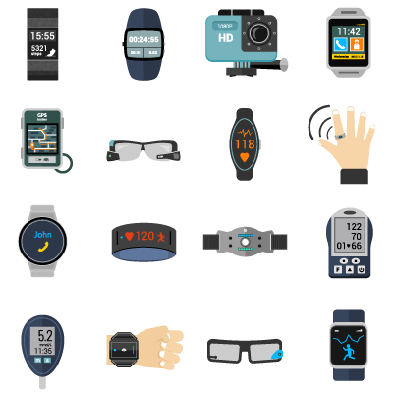
Activity Recognition
[5]
Main Challenges
Dependency on ground truth
Individual variations
Platform diversity
[5] http://engineerpal.com/wp-content/uploads/2015/12/wearable_solution_image.png

Slide 4
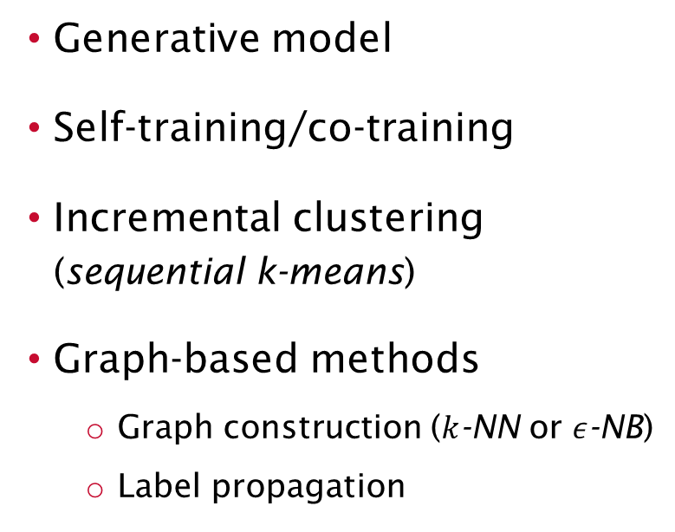
Semi-supervised Learning
Highly Dynamic
A few labeled data (seed)
A large number of unlabeled data
Learn on both labeled and unlabeled data
Generative model
Self-training/co-training
Incremental clustering (sequential k-means)
Graph-based methods
Graph construction ($k$-NN or $ε$-NB)
Label propagation
[6]
[6 ] Margareta Ackerman and Sanjoy Dasgupta, “Incremental Clustering: The Case for Extra Clusters”, CoRR, 2014.

Slide 5
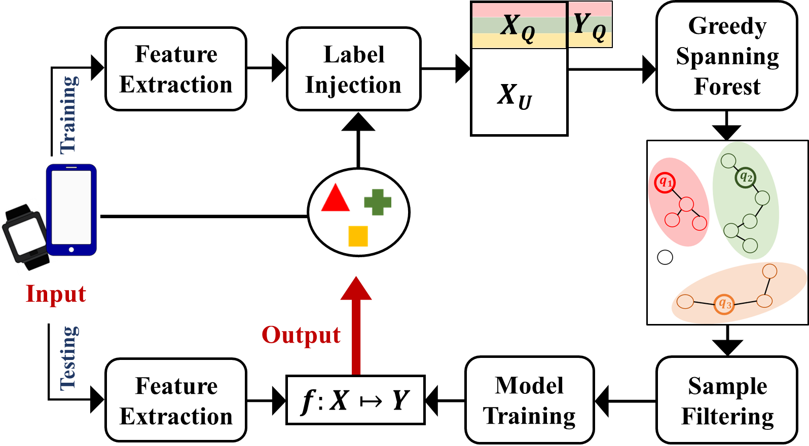
LabelForest
Labeled set augmentation
[13 ] Yuchao Ma et al., “LabelForest: Non-Parametric Semi-Supervised Learning for Activity Recognition”, AAAI 2019. [Pending]

Slide 6
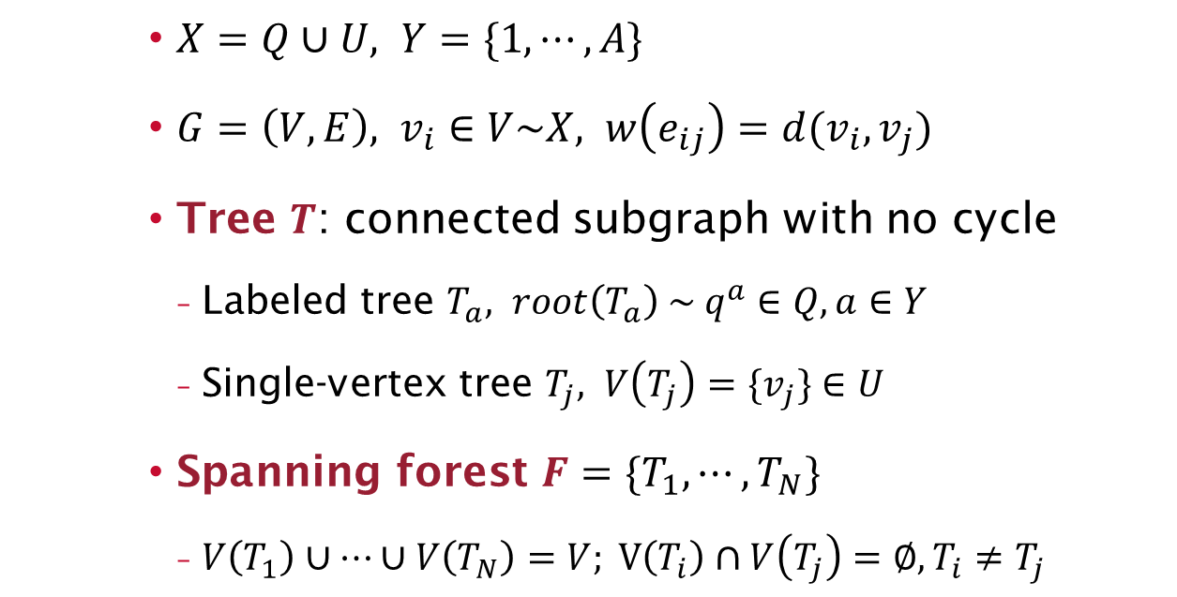
Graph Modeling
$X=Q∪U, Y=\{1,⋯, A\}$
$G=\left(V,E\right), v_{i}∈V\sim X, w\left(e_{ij}\right)=d(v_{i},v_{j})$
Tree $T$: connected subgraph with no cycle
Labeled tree $T_{a}, root\left(T_{a}\right) \sim q^{a}∈Q, a∈Y$
Single-vertex tree $T_{j}, V\left(T_{j}\right)=\{v_{j}\}∈U$
Spanning forest $F=\{T_{1},⋯,T_{N}\}$
$V\left(T_{1}\right)∪⋯∪V\left(T_{N}\right)=V; V\left(T_{i}\right)∩V\left(T_{j}\right)=∅, T_{i}≠T_{j}$

Slide 7
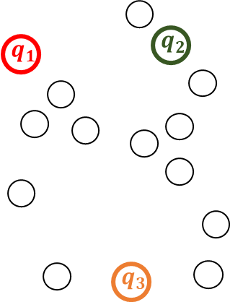
Greedy Spanning Forest Algorithm
Start:
Labeled trees rooted by seed data samples
Stop:
All vertices are either accepted or rejected

Slide 8


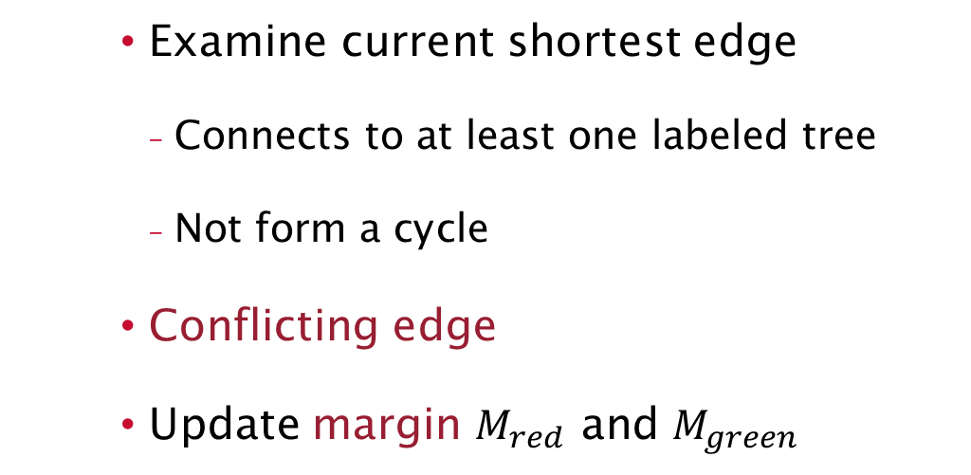









Forest Spanning Criteria
$$1$$
Examine current shortest edge
Connects to at least one labeled tree
Not form a cycle
Conflicting edge
Update margin $M_{red}$ and $M_{green}$
$$q_{1}$$
$$q_{2}$$
$$3$$
$$2$$
$$4$$
$$5$$
$$6$$
$$7$$
$$8$$
$$q_{3}$$

Slide 9
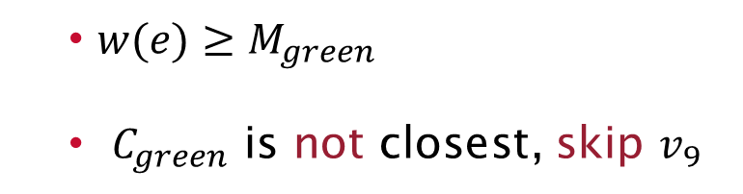




Forest Spanning Criteria – cont.
$$q_{1}$$
$$q_{2}$$
$w(e)≥M_{green}$
$C_{green}$ is not closest, skip $v_{9}$
$$9$$
$$q_{3}$$

Slide 10

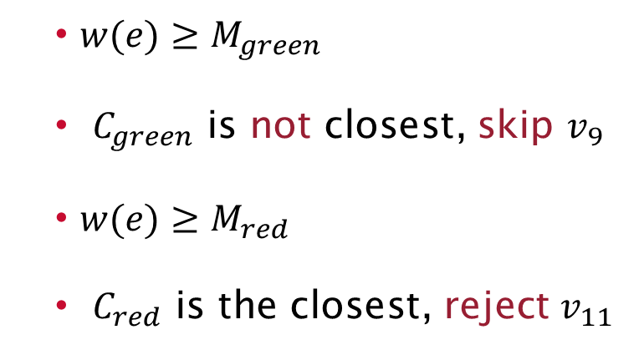





Forest Spanning Criteria – cont.
$$q_{2}$$
$w(e)≥M_{green}$
$C_{green}$ is not closest, skip $v_{9}$
$w(e)≥M_{red}$
$C_{red}$ is the closest, reject $v_{11}$
$$q_{1}$$
$$11$$
$$9$$
$$10$$
$$q_{3}$$

Slide 11














Forest Spanning Criteria – cont.
$$1$$
$$q_{1}$$
$$q_{2}$$
Skipped vertex is assigned eventually
Guaranteed to terminate due to finite number of edges
$$3$$
$$2$$
$$4$$
$$5$$
$$6$$
$$7$$
$$8$$
$$11$$
$$9$$
$$10$$
$$q_{3}$$
$$12$$

Slide 12


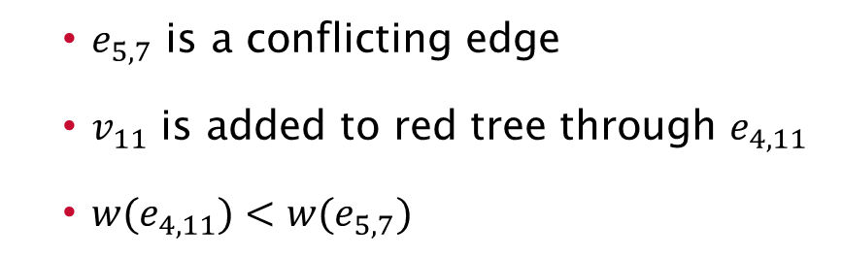












Automated Tradeoff
Pairwise similarity – greedy spanning over valid shortest edge
Accumulative dissimilarity – conflicting edge to terminate the growth
$$1$$
$$q_{1}$$
$$q_{2}$$
$e_{5,7}$ is a conflicting edge
$v_{11}$ is added to red tree through $e_{4,11}$
$w(e_{4,11})<w(e_{5,7})$
$$3$$
$$2$$
$$4$$
$$5$$
$$6$$
$$7$$
$$8$$
contradict
$$11$$
$$9$$
$$10$$
$$q_{3}$$
$$12$$
12

Slide 13
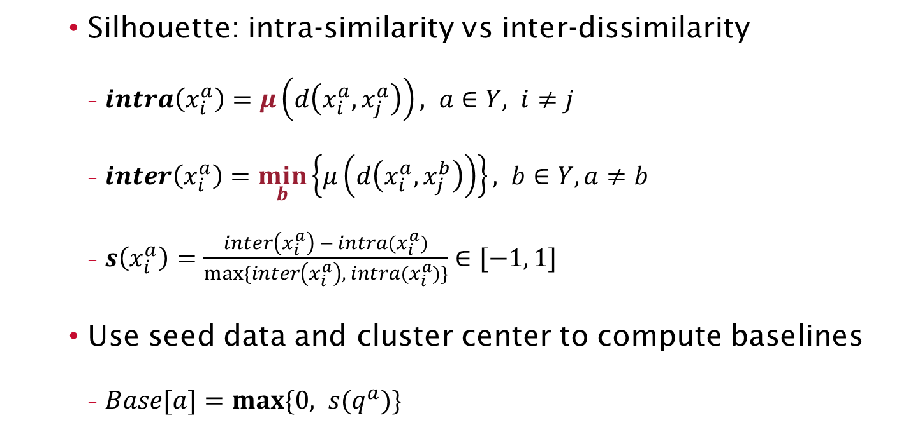
Sample Filtering
Silhouette: intra-similarity vs inter-dissimilarity
$intra\left(x_{i}^{a}\right)=μ\left(d\left(x_{i}^{a},x_{j}^{a}\right)\right), a∈Y, i≠j$
$inter\left(x_{i}^{a}\right)=\min_{b}\left\{μ\left(d\left(x_{i}^{a}, x_{j}^{b}\right)\right)\right\}, b∈Y, a≠b$
$s\left(x_{i}^{a}\right)=\frac{inter\left(x_{i}^{a}\right) − intra(x_{i}^{a})}{max⁡\{inter\left(x_{i}^{a}\right), intra(x_{i}^{a})\}}∈[−1, 1]$
Use seed data and cluster center to compute baselines
$Base[a]=max⁡\{0, s(q^{a})\}$

Slide 14
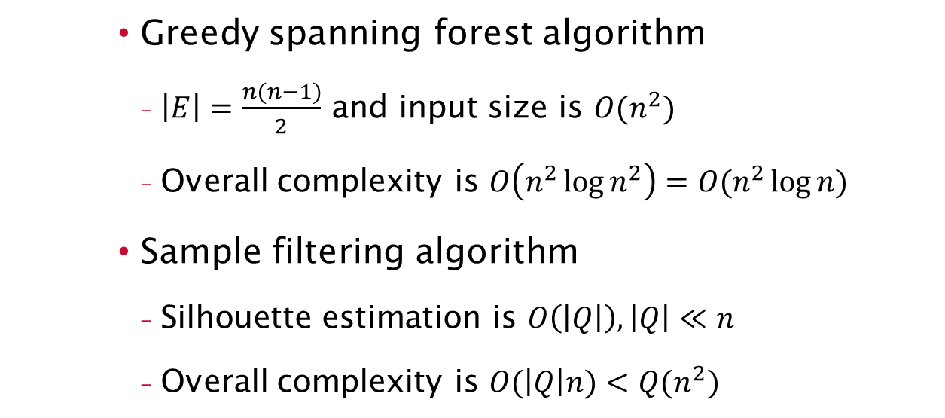
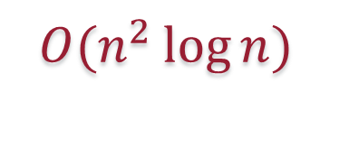
LabelForest Complexity
Greedy spanning forest algorithm
$\left|E\right|=\frac{n(n−1)}{2}$ and input size is $O(n^{2})$
Overall complexity is $O\left(n^{2}\log{n^{2}}\right)=O(n^{2}\log{n})$
Sample filtering algorithm
Silhouette estimation is $O\left(\left|Q\right|\right), \left|Q\right|≪n$
Overall complexity is $O(\left|Q\right|n)<Q(n^{2})$
$$O(n^{2}\log{n})$$

Slide 15
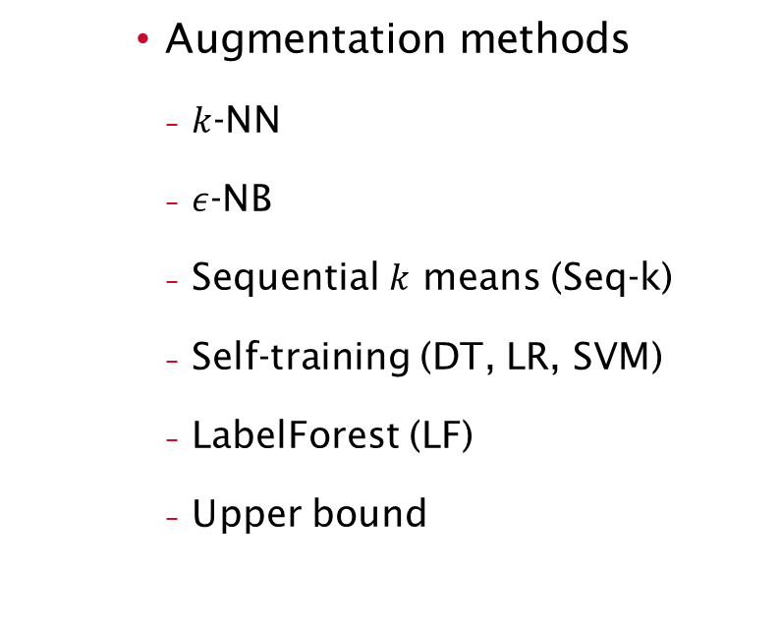
Validation
Selective labeling
Labeling rate (l-rate)
Precision, recall, F1 score (f1)
Labeling accuracy
Activity recognition
Machine learning model: SVM
Classification accuracy
Augmentation methods
$k$-NN
$ε$-NB
Sequential $k$ means (Seq-k)
Self-training (DT, LR, SVM)
LabelForest (LF)
Upper bound

Slide 16
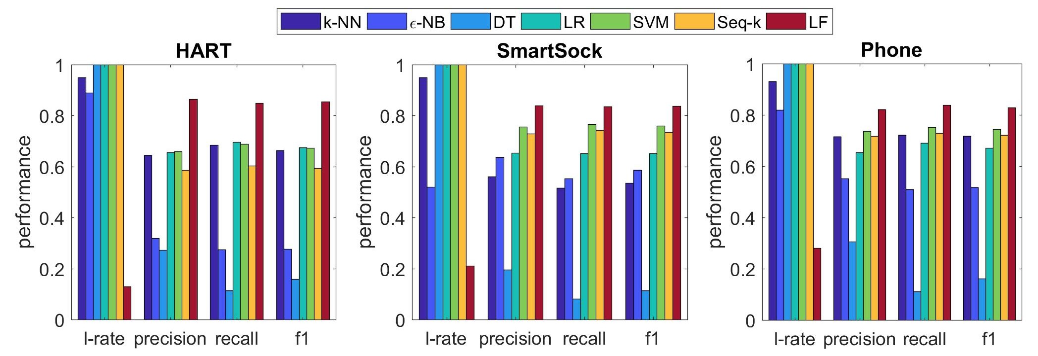
Results of Selective Labeling
One seed data sample per label
0.86
0.84
0.83

Slide 17
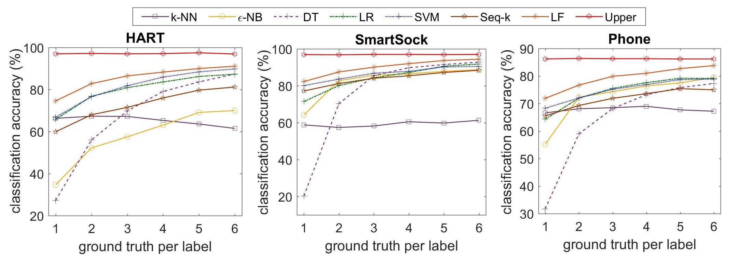
Results of Activity Recognition
Evenly increase seed data size for each label
6%
2.7%
2.8%

Slide 18
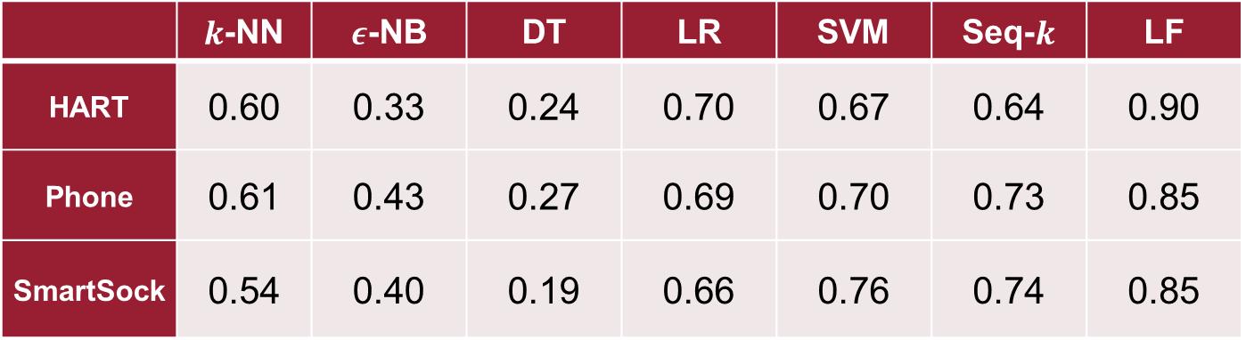
Unbalanced Seed Data
F1 score averaging over classes for selective labeling
8 seed data samples for one label and 1 for each others
 | $k$-NN | $ε$-NB | DT | LR | SVM | Seq-$k$ | LF
HART | 0.60 | 0.33 | 0.24 | 0.70 | 0.67 | 0.64 | 0.90
Phone | 0.61 | 0.43 | 0.27 | 0.69 | 0.70 | 0.73 | 0.85
SmartSock | 0.54 | 0.40 | 0.19 | 0.66 | 0.76 | 0.74 | 0.85

Slide 19
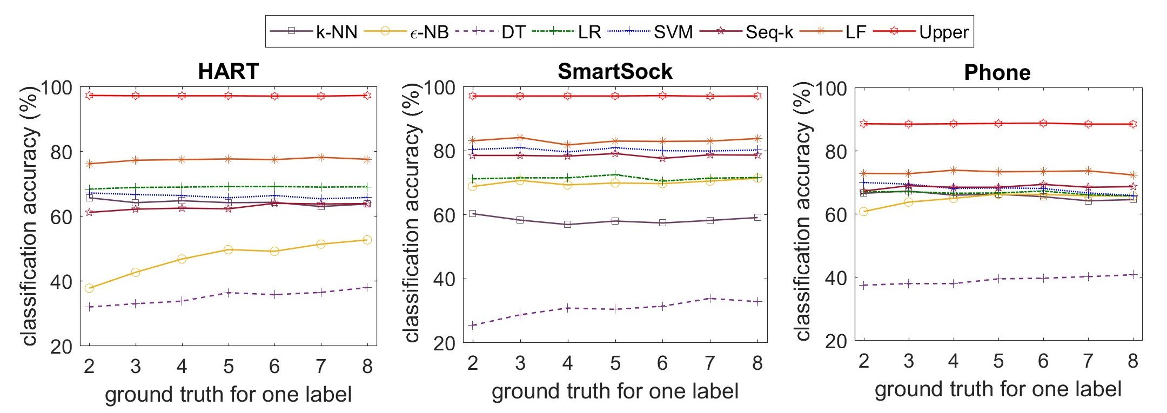
Unbalanced Seed Data – cont.
Only increase seed data size for one random label

Slide 20
Summary
Non-parametric semi-supervised learning
Intrinsic method for similarity tradeoff
Personalized activity recognition on wearable devices
F1 score > 0.83 given balanced or unbalanced seed data

Slide 21
Future Work
Machine learning with new activities
Online processing on sensor time series
Validation method in free living environment

Slide 22

The End
Thank you!
yuchao.ma@wsu.edu
http://epsl.eecs.wsu.edu/

