Slide 1
Predicting Customer Ratings of Beauty Products Based on Amazon Reviews
Yanran Qiu
MACSS
Mar 8, MACS 30100
Link to the video recording of the presentation:
https://drive.google.com/file/d/13UVpUAcbJJElUE4-2sxq4pm5DOtbvrPA/view?usp=sharing

Slide 2
Research Questions
Motivation: Online customer reviews contain rich information about how users experience products, yet much of this information is unstructured and difficult to interpret at scale.
RQ 1: Can customer review text be used to predict whether a review corresponds to a high or low product rating?
supervised machine learning task
classification task
Logistic Regression, Decision Tree, Random Forest
RQ2: What are the distinct rating dimensions that customers emphasize when reviewing beauty products?
unsupervised machine learning task
topic modeling task
BERTopic
RQ3: How are individual products rated on each dimension based on the predicted rating and topics?

Slide 3
Data
Data source:
Amazon Reviews 2023 dataset collected in 2023
Use a subset of the review dataset for the All_Beauty category, with 14405 reviews posted in 2023
ensuring computational feasibility by reducing the sample size
optimizing the classifier for contemporary review analysis

Slide 4
Data
14405 samples, 7 features (4 text, 1 numerical, 1 categorical, 1 timestamp)
Text features:
title: title of the review
text: the review text
product_title: the name of the product, 5397 unique values
parent_asin: the primary identifier for the product, 5397 unique values
Numerical feature:
rating (1-5): the corresponding rating of the product from the review
standard deviation: 1.56
mean: 3.87
median: 5

Slide 5
Data
14405 samples, 7 features (4 text, 1 numerical, 1 categorical, 1 timestamp)
Categorical feature:
verified_purchase: 2 categories
True: the purchase of the review is verified
False: the purchase of the review is not verified
Timestamp feature:
timestamp: the date and time at which the review was posted, from Jan 1, 2023 to September 9, 2023.

Slide 6
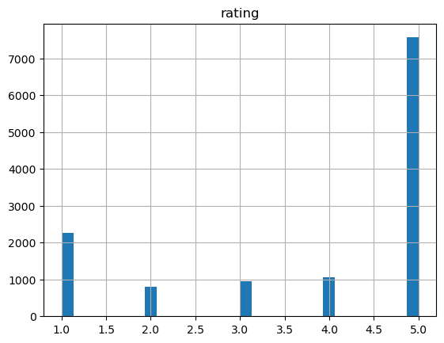
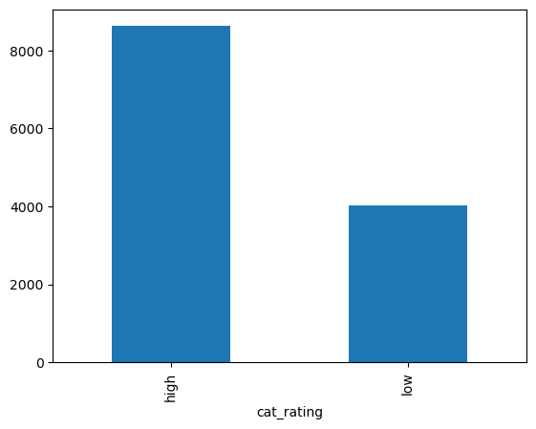
Exploratory Data Analysis
Data Cleaning and Processing:
remove missing values, duplicates, and unverified purchases
Target variable: Transform “rating” into categorical feature “cat_rating”
1-3 low (0): point out product flaws
4-5 high (1): convey positive endorsement

Slide 7
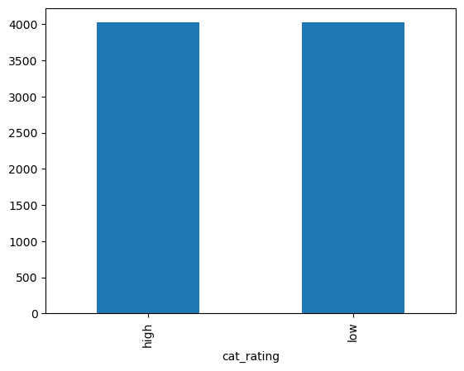
Exploratory Data Analysis
Data Cleaning and Processing:
undersampling: balance the dataset to avoid prediction bias
cleaned dataset: 8048 samples (4024 high, 4024 low)

Slide 8
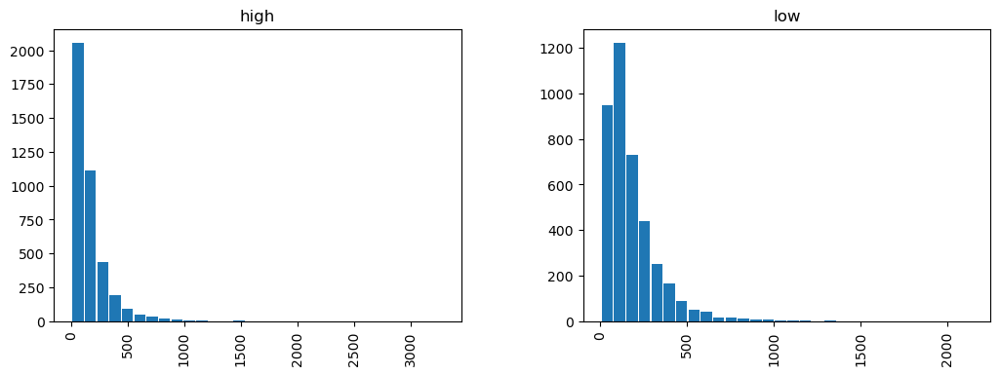
Exploratory Data Analysis
Data Cleaning and Processing:
Feature variable: merge “title” and “text” as “review”
Distribution of review length (4 - 3289 words)
mean: 172.8, standard deviation: 173.1
no clear difference between two classes

Slide 9
Exploratory Data Analysis
Data Cleaning and Processing:
Text data cleaning and representation
expand contractions into normal words, lowercase, and remove html tags, non-alphabetic characters, url, punctuations, and repetitive letters
tf-idf vectorizer: 4101 features

Slide 10
Supervised Machine Learning
Model exploration and hyperparameter tuning:
Logistic Regression, Decision Tree, Random Forest
split training and testing data: 70% training, 30% testing
GridSearchCV: hyperparameter tuning for each model

Slide 11
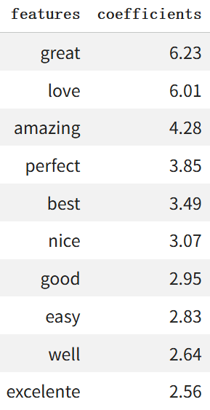
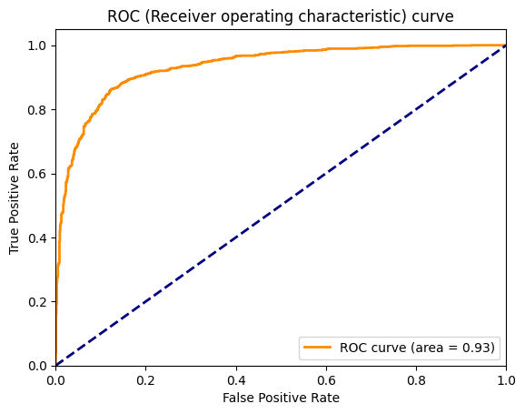
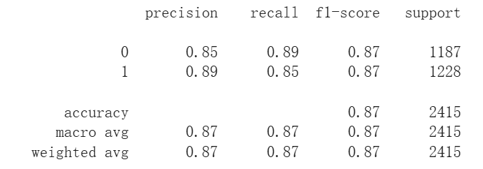
Supervised Machine Learning
Logistic Regression Model:
L2 penalty, C = 1, lbfgs solver
f1-score: 0.87
AUC = 0.93
recall (0): 0.89, recall (1): 0.85

Slide 12
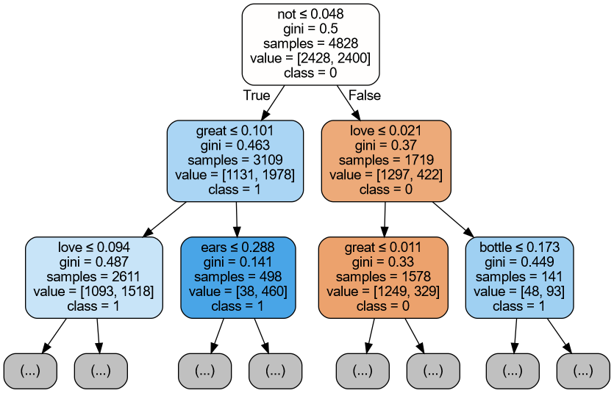
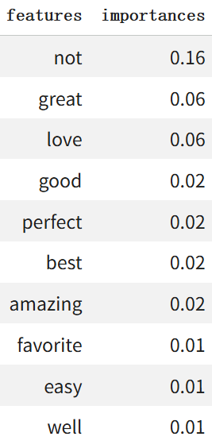
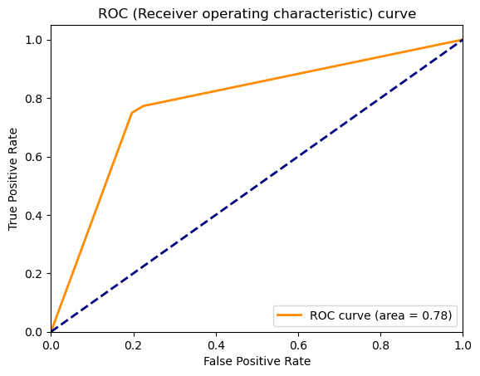
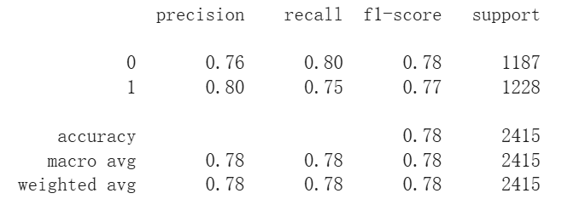
Supervised Machine Learning
Decision Tree Model:
criterion: gini, max_depth: None,
min_samples_split: 2, min_samples_leaf: 1
f1-score: 0.78
recall (0): 0.80, recall (1): 0.75
AUC = 0.78

Slide 13
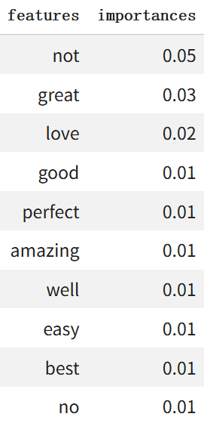
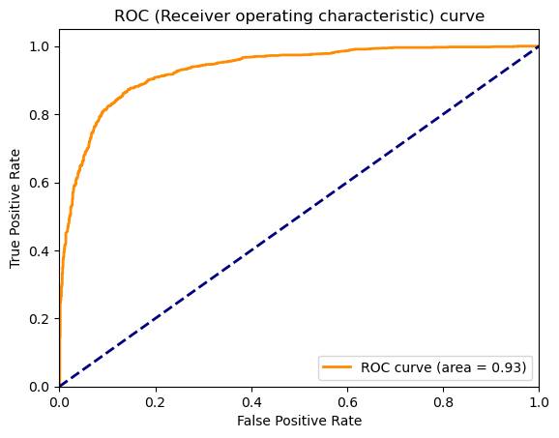
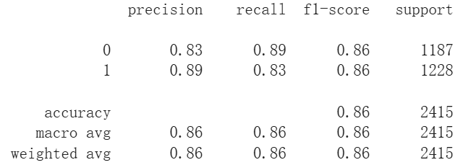
Supervised Machine Learning
Random Forest Model:
criterion: gini, n_estimators: 200, max_features: log2,
max_depth: None, min_samples_leaf: 1
f1-score: 0.86
recall (0): 0.89, recall (1): 0.83
AUC = 0.93

Slide 14
Supervised Machine Learning
 | f1-score | AUC | recall (0) | recall (1) | Top 5 features
Logistic Regression | 0.87 | 0.93 | 0.89 | 0.85 | great, love, amazing, perfect, best
Decision Tree | 0.78 | 0.78 | 0.80 | 0.75 | not, great, love, good, perfect
Random Forest | 0.86 | 0.93 | 0.89 | 0.83 | not, great, love, good, perfect

Slide 15
Supervised Machine Learning
Comparison:
Logistic regression is the best performing model. It adopted L2 regularization, which reduces overfitting and improves generalization.
The decision tree is prone to instability and overfitting, especially at greater depths.
The random forest mitigates this weakness by aggregating many trees, improving robustness and reducing variance.
Overall, the results suggest that ensemble methods and regularized linear models are both highly effective for sentiment classification, while a single tree is comparatively less reliable.

Slide 16
Supervised Machine Learning
Error analysis:
A common false positive error:
Silky smooth(1.143) but slips(-0.140) off The material(-0.328) is great(6.227) It is more like(0.073) a doo rag(0.173) or wave(0.101) cap(-0.429) It just keeps(1.468) slipping(-0.148) off while im(0.265) sleep(-0.124)
The positive feature “great” has very high importance in the classifiers.
The review expressed both positive and negative comments.
The classifiers rely on individual words, unable to learn the context.

Slide 17
Unsupervised Machine Learning
Why BERTopic:
The dataset consists of short, and informal product reviews.
Traditional models such as LDA do not work well on short documents.
BERTopic leverages contextual sentence embeddings and clustering to capture semantic similarity between reviews.

Slide 18
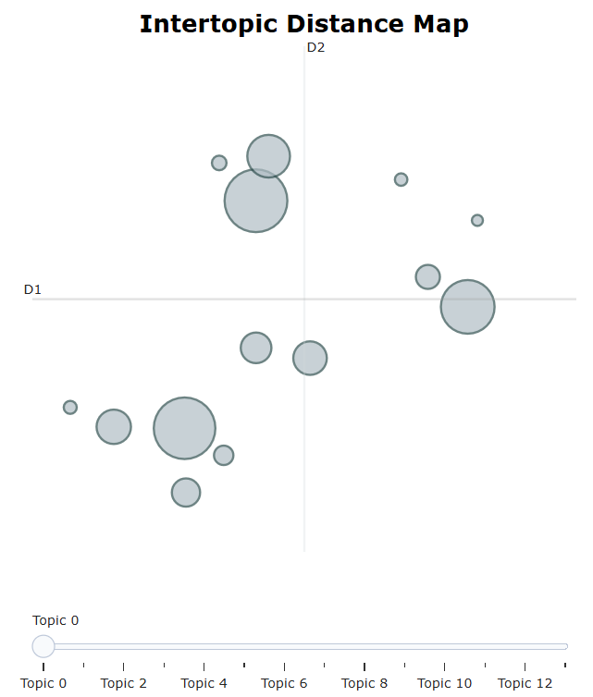
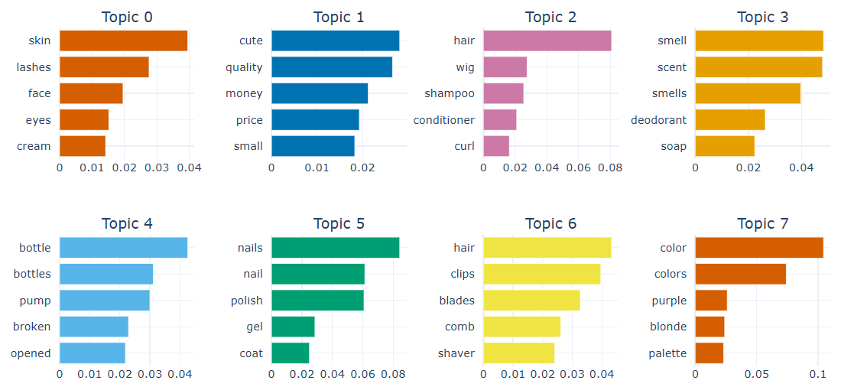
Unsupervised Machine Learning
Modeling:
hyperparameter tuning:
CountVectorizer
UMAP: n_neighbors=15
HDBSCAN: min_cluster_size=30
nr_topics=15
result: 14 topics
evaluation: topic coherence: 0.47

Slide 19
Unsupervised Machine Learning
Topic ID | Topic Name | Top Keywords | Number of Reviews
0 | product_skin_eye_face | skin, lashes, face, eyes, cream | 1164
1 | dimension_size_quality_value | cute, quality, money, price, small | 1120
2 | product_hair_care_wigs | hair, wig, shampoo, conditioner, curl | 851
3 | dimension_fragrance_scent | smell, scent, smells, deodorant, soap | 538
4 | dimension_packaging_bottle_pump | bottle, bottles, pump, broken, opened | 349
5 | product_nail_products | nail, nails, polish, gel, coat | 332
6 | product_hair_tools_clips_shavers | hair, clips, blades, comb, shaver | 277
7 | dimension_color_shade | color, colors, purple, blonde, palette | 235

Slide 20
Unsupervised Machine Learning
Topic ID | Topic Name | Top Keywords | Number of Reviews
8 | product_brushes_bristles | brush, brushes, bristles, dog, hair | 170
9 | product_glue_tape | stick, sticky, glue, tape, adhesive | 111
10 | product_dental_tools | teeth, dentist, plaque, dental, cleaning | 63
11 | dimension_durability | broke, broken, apart, plastic, fell | 50
12 | product_waxing_hair_removal | wax, waxing, hair, roll, legs | 46
13 | product_dryer_diffuser_fit | diffuser, dryer, hair dryer, orchid, fit | 36
-1 | unassigned | smell, hair, scent, color, quality | 1707

Slide 21
How are individual products rated on each dimension
Product | Grucioso Gel Nail Polish Set | Sekaler Heated Eyelash Curler
size/quality/value | 2.59 | 2.67
scent | / | /
packaging | 4.39 | /
color | 4.27 | /
durability | / | 1.11
predicted rating | 3.76 | 3.30
rating: 5pt

Slide 22
Conclusion
RQ1: Can customer review text be used to predict whether a review corresponds to a high or low product rating?
Customer reviews can predict the high or low rating of a product with logistic regression classifier, decision tree classifier, and random forest classifier. The logistic regression classifier has the strongest prediction ability.
RQ2: What are the distinct rating dimensions that customers emphasize when reviewing beauty products?
5 out of 14 topics identified by BERTopic are about dimensions of products: 1) size, quality and value, 2) scent, 3) packaging, 4) color, 5) durability.
RQ3: How are individual products rated on each dimension based on the predicted rating and topics?
By applying machine learning methods to review text, we can measure product performance across key aspects.

