Slide 1
Open the book ↗
SESSION 1 · 75 MINUTES
Choosing a Programming Language
What software is written in, and how the choice is made
How Modern Software Is Built (in 2026)

Slide 2
SESSION 1 · 1.1 WHAT A PROGRAMMING LANGUAGE IS
Book ↗
From human ideas to machine instructions
• Processors understand only machine code: numbers
• A programming language is a human-readable notation with strict grammar (syntax)
• What the programmer writes is source code
• Something must translate source code into machine code

Slide 3
SESSION 1 · 1.1 WHAT A PROGRAMMING LANGUAGE IS
Book ↗
Two ways to translate
• Compiler: translate the whole program ahead of time into an executable. Fast; tied to one platform. C, C++, Rust, Go, Swift
• Interpreter: carry out the source code on the spot. Portable; slower. Python, JavaScript, Ruby
• Analogy: a published translation versus a live interpreter in the room

Slide 4
SESSION 1 · 1.1 WHAT A PROGRAMMING LANGUAGE IS
Book ↗
Language, library, framework
• Language: the notation itself (Python)
• Library: ready-made code for one job (send email, draw a chart)
• Framework: the skeleton of a whole kind of application (Flask, React)
• Hundreds of languages exist because each makes one kind of work easier at the cost of another
In the age of AI: syntax is the part AI has fully absorbed. The trade-offs below have not gone away.

Slide 5
SESSION 1 · 1.2 FIT FOR PURPOSE
Book ↗
Was the language built for the job?
• General-purpose languages can write almost anything: Python, JavaScript, Java, C#, C++, Go, Rust
• Domain-specific languages do one thing superbly: SQL (database questions), HTML (structure), CSS (style)
• Nobody writes a website in SQL: it cannot draw a button, react to a click, or send an email

Slide 6
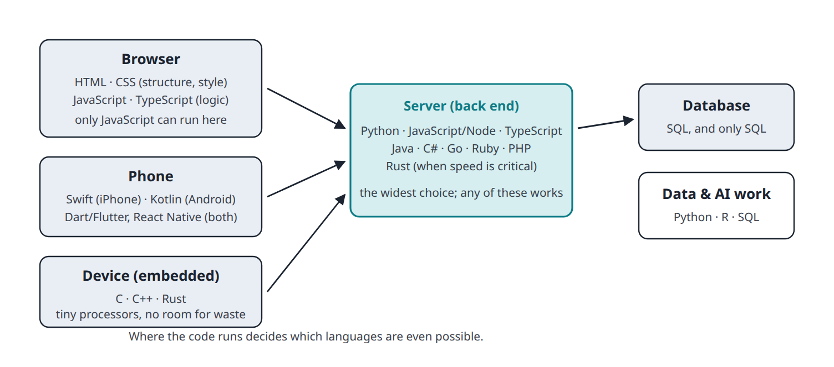
SESSION 1 · 1.2 FIT FOR PURPOSE
Book ↗
Where each language lives
• Browser: only JavaScript. Database: only SQL
• The server admits almost anything: that is the real choice

Slide 7
SESSION 1 · 1.2 FIT FOR PURPOSE
Book ↗
A product is never one language
• Typical web product: HTML + CSS + JavaScript in the browser, Python (or JS) on the server, SQL in the database
• Add Swift and Kotlin for native phone apps
• "Choosing a language" really means choosing the back-end language and the mobile strategy
In the age of AI: fit for purpose is unchanged. Using several languages in one product is cheaper than it was.

Slide 8
SESSION 1 · 1.3 POPULARITY, MATURITY, AND COMMUNITY
Book ↗
A language is a community, not just a notation
• Hiring: millions of developers versus a few thousand
• Answers: every problem in a popular language has been solved publicly
• Longevity: COBOL from the 1970s still runs banks; who maintains it now?
• Security: many eyes find and fix flaws quickly
• Tooling: editors, testing, hosting support the popular languages first

Slide 9
SESSION 1 · 1.3 POPULARITY, MATURITY, AND COMMUNITY
Book ↗
The mainstream, and the caution about the new
• Mainstream today: Python, JavaScript/TypeScript, Java, C#, C/C++, Go, SQL; Rust, Swift, Kotlin in their niches
• A brand-new language may be better designed and still be the wrong choice: few libraries, breaking changes, unproven survival
• Most successful languages needed ten years to become safe bets
In the age of AI: popularity matters MORE. AI learns from public code, so mainstream, stable languages get the best help.

Slide 10
SESSION 1 · 1.4 THE ECOSYSTEM: PACKAGES AND LIBRARIES
Book ↗
Nobody writes it from scratch
• Email, spreadsheets, payments, images, charts: someone already wrote it and published it free
• The ecosystem = the libraries plus the tools to find and install them
• Package manager: pip (Python), npm (JavaScript). "We added a dependency"
• Almost all of it is open source, which is also a supply chain to watch

Slide 11
SESSION 1 · 1.4 THE ECOSYSTEM: PACKAGES AND LIBRARIES
Book ↗
The ecosystem steers the choice
If the product is mostly about… | The ecosystem pulls toward
AI, machine learning, data | Python
Rich interactive web front end | JavaScript / TypeScript
Conventional web back end | Python, JavaScript, Ruby, Java, C#, Go
Enterprise integration | Java, C#
Games | C# (Unity), C++ (Unreal)
Native phone app | Swift / Kotlin
In the age of AI: ecosystems matter as much as ever. Watch for hallucinated packages that do not exist.

Slide 12
SESSION 1 · 1.5 SPEED AND MEMORY
Book ↗
The fastest language is usually the wrong question
• Compiled languages can be 10 to 100 times faster than Python at raw computation
• But most business apps wait (database, network, disk); they do not compute
• Developer time costs far more than machine time
• Python's AI libraries are C inside: "Python is slow" and "Python runs AI" are both true

Slide 13
SESSION 1 · 1.5 SPEED AND MEMORY
Book ↗
When performance genuinely decides
Situation | Why | Typical choice
Embedded devices, wearables | Kilobytes of memory, a battery | C, C++, Rust
Games, video | 16 ms per frame | C++, C#, Rust
Trading, real-time control | Microseconds are money or safety | C++, Rust
Very large services | 10× efficiency = thousands of servers | Go, Rust, Java
Mobile apps | Battery and memory limits | Swift, Kotlin
Build in the productive language, measure, then rewrite only the proven hot spot. In the age of AI that last step is cheap.

Slide 14
SESSION 1 · 1.6 PLATFORMS AND PORTABILITY
Book ↗
A platform is processor + operating system
• Processor families: x86 (Intel, AMD) and ARM (phones, Apple silicon, new servers)
• Operating systems: Windows, macOS, Linux, iOS, Android
• Machine code for one platform is gibberish to another
• Every extra platform is another version to build, test, and support

Slide 15
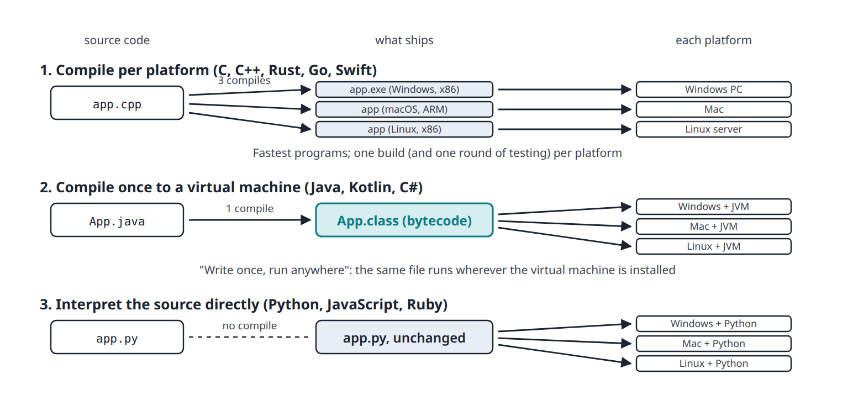
SESSION 1 · 1.6 PLATFORMS AND PORTABILITY
Book ↗
Three ways to reach three platforms

Slide 16
SESSION 1 · 1.6 PLATFORMS AND PORTABILITY
Book ↗
Recompile, virtual machine, or interpret
• Recompile per platform (C, C++, Rust): fastest; one build per platform. Apple's 2020 move to ARM forced every Mac app to be rebuilt
• Compile once to bytecode (Java, Kotlin, C#): "write once, run anywhere" on a virtual machine
• Interpret the source (Python, JavaScript): ship the file itself. JavaScript's interpreter is in every browser, so the web is the most portable platform ever

Slide 17
SESSION 1 · 1.6 PLATFORMS AND PORTABILITY
Book ↗
Phones are the special case
• Apple prefers Swift; Google prefers Kotlin. Both compiled for the phone
• The best app on both platforms means writing it twice
• Cross-platform frameworks (React Native, Flutter) produce both from one codebase, with some loss of polish
• Electron does the same for desktop (Slack, VS Code, Discord)
In the age of AI: porting code between platforms is cheaper. Testing on every real device is not.

Slide 18
SESSION 1 · 1.7 MAKING THE DECISION IN THE AGE OF AI
Book ↗
How each factor shifts
Factor | Before AI | With AI assistance
Fit for purpose | Decisive | Unchanged
Popularity and maturity | High | Higher: AI quality tracks public code
Ecosystem | High | Unchanged to higher; verify packages
Speed and memory | Decisive in a few domains | Same domains; elsewhere lower
Platforms | High (duplicated work) | Lower for writing; same for testing
Your own familiarity | Often decisive | Lower, but you still review the code

Slide 19
SESSION 1 · 1.7 MAKING THE DECISION IN THE AGE OF AI
Book ↗
Three conclusions
• Choose mainstream. Python, JavaScript/TypeScript, SQL; Java or C# when the enterprise requires; Swift and Kotlin for native mobile
• Optimise for readability. When AI writes the code, the human's job is reading it
• The language is rarely the risk. Products fail on requirements, data models, and security, not Python versus Go
This module uses HTML, CSS, JavaScript in the browser; Python on the server; SQL in the database.

