Slide 1
Open the book ↗
SESSION 2 · 75 MINUTES
From a File on Your Laptop to a Page on the Internet
Browsers, the three languages of a web page, addresses, and the request–response conversation
How Modern Software Is Built (in 2026)

Slide 2
SESSION 2 · 2.1 WHY ARCHITECTURE IS A BUSINESS TOPIC
Book ↗
Architecture is the set of decisions that are expensive to change
• What the major parts are, what each does, how they talk
• Cost: a few dollars a month or tens of thousands
• Risk: what happens when a component fails; how a breach could occur
• Speed: how fast features ship without breaking what works
The person who cannot follow the conversation does not get a vote.

Slide 3
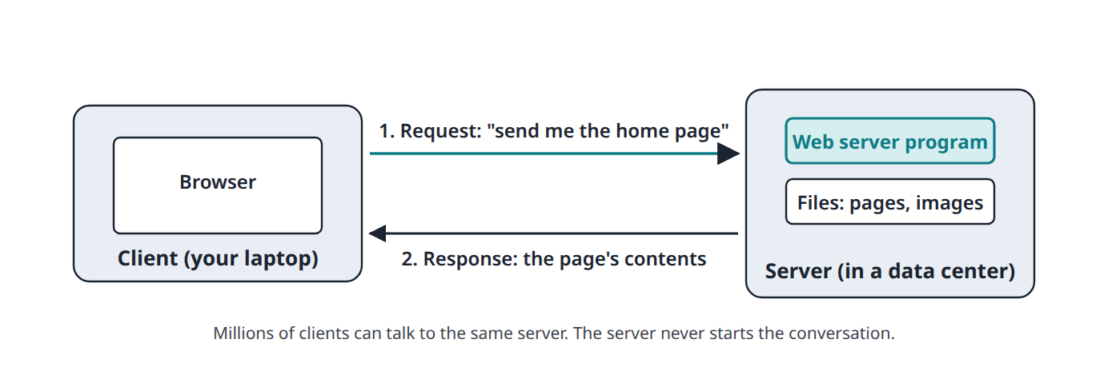
SESSION 2 · 2.2 CLIENTS, SERVERS, AND PROGRAMS
Book ↗
One computer asks, another answers
• Client asks; server waits and answers. The client always speaks first
• A server is an ordinary computer in a data center, running 24 hours a day

Slide 4
SESSION 2 · 2.2 CLIENTS, SERVERS, AND PROGRAMS
Book ↗
Two things people get wrong about servers
• A server is an ordinary computer: processor, memory, disk. Usually no screen
• "Server" also names a program: a web server program listens for requests and hands back pages
• The client for a website is a browser: Chrome, Safari, Firefox, Edge
• Analogy: the restaurant. You order from the menu; the kitchen cooks; you never enter the kitchen

Slide 5
SESSION 2 · 2.3 A WEB PAGE IS THREE LANGUAGES
Book ↗
A web page is a plain text file
• HTML: what is on the page (headings, paragraphs, images, links), marked with tags
• CSS: what it looks like (colors, fonts, layout, phone versus desktop)
• JavaScript: what it does (react to clicks, validate forms, load more posts)
• JavaScript is unrelated to Java despite the name

Slide 6
SESSION 2 · 2.3 A WEB PAGE IS THREE LANGUAGES
Book ↗
HTML by example
<h1>Rosenthal's Bakery</h1>
<p>Fresh bread every morning since 1998.</p>
<img src="storefront.jpg" alt="Our shop">
<a href="menu.html">See the menu</a>
• Read it aloud and it explains itself: heading, paragraph, image, link

Slide 7
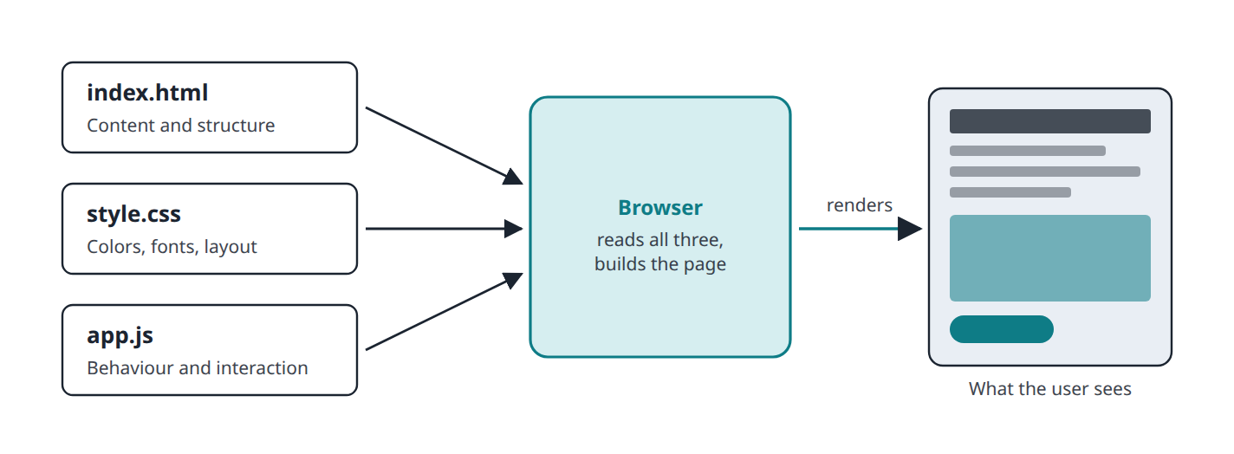
SESSION 2 · 2.3 A WEB PAGE IS THREE LANGUAGES
Book ↗
Three files, one page
• The browser combines all three and renders the result

Slide 8
SESSION 2 · 2.4 THE STATIC WEBSITE ON YOUR OWN COMPUTER
Book ↗
The zero-infrastructure starting point
• A static website is fixed files sent to every visitor exactly as stored
• Double-click index.html: the browser reads it straight off your disk. Address starts with file:///
• No server, no internet, no company involved
• Limitation: only you can see it. Sharing needs an always-on server with an address

Slide 9
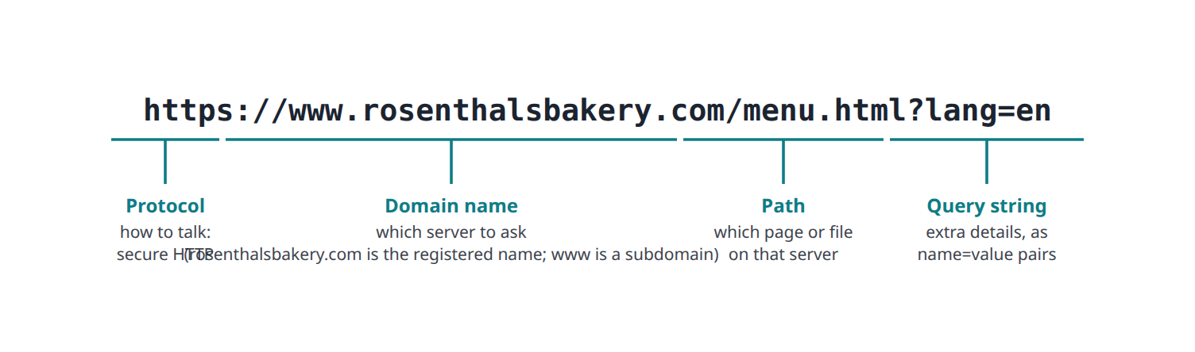
SESSION 2 · 2.5 HOW THE INTERNET DELIVERS A PAGE
Book ↗
Anatomy of a URL
• Protocol (how to talk), domain (which server), path (which page), query string (extra details)

Slide 10
SESSION 2 · 2.5 HOW THE INTERNET DELIVERS A PAGE
Book ↗
Finding the server: DNS
• Every machine on the internet has a numeric IP address, such as 142.250.72.14
• DNS is the distributed phone book: domain name in, IP address out
• A business rents its domain from a registrar; pointing it at a host means editing a DNS record
• "DNS changes take up to 48 hours": thousands of copies of the phone book refresh on a schedule

Slide 11
SESSION 2 · 2.5 HOW THE INTERNET DELIVERS A PAGE
Book ↗
The conversation: HTTP
GET /menu.html HTTP/1.1
Host: www.rosenthalsbakery.com
User-Agent: Chrome/128.0
HTTP/1.1 200 OK
Content-Type: text/html
<!DOCTYPE html> ...
• A request names a method and a path plus headers; a response carries a status code and the content
• 200 OK, 301 moved, 404 not found, 500 server error, 503 overloaded

Slide 12
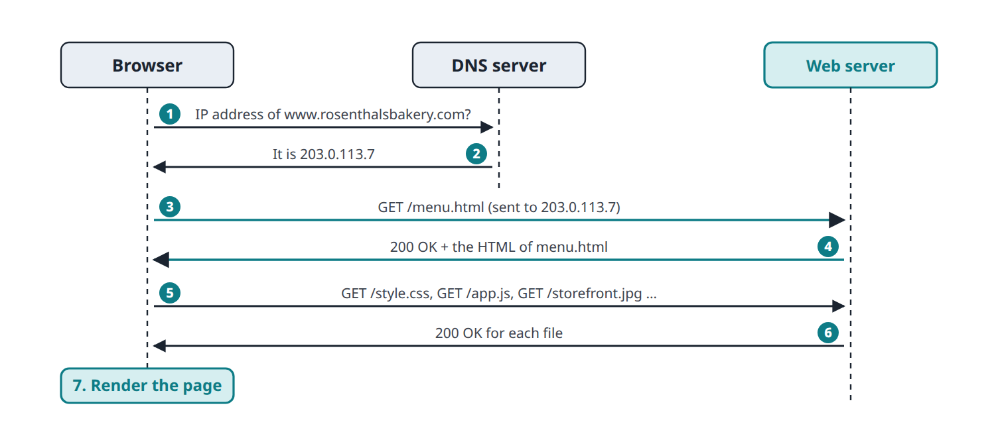
SESSION 2 · 2.5 HOW THE INTERNET DELIVERS A PAGE
Book ↗
What happens after you press Enter
• One page usually means 50 to 150 requests: HTML first, then CSS, JavaScript, images

Slide 13
SESSION 2 · 2.5 HOW THE INTERNET DELIVERS A PAGE
Book ↗
HTTPS and hosting
• Plain HTTP is readable by anyone on the same Wi-Fi. HTTPS wraps it in encryption; the padlock
• The server proves its identity with a free certificate. No business reason to skip HTTPS
• Hosting: rent space on someone's always-on server. Static hosting is free or nearly so
• Serving static files is the easiest job a computer can do: fast, hard to hack, hard to overload

Slide 14
SESSION 2 · 2.6 FRONT END, BACK END, AND THE LIMITS OF STATIC
Book ↗
What a static site cannot do
• Front end: runs on the user's device. Back end: runs on the server, out of sight
• A static site is front end only, so it cannot: remember anything, personalise, keep a secret, or do work (email, charge a card)
• A dynamic website runs a program per request and can do all four

Slide 15
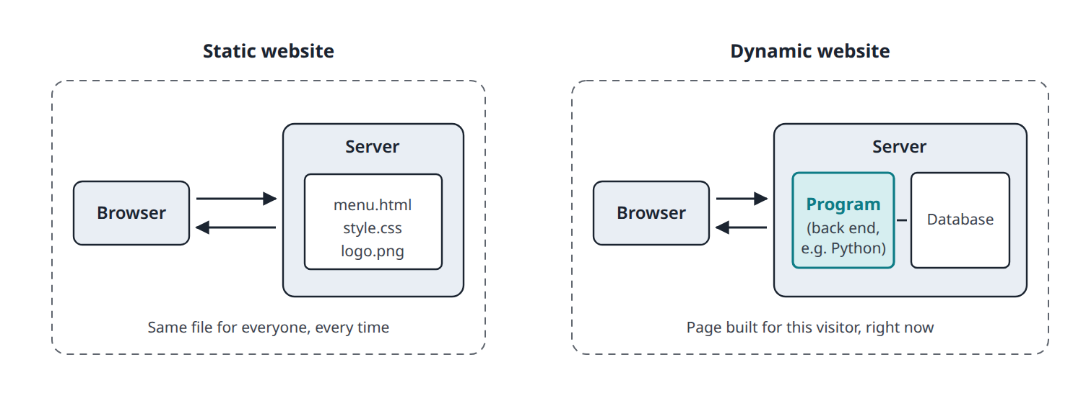
SESSION 2 · 2.6 FRONT END, BACK END, AND THE LIMITS OF STATIC
Book ↗
Static versus dynamic
• Most real products mix the two: static marketing pages, dynamic product behind the login

Slide 16
SESSION 2 · 2.7 WHERE PYTHON FITS
Book ↗
Python runs on the server, not in the browser
Language | Where it runs | Job
HTML, CSS | Browser | Content and appearance
JavaScript | Browser (and servers via Node.js) | Interactivity; also back ends
Python | Servers and your own computer | Back-end logic, data, AI, scripts
SQL | Database server | Questions about stored data
Swift, Kotlin | Phones | Native apps
Your Python skills are directly the skills of writing back ends. "What's your stack?" means "what's your architecture?"

