Slide 1
Open the book ↗
SESSION 3 · 75 MINUTES
Dynamic Websites, APIs, and Databases
Inside the back end: server code, APIs and JSON, the relational model, and SQL by example
How Modern Software Is Built (in 2026)

Slide 2
SESSION 3 · 3.1 INSIDE THE BACK END: A PYTHON WEB SERVER
Book ↗
A complete dynamic web server
from flask import Flask
from datetime import datetime
app = Flask(__name__)
@app.route("/hours")
def hours():
if 7 <= datetime.now().hour < 18:
return "<p>We are <b>open</b> right now!</p>"
return "<p>We are closed. Back at 7 a.m.</p>"
app.run(port=5000)
• Flask is a framework: it handles the routine parts of being a server
• Each route connects a path to a function; the function's return value is the response

Slide 3
SESSION 3 · 3.1 INSIDE THE BACK END: A PYTHON WEB SERVER
Book ↗
Localhost, ports, and templates
• localhost means "this computer": browser and server on the same laptop
• A port is a numbered door: 443 for HTTPS, 5000 or 3000 for testing
• Two visitors a minute apart at 5:59 and 6:00 see different pages: that is "dynamic"
• Real back ends fill in templates (HTML with blanks) rather than gluing strings

Slide 4
SESSION 3 · 3.2 APIS AND JSON
Book ↗
The menu is the API
• An API is the defined set of requests a program accepts and the answers it gives
• Callers are often programs, not people: page JavaScript, a mobile app, a partner, an AI
• Each address in an API is an endpoint; answers come back as data, not designed pages

Slide 5
SESSION 3 · 3.2 APIS AND JSON
Book ↗
JSON: the common tongue of the web
{
"products": [
{"id": 1, "name": "Sourdough loaf", "price": 7.5, "in_stock": true},
{"id": 2, "name": "Rye bread", "price": 6.0, "in_stock": false}
]
}
• Curly braces: named values. Square brackets: lists. Almost exactly a Python dictionary and list

Slide 6
SESSION 3 · 3.2 APIS AND JSON
Book ↗
Verbs: nouns in the URL, verbs in the method
Method | Meaning | Bakery example | CRUD
GET | Read | GET /api/products | Read
POST | Create | POST /api/orders | Create
PUT / PATCH | Update | PATCH /api/orders/88 | Update
DELETE | Remove | DELETE /api/orders/88 | Delete
This style is REST. Most business software is CRUD screens over a database.

Slide 7
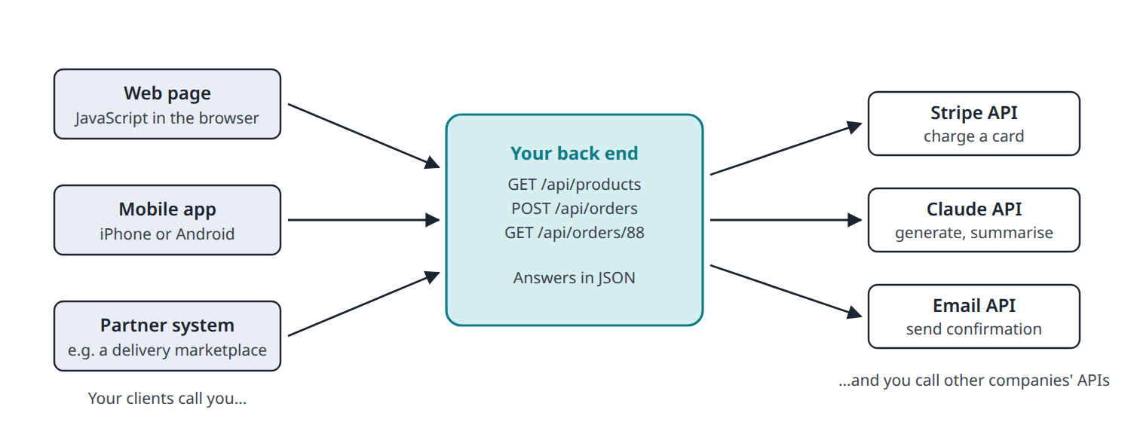
SESSION 3 · 3.2 APIS AND JSON
Book ↗
APIs in both directions
• You offer an API to your front ends and partners; you consume third-party APIs (Stripe, Claude, email) instead of building
• An API key identifies your account to a third party. It lives on your server, never in front-end code

Slide 8
SESSION 3 · 3.3 WHY EVERY PRODUCT NEEDS A DATABASE
Book ↗
Why not just save to a file?
• Many writers at once: two customers buying the last challah must not both succeed
• Speed at scale: an index finds one order in ten million in milliseconds
• Reliability: a transaction is all-or-nothing, even if the power fails halfway
• Questions: "who ordered rye three times last quarter?" is one line
• The database is a separate program (PostgreSQL, MySQL, SQLite) your back end talks to

Slide 9
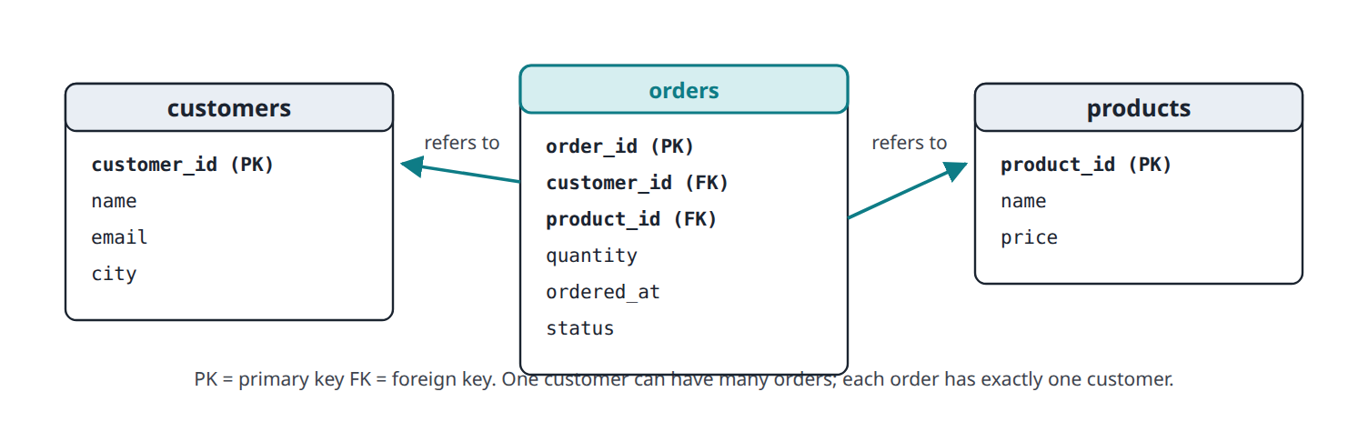
SESSION 3 · 3.3 WHY EVERY PRODUCT NEEDS A DATABASE
Book ↗
The relational model
• Tables of rows and columns; each table holds one kind of thing
• Primary key: the unique ID of a row. Foreign key: a column pointing at another table's row
• Change Dana's email once; every order she placed reflects it
The table design (the schema) is really a design of the business.

Slide 10
SESSION 3 · 3.4 SQL BY EXAMPLE
Book ↗
Reading: SELECT
SELECT name, email FROM customers WHERE city = 'Boston';
SELECT status, COUNT(*) AS how_many
FROM orders
GROUP BY status;
• SELECT picks columns, FROM picks the table, WHERE filters rows
• COUNT, SUM, AVG, MIN, MAX are aggregate functions: every dashboard is a stack of these

Slide 11
SESSION 3 · 3.4 SQL BY EXAMPLE
Book ↗
Combining tables: JOIN
SELECT customers.name, products.name, orders.quantity
FROM orders
JOIN customers ON orders.customer_id = customers.customer_id
JOIN products ON orders.product_id = products.product_id
WHERE orders.status = 'placed';
• A JOIN stitches rows together using the keys, so "Dana Levi, Rye bread, 1" comes out readable

Slide 12
SESSION 3 · 3.4 SQL BY EXAMPLE
Book ↗
Writing: INSERT, UPDATE, DELETE
INSERT INTO orders (customer_id, product_id, quantity, status)
VALUES (3, 1, 2, 'placed');
UPDATE orders SET status = 'ready' WHERE order_id = 88;
DELETE FROM orders WHERE order_id = 89;
• DELETE FROM orders; with no WHERE deletes every order in the company
• CREATE TABLE defines columns, data types, keys, and constraints the database enforces

Slide 13
SESSION 3 · 3.4 SQL BY EXAMPLE
Book ↗
Which database?
Product | Type | Typical use
SQLite | Relational, single file | Prototypes, phone apps; built into Python
PostgreSQL | Relational server | Default for new web products
MySQL | Relational server | Older web products, WordPress
SQL Server, Oracle | Relational server | Large enterprises, finance
MongoDB | Document (NoSQL) | Flexible data shapes
Redis | Key-value, in memory | Caching, sessions
You will not write SQL in this course. You will read it and say what it does.

Slide 14
SESSION 3 · 3.5 BEYOND TABLES: NOSQL AND ORMS
Book ↗
NoSQL and ORMs
• NoSQL relaxes the rules: a document database (MongoDB) stores JSON-like records with any fields
• Price of flexibility: fewer guarantees, clumsier joins. Rule of thumb: start relational
• An ORM lets Python treat rows as objects and writes the SQL behind the scenes
• Claude Code will almost certainly use an ORM; the concepts underneath are unchanged

Slide 15
SESSION 3 · 3.6 THE THREE-TIER ARCHITECTURE
Book ↗
Presentation, application, data
• Presentation tier: the front end in the browser or app
• Application tier: the back-end program; where business logic lives (prices, permissions, workflows)
• Data tier: the database

Slide 16
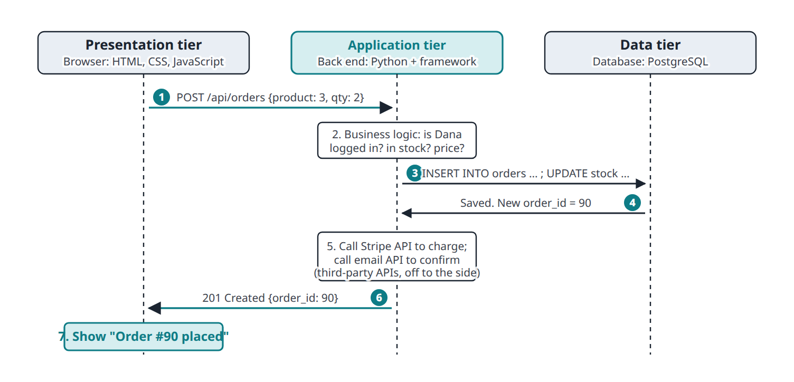
SESSION 3 · 3.6 THE THREE-TIER ARCHITECTURE
Book ↗
One order through three tiers

Slide 17
SESSION 3 · 3.6 THE THREE-TIER ARCHITECTURE
Book ↗
Three consequences
• The browser never touches the database directly; the back end checks identity and applies rules
• Each tier can be changed independently: redesign the front end without touching the data
• Each tier can live on different hardware: today one laptop, tomorrow ten servers (Session 4)
Anything in the browser can be altered by the user. Rules and secrets live on the server.

