Slide 1
Open the book ↗
SESSION 4 · 75 MINUTES
Hosting, Scaling, and the Cloud
From one rented server to the distributed architecture behind products serving millions
How Modern Software Is Built (in 2026)

Slide 2
SESSION 4 · 4.1 FROM LOCALHOST TO PRODUCTION
Book ↗
Deploying, and the three environments
Environment | Who uses it | Purpose
Development | Each programmer, own machine | Write and try code; break things
Staging | The team, testers | Private replica of production to check a release
Production | Real customers | The actual business; real, protected data
• Deployment: putting a version where real users can reach it
• "It works on my machine" is why staging exists

Slide 3
SESSION 4 · 4.1 FROM LOCALHOST TO PRODUCTION
Book ↗
Uptime and latency
Uptime | Downtime per year | Typical of
99% | About 3.7 days | Hobby site on one cheap server
99.9% | About 8.8 hours | Small business with sensible hosting
99.99% | About 53 minutes | Payments, banking, large SaaS
99.999% | About 5 minutes | Telecom; very expensive
Each extra nine costs dramatically more. Latency: users notice anything over ~100 ms.

Slide 4
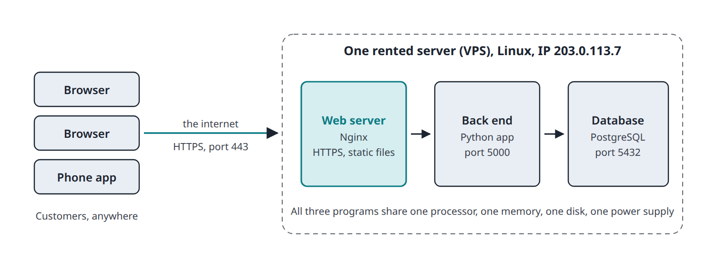
SESSION 4 · 4.2 STEP 1: EVERYTHING ON ONE SERVER
Book ↗
Rent one computer and install everything
• A VPS for 5 to 50 dollars a month, running Linux: web server (Nginx) + Python app + PostgreSQL
• Enough for tens of thousands of visits a day

Slide 5
SESSION 4 · 4.2 STEP 1: EVERYTHING ON ONE SERVER
Book ↗
Why it eventually breaks
• Single point of failure: disk dies, site and data vanish together
• Resource contention: a heavy report query slows the website for everyone
• Hard ceiling: the only upgrade is a bigger machine
• Security blast radius: break into the web server, you are sitting on the customer data
Take each next step when the problem is real, not before.

Slide 6
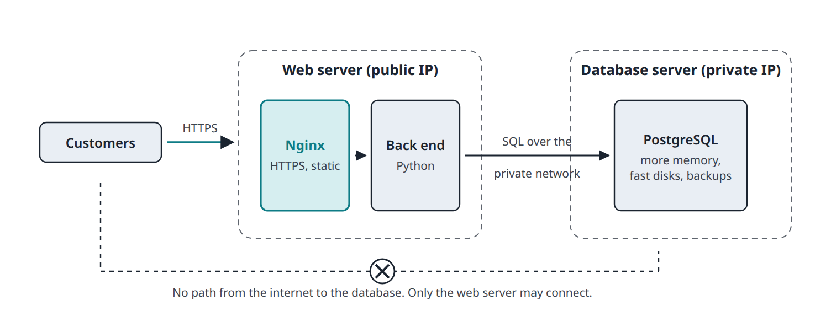
SESSION 4 · 4.3 STEP 2: THE DATABASE GETS ITS OWN MACHINE
Book ↗
Separate the data tier
• The database server sits on a private network; a firewall lets only the web server connect
• No path from the internet to the data

Slide 7
SESSION 4 · 4.3 STEP 2: THE DATABASE GETS ITS OWN MACHINE
Book ↗
Why the second bill is worth it
• Right-sized hardware: databases want memory and fast disks; web servers want cores and bandwidth
• Security: a second wall for an attacker; nobody stumbles across the records from outside
• Independent maintenance: rebuild the web server without touching a byte of data
• It unlocks Step 3: many web servers sharing one database
• In practice: a managed database (RDS, Supabase, Neon) with backups, patches, and failover done for you

Slide 8
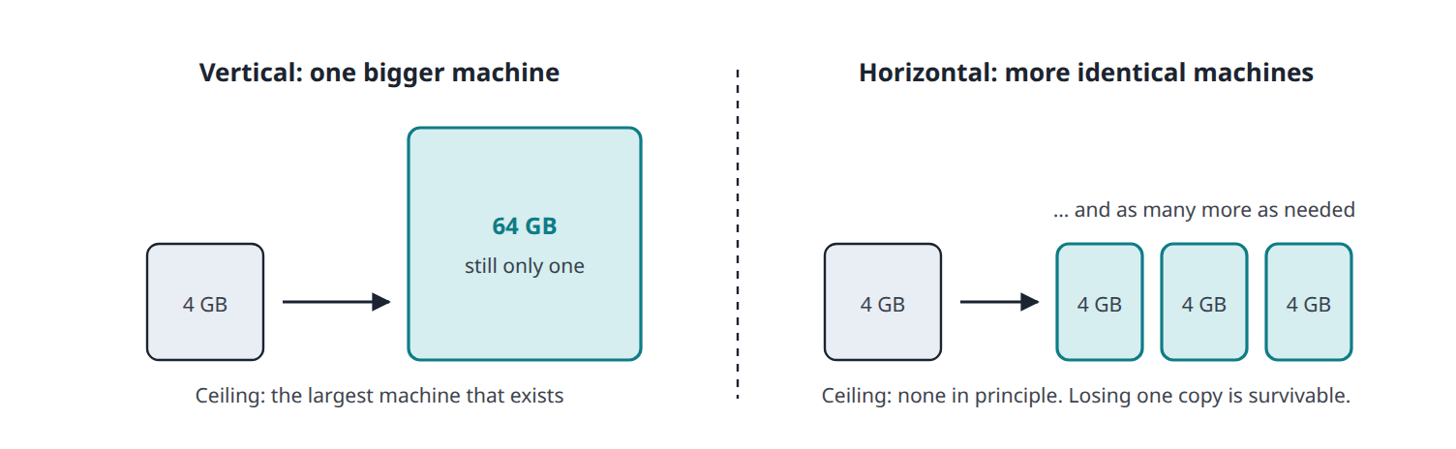
SESSION 4 · 4.4 STEP 3: MANY WEB SERVERS BEHIND A LOAD BALANCER
Book ↗
Two ways to add capacity
• Vertical scaling: a bigger machine. Simple; a ceiling; still one of it
• Horizontal scaling: more identical machines. No ceiling in principle; losing one is survivable

Slide 9
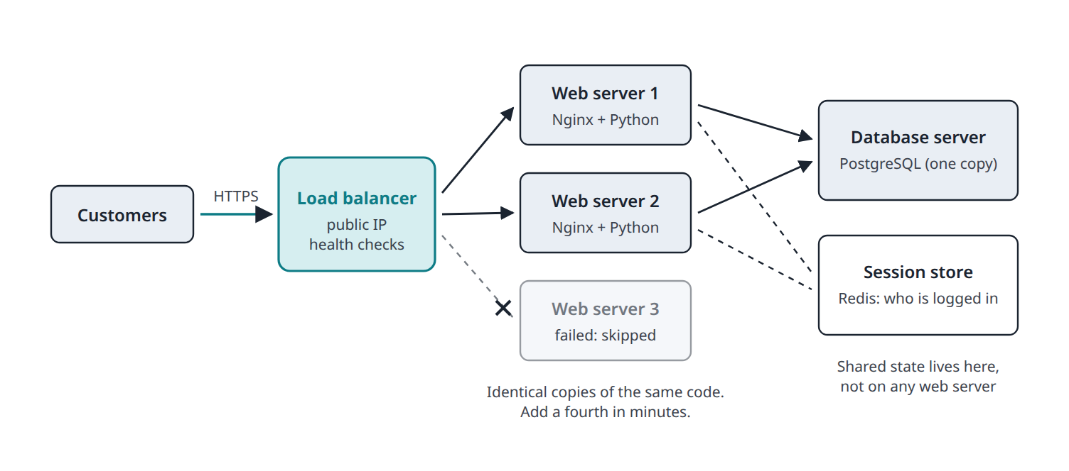
SESSION 4 · 4.4 STEP 3: MANY WEB SERVERS BEHIND A LOAD BALANCER
Book ↗
Horizontal scaling with a load balancer
• The load balancer owns the public address and spreads requests; health checks skip a dead server

Slide 10
SESSION 4 · 4.4 STEP 3: MANY WEB SERVERS BEHIND A LOAD BALANCER
Book ↗
The catch: servers must be stateless
• Dana logs in on server 1; her next click lands on server 2, which has never heard of her
• Stateless servers remember nothing between requests; shared facts live in the database or Redis
• Interchangeable servers can be added at 9 a.m. and removed after lunch: costs become elastic
• Duplicates at every layer = high availability: how three and four nines are bought
Ask before launch: "Can we run two copies of this?"

Slide 11
SESSION 4 · 4.5 STEP 4: CACHES, CDNS, AND STORAGE
Book ↗
Four more components
• Cache: a fast temporary copy of something expensive (a product list in Redis for 60 seconds). Hard problem: staleness
• CDN: copies of images, CSS, JS in hundreds of cities; Singapore gets the image from Singapore
• Object storage (S3): unlimited files by URL; uploads never live on a web server's disk
• Read replica: a live copy of the database that answers reads and stands by as a spare

Slide 12
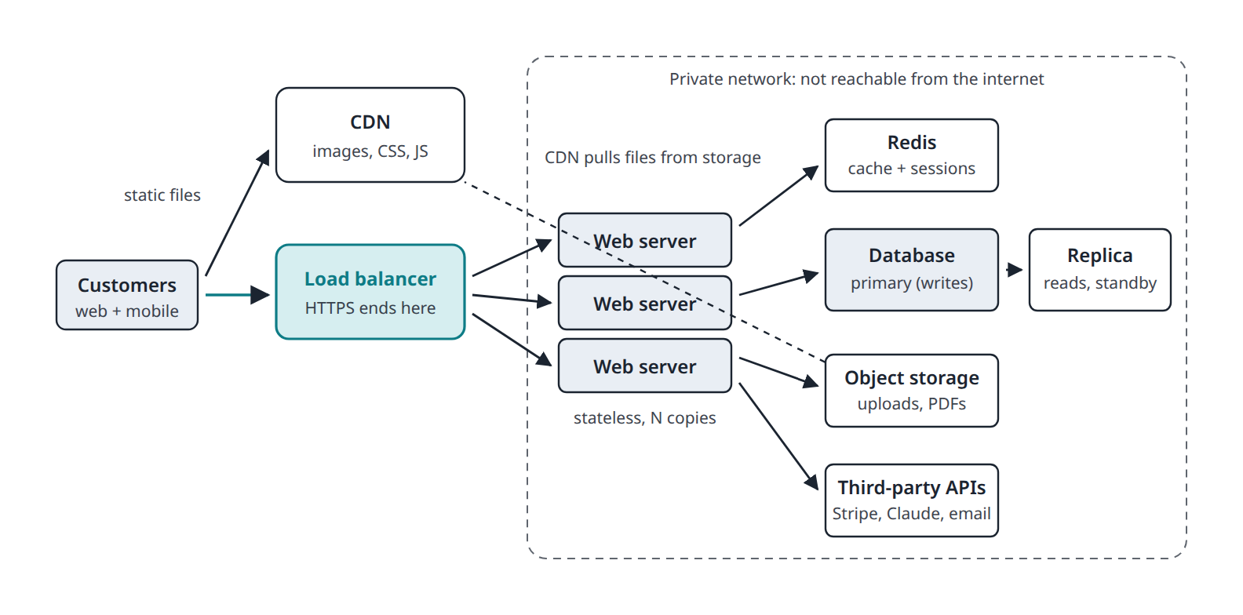
SESSION 4 · 4.5 STEP 4: CACHES, CDNS, AND STORAGE
Book ↗
The standard architecture of a serious web product
• Still three tiers: each one now duplicated, cached, or moved closer to the user

Slide 13
SESSION 4 · 4.6 THE CLOUD MENU
Book ↗
How much of the work do you want to do yourself?
Layer | You get | You manage | Examples
IaaS | Virtual machines, disks | Everything on them | EC2, DigitalOcean
PaaS | "Here is my code; run it" | Just code and data | Render, Railway, Vercel, Fly.io
SaaS | A finished product | Your settings | Gmail, Shopify, Slack
Serverless | Run this function on demand | The function | AWS Lambda, Cloudflare Workers
Pizza: rent a kitchen, a meal kit, delivery, or a vending machine that bakes one slice.

Slide 14
SESSION 4 · 4.6 THE CLOUD MENU
Book ↗
Containers, and the advice for this course
• A container (Docker) packages a program with everything it needs, so it runs identically everywhere
• Kubernetes runs thousands of containers; almost never the right first choice for a small team
• For a Claude Code prototype: a PaaS plus a managed database, 0 to 50 dollars a month, no servers to log into

Slide 15
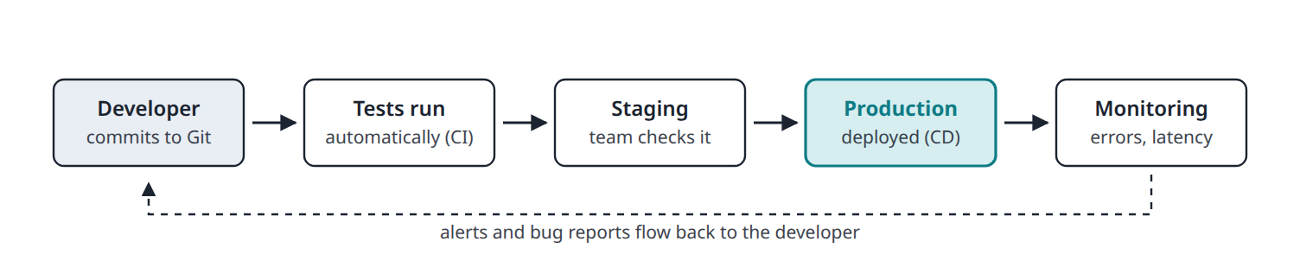
SESSION 4 · 4.7 SHIPPING CODE SAFELY
Book ↗
How code reaches customers
• Version control (Git, GitHub): every change recorded and reversible
• CI/CD: tests run on every change; if they pass, it deploys. Small, frequent, low-risk releases
• Monitoring and logs: find out about outages before customers do

