Slide 1
Open the book ↗
SESSION 5 · 75 MINUTES
Identity, Security, and Software Beyond the Browser
How the server knows who is asking, how to keep it safe, and how phones, desktops, devices, and AI fit in
How Modern Software Is Built (in 2026)

Slide 2
SESSION 5 · 5.1 AUTHENTICATION VERSUS AUTHORIZATION
Book ↗
Two questions
• Authentication: "Who are you?" Password, phone code, fingerprint, Google login
• Authorization: "What may you do?" May Dana see order 90? Sam's order 88? Issue a refund?
• Office building: the badge check is authentication; which doors open is authorization
• Authorization is organised by roles: customer, staff, manager, administrator
Every request touching a record must check that THIS user may touch THIS record. Forgetting that has caused huge leaks.

Slide 3
SESSION 5 · 5.2 PASSWORDS DONE RIGHT
Book ↗
Never store the password
• Store a hash: a one-way scramble that cannot be reversed. Check a login by hashing what was typed
• A stolen database then reveals no passwords. (Salted, with slow algorithms such as bcrypt)
• If a company can email you your old password, it is doing this wrong
• Multi-factor authentication: something you know + something you have (or are). Require it for staff
• Passkeys: a device-held key unlocked by fingerprint or face; no password at all

Slide 4
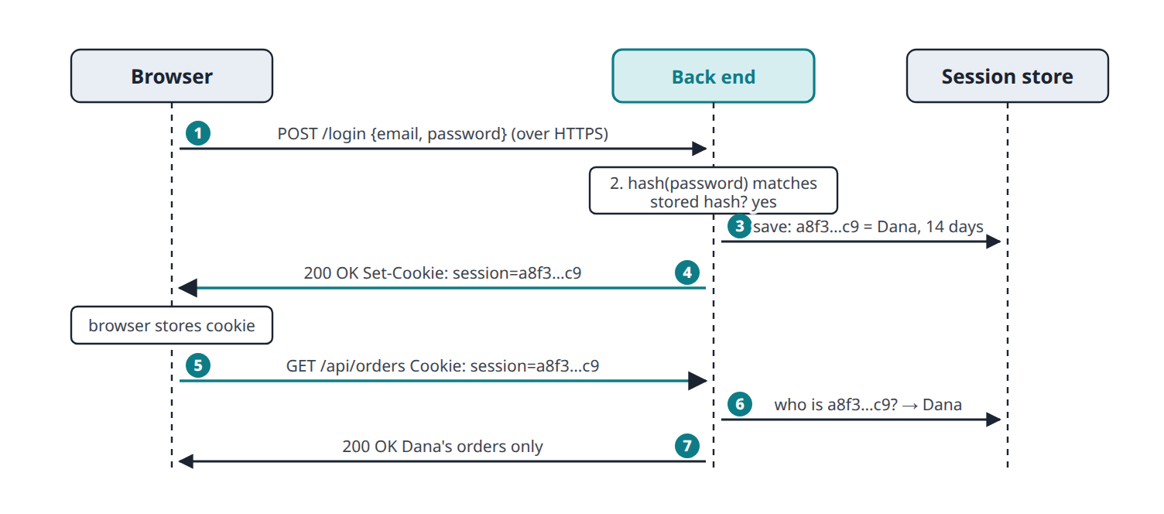
SESSION 5 · 5.3 STAYING LOGGED IN: COOKIES, SESSIONS, TOKENS
Book ↗
How a login survives stateless HTTP
• The password is sent once. A random session ID in a cookie stands in for it afterwards
• Any web server in the pool looks the ID up in the shared session store

Slide 5
SESSION 5 · 5.3 STAYING LOGGED IN: COOKIES, SESSIONS, TOKENS
Book ↗
Consequences
• The cookie is as good as the password while it lasts: HTTPS-only, invisible to JavaScript, re-ask for sensitive actions
• This is exactly what lets stateless, load-balanced servers work
• The same mechanism lets advertisers track browsers across sites: hence consent banners
• Apps and APIs often use a signed token (a JSON Web Token) sent in a header instead of a cookie

Slide 6
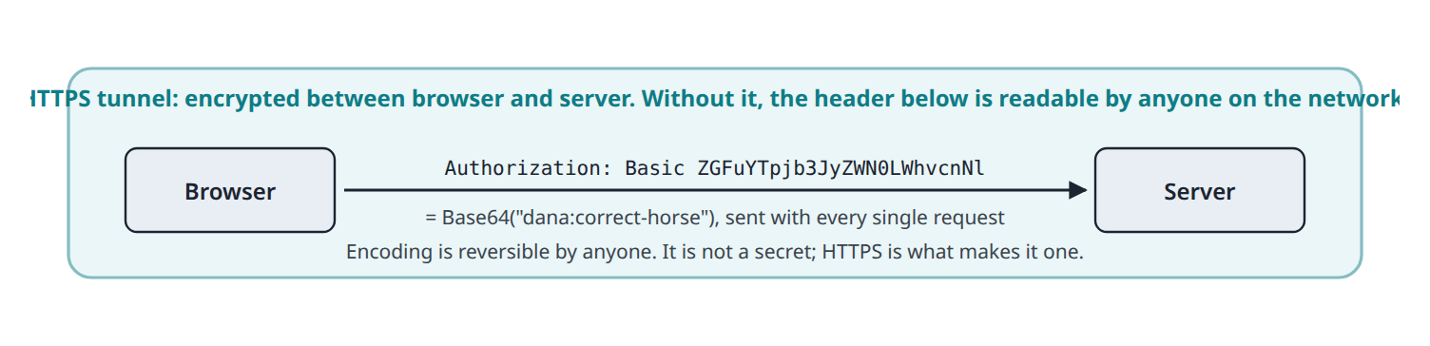
SESSION 5 · 5.4 HTTP BASIC AUTHENTICATION AND API KEYS
Book ↗
The simplest scheme, built into HTTP
• Basic Auth sends username:password on every request, encoded in Base64, which anyone can decode
• Only over HTTPS; only for staging sites, internal tools, and some APIs

Slide 7
SESSION 5 · 5.4 HTTP BASIC AUTHENTICATION AND API KEYS
Book ↗
API keys are passwords for programs
• A long random secret a provider issues so it knows whom to bill
• Stored in server configuration (environment variables, a .env file); never in front-end code; never in Git
• Bots scan GitHub constantly for leaked keys and can spend thousands within minutes
The single most important habit when building with Claude Code and the Claude API.

Slide 8
SESSION 5 · 5.5 OAUTH: HOW "SIGN IN WITH GOOGLE" WORKS
Book ↗
The problem OAuth solves
• New apps want login without another password; apps want to use your Google Calendar or bank on your behalf
• Typing your Google password into a third-party app would give it everything, forever
• OAuth 2.0: the user approves a limited request at the trusted service; the app gets a valet key
• Four roles: resource owner (you), client (the app), authorization server (Google login), resource server (Google's API)

Slide 9
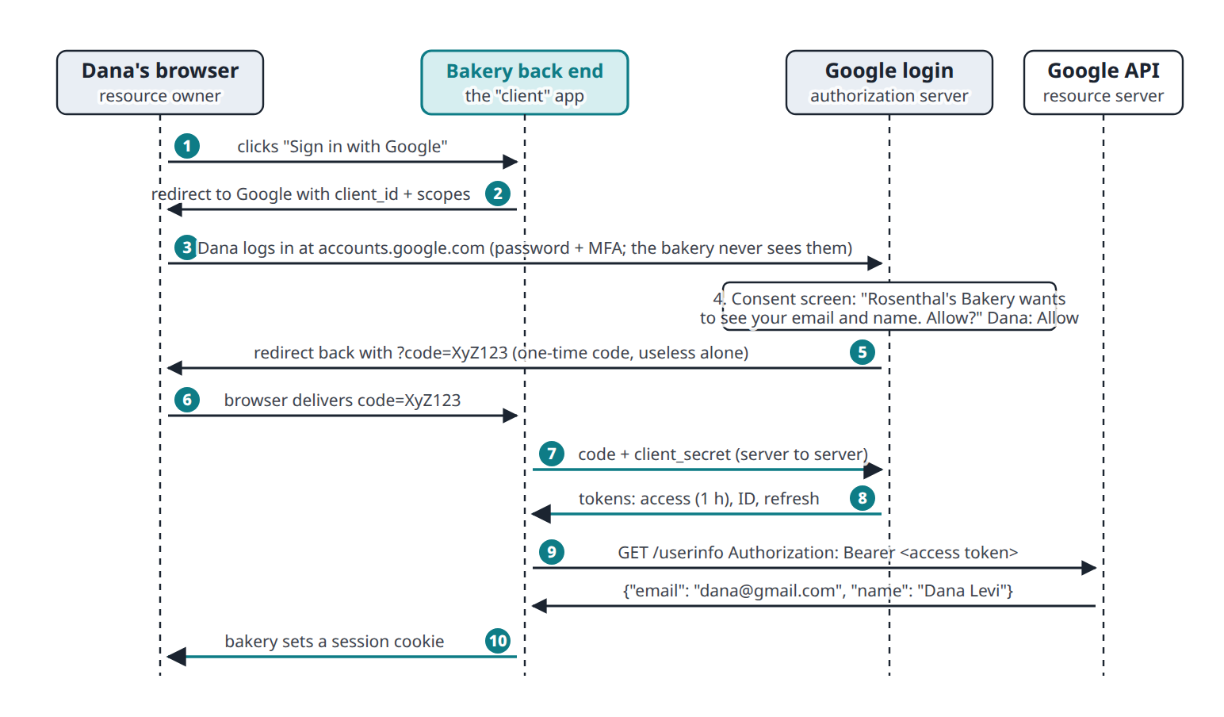
SESSION 5 · 5.5 OAUTH: HOW "SIGN IN WITH GOOGLE" WORKS
Book ↗
The authorization-code flow

Slide 10
SESSION 5 · 5.5 OAUTH: HOW "SIGN IN WITH GOOGLE" WORKS
Book ↗
Why the roundabout design
• The password is typed only at Google; the app never sees it
• Scopes limit what the access token can do; the user sees them on the consent screen
• The one-time code is swapped for the token server-to-server, using the app's client secret
• Tokens expire in about an hour; the user can revoke any app with one click
• OpenID Connect adds an ID token for login; single sign-on lets employees use one company identity everywhere
Offer "Sign in with Google": higher conversion, no password liability. And always read the scopes.

Slide 11
SESSION 5 · 5.6 SECURITY BASICS EVERY PRODUCT OWNER SHOULD KNOW
Book ↗
Six ideas that catch most mistakes
• Encrypt in transit (HTTPS) and at rest (encrypted disks)
• Never trust the front end: prices, permissions, secrets live on the server
• SQL injection: user text pasted into a query. Typing ' OR 1=1 -- logs in as everyone. Frameworks prevent it with parameterised queries
• Least privilege: every person, program, and key gets the minimum access
• Secrets out of code and out of Git; rotate anything exposed
• Patch software and test that backups restore
"Have we reviewed against the OWASP Top Ten?" is a question any engineer or AI assistant can act on.

Slide 12
SESSION 5 · 5.7 BEYOND THE BROWSER: MOBILE, DESKTOP, EMBEDDED
Book ↗
Where the front end runs
Kind | Front end runs | Built with | Distributed
Web app | Browser | HTML, CSS, JavaScript | A URL; updates instantly
Native mobile | Phone, installed | Swift (iOS), Kotlin (Android) | App stores; 15 to 30% commission
Cross-platform | Phone, installed | React Native, Flutter | App stores
Progressive web app | Browser, installable | Web technologies | A URL, no store
Desktop | Laptop, installed | Native or Electron | Download, installer
Embedded | Inside a device | C, C++, Rust | Shipped in the hardware

Slide 13
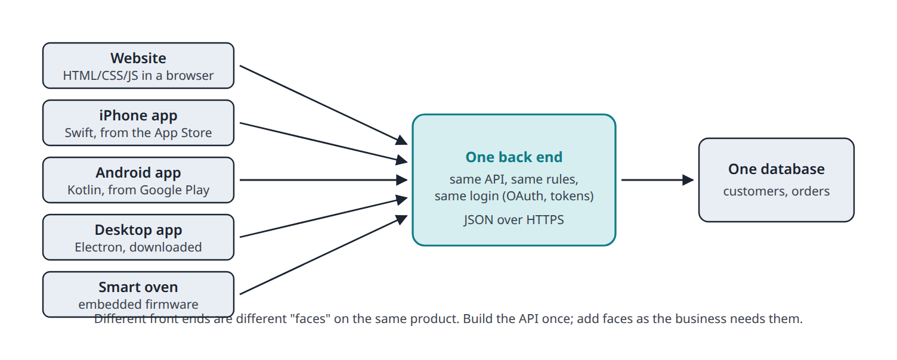
SESSION 5 · 5.7 BEYOND THE BROWSER: MOBILE, DESKTOP, EMBEDDED
Book ↗
One back end, many clients
• Different front ends are different faces on the same product; the API and database do not change

Slide 14
SESSION 5 · 5.7 BEYOND THE BROWSER: MOBILE, DESKTOP, EMBEDDED
Book ↗
What this explains
• "We need an app" is a new front end if the API exists, and secretly a back-end project if it does not
• Companies start with the web: no store review, no commission, one codebase, instant updates
• The API outlives several generations of front ends
• Embedded devices are the exception: a 2026 thermostat must work in 2036; a mistake is a recall, not a redeploy

Slide 15
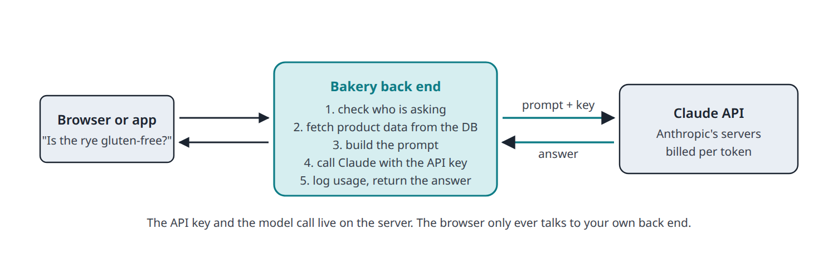
SESSION 5 · 5.8 WHERE AI FITS
Book ↗
An AI model is a third-party API called from your back end
• The key and the model call stay on the server; the browser talks only to your back end

Slide 16
SESSION 5 · 5.8 WHERE AI FITS
Book ↗
Three practical consequences
• The API key stays on the server: a call from the browser exposes it to every visitor
• Your data is the differentiator: add this customer's history and your catalogue to the prompt (RAG)
• AI calls cost money per token, take seconds, and can fail: cache, monitor, and give them a fallback
Claude itself is served through exactly this architecture. Now you know what is on the other end of the request.

