Slide 1
Projekt im Bachelor: MAPC
3. Milestone
Team: JNY Nader Jawhary, Yamen Sahyouni, Joakim Vik Haukedal
02.12.2021
Notes:
1

Slide 2
Brief Overview
Spiralling movement + finding task
Accepting tasks
Completing tasks

Slide 3
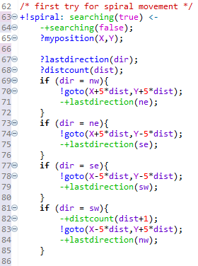
Code
lastdirection(nw). // init
distcount(1). // init
+!spiral: searching(true) <-
-+searching(false);
?myposition(X,Y);
?lastdirection(dir);
?distcount(dist);
if (dir = nw){
!goto(X+5*dist,Y+5*dist);
-+lastdirection(ne);
}
if (dir = ne){
!goto(X+5*dist,Y-5*dist);
-+lastdirection(se);
}
if (dir = se){
!goto(X-5*dist,Y-5*dist);
-+lastdirection(sw);
}
if (dir = sw){
-+distcount(dist+1);
!goto(X-5*dist,Y+5*dist);
-+lastdirection(nw);
}

Slide 4
Problems
Normal ausführen funktioniert ab und zu nicht, aber bei debugg (fast)immer. Sind unsere Überlegunszeit zu lang?
Agent wartet ~15 cycles, ohne was zu tun, arbeitet aber danach weiter.

Slide 5
Problems

Slide 6
Future plans
Having multiple agents
Communication

