Slide 1
Projekt im Bachelor: MAPC
3. Milestone
Team: JNY Nader Jawhary, Yamen Sahyouni, Joakim Vik Haukedal
16.12.2021
Notes:
1

Slide 2
Brief Overview
Spiralling movement + finding task
Accepting tasks
Remembering POIs
Dispenser, taskboards/goal(not implemented yet)
Completing tasks

Slide 3
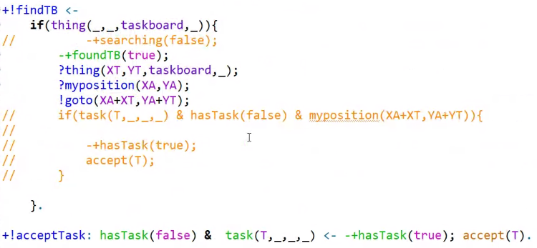
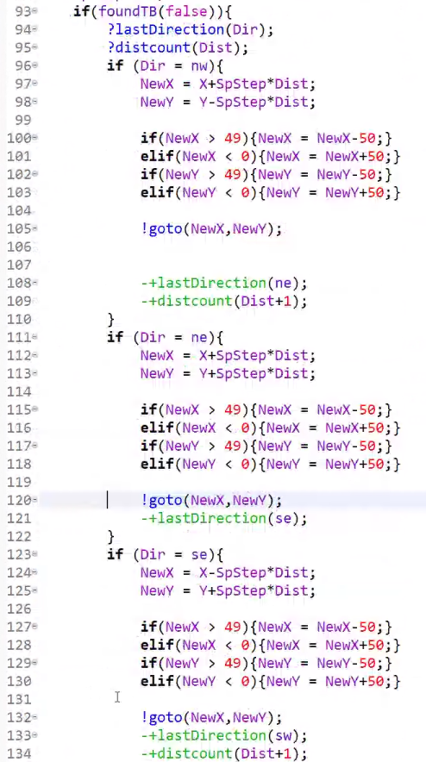
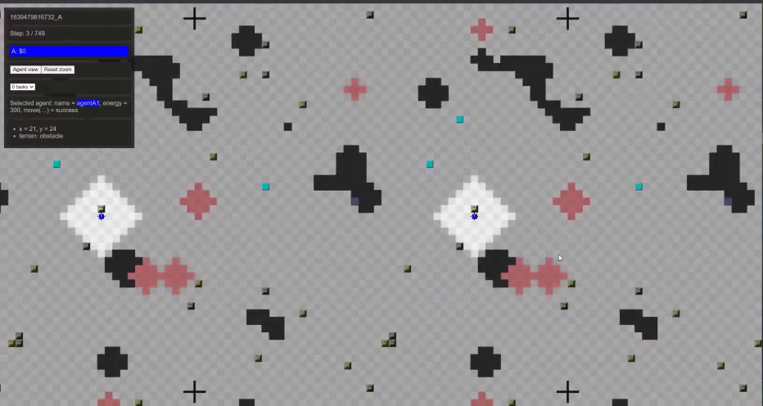
Code

Slide 4
Problems encountered
Position counter not working
Leads to the agent thinking it has a different position, than true position
Running the program in normal mode, only works some of the time, but in debug mode it works (almost) every time
The agent waits for several cycles before doing an action, afterwards it continues to work like normal for a while
Not able to overwrite Variables

Slide 5
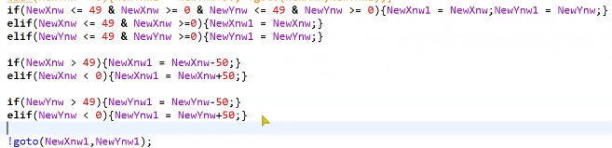
Problems solved
Not able to overwrite Variables
☺

Slide 6
Future plans
Having multiple agents
Communication
Understand tasks to complete tasks

