Slide 1
Projekt im Bachelor: MAPC
2. Milestone
Teamname: JNY Nader Jawhary, Yamen Sahyouni, Joakim Vik Haukedal
02.12.2021
Notes:
1

Slide 2

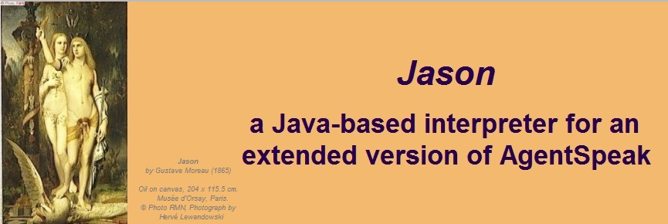
Brief Overview
Reading/Implementing examples
Exploration implementation
Fixing problems ☹

Slide 3
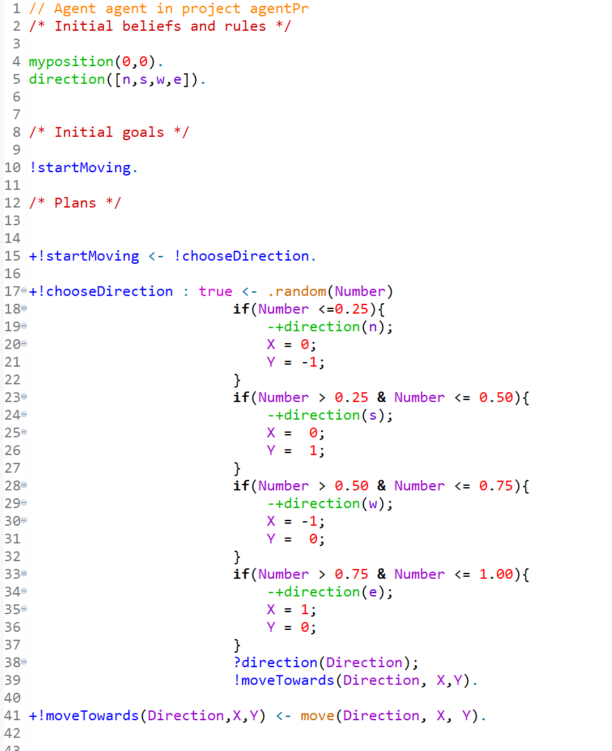
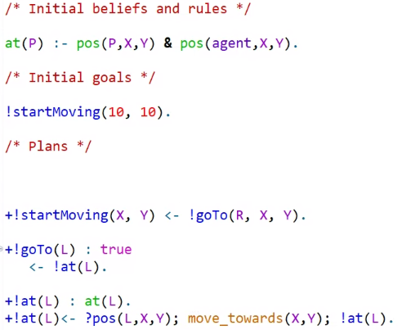
Code

Slide 4
Problems
Agent & Server connection(main problem)
Late testing due to main problem

Slide 5
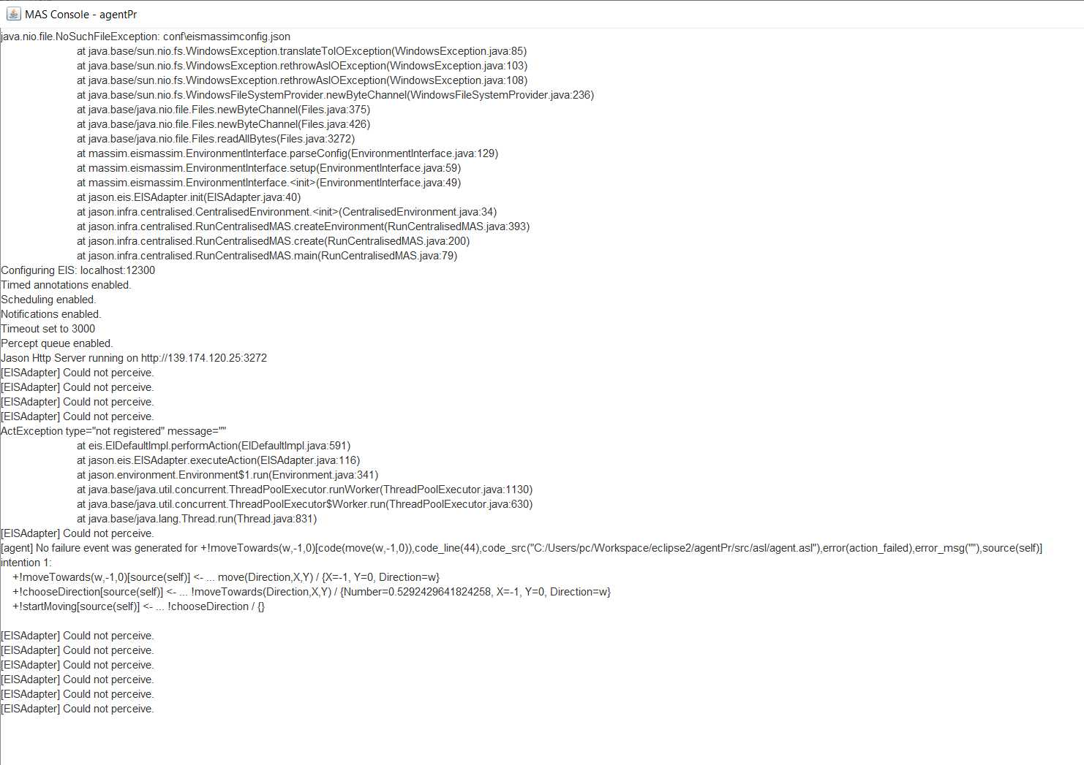
Problems

Slide 6
Future plans
Creating a functioning pathing algorithm
Improve (not random, have a goal)
Next milestone
Completing tasks
Having multiple agents

