Slide 1
C372 Payment Technologies
Week 03
Lesson 06 Payment API architecture with Postman

Slide 2



Administrative matters
As you go through the day with your lecturer, there will be activities for you to work on.
Some activities are meant to help you take notes, while others are for you to delve deeper into the topics.
These activities will be mapped in both the slides and worksheet. You should put your answers in the worksheet.
Below are some icons to guide you on what an activity will require you to do.
Answer some questions on your own as you watch a video or listen to your lecturer.
Team discussions
This is a lecturer-led activity. Your lecturer will guide you through an activity step-by-step. Pay close attention!

Slide 3
Recall

Slide 4




Exercise 4 Check: Implementation matches requirements
Remember to commit and push your code to your C372 weekly lesson repository with suitable comments

Slide 5


Where we left off in Lesson 5
CONTINUE FROM YOUR APPROVED SPEC AND WORKING GET ENDPOINT
LESSON 5
LESSON 6
Specified the GET prepare endpoint.
Built mock data, controller, router.
Checked JSON in the browser.
Re-test GET in Postman.
Add the supplied POST code.
Explain and test the payment flow.
2

Slide 6

Lesson Objectives
By the end of this lesson, you will be able to:
Use Postman to send GET and POST requests and read the status, headers and body.
Explain merchant/provider roles, trusted data and why a payment can stay pending.
Apply a short API contract and integrate supplied code into the correct project files.
Map provider outcomes to business outcomes and verify them with Postman evidence.
Note:
Record your responses to all activity questions in your worksheet.
Slides with this icon is for your self-reading
No real payments, provider SDK, API keys or new database tables today.

Slide 7
Testing APIs with Postman

Slide 8
Meet Postman | A dedicated API client
USE THE DESKTOP APP | NOT THE VS CODE EXTENSION
WHAT IT DOES
WHAT IT DOES NOT DO
Sends GET, POST and more.
Sends a JSON request body.
Shows status, headers, body.
Saves requests to re-run later.
It does not start your Node app.
It is not your payment provider.
It does not prove money moved.
It does not replace the specification.
Postman lets you send HTTP requests and inspect responses directly, without creating EJS views.
The browser address bar only sends GET. Today's new endpoint needs POST + a JSON body.
9

Slide 9
Exercise 1 Set up your Lesson 6 project
In your C372 project workspace, Week03 folder, create a new folder named Lesson06.
Copy your completed Week03\Lesson05\PetCareAppMVC into Lesson06
Right-click on Week03\Lesson06\PetCareAppMVC, select Open in Integrated Terminal
Run npm install, then node app.js.
Test that the application is working as expected.
Keep the Lesson05 folder unchanged as your reference.
When copying a project, do not include node_modules as it is a very large folder
No working Lesson 5 app? Copy PetCareAppMVC from today's Resources folder.

Slide 10
Exercise 2 Install and open Postman
DESKTOP APP SETUP | SKIP IF ALREADY INSTALLED
Visit https://www.postman.com/downloads/ and select the desktop app for your OS.
On Windows, run the installer; then launch Postman from Start.
Complete any sign-in or initial setup following the on-screen instructions
The native desktop app accesses localhost directly; no separate Desktop Agent is needed.

Slide 11
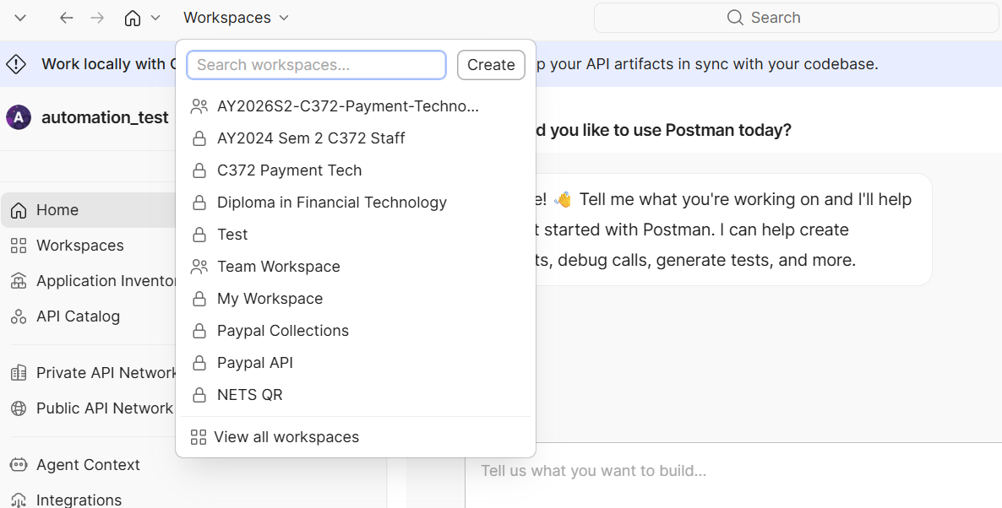
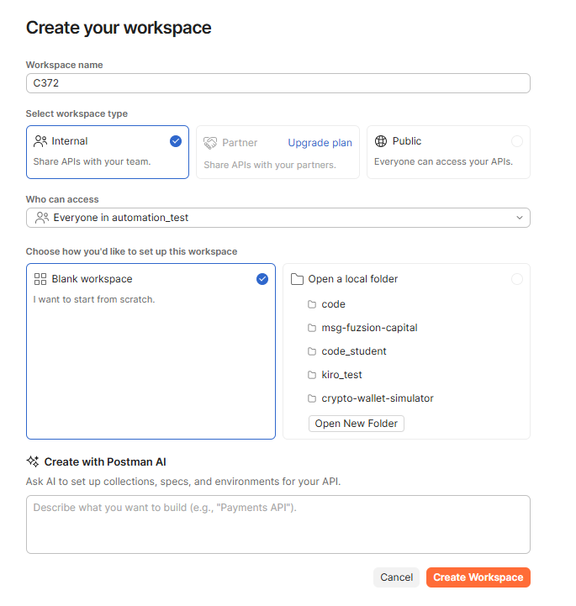
Exercise 2 Setting up Postman workspace
Once logged in to Postman, click on Workspaces at the top left, select Create
Give your workspace a name, keep the default settings. Click Create Workspace

Slide 12
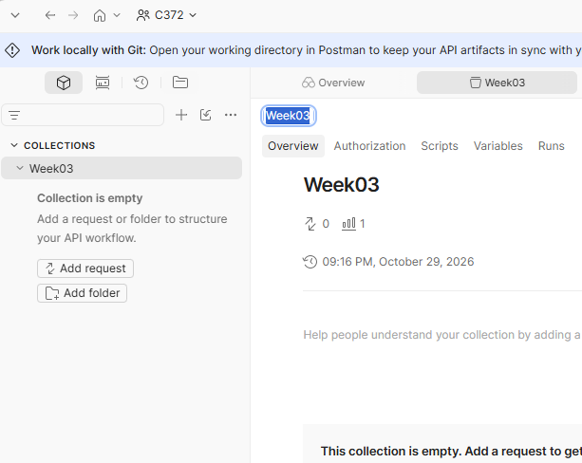
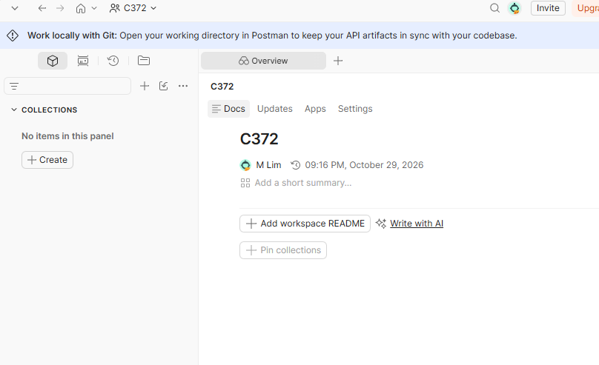
Exercise 2 Setting up Postman workspace
Under COLLECTIONS, click Create
Give your collections a name, Week03
Postman collections help you organise related API requests so you can easily find, manage and re-run them.

Slide 13
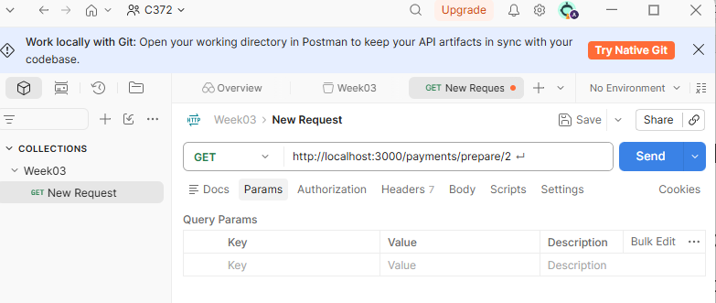
Exercise 2 Adding a Postman request
LECTURER DEMO, THEN FOLLOW ALONG | GET
In Week03 collections, click Add request
Choose GET and enter the full URL shown below
Leave everything else as it is
Click Send.
You should see the following HTTP status and response.
Ensure that PetCareAppMVC app is running in VS Code.
http://localhost:3000/payments/prepare/2
HTTP Status: 200 Response: { "serviceId": 2, "serviceName": "Pet Grooming", "amount": 50, "currency": "sgd", "status": "READY_FOR_PAYMENT" }

Slide 14
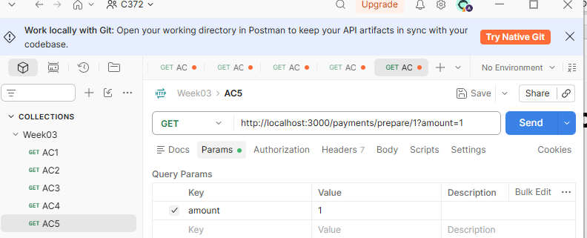
Exercise 3 Re-run your Lesson 5 checks
You can rename the request.
Create a new request for each URL below and give it a name.
Test the request and fill in the blanks
Check | Request (Body: none) | HTTP Status | Service Name; amount
AC1 | GET /payments/prepare/1 | 200 | Grooming, 50
AC2 | GET /payments/prepare/2 | 200 | Vaccination, 35
AC3 | GET /payments/prepare/3 | 200 | Boarding, 80
AC4 | GET /payments/prepare/999 | 404 | "error": "Service not found"
Price | GET /payments/prepare/1?amount=1 | 200 | Grooming, 50
Compare with your Lesson 5 browser results. What extra evidence does Postman show?
13

Slide 15
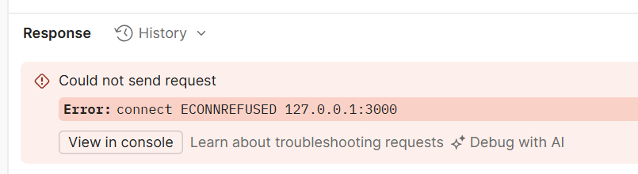
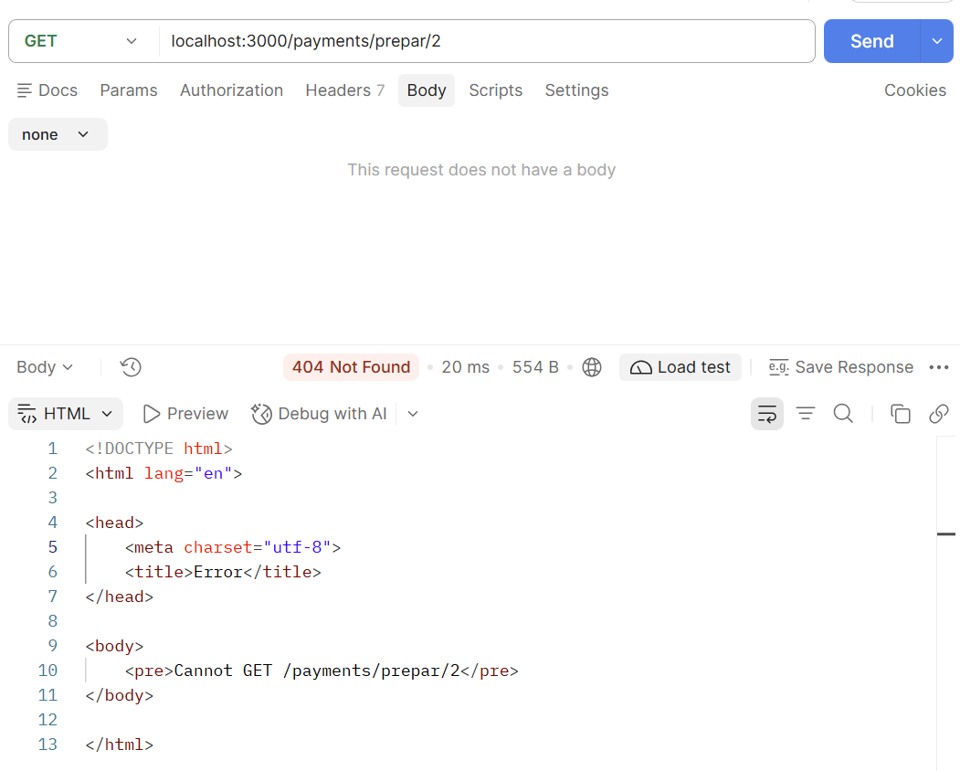
Possible Errors
app.js not yet started
Spelling error in the URL

Slide 16
Payment API architecture

Slide 17
Who does what in a payment flow?
REAL PAYMENT ROLES AND TODAY'S LOCAL SIMULATION
CUSTOMER
MERCHANT
(PETCARE)
PAYMENT
PROVIDER
BANKS AND
CARD NETWORK
>
>
>
Chooses a service and starts checkout.
Looks up the trusted price and requests payment.
Coordinates payment processing and returns an ID with the current status.
Handle authorisation behind the provider.
The provider returns an identifier and current status.
The merchant interprets that result for its own business workflow.
Today, a local mock stands in for the provider. No bank connection or real payment takes place.
16

Slide 18
What a payment context contains
CONCEPTUAL MODEL WITH EXAMPLES FROM OUR MOCK
IDENTITY
CURRENT STATE
PAYMENT DETAILS
A provider payment ID identifies the payment context.
Mock example:
mock_<digits>
The status tells the app the current outcome.
Example: PENDING
Amount 50, currency sgd and merchant reference SERVICE-2 stay associated with the interaction.
A payment context can exist before approval. Today’s mock returns a simplified response and saves no payment record.
17

Slide 19
Why a payment can remain pending
TODAY'S MOCK
A REAL INTEGRATION, LATER
The mock returns an ID and the selected simulated status immediately.
If the status is PENDING, PetCare returns AWAITING_PAYMENT.
The mock sends no later update.
Customer authentication or bank processing can delay the final result.
A provider may send a webhook, an HTTP notification to the merchant, when the status changes.
While payment is pending, keep the booking awaiting payment. A browser success page alone does not prove payment.
17

Slide 20
Example: Pet Grooming for $50
1. PET OWNER
2. PETCARE
3. MOCK PROVIDER
4. PETCARE
Chooses service 2 and starts POST via the client.
>
Reads price $50, builds the request and calls the mock.
>
The mock provider returns a payment ID and simulated status.
>
Maps the status and returns the HTTP response.
PetCare creates SERVICE-2.
The mock creates mock_<digits>.
These references link the interaction. Neither proves payment.
18

Slide 21
Payment requests: events 1–2
POSTMAN CALLS http://localhost:3000. PETCARE THEN CALLS THE LOCAL MOCK.
1. CLIENT SENDS THE POST
2. PETCARE CALLS THE MOCK
POST /payments/mock/2
Body: {"testStatus":"PENDING"}
const paymentRequest = {
amount: 50,
currency: "sgd",
merchantReference: "SERVICE-2",
description: "Pet Grooming",
testStatus: "PENDING"
};
await MockProvider.createPayment(
paymentRequest);
POSTMAN ACTS AS THE CLIENT
The owner selects service 2.
Postman requests a PENDING result.
Content-Type: application/json.
Separate GET check: GET /payments/prepare/2 (no body). Expected HTTP 200.
{"serviceId":2, "serviceName":"Pet Grooming", "amount":50,
"currency":"sgd", "status":"READY_FOR_PAYMENT"}
19

Slide 22
Payment results: events 3–4
THE MOCK RETURNS A LOCAL OBJECT. PETCARE MAPS IT AND SENDS HTTP JSON.
3. MOCK RETURNS THE RESULT
4. PETCARE RESPONDS TO CLIENT
{
providerPaymentId: "mock_<digits>",
merchantReference: "SERVICE-2",
status: "PENDING"
}
The local call has no HTTP status.
<digits> varies with each mock ID.
HTTP 200
{
"serviceId": 2,
"providerPaymentId": "mock_<digits>",
"merchantReference": "SERVICE-2",
"paymentStatus": "PENDING",
"bookingStatus": "AWAITING_PAYMENT"
}
PetCare maps PENDING to bookingStatus AWAITING_PAYMENT.
HTTP 200 confirms the request succeeded. The payment still awaits completion.
20

Slide 23
Exercise 4 Payment flow
Indicate the correct sequence of the events below.
Add a role to each event: client, PetCare or local mock.
Event | Sequence | Role
Returns providerPaymentId and status PENDING.
Maps the status and sends the HTTP JSON response.
Sends POST /payments/mock/2 with testStatus PENDING.
Reads the $50 catalogue price, then calls the local mock.
20a

Slide 24
Payment status and booking status
THE MOCK RETURNS THE PAYMENT RESULT. PETCARE SETS THE BOOKING OUTCOME.
paymentStatus | bookingStatus | Meaning for the booking
APPROVED | CONFIRMED | Confirm the simulated booking.
PENDING | AWAITING_PAYMENT | Keep the booking awaiting payment.
DECLINED | PAYMENT_FAILED | Payment failed. Keep the booking unconfirmed.
HTTP 200 means PetCare handled the request. Read paymentStatus to check for payment approval.
26

Slide 25
Mock Payment API Integration

Slide 26
What is an API contract?
An API contract defines what a client sends and what the API returns.
Request: HTTP method, URL and input data.
Response: Status code, fields and data types.
Rules: Trusted data, status mappings, defaults and errors.
Testing: Expected results to check in Postman.
Use the contract to guide implementation and check results in Postman.

Slide 27
API contract for the mock payment endpoint
POSTMAN SENDS THE REQUEST. PETCARE RETURNS THE RESPONSE.
Part of contract | What the API expects or returns
Client request | POST /payments/mock/:serviceId (use /2 for service 2) JSON body: {"testStatus":"PENDING"}
testStatus choices | APPROVED, PENDING or DECLINED. Send {} to use PENDING.
Trusted values | Price/name: server catalogue. Currency: sgd. Reference: SERVICE-<id>.
Valid service ID | HTTP 200 + five JSON fields (next slide), even for PENDING or DECLINED.
Unknown service ID | HTTP 404 with {"error":"Service not found"}.
Lesson scope | Local mock only. No real payment, database write or webhook.
Code limitation: it does not reject unsupported testStatus values (e.g. "OTHER").
29

Slide 28
Expected API response
EXPECTED HTTP 200 FOR POST /payments/mock/2 WITH {"testStatus":"PENDING"}
{
"serviceId": 2,
"providerPaymentId": "mock_<digits>",
"merchantReference": "SERVICE-2",
"paymentStatus": "PENDING",
"bookingStatus": "AWAITING_PAYMENT"
}
Example JSON response for a PENDING payment.
Check these five fields when you test in Postman.
serviceId is numeric. Other fields are strings. <digits> is a placeholder for generated digits.
30

Slide 29
Exercise 5: Where the code goes
We will be creating/modifying the files below
Action | Path | Purpose
CREATE | services\mockPaymentProvider.js | Simulate provider boundary.
MODIFY | controllers\paymentController.js | Keep GET; add POST.
MODIFY | routes\paymentRoutes.js | Keep GET; add full POST path.
MODIFY | app.js | Parse JSON before the routes.
KEEP | Catalogue, models, views, database | No changes for this exercise.
Use the supplied snippets: create one file and update three. Keep all existing GET code.
31

Slide 30
Exercise 5 Mock Payment Provider function
In Lesson06/PetCareAppMVC, create a new folder named services
In services, create a new file named mockPaymentProvider.js
In mockPaymentProvider.js, copy and paste the code below:
exports.createPayment = async (request) => {
return {
providerPaymentId: 'mock_' + Date.now(),
merchantReference: request.merchantReference,
status: request.testStatus || 'PENDING'
};
};
This code creates a mock payment provider so we can practise the payment flow without connecting to a real provider or moving money.

Slide 31
Exercise 5 Controller handler, trusted request and awaited mock call
In Lesson06/PetCareAppMVC/controllers/paymentController.js, at the top of the file, add the code below:
In paymentController.js, after the preparePayment(req, res){..} function, copy and paste the function from the text file provided in the Resources folder, createMockPayment.txt
In paymentController.js, after adding the createMockPayment function, add the code below:
const MockProvider = require('../services/mockPaymentProvider');
module.exports = {
preparePayment,
createMockPayment
};
This code connects the payment controller to the mock payment provider and makes both payment handlers available to the router.

Slide 32
Exercise 5 POST route and JSON parsing
In Lesson06/PetCareAppMVC/routes/paymentRoutes.js, below the route for /payments/prepare/:serviceId add the code below:
In Lesson06/PetCareAppMVC/app.js, before the route registrations, add the code below:
Restart app.js
router.post(
'/payments/mock/:serviceId',
paymentController.createMockPayment
);
app.use(express.json());
This code enables PetCare to receive POST payment requests and read their JSON body before passing them to the payment controller

Slide 33
PetCare’s JavaScript object for the local mock
THE CONTROLLER CREATES THIS OBJECT. USERS DO NOT ENTER IT IN POSTMAN.
{
amount: service.price,
currency: 'sgd',
merchantReference: 'SERVICE-' + service.id,
description: service.name,
testStatus: req.body?.testStatus
}
In Postman: POST /payments/mock/2
JSON body: {"testStatus":"PENDING"}
PetCare uses catalogue price/name and creates the reference.
Only testStatus comes from the client for this simulation.
35

Slide 34
Exercise 6
Scenario: A client sends the following request to simulate a pending payment for service 2:
Trusted price: Where should PetCare obtain the payment amount - from the client’s request or the server catalogue?
Booking outcome: The mock provider returns PENDING. What value should PetCare return in bookingStatus?
Unknown service: If the request uses a service ID that does not exist, what HTTP status code and error message should PetCare return?
POST /payments/mock/2
Content-Type: application/json
{"testStatus":"PENDING"}

Slide 35
Code and Payment Flow: Recap and Check
Part | Explanation
express.json() | Parses application/json bodies before the router runs.
POST route | Connects the request and serviceId to createMockPayment.
Controller | Builds trusted payload, awaits result and interprets status.
Provider service | Keeps simulated provider behaviour outside HTTP handling.
Existing GET | Still returns the Lesson 5 five-field preparation contract.
41

Slide 36
Test the mock payment in Postman

Slide 37
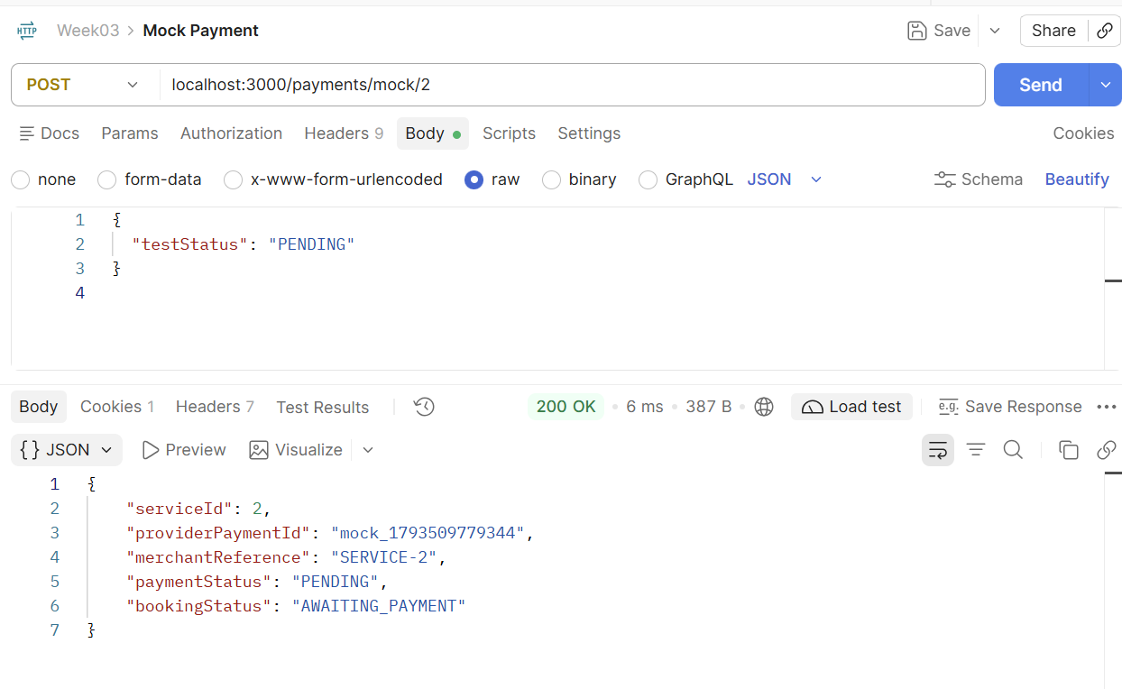
Postman: Send a POST request
Select POST and enter:
http://localhost:3000/payments/mock/2
Choose Body > raw > JSON.
Enter the request body:
{"testStatus":"PENDING"}
Click Send.
Check HTTP 200 and the response:
paymentStatus: PENDING
bookingStatus: AWAITING_PAYMENT
Request
Response
Ensure that your app is running before using POSTMAN

Slide 38
Postman: Path, query and body
WHERE EACH REQUEST VALUE GOES
Location | Lesson example | Meaning
Path in URL | /payments/mock/2 | The handler reads serviceId from req.params.
Query / Params | ?amount=1 | The handler ignores this value and uses the catalogue price.
Body > raw > JSON | {"testStatus":"PENDING"} | The handler reads testStatus from req.body.
Put testStatus in Body. The handler reads req.body.testStatus.
Price-source check: add "amount":1 to the JSON body. Inspect the server's provider payload.
39

Slide 39
Exercise 7 Test matrix: outcomes + defaults
Test the requests in POSTMAN. Predict each result before clicking Send.
Check | Request / JSON body | Expected result
MC1 | payments/mock/2 + {"testStatus":"APPROVED"} | 200; APPROVED > CONFIRMED
MC2 | payments/mock/2 + {"testStatus":"PENDING"} | 200; PENDING > AWAITING_PAYMENT
MC3 | payments/mock/2 + {"testStatus":"DECLINED"} | 200; PENDING > AWAITING_PAYMENT
MC4 | payments/mock/999 + {"testStatus":"PENDING"} | 404; Service not found
MC5 | payments/mock/2 + {} | 200; PENDING > AWAITING_PAYMENT
MC = mock-payment check. Record expected and actual results.
Use POST /payments/mock/<id>. Check all five fields on success.
40

Slide 40
Postman: Troubleshooting guide
MATCH THE SYMPTOM TO THE FIRST CHECK. RE-RUN THE REQUEST AFTER A FIX.
What you see | What to check
Connection refused | Start Node. Check localhost and port 3000.
Cannot GET / Cannot POST | Check method, full path and route. Restart the app.
JSON parse error / HTTP 400 | Use double quotes, valid braces and no trailing comma.
Always PENDING | Check raw JSON, testStatus spelling and parser order.
Unexpected 404 JSON | Check serviceId and catalogue lookup. 999 is unknown.
Wrong bookingStatus | Check the returned provider status and controller mapping.
Existing GET stops working | Restore preparePayment and its GET route.
Ask for help if access is blocked. Keep SSL and proxy settings unchanged unless instructed.
44

Slide 41
Limits of this classroom mock
FIVE SHORTCUTS TO RECOGNISE BEFORE A REAL INTEGRATION
Shortcut | Why it matters later
Client chooses testStatus | Simulates outcomes. A real provider determines payment status.
Unsupported statuses pass through | Values such as OTHER can omit bookingStatus.
SERVICE-2 reference | Identifies a service, rather than a unique payment attempt.
Timestamp-based mock ID | Date.now() does not guarantee a unique identifier.
No saved records | bookingStatus is calculated and returned. No record is saved.
No real money moves. Keep production improvements separate from today's baseline.
45

Slide 42
Reminders

Slide 43
AI Journal
Document your AI-assisted work in your AI interaction journal as you go, not just after completing the task.
  Record your prompts: Capture what you asked AI, including the context or requirements you provided.
  Keep relevant AI responses: Include excerpts or screenshots of suggestions, explanations or generated code - not only your final solution.
  Show your verification: Explain how you checked the AI’s output against your specification and tests. Record expected and actual results, including failed checks.
  Explain your decisions: State which suggestions you accepted, rejected or modified, and why.
  Document corrections: Show errors or gaps you identified, what you changed and how you confirmed the correction worked.
  Commit to GitHub regularly: Commit after meaningful steps. Use clear commit messages describing what changed and why, rather than “update” or “done”.
Your journal should demonstrate your understanding and judgement - not simply reproduce an AI conversation.

Slide 44
GitHub Repositories
You will need to create 3 GitHub repositories:
  Weekly Lessons(public)
  CAs(1 and 2)(private)
  FA(private)
Add your lecturer’s GitHub ID to your repositories
Please update your links here: C372 Student Weekly lessons, CA and FA Individual GitHub Repository – Fill out form
If you have already added a link earlier for weekly lessons, you may still update the repository links in the updated form.

Slide 45
Schedule
Note: Kahoot quiz date added, FA milestones shifted
Updated: 25 October 2026
Week | Lesson |  |  |  | Remarks
 | No. | Mode | No. | Mode
1 | 1 | F2F | 2 | F2F | Learning Memo 1 Release
2 | 3 | F2F | 4 | F2F | FA* Release
3 | 5 | F2F | 6 | F2F
4 | 7 | AEL | 8 | F2F | CA1 Kahoot Quiz in Lesson 08
5 | 9 | AEL | 10 | AEL | Singapore Fintech Fest Week CA1 SA3 Submission Week
6 | 11 | F2F | 12 | F2F | FA Milestone 1 Submission
7 | 13 | F2F | 14 | F2F
8 | 15 | F2F | 16 | F2F | OH2027 (7 – 9 Jan) Learning Memo 2 Release FA Milestone 2 Submission
9 | 17 | F2F | 18 | F2F | CA2 SA3 Submission Week
10 | 19 | F2F | 20 | F2F | CA2 Kahoot Quiz in Lesson 19
11 | 21 | F2F | 22 | F2F | FA Final SA3 Submission Week
12 | 23 | F2F | 24 | F2F | FA Presentation Week
13 | 25 | AEL | 26 | AEL

Slide 46
Summary
In this lesson, you have:
Used Postman to re-test GET and inspect POST requests and responses.
Explained merchant/provider roles, trusted values and pending outcomes.
Applied a short supplied API contract to the mock-payment flow.
Integrated supplied code into the service, controller, router and app.
Predicted outcomes and verified status mapping, errors, price and regression.

Slide 47
Submissions
Worksheet (Individual)
Upload your deliverables to POLITEMALL even if it is incomplete before the next session.
You can resubmit by 2359 if there are updates.

