Slide 1
Lab4 – Color legend
5/9

Slide 2
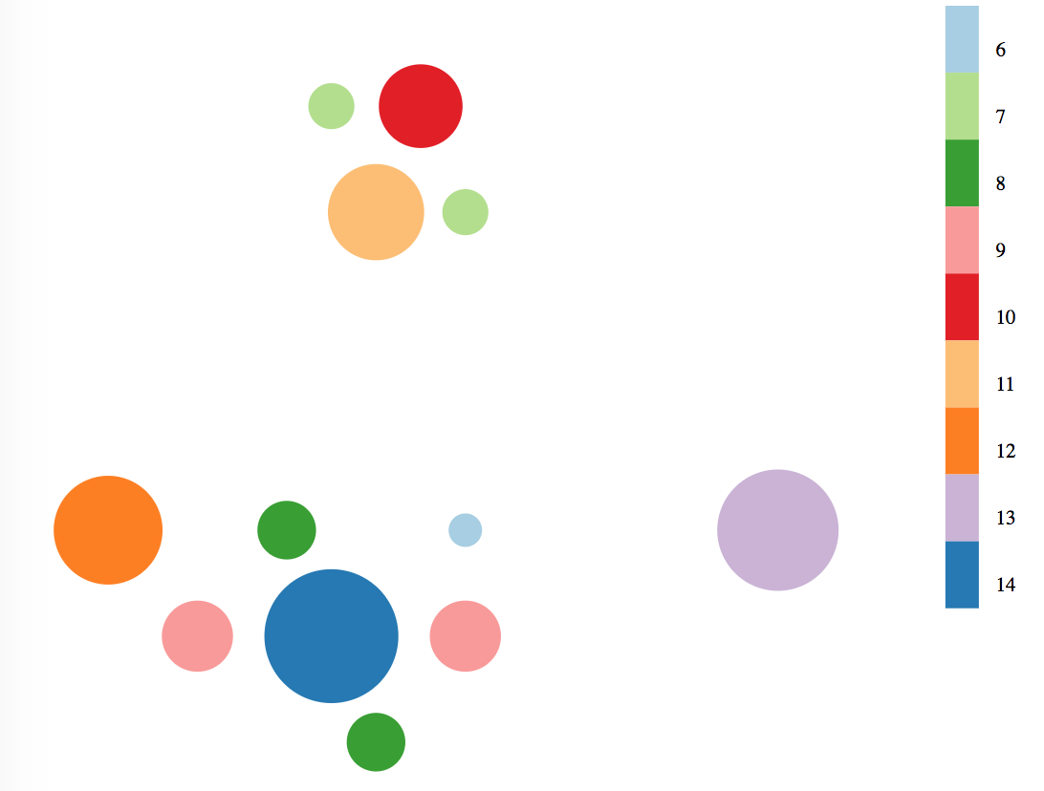
Color legend
1. For categorical color scheme.

Slide 3
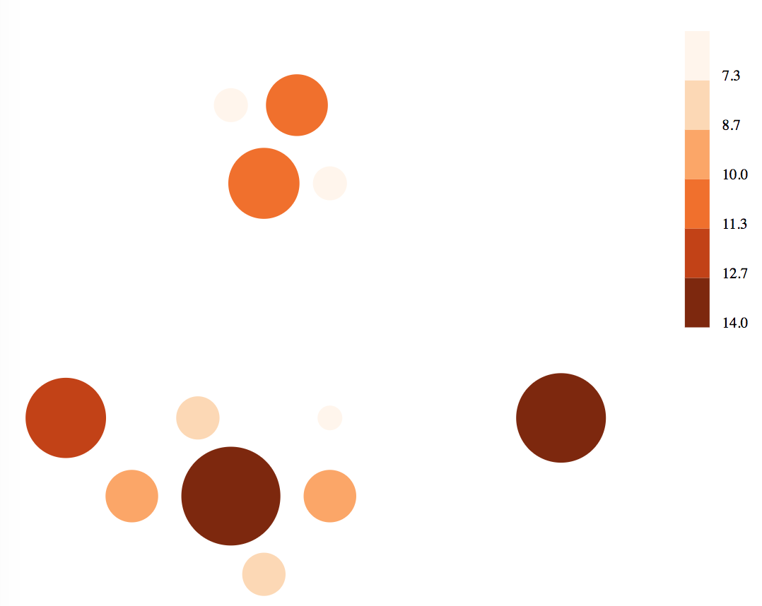
Color legend
2. For sequential color scheme.

Slide 4
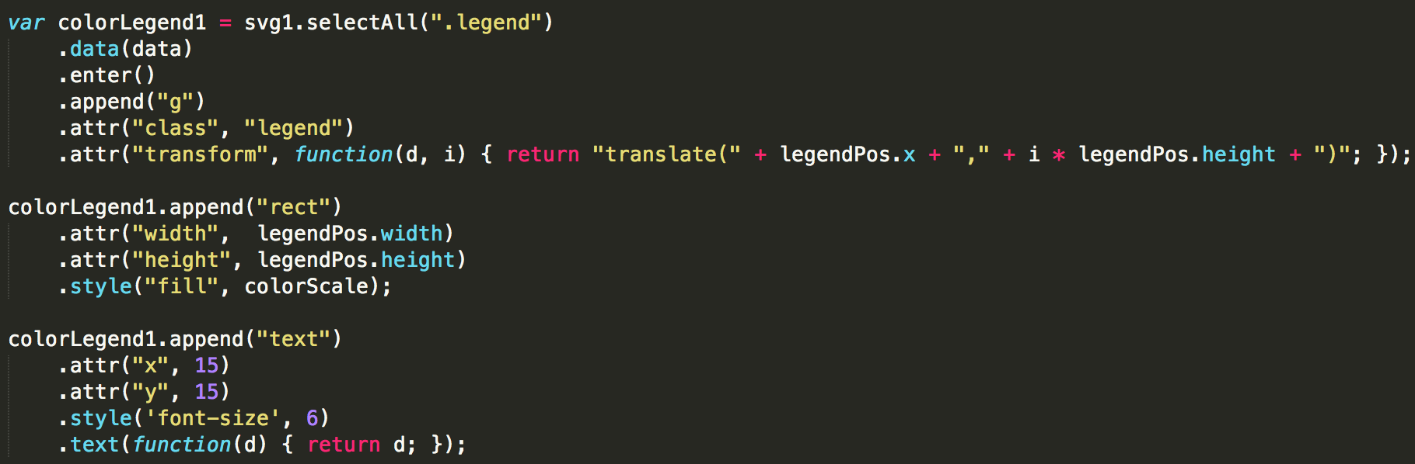
How to add legend
Example.

Slide 5
Exercise
Add color legend for categorical color scheme.

Slide 6
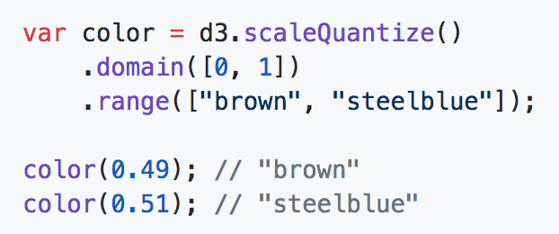
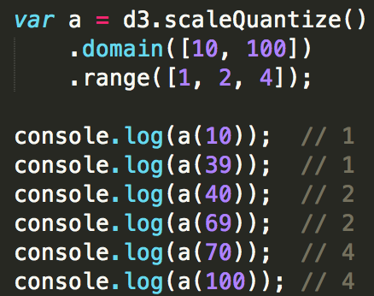
Quantize scales
d3.scaleQuantize() <>
Similar to linear scale
But they use a discrete rather than continuous range.
Input domain is divided into segments based on the range.

Slide 7
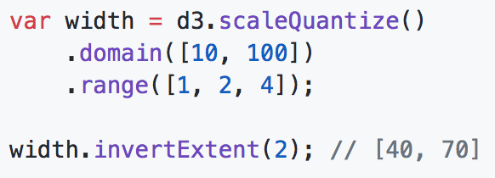
Quantize scales
quantize.invertExtent(value) <>
“Returns the extent of values in the domain for the corresponding value in the range.”

