Slide 1
Lab5-Bubble chart
5/15

Slide 2
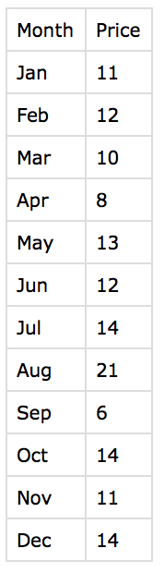
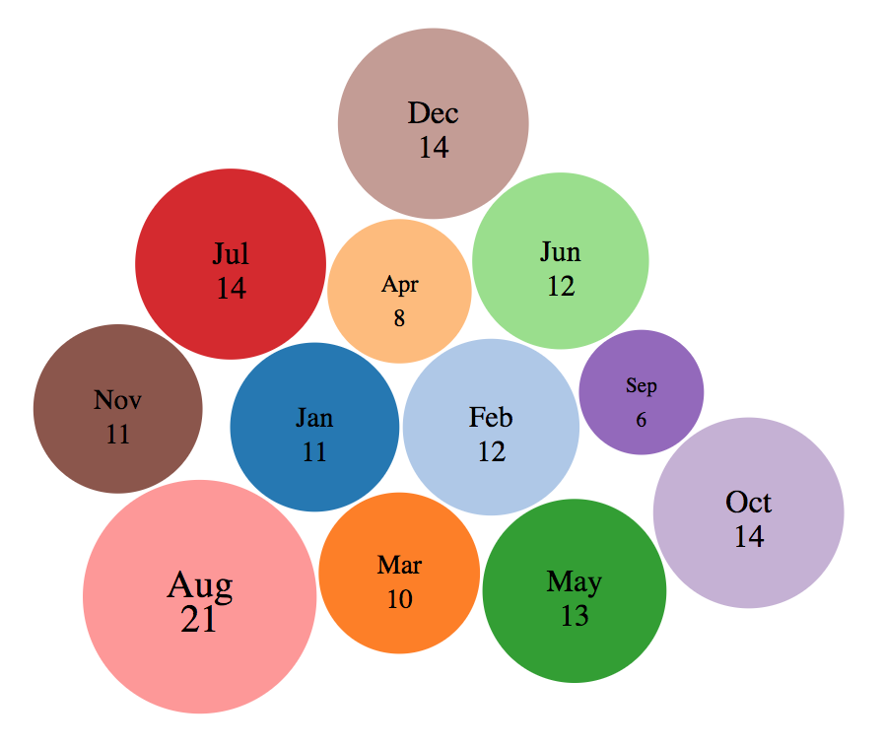
Bubble Chart in D3

Slide 3
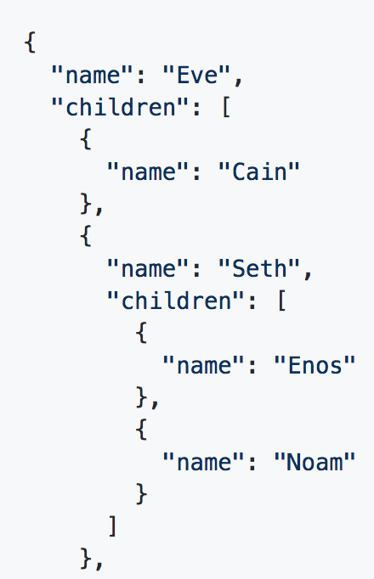
Draw Bubble Chart with Pack Layout
d3.pack()
Create a new pack layout.
pack(root)
Lays out the root hierarchy.
d3.hierarchy(data[, children])
Constructs a root node from hierarchical data
Hierarchy format data (e.g. JSON)

Slide 4
Something needs to know
node = d3.hierarchy(data[, children])
“You must call node.sum or node.count before invoking a hierarchical layout that requires node.value.”
d3.packSiblings(circles)
“The circles are positioned according to the front-chain packing algorithm by Wang et al.”

Slide 5
Code

Slide 6
More examples
Circle packing.

