Slide 1
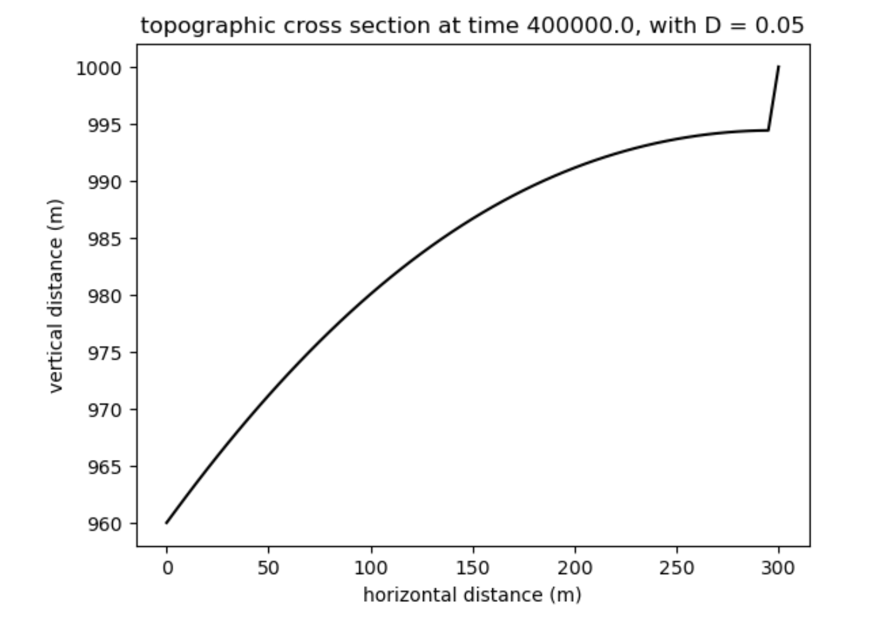
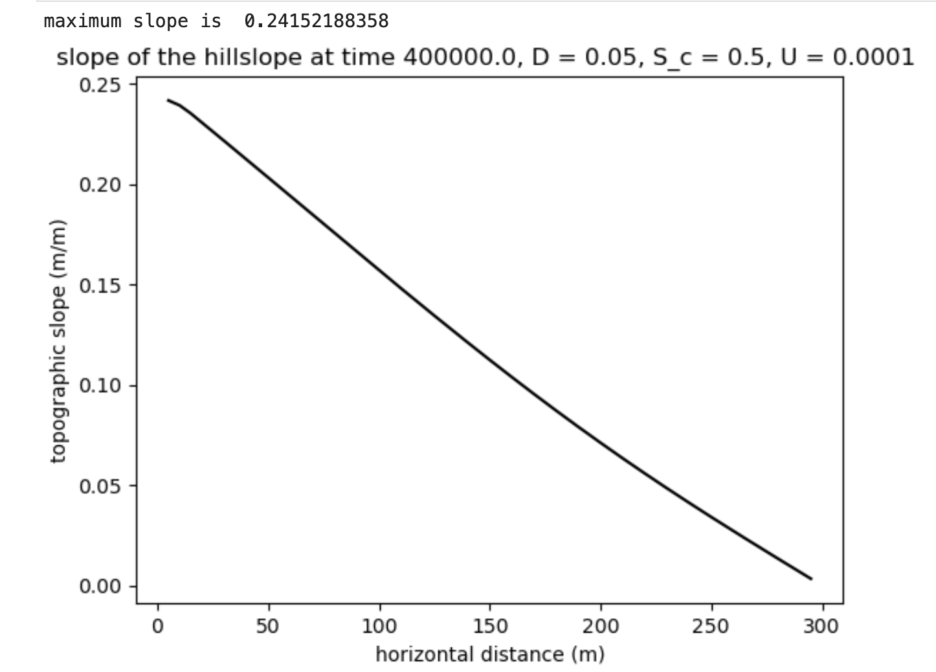
Initial condition, erosion rate ~0.1 mm/yr everywhere. Ignore the cliff at the top of the profile. That is a boundary node.

Slide 2
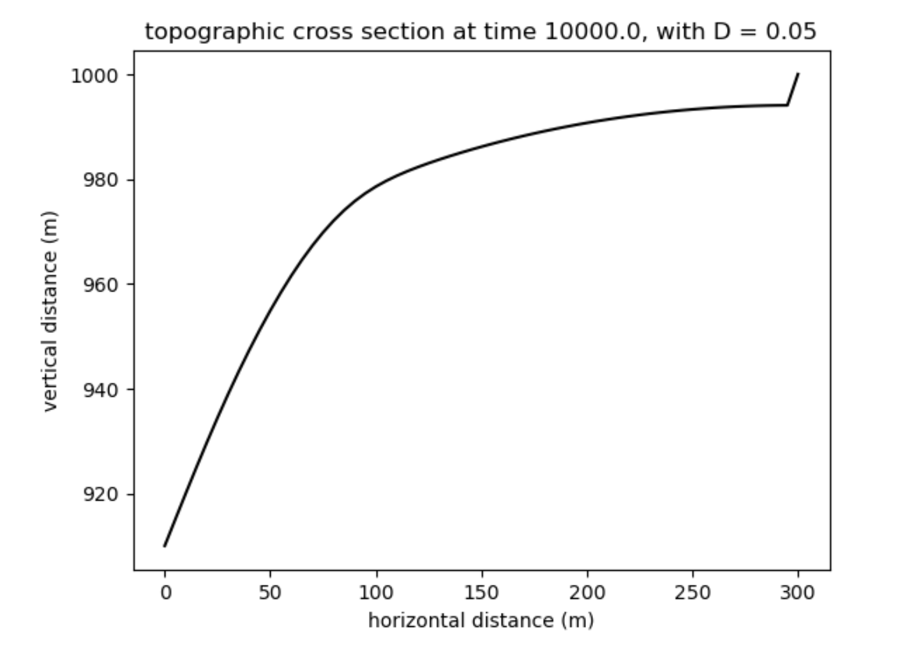
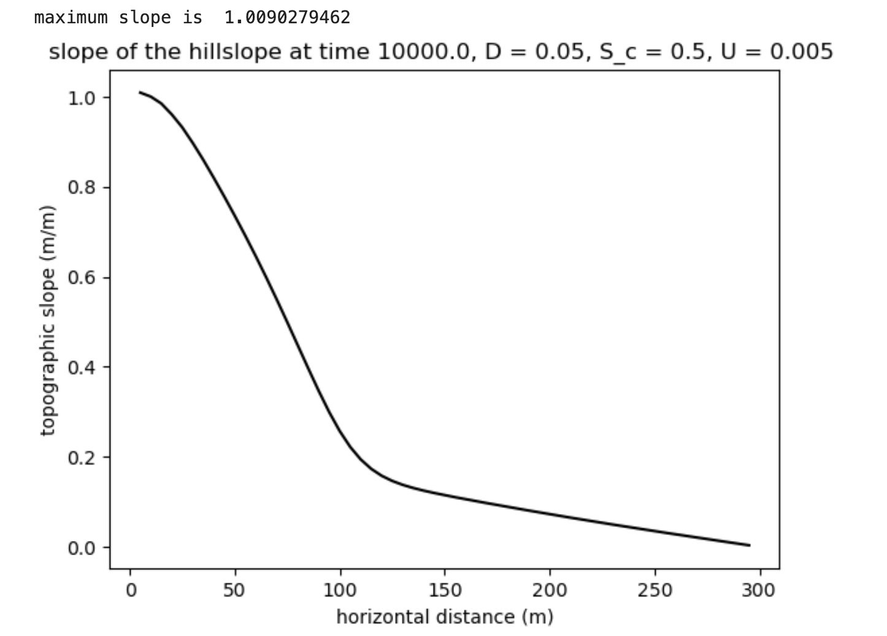
Increase uplift rate to 5 mm/yr. 10,000 years later. parameters in sediment transport function unchanged.

Slide 3
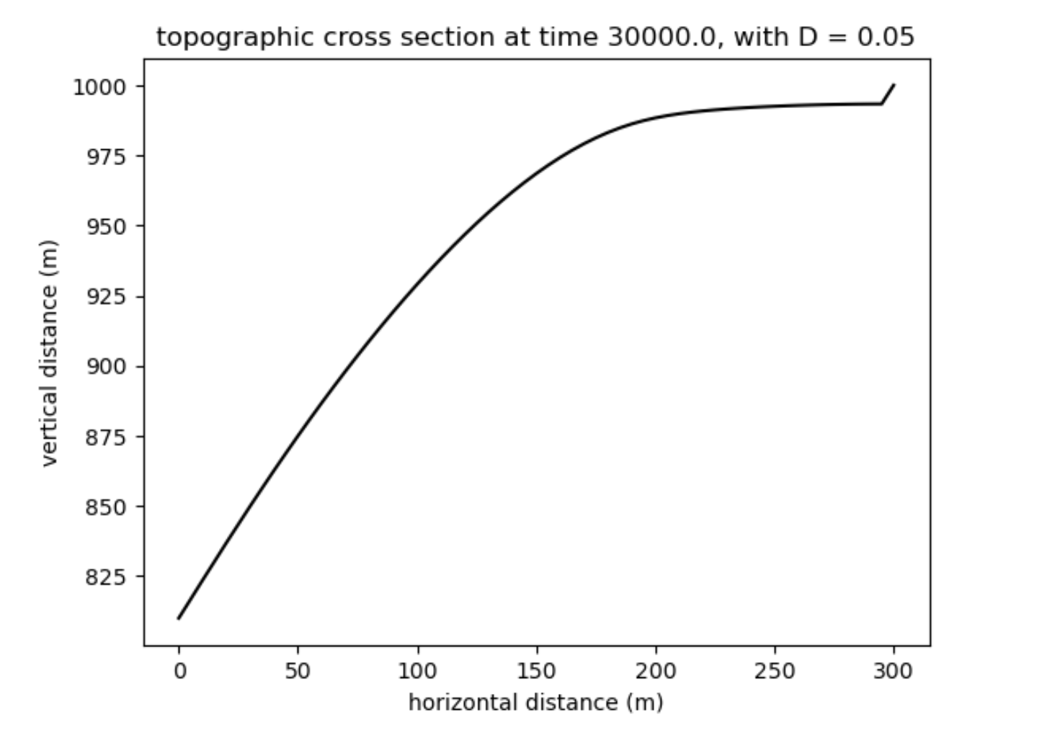
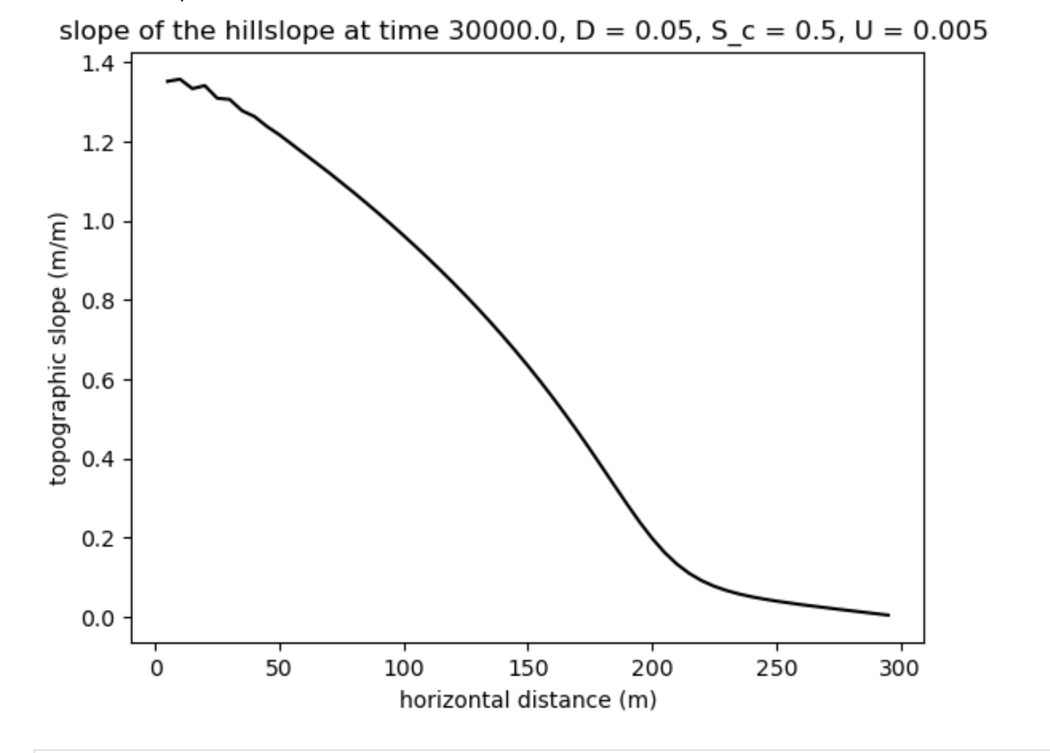
Increase uplift rate to 5 mm/yr. 30,000 years later. parameters in sediment transport function unchanged. There is some instability at the bottom of the slope, evident in the slope profile. Ignore that.

