Slide 1
Image Classification

Slide 2
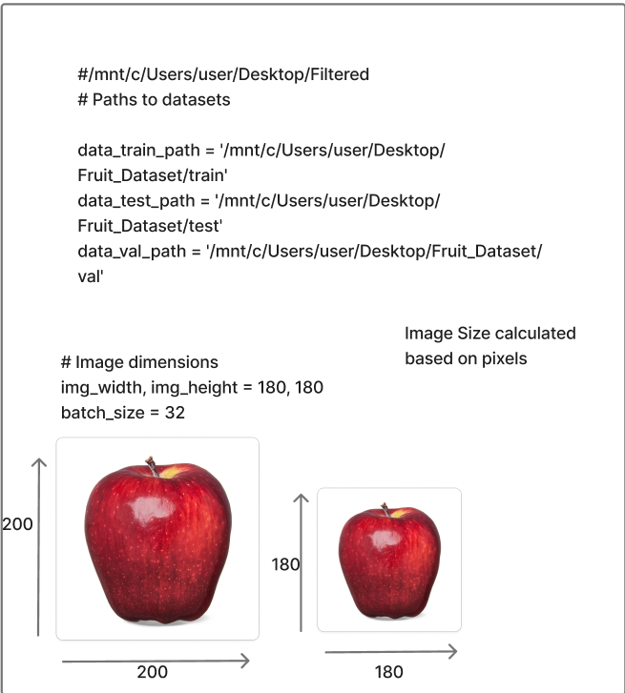
Data Loading

Slide 3
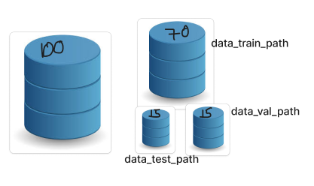
Data Splitting
import splitfolders # or import split_folders
input_folder = '/mnt/c/Users/user/Desktop/Filtered' # Path to your dataset
output_folder = '/mnt/c/Users/user/Desktop/Fruit_Dataset' # Path where the split datasets will be saved
Split the dataset into train (70%), validation (15%), and test (15%)
splitfolders.ratio(input_folder, output=output_folder, seed=42, ratio=(.7, .15, .15))

Slide 4
Data Processing
data_test = tf.keras.utils.image_dataset_from_directory(
data_test_path,
image_size=(img_width, img_height),
batch_size=batch_size,
shuffle=False
)
data_val = tf.keras.utils.image_dataset_from_directory(
data_val_path,
image_size=(img_width, img_height),
batch_size=batch_size,
shuffle=False
)
# Load datasets
data_train = tf.keras.utils.image_dataset_from_directory(
data_train_path,
shuffle=True,
image_size=(img_width, img_height),
batch_size=batch_size,
validation_split=False
)

Slide 5
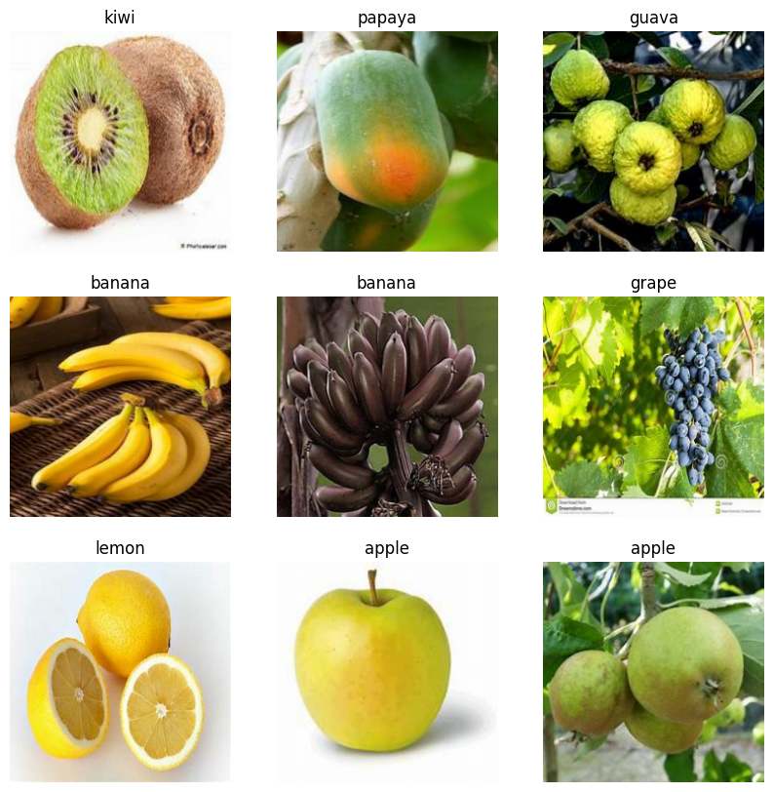
# Data visualization
# Class names and weights
data_cat = data_train.class_names
class_counts = np.concatenate([y.numpy() for _, y in data_train], axis=0)
class_weights = class_weight.compute_class_weight('balanced', classes=np.unique(class_counts), y=class_counts)
class_weights = dict(enumerate(class_weights))
# Data visualization
plt.figure(figsize=(10, 10))
for images, labels in data_train.take(1):
for i in range(9):
plt.subplot(3, 3, i + 1)
plt.imshow(images[i].numpy().astype("uint8"))
plt.title(data_cat[labels[i]])
plt.axis("off")
plt.show()

Slide 6
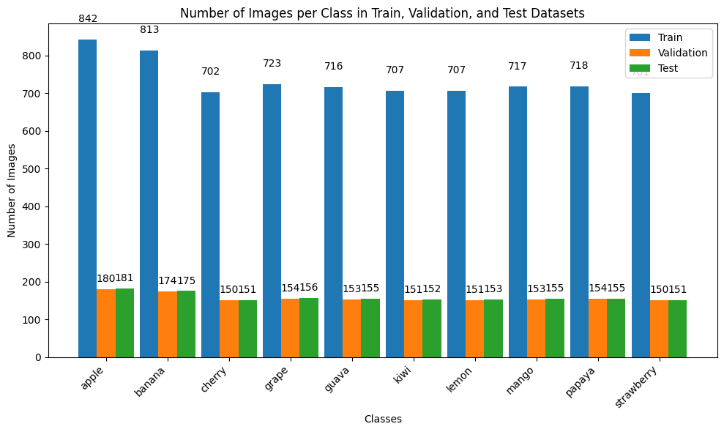
BAR VISUALIZATION

Slide 7
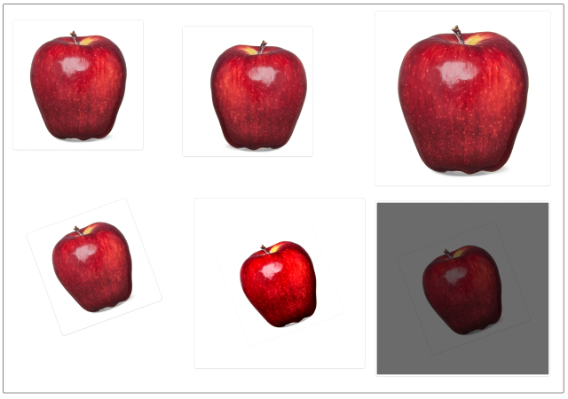
Data Regularization Data Regularization
# Data augmentation
data_augmentation = Sequential([
layers.RandomFlip("horizontal"),
layers.RandomRotation(0.1),
layers.RandomZoom(0.1),
layers.RandomBrightness(0.1),
layers.RandomContrast(0.1)
])

Slide 8
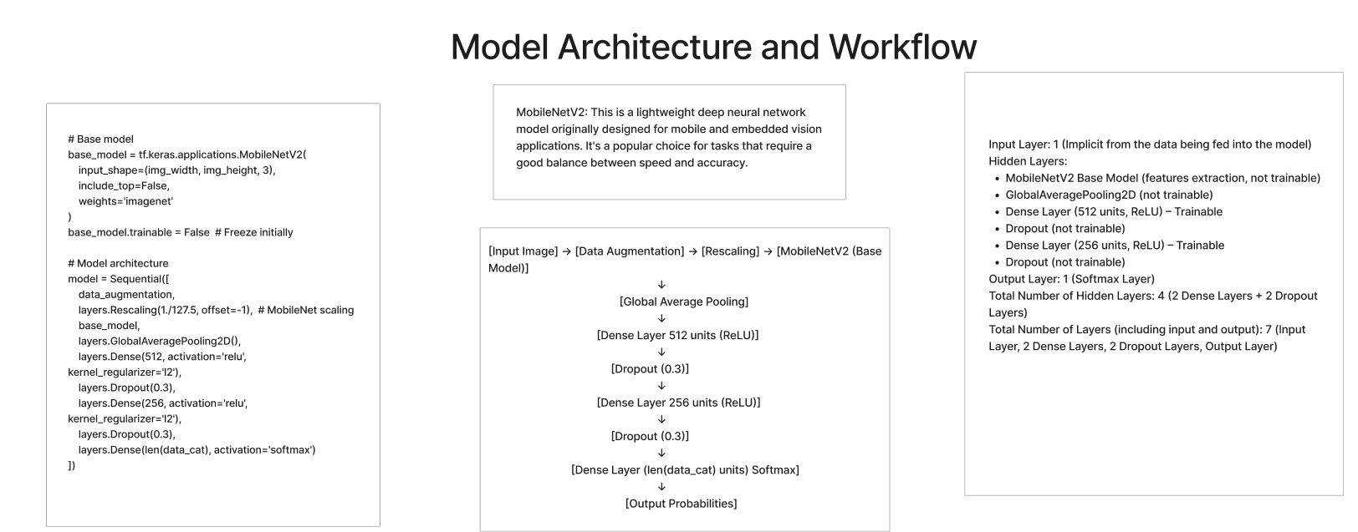

Slide 9
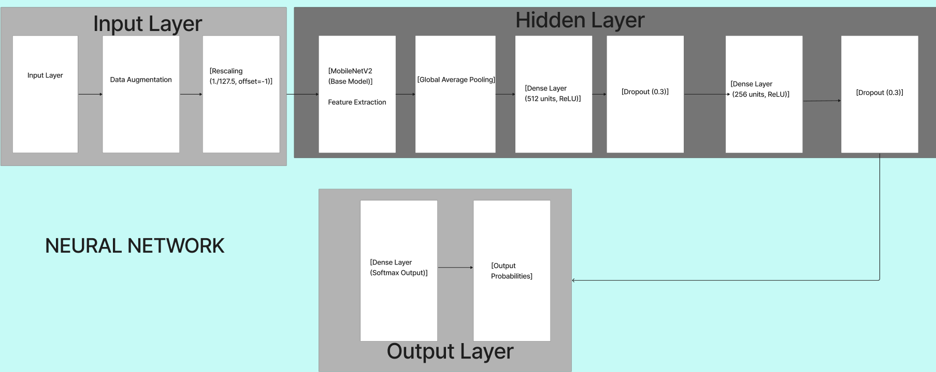

Slide 10
Early Stopping Callback
early_stopping = EarlyStopping(
monitor='val_loss',
patience=15,
restore_best_weights=True
)
The EarlyStopping callback is used to stop training if the model's performance (on the validation set) is no longer improving, thereby preventing overfitting and unnecessary training epochs. This helps the model to stop training early when it is unlikely to improve further.
ReduceLROnPlateau Callback
reduce_lr = ReduceLROnPlateau(
monitor='val_loss',
factor=0.2,
patience=5,
min_lr=1e-6 # 0.000001
)
If the model's validation loss doesn't improve, the learning rate will be reduced, potentially allowing the model to find a better local minimum and improve further.

