Slide 1
Hackathon 2: McKinsey Challenge
Ramya, Yogesh, Rushabh, Pri, Nikhila, Sagar

Slide 2
Structure of Presentation
Problem Statement
Our Solution
Data cleaning and Preprocessing
Data visualization and exploratory data analysis
User based collaborative filtering model
Alternative Approaches
Challenges we faced

Slide 3
Problem Statement
Building a recommender system for Mckinsey challenges
Resources: training set, test set, targets
Training set: A list of challenges done by users
Challenge: A database of challenges
Test set: A partially completed list of challenges done by users, wherein each user requires 3 additional challenges to be recommended to them
Targets: The actual 3 new challenges each test user selected

Slide 4
Our solutions deck
User based collaborative filtering algorithm
Item based collaborative filtering algorithm
Content based recommender system
Reorganize the problem as a supervised learning problem- multi-class classification problem per user.

Slide 5
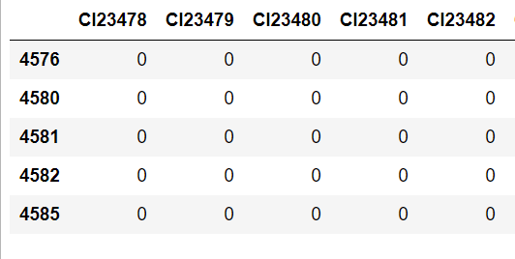
Data Cleaning
Goal: To create a user-challenge matrix for our training set
Approach
We took a random subsample of 250,000 records
Data preprocessing to create a user-challenge matrix of 20,000 users

Slide 6
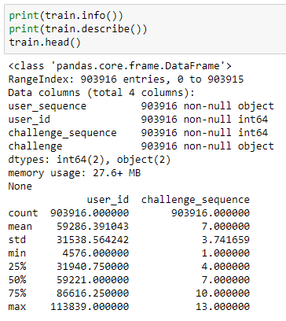
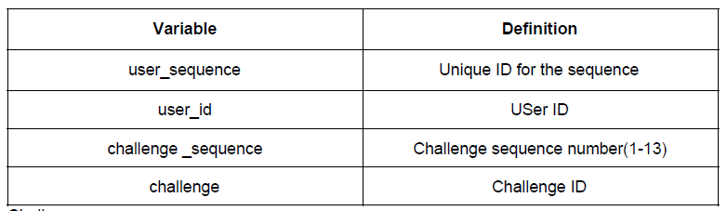
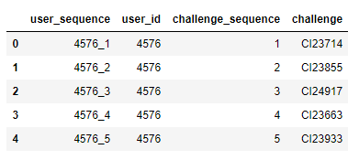
Train.csv
Data description
Data snapshot

Slide 7
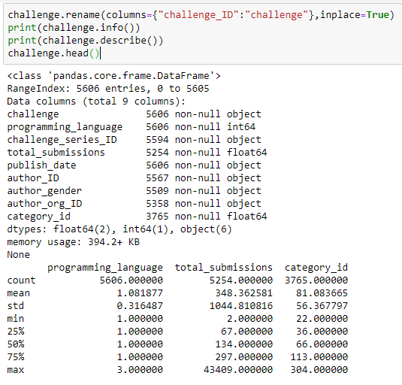
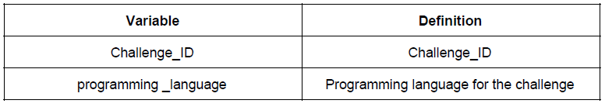
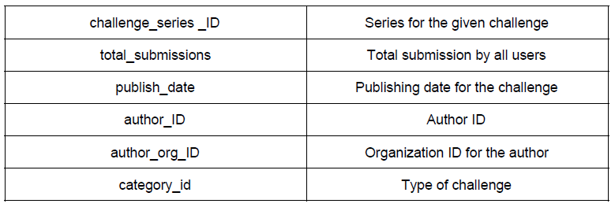
Challenge.csv
Data description

Slide 8
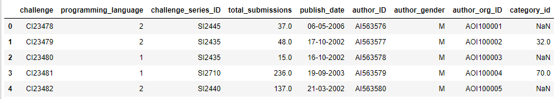
Challenge.csv
Data snapshot
The programming language and category columns were being read as numeric column whereas they were categories. So we converted them to string.
Missing values were replaced.

Slide 9
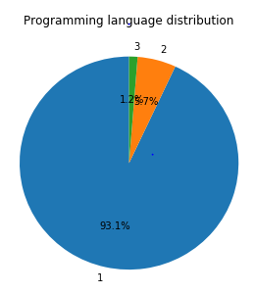
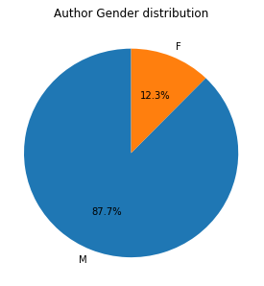


Language 1 is the popular choice for challenges
Male authors dominate challenges

Slide 10
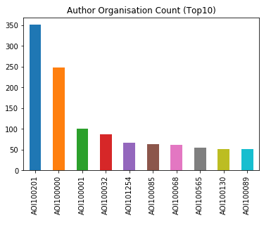
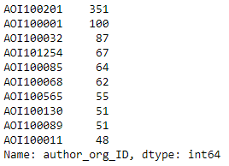
We observe that 2 organisations out of 1718 have maximum participations for challenge development

Slide 11
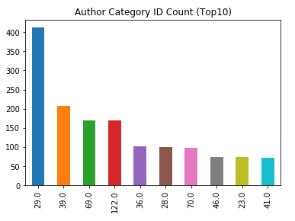
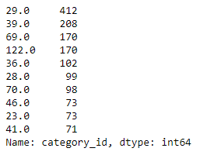
We observe that 5 categories out of 195 are the popular category used for development.

Slide 12
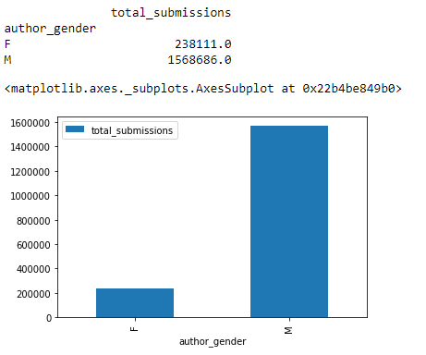
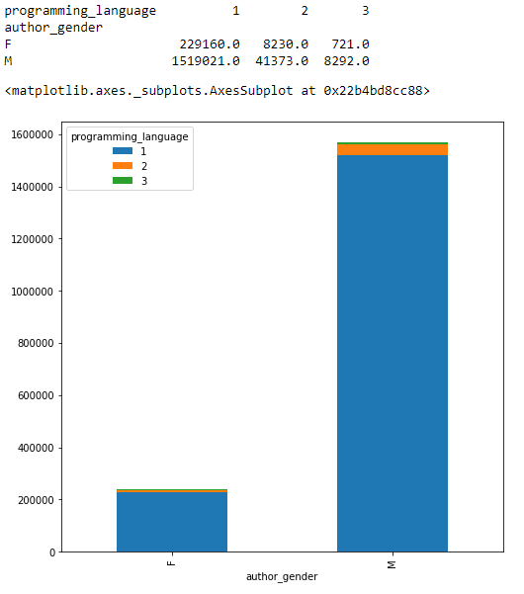
Maximum participation is by male candidate for challenges with language 1.

Slide 13
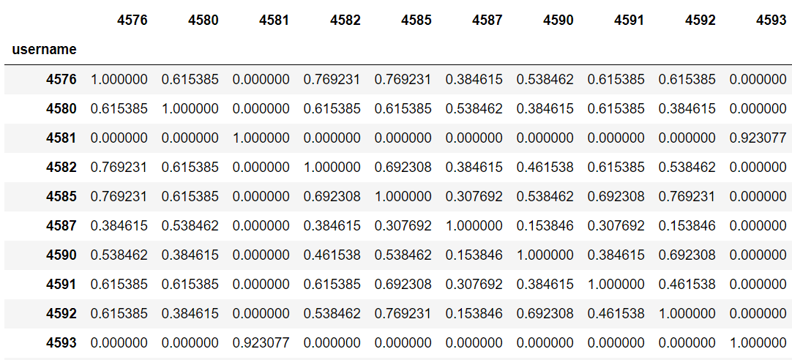
Similarity Metrics
We used both cosine similarity and Euclidian distance to measure the distance between users based on their challenge histories in the training set
Cosine similarity gave us better results when compared with the target sample submission results

Slide 14
User based collaborative filtering
Our approach:
Using the calculated cosine similarity got the top ten similar users.
Got the challenges solved by the similar users and not solved by the target user.
Selected the top 3 challenges from the above generated results.
Calculated the Mean Average Precision (for K=3).
We got a MAP value of 24% (0.24).

Slide 15
Alternative Approaches
Use feature engineering to create similarity features and use them as input to a supervised classifier (logistic regression).
Use item based collaborative filtering in combination with user based.

Slide 16
Challenges we faced
A lot of memory errors due to the huge size of data and not enough computing power!

