Slide 1
MATOI
NEWS
DATA
A market for
AI intelligence
BUY
Autonomous agents discover information, judge its value,
pay per request, and prove every move onchain
RISK
VIDEO
PRIMARY TRACK
DISCORD
ARC HOUSE
Best Agentic
Economy Application
yomek
Niki Li (yomek)

Slide 2
2/16 · MATOI
WHY MATOI EXISTS
訳
From cyberpunk to
a working agent market.
Cyberpunk gave the image: autonomous systems trading information and services. Matoi turns one piece of that idea into a product loop reviewers can run.
ORIGIN
TODAY
MATOI RUN
Autonomous software searches, negotiates and transacts with other software.
Crypto intelligence is split across Telegram, APIs, feeds and private chats.
BuyerAgent finds providers, checks quotes, pays accepted calls and records the receipt.
源
RUN RESUKT
A buyer agent requests intelligence, pays for it, and leaves an auditable trail.

Slide 3
3/16 · MATOI
WHAT MATOI DOES
訳
One RUN click.
BuyerAgent handles
the loop.
DISCOVER
01
Provider directory → quotes per call
Telegram, RSS, prices, TVL, releases
EVALUATE
02
Budget + risk policy → ranked offers
The user picks a scenario. BuyerAgent discovers providers, asks for quotes, checks policy, pays selected calls and writes the proof trail.
BuyerAgent decides what is worth paying for
PAY
03
Circle wallet authorizes USDC spend
Hedera x402 facilitator settles the accepted call
INSIDE ONE MISSION
Input: buyer scenario + budget policy
PROVE
Output: transcript + receipt + HCS proof
04
Receipt hash → HCS anchor
A2A transcript stores every mission step
源
Discover → evaluate → pay → prove
The UI shows the run as a live transcript, so reviewers can follow each decision and payment step.

Slide 4
4/16 · MATOI
THE AGENTS ARE SMART
評
Agents read, price,
and decide.
Matoi has agents on both sides of the trade: providers turn raw streams into priced intelligence; BuyerAgent decides what is worth buying for the current mission.
PROVIDER AGENTS
BUYER AGENT
• Read raw sources: Telegram, RSS, prices, TVL, releases
• Score each item: importance, asset, horizon, impact
• Set price per call based on usefulness
• Publish the catalog in the marketplace directory
• Reads the marketplace and asks for quotes
• Knows its budget and risk profile
• Ranks providers for the current task
• Holds the wallet and pays accepted calls
買
LIVE EXAMPLE
TelegramPulse Provider Agent
A public Telegram bot aggregates market-moving messages. TelegramPulse reads the stream, scores sentiment and intensity, then sells the signal behind a 402-style payment boundary. BuyerAgent pays per call, receives a tagged hashed sample, and uses it inside the mission.
MORE PROVIDERS CAN USE THE SAME PATTERN
video/speech analysis · policy speech readers · social-feed scoring · contract-deploy watchers
New agents can be added without changing the buyer flow or payment rail.

Slide 5
5/16 · MATOI
CORE FUNCTION
An autonomous buyer-agent runs one mission:
picks providers,
authorizes Arc/Circle spend,
pays per call on Hedera,
anchors proof on HCS.
Three rails, one transcript, one receipt.
Discover → Authorize → Pay → Prove.

Slide 6
6/16 · MATOI
CIRCLE DEVELOPER TOOLS
How Matoi uses
Circle.
Matoi uses Circle in three places: wallet control, USDC movement, and spend records.
Developer Controlled Wallets
Three role wallets on ARC-TESTNET: Trader, ArcResearch, Risk. They hold USDC and sign spend intents.
BuyerAgent reads the role wallet, signs the spend intent, then passes the receipt back into the mission.
USDC transfer API
A real testnet USDC transfer shows that the agent paid. Matoi calls the Circle transfer API end-to-end.
After BuyerAgent picks a provider, the trader wallet authorizes and moves USDC to ArcResearch.
Authorization ledger
Authorized spend is written with idempotency keys. That prevents double-pay and silent loss.
The mission log shows what was authorized, what was paid, and what stayed simulation-only.

Slide 7
7/16 · MATOI
Why Circle in
our agent flow
An agent economy needs controlled wallets, programmable payment calls, and a spend record the app can inspect.
PROBLEM
CIRCLE ANSWER
WHY IT FITS MATOI
Agents need to hold funds, request payment, and prove what happened. Manual wallets break the flow.
Developer Controlled Wallets hold the role accounts. USDC APIs move testnet funds. The authorization ledger keeps the mission auditable.
The buyer agent can authorize a small spend, pay a provider, and continue the mission from one RUN click.

Slide 8
8/16 · MATOI
Where Circle shows up
in one run
The UI has one RUN button. Under it, BuyerAgent discovers providers, authorizes spend, pays per call, and anchors proof.
Pick scenario
The user selects DAO treasury, market narrative, ETH risk, security shock, or provider marketplace.
1
Discover providers
BuyerAgent requests quotes and ranks them by budget and risk.
2
3
Authorize spend
Trader wallet signs a small testnet USDC spend intent for each accepted provider.
CIRCLE
4
Pay per call
The Hedera x402 facilitator settles the per-call price and returns a signed receipt.
CIRCLE
Anchor proof
The receipt hash is anchored to HCS. The mission remains simulation-only by default.
5

Slide 9
訳
9/16 · MATOI
ARCHITECTURE
The buyer side
Where one RUN click becomes a priced mission.
BUYER-FACING SURFACE
AGENT RUNTIME
MISSION ROUTES
/api/mission/run
PAYMENT BOUNDARY
Control Room UI
BuyerAgent
turns scenario into a transcript
discover · score · spend
Next.js 16 · React · TypeScript
scenario picker · RUN button
A2A transcript
TypeScript scenario runner
mission · budget · risk
chooses providers
Blocky402 toggle
keeps real payments explicit
returns receipt data to mission
/api/x402/blocky402/pay
paid request endpoint
used when Blocky402 is ON
WHAT THIS SLIDE PROVES
買
The buyer side is small on purpose. The user picks a scenario, then the agent owns the mission logic and calls only two routes before the payment rail takes over.
UI
Agent
Routes
Output
scenario + RUN
budget + risk
mission + 402
transcript
Next: provider sources. The same buyer can pay different agents without changing this surface.

Slide 10
10/16 · MATOI
ARCHITECTURE
Provider sources
Where the intelligence enters the market.
LIVE SOURCE
TelegramPulse
Provider Agents
BuyerAgent
Telethon reader bridge pulls a public Telegram stream, scores sentiment and intensity, then exposes the signal behind a 402 boundary.
read source
score item
quote price
publish catalog
CATALOG + PRICE
chooses providers by task, budget and risk
then pays per accepted call
QUOTE ACCEPTED
HASHED SAMPLE · PAID CALL
TelegramNews
RSS News
CoinGecko
DefiLlama
GitHub Releases
OpenRouter
headline feed
CoinDesk / Cointelegraph
price + volume API
TVL + protocol flows
release / security activity
LLM evaluator
源
Add one provider agent to the directory. The buyer flow and payment rail stay unchanged.
This is why the Telegram demo matters: it is one live source, not a special case.

Slide 11
11/16 · MATOI
ARCHITECTURE
Payment rails
How a paid provider call becomes a Hedera USDC receipt.
LOCAL PAYMENT PACKAGE
SETTLEMENT RAIL
Build spend
Sign transfer
Attach header
Settle
Receipt
Pick quote
prepare paid call
Create signed
USDC transaction
Attach x402 signature
to the request
Blocky402 route
verifies the call
USDC receipt
plus tx hash
TECHNICAL PATH
ECDSA key → USDC transfer → x402 header → /settle → receipt
The mission stores receiptId and txHash in the transcript. HCS anchors the proof on the next slide.
USDC
x402
Ledger
testnet transfer
pay per call
idempotent entry

Slide 12
12/16 · MATOI
ARCHITECTURE
Audit and nanopayments
Every accepted paid call writes an app record and a public proof.
ACCEPTED CALL
provider selected · price accepted · usage counted
APP LEDGER
PUBLIC PROOF
Meter entry
Arc spend ledger
Transcript
Hash
HCS topic
base + costPerCall × calls
PROVIDER_PAYMENT
mission summary
allowlisted
0.0.10426202
NANOPAYMENT_SETTLED
Hedera testnet
Stored idempotently in .data/arc-spend-ledger.json
Public payload contains hashes and summaries only
PAYLOAD
GUARD
No bot tokens, API keys, private keys, or raw Telegram messages are stored.
Result: UI transcript for review · JSON ledger for the app · HCS proof for verification

Slide 13
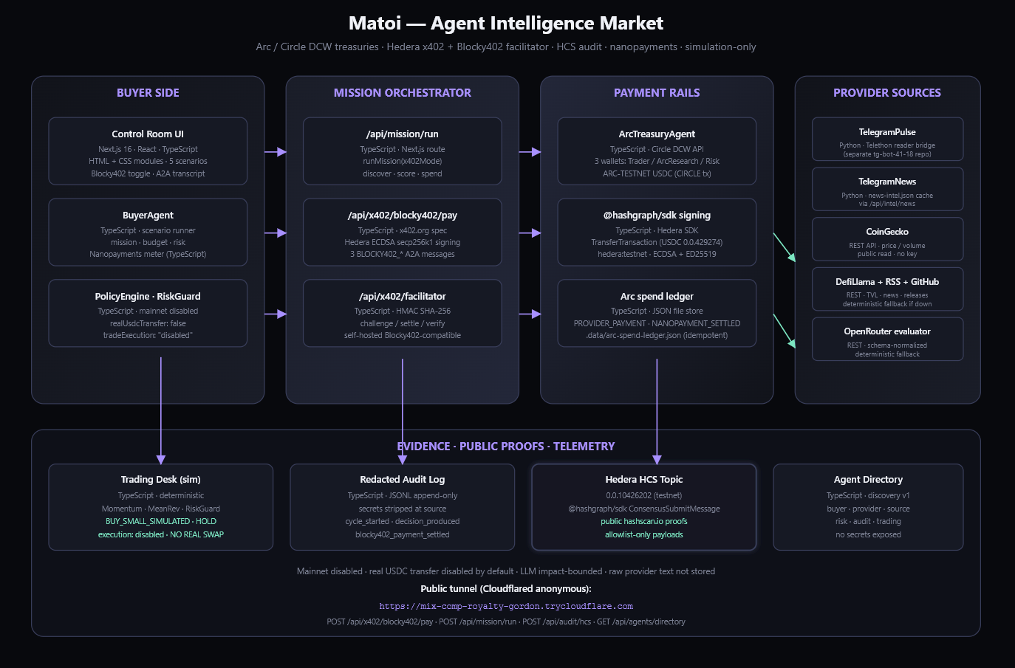
13/16 · MATOI
ARCHITECTURE
The full system in one view.

Slide 14
14/16 · MATOI
SAFETY AND SCOPE
Safety and scope
Testnet-only execution with explicit transfer gates.
RUN MODE
ARC-TESTNET only · simulation decisions · no mainnet path exposed
real transfers gated
MAINNET LOCK
TRADE LOCK
TRANSFER GATE
mainnetDisabled = true
realTrade = false
execution = disabled
ARC_REAL_USDC_TRANSFER
CONFIRM_REAL_TRANSFER
returned on every response
decision stays simulated
required before testnet USDC moves
LIVE IN THE DEMO
PAYLOAD GUARD
OpenRouter evaluations
live
HCS payloads are allowlisted
hashes + summaries
Arc spend authorization
testnet
No bot tokens or API keys
repo stays clean
Hedera USDC x402 request
receipt
Raw Telegram messages are not stored
redacted output
HCS proof + UI transcript
visible
Matoi runs real testnet payment and proof steps while keeping trading execution disabled.

Slide 15
15/16 · MATOI
DOCS AND EVIDENCE
Docs and live evidence
Where reviewers can check the build, the tracks, and the live proof artifacts.
README AND DOCS
LIVE PROOF ARTIFACTS
README.md
track fit, setup, architecture
GET /api/arc/status
Circle wallet status
docs/ARC_TRACK.md
Arc/Circle bounty mapping
GET /api/system/status
Hedera readiness
docs/HEDERA_TRACK.md
Hedera bounty mapping
POST /api/x402/blocky402/pay
paid request
blocky402-real-setup.md
paid-request setup
x402-ddefa10403571327
sample receipt
docs/SETUP.md
per-integration wiring
0.0.10380366@1789189919.552662668
USDC association tx
architecture.svg
full system diagram
HCS topic 0.0.10426202
public proof topic
DEMO_SCRIPT.md
voiceover and shot list
42 files / 91 tests passing
test suite
Technical submission doc
DOCX in submission package
SMOKE_HTTP_OK
every build
The README carries the full technical story; this deck keeps the reviewer path short.

Slide 16
16/16 · MATOI
MATOI
Thanks for reading
“The future is already here —
it’s just not very evenly distributed.”
— William Gibson

