Slide 1
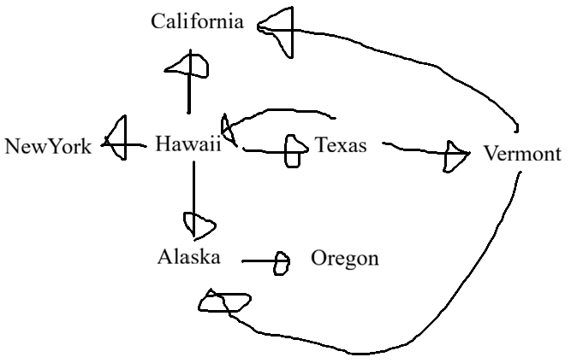
CMSC204
Kartchner
V(StateGraph) = {Oregon, Alaska, Texas, Hawaii, Vermont, NewYork, California}
E(StateGraph) = {(Alaska, Oregon), (Hawaii, Alaska), (Hawaii, Texas), (Texas, Hawaii), (Hawaii, California), (Hawaii, New York), (Texas, Vermont), (Vermont, California), (Vermont, Alaska)}
1. Draw the StateGraph

Slide 2
a. Show the adjacency matrix that would describe the edges in the graph. Store the vertices in alphabetical order
States
AK CA HI NY OR TX VT
AK
CA
HI
NY
OR
TX
VT
0 | 0 | 0 | 0 | 1 | 0 | 0
0 | 0 | 0 | 0 | 0 | 0 | 0
1 | 1 | 0 | 1 | 0 | 1 | 0
0 | 0 | 0 | 0 | 0 | 0 | 0
0 | 0 | 0 | 0 | 0 | 0 | 0
0 | 0 | 1 | 0 | 0 | 0 | 1
1 | 1 | 0 | 0 | 0 | 0 | 0
3. b. Show the adjacency lists
that would describe the edges in the graph
Alaska | Oregon
California | [No neighbors]
Hawaii | Alaska, Texas, California, NewYork
NewYork | [No neighbors]
Oregon | [No neighbors]
Texas | Hawaii, Vermont
Vermont | California, Alaska

Slide 3
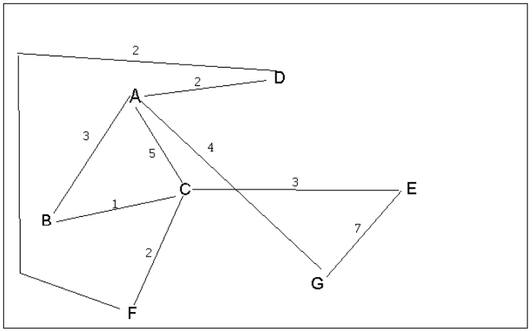
4 a. Which of the following lists the graph nodes in depth first order beginning with E?
A) E, G, F, C, D, B, A
B) G, A, E, C, B, F, D
C) E, G, A, D, F, C, B
D) E, C, F, B, A, D, G
ANSWER: C
(I’m not sure what order was chosen when there were multiple options,
but the other answers are not possible as they backtrack instead of focusing on depth first
4 b. Which of the following lists the graph nodes in breadth first order beginning at F?
A) F, C, D, A, B, E, G
B) F, D, C, A, B, C, G
C) F, C, D, B, G, A, E
D) a, b, and c are all breadth first traversals
Alphabetical order gets option A
Reverse alphabetical order gets FDCAEBG which isn’t an option
Option B cannot be correct since it repeats vertices
ANSWER: A

Slide 4
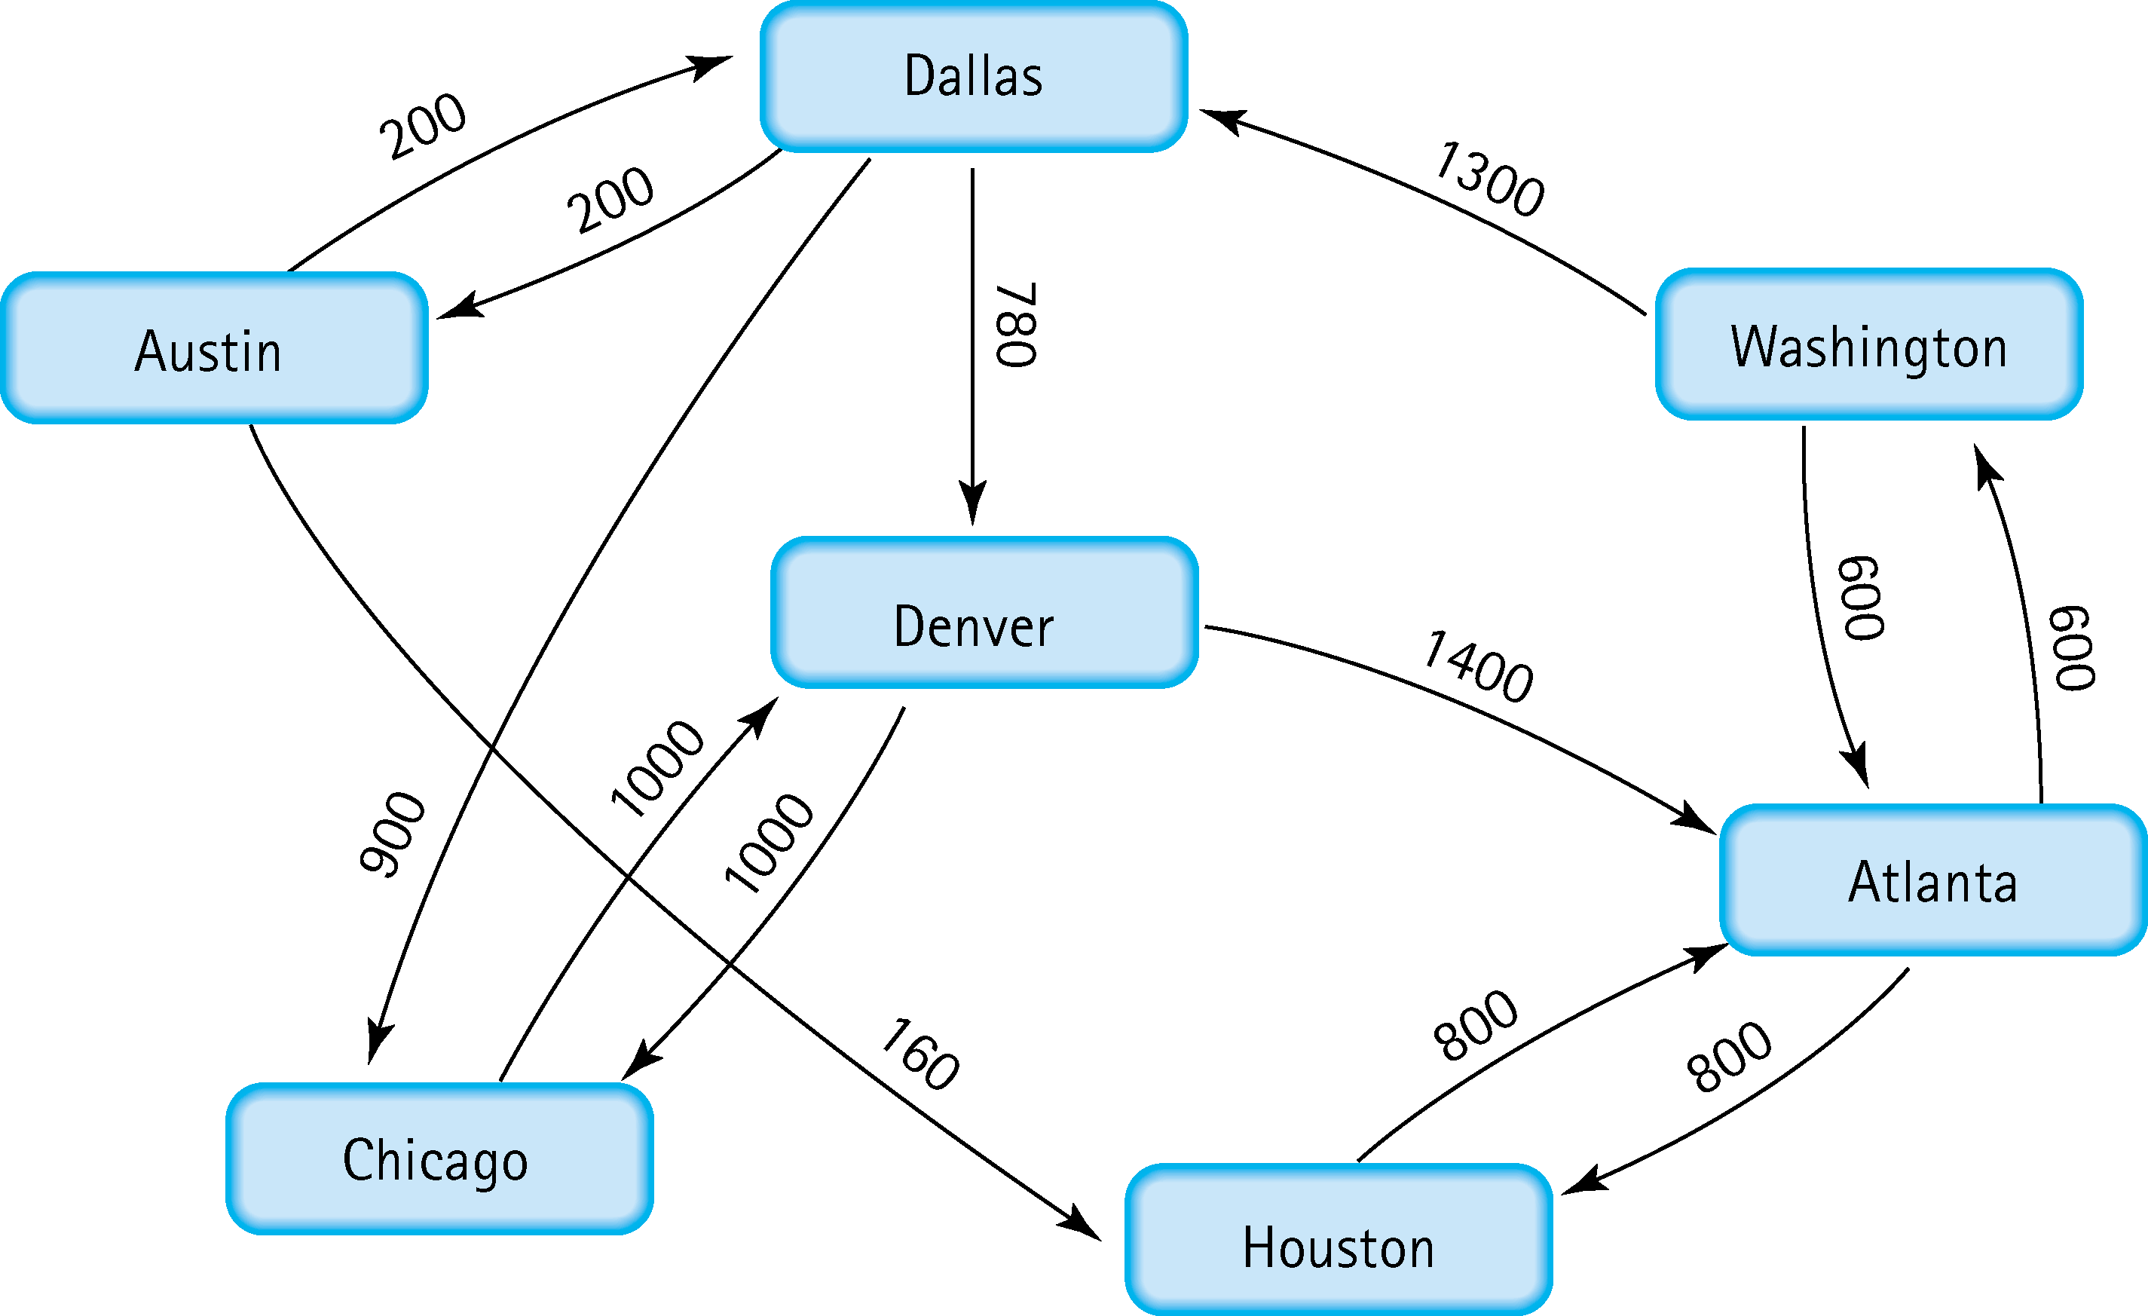
Find the shortest distance from Atlanta to every other city
To Austin (2100): Atlanta -> Washington -> Dallas -> Austin
To Chicago (2800): Atlanta -> Washington -> Dallas -> Chicago
To Dallas (1900): Atlanta -> Washington -> Dallas
To Denver (2680): Atlanta -> Washington -> Dallas -> Denver
To Houston (800): Atlanta -> Houston
To Washington (600): Atlanta -> Washington

Slide 5
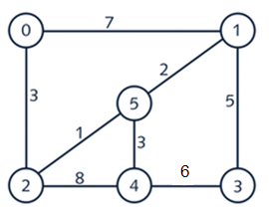



6. Find the minimal spanning tree using Prim’s algorithm. Use
0 as the source vertex . Show the steps.
ANSWER

Slide 6


7. Find the minimal spanning tree using Kruskal’s algorithm.
Show the weights in order and the steps.
ANSWER

Slide 7
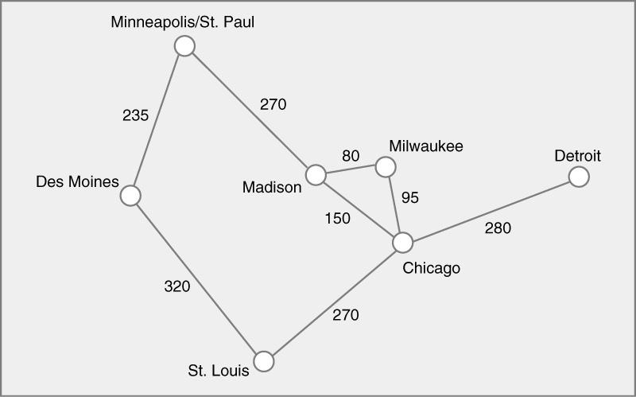
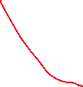


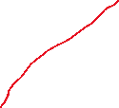
8. Find the minimal spanning tree using the algorithm you prefer. Use
Minneapolis/St. Paul as the source vertex

Slide 8
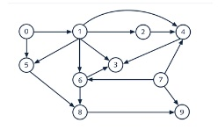
9. List the nodes of the graph in a breadth first topological ordering. Show the
steps using arrays predCount, topologicalOrder and a queue
Starting predCounts: [0:0, 1:1, 2:1, 3:3, 4:3, 5:2, 6:2, 7:0, 8:2, 9:2]
Current Queue: [0, 7]
Processing: 0
-> Decrementing predCount for 1 (New count: 0)
-> 1 hit 0 predCount. Adding to queue.
-> Decrementing predCount for 5 (New count: 1)
Current predCounts: [0:0, 1:0, 2:1, 3:3, 4:3, 5:1, 6:2, 7:0, 8:2, 9:2]
Current Queue: [7, 1]
Processing: 7
-> Decrementing predCount for 4 (New count: 2)
-> Decrementing predCount for 6 (New count: 1)
-> Decrementing predCount for 9 (New count: 1)
Current predCounts: [0:0, 1:0, 2:1, 3:3, 4:2, 5:1, 6:1, 7:0, 8:2, 9:1]

Slide 9
Current Queue: [1]
Processing: 1
-> Decrementing predCount for 2 (New count: 0)
-> 2 hit 0 predCount. Adding to queue.
-> Decrementing predCount for 3 (New count: 2)
-> Decrementing predCount for 4 (New count: 1)
-> Decrementing predCount for 5 (New count: 0)
-> 5 hit 0 predCount. Adding to queue.
-> Decrementing predCount for 6 (New count: 0)
-> 6 hit 0 predCount. Adding to queue.
Current predCounts: [0:0, 1:0, 2:0, 3:2, 4:1, 5:0, 6:0, 7:0, 8:2, 9:1]
Current Queue: [2, 5, 6]
Processing: 2
-> Decrementing predCount for 4 (New count: 0)
-> 4 hit 0 predCount. Adding to queue.
Current predCounts: [0:0, 1:0, 2:0, 3:2, 4:0, 5:0, 6:0, 7:0, 8:2, 9:1]
Current Queue: [5, 6, 4]
Processing: 5
-> Decrementing predCount for 8 (New count: 1)
Current predCounts: [0:0, 1:0, 2:0, 3:2, 4:0, 5:0, 6:0, 7:0, 8:1, 9:1]
Current Queue: [6, 4]

Slide 10
Processing: 6
-> Decrementing predCount for 3 (New count: 1)
-> Decrementing predCount for 8 (New count: 0)
-> 8 hit 0 predCount. Adding to queue.
Current predCounts: [0:0, 1:0, 2:0, 3:1, 4:0, 5:0, 6:0, 7:0, 8:0, 9:1]
Current Queue: [4, 8]
Processing: 4
-> Decrementing predCount for 3 (New count: 0)
-> 3 hit 0 predCount. Adding to queue.
Current predCounts: [0:0, 1:0, 2:0, 3:0, 4:0, 5:0, 6:0, 7:0, 8:0, 9:1]
Current Queue: [8, 3]
Processing: 8
-> Decrementing predCount for 9 (New count: 0)
-> 9 hit 0 predCount. Adding to queue.
Current predCounts: [0:0, 1:0, 2:0, 3:0, 4:0, 5:0, 6:0, 7:0, 8:0, 9:0]
Current Queue: [3, 9]
Processing: 3
Current predCounts: [0:0, 1:0, 2:0, 3:0, 4:0, 5:0, 6:0, 7:0, 8:0, 9:0]
Current Queue: [9]
Processing: 9
Current predCounts: [0:0, 1:0, 2:0, 3:0, 4:0, 5:0, 6:0, 7:0, 8:0, 9:0]
Final order: 0, 7, 1, 2, 5, 6, 4, 8, 3, 9
(too big to fit on one page)

Slide 11
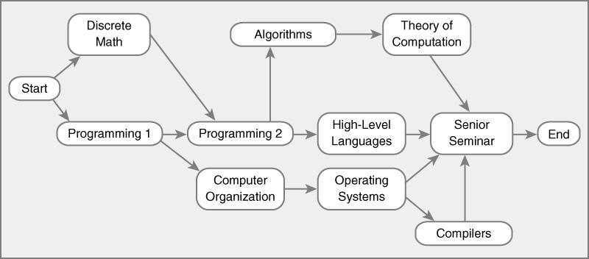
10. List the nodes of the graph in a breadth first topological ordering.
Start,
Discrete Math, Programming 1,
Programming 2, Computer Organization,
Algorithms, High-Level Languages, Operating Systems,
Theory Of Computation, Compilers,
Senior Seminar,
End
(it wouldn’t fit on one line so it’s broken into pieces)

Slide 12


