Slide 1
Capstone Project
Play Store App Review Analysis By- Yotish Lakhanpal Data Science Trainee, AlmaBetter

Slide 2
Points For Discussion
Problem Statement
Dataset Preparation
Attributes in Google Play Store Data
Attributes in User Review
Paid v/s Apps
Content Rating
Number of Apps in Each Category
Number of Installs in each Category
Size Analysis
Rating Analysis
Positive and Negative Review
Sentiment Polarity
Conclusions

Slide 3
Problem Statement
Two datasets are provided, one with basic information and the other with user reviews for the respective app.
We must examine and evaluate the data in both datasets in order to identify the important characteristics that inﬂuence app engagement and success.
So, what factors inﬂuence an app's success?
An app is said to be successful if it has:
A high average user rating
A good number of positive reviews
A good number of monthly average users
High revenue per customer and so on.

Slide 4
Dataset Preparation
Loading the data sets: Two datasets, First Play store app
dataset and User Reviews dataset.
Import Libraries: NumPy, Pandas, Seaborn and Matplotlib
Data cleaning: Null values, Finding and removing Outliers, Removing duplicate data.
Data Imputation: Filling the missing categorical values with mode and numerical values with median. Conversion of price, installs, reviews into numerical values.
Exploratory Data Analysis: Analyzing the data sets to summarize their main characteristics using statistical graphics and data visualizations method.

Slide 5
Attributes in Google Play store Data
App : This column Contains the name of the app for each observation.
Category: This column Contains Category to which the app belongs.
Rating: This column contains the average rating for the app.
Review: This column contains the average rating for the app.
Size: This column contains the amount of memory the app occupies on the device.
Installs: This column contains the number of times that the app has been downloaded and installed from the play store.
Type: This column contains the information whether the app is free or paid.
Content Rating: This column contains the maturity rating of the app i.e. the age group of the audience for which it is suitable.
Price: If the app is a paid app, this column contains the data about its price.
Genres: This column contains the data about to which genre the app belongs. Genres can be considered as a further division of the group of Category.
Last Updated: Contains the date on which the latest update of the app was released.
Current Version: Contains information on the current version of the app available on the play store.
Android Version: Contains information about the android versions on which the app is supported.

Slide 6
Attributes in User reviews
App- Application name
Translated Review- User review
Sentiment- Positive/Negative/Neutral
Sentiment Polarity- Sentiment polarity score
Sentiment Subjectivity- Sentiment subjectivity score

Slide 7
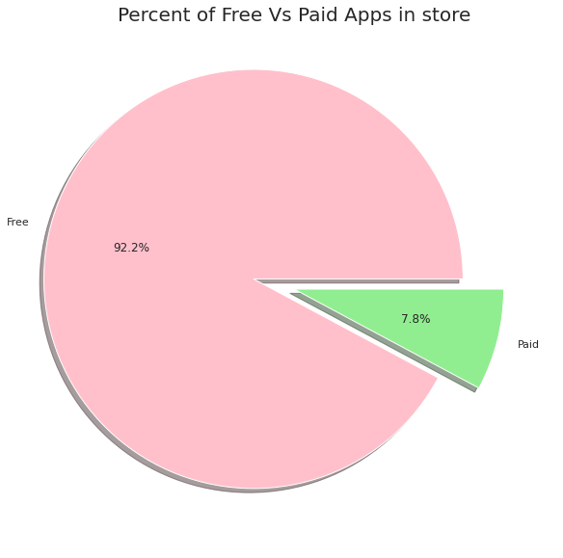
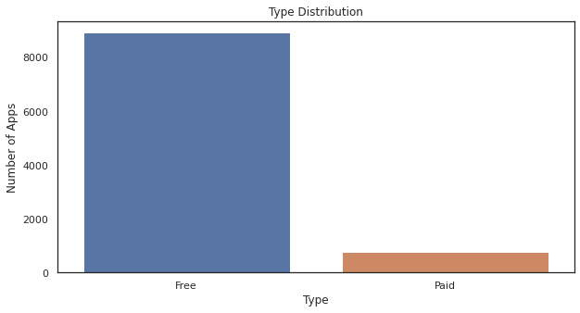
Paid apps v/s Free apps
We Observed that 92.20% of Apps are free and only 7.80% of Apps are paid in Play store.

Slide 8
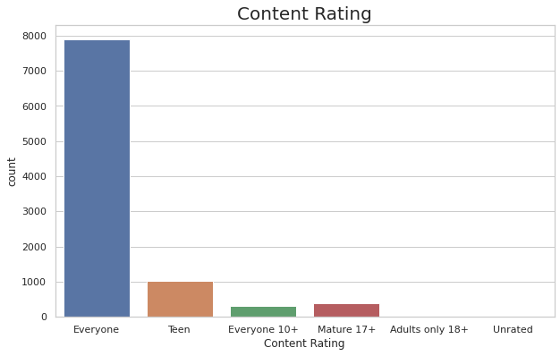
Content Rating
From the above plot we can see that EVERYONE category is having majority of apps.

Slide 9
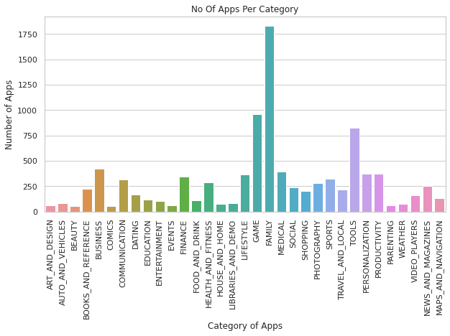
Number of Applications in each category
Most No of Apps in the play store are from Category FAMILY,GAMES AND TOOLS.

Slide 10
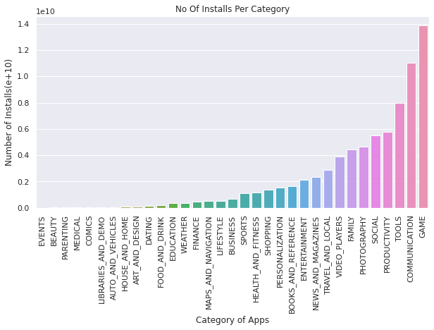
Number of Installs in each Category
The most no of Installs is for GAME whereas for category FAMILY has less no of Installs. The COMMUNICATION Category has quite less no of apps but this category has 2nd in most No of Installs.

Slide 11
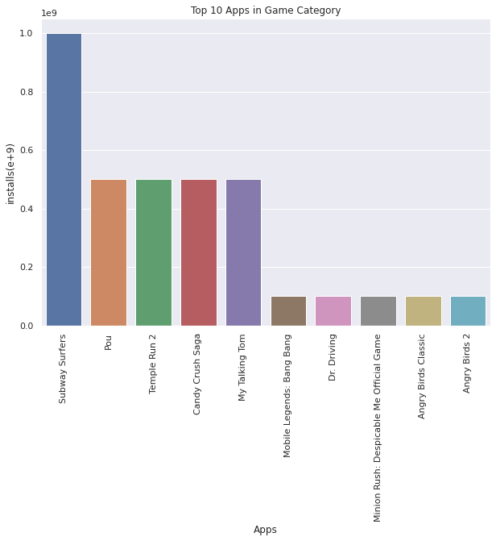
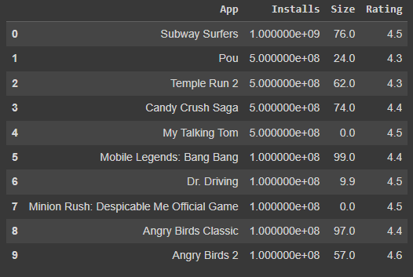
Top 10 Apps in Games Category
The Graph shows the Top 10 installed apps in GAME Category, Further from the Table we can see that these apps are Heavy weighted and all apps are Free. Also the Rating of these apps are quiet remarkable.

Slide 12
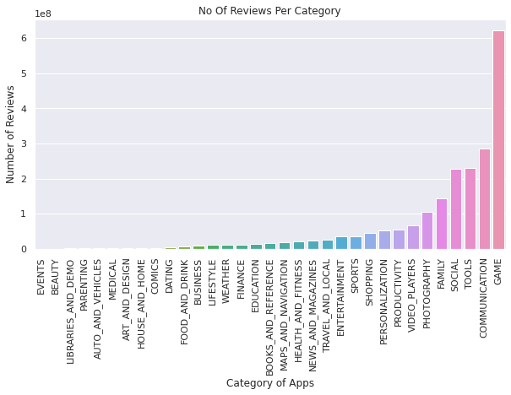
Number of Reviews Per Category
Most Number of reviews are also for GAME Category followed by COMMUNICATION and TOOLS.

Slide 13
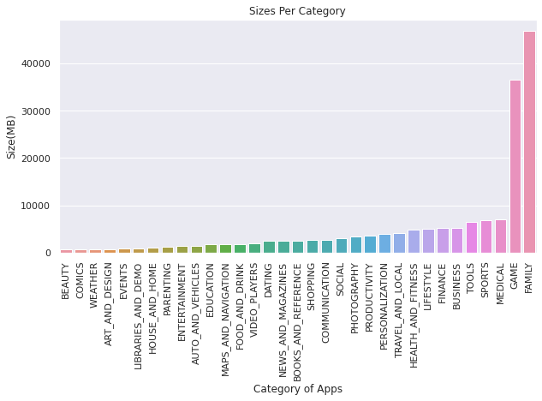
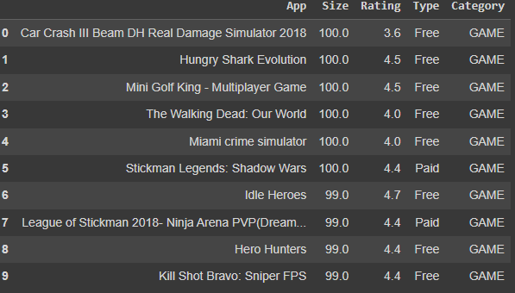
Size Analysis
Most number of heavy apps in sizes are in category FAMILY and GAME.

Slide 14
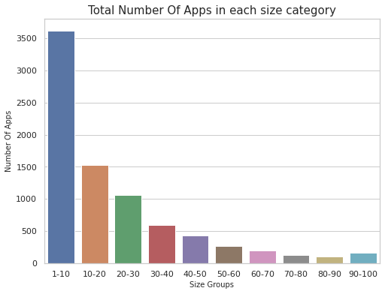
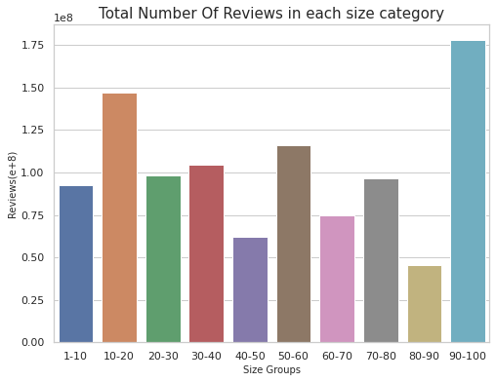
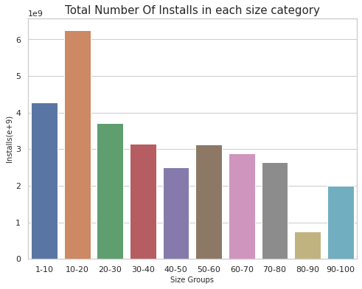
Here size is Categorizes into 10 groups of sub sizes and sizes are in MB.
We can see that (~1MB to~10MB ) category has more no of apps but their Installs and review are less.
User prefer to install those apps which has a size between (~10MB to ~ 20MB).
As (~10MB to ~ 20MB) sizes apps have more installs therefore they also have more number of reviews.
But (~90MB to ~ 100MB) have most number of reviews although this category have least number of apps and also the installs are not that remarkable.(why?)

Slide 15
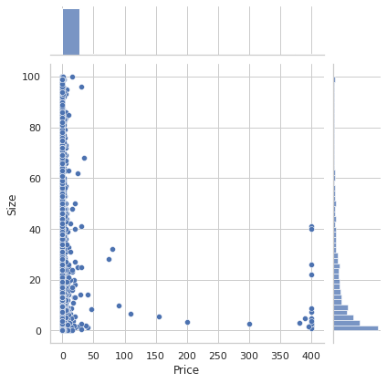
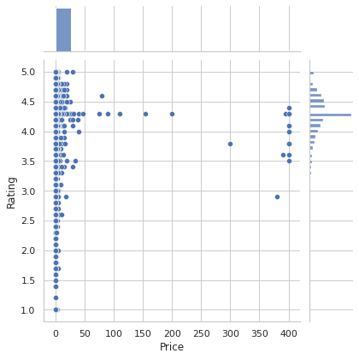
Majority of the paid apps that are highly rated have small sizes. This means that most paid apps are designed and developed to cater to specific functionalities and hence are not in higher size.
Users prefer to pay for apps that are light-weighted. A paid app that is higher in size may not perform well in the market

Slide 16
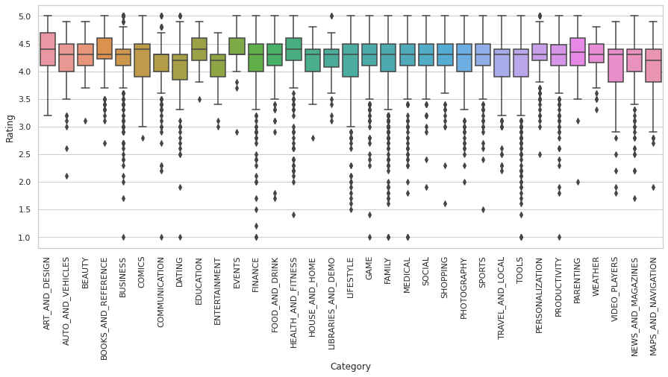
Rating Analysis
Education, Health & Fitness , Art & Design are the categories which are performing well in the market as their average rating are higher from average rating of all categories.
Business, Comics, Tools, Finance are the categories in which 50% of the apps have lower rating then their respective median rating or average rating. Interestingly dating apps also dose not perform well in market.

Slide 17
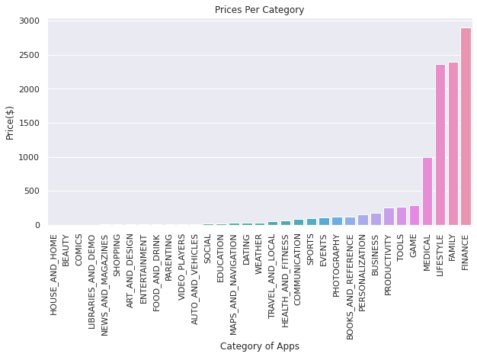
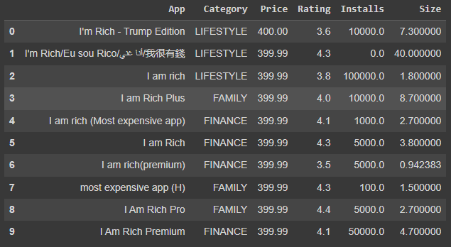
Paid apps in each Category
Most Paid apps is for category FINANCE and LIFESTYLE but their ratings are not so good, some of the FAMILY apps are there too in top ten most expensive apps

Slide 18
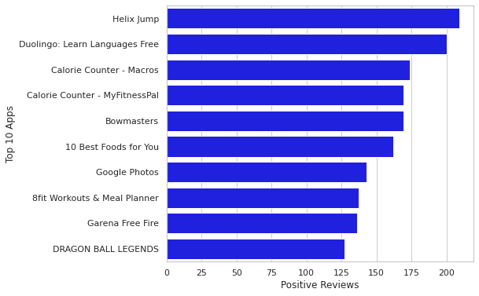
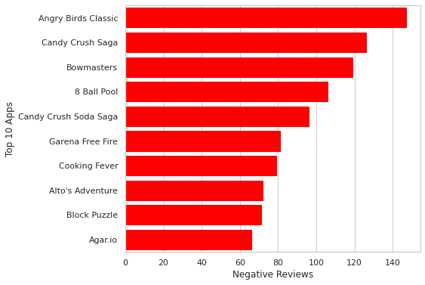
Positive And Negative Reviews
Above bar plot shows Top 10 apps which has most number of Positive or Negative Reviews.
In the Positive review section , the apps are from different Categories.
In the Negative review section, the apps are mostly from GAME Category.
DO YOU REMEMBER?
When we were doing the size analysis games apps have more reviews than that of number of installs.

Slide 19
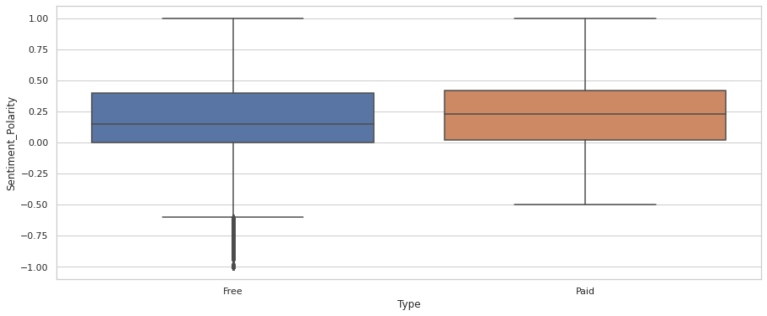
Sentiment Polarity
We compared the reviews between free and paid apps and found that user are harsher towards free apps whereas users are more tolerant when they are paying for it.

Slide 20
Inferences and Conclusion
More Than 90% of Apps are Free In play store and almost all apps have content rating ‘Everyone’.
Most Number of Apps are of FAMILY, GAME and TOOLS Category.
The most no of Installs(in sum) is for GAME whereas for category FAMILY has less no of Installs. The COMMUNICATION Category has quite less no of apps but this category has 2nd in most No of Installs.
The Games Apps which are light in size have more number of installs.
Most Number of reviews are also for GAME Category followed by COMMUNICATION and TOOLS. We can say that the Apps or the Category which have more number of installs have more number of reviews.
Most number of heavy apps in sizes are in category FAMILY and GAME.
From size analysis we can say that (~1MB to~10MB ) size group has more no of apps but their Installs and review are less.
User prefer to install those apps which has a size between (~10MB to ~ 20MB).
As (~10MB to ~ 20MB) sizes apps have more installs therefore they also have more number of reviews.

Slide 21
Inferences and Conclusion
10. (~90MB to ~ 100MB) have most number of reviews although this category have least number of apps and also the installs are not that remarkable.(This is because mostly heavy weighted apps are in GAME Category and this Category got most no of Negative Reviews),we can say that the games apps which comes in this size group may not perform well in market.
11. Majority of the paid apps that are highly rated have small sizes. This means that most paid apps are designed and developed to cater to specific functionalities and hence are not in higher size.
12. Users prefer to pay for apps that are light-weighted. A paid app that is higher in size may not perform well in the market
13. Education, Health & Fitness , Art & Design are the categories which are performing well in the market as their average rating are higher from average rating of all categories.
14. Business, Comics, Tools, Finance are the categories in which 50% of the apps have lower rating then their respective median rating or average rating. Interestingly dating apps also dose not perform well in market.
15. User are harsher towards free apps whereas users are more tolerant when they are paying for it.

Slide 22
Thank You

