Slide 1

OmniAcc: A Heterogeneous Memory-Centric LLM Accelerator with Reconfigurable Fixed-Point Nonlinear Operations and Layer-Agnostic Compute Fabric
Yimin Wang*, Zixuan Wang*, Yue Jiet Chong, Xuanyao Fong
National University of Singapore
Notes:
Good afternoon, everyone. I'm Yimin Wang from the National University of Singapore. Today, I'm pleased to present OmniAcc, a memory-centric accelerator designed for efficient, full-model large language model inference.

Slide 2
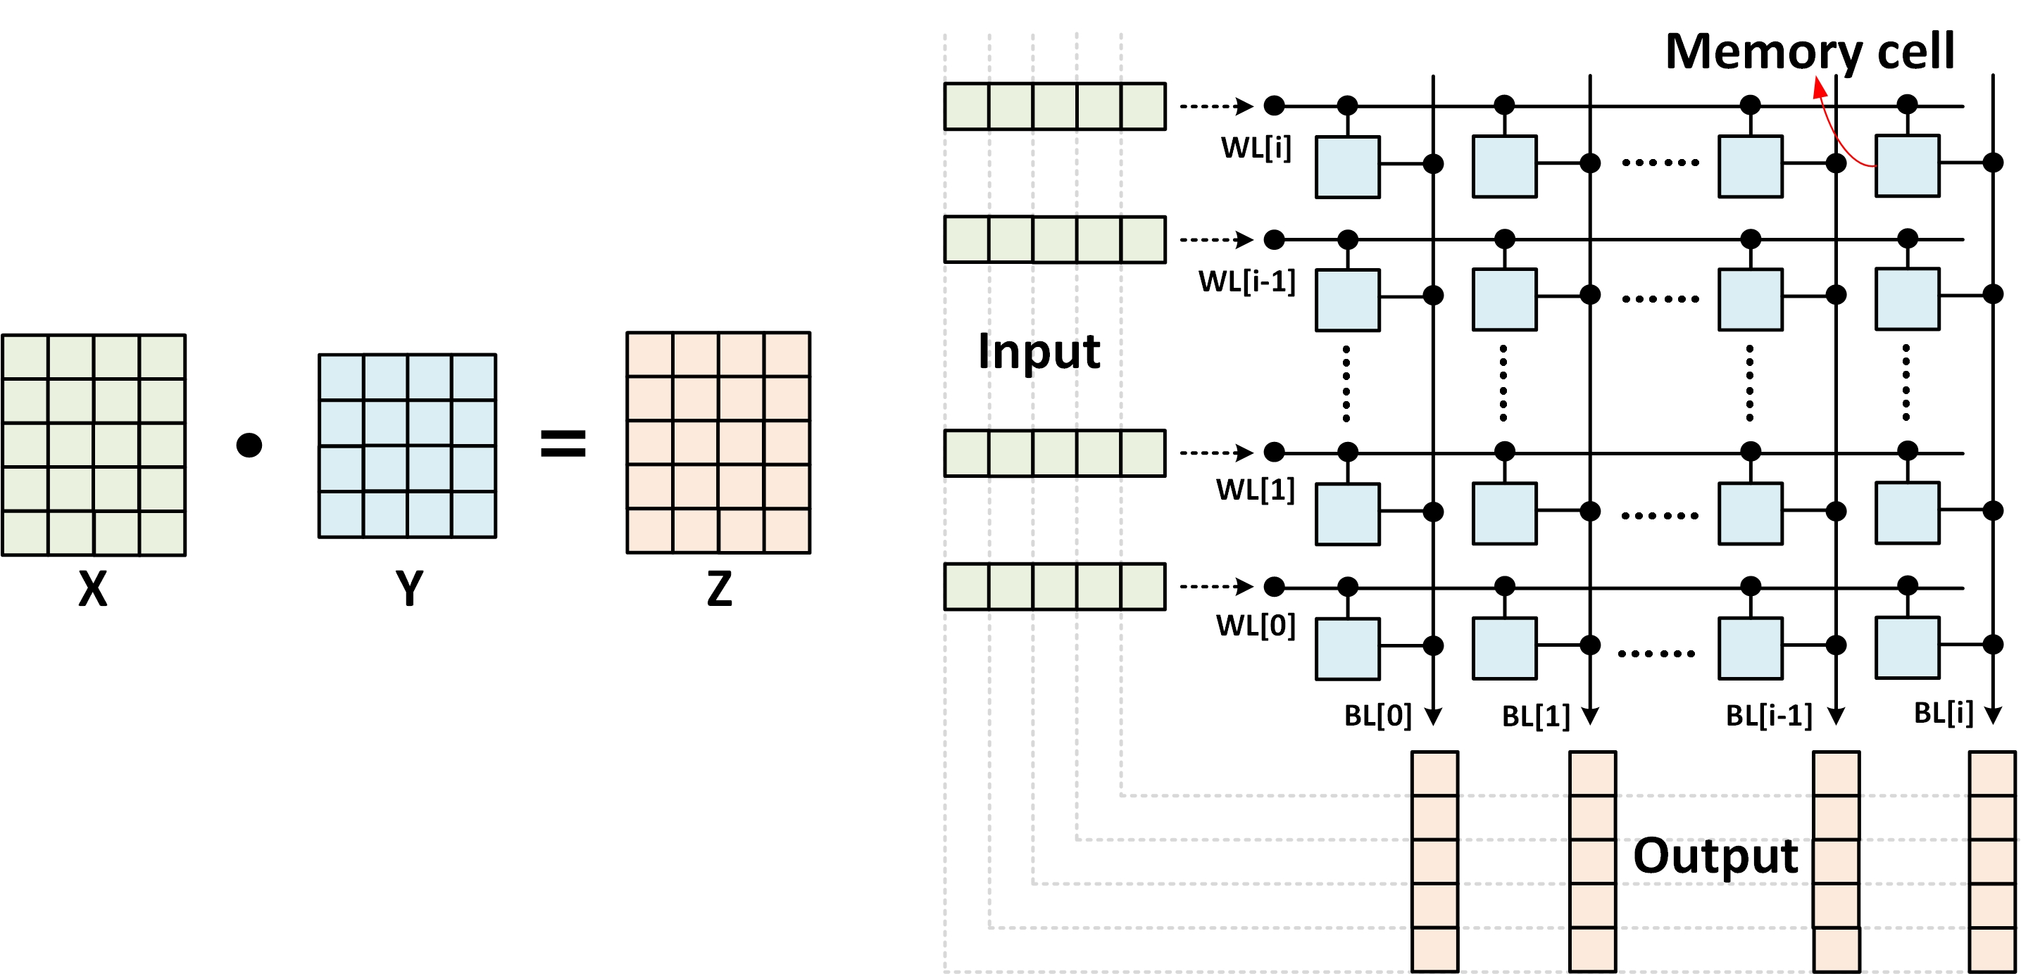
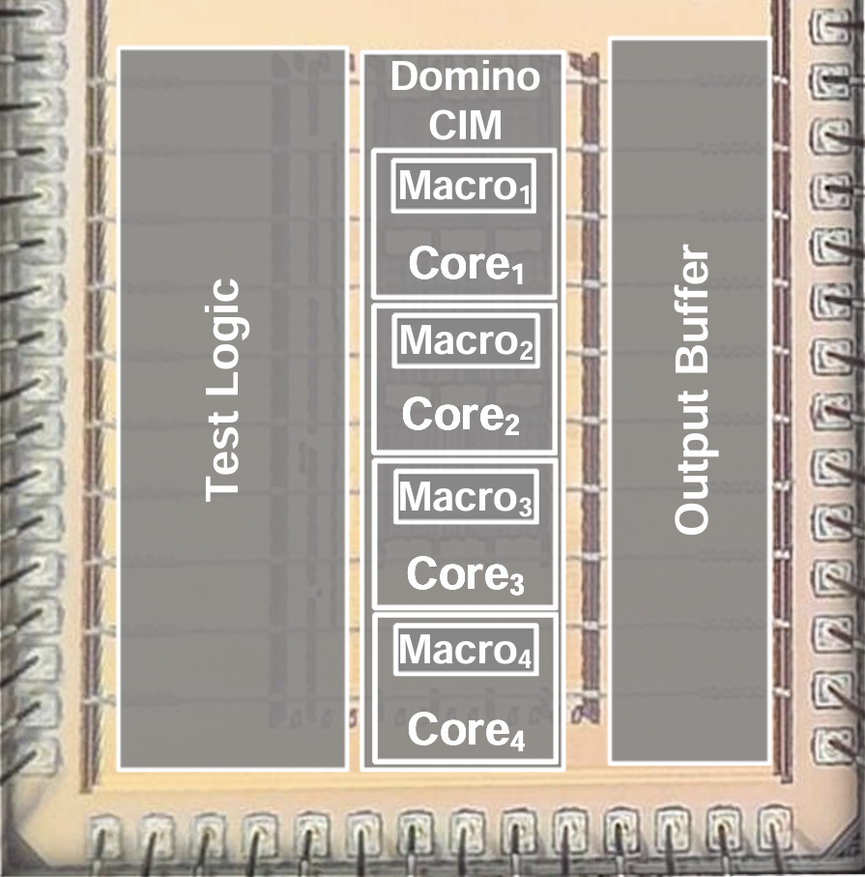
Why Accelerating Matrix Multiplication Is Not Enough
Nonlinear processing overhead
Precision and conversion overhead
In-memory computing (IMC)
IMC
INT
INT
to
FP
NL
FP
FP
to
INT
(b)
Nonlinear ops
MVM/MM
GPU
IMC
Source: Li et al. (2026)
Accelerating linear operations exposes nonlinear processing and precision conversion as bottlenecks
2
Notes:
In-memory computing, or IMC, reduces weight movement and accelerates matrix operations, which account for a major part of LLM inference.
[Click 1] As the first comparison shows, IMC can substantially shorten the time spent on linear computation.
[Click 2] However, the rest of the model still needs to run. Nonlinear operations, including normalization, Softmax, and activation functions, do not benefit to the same extent. As linear computation gets faster, the relative cost of these functions becomes more significant.
[Clicks 3–4] There is also a mismatch in numerical formats. IMC mainly uses integer arithmetic, whereas nonlinear functions are commonly implemented in floating point. Moving between them requires conversion hardware and additional data movement.
[Click 5] The chip example here illustrates just how significant that conversion cost can be.
[Click 6] This motivates our central question: how can we accelerate the entire model, rather than matrix multiplication alone?

Slide 3
OmniAcc: Three Connected Design Challenges
RQ 1 | Can nonlinear functions use fixed-point arithmetic without material accuracy loss?
Algorithm
Solution 1 | Outlier-aware, accuracy-preserving fixed-point quantization
RQ 2 | How can nonlinear processing be integrated efficiently into a scalable architecture?
Architecture
Solution 2 | Reconfigurable nonlinear units and regularly interleaved functional slices
RQ 3 | How can computation and communication be orchestrated with low runtime overhead?
System
Solution 3 | Stationarity-aware mapping with predictable, deterministic dataflow
3
Notes:
OmniAcc approaches this question at three connected levels. First, at the algorithm level, how can we run nonlinear functions in fixed point while maintaining model quality?
[Click 1] Second, at the architecture level, how can we bring nonlinear hardware close to linear computation, without duplicating too many resources?
[Click 2] And third, at the system level, how can we coordinate these heterogeneous resources with predictable and efficient data movement?
[Clicks 3–5] We address these challenges through outlier-aware fixed-point quantization, a regularly interleaved architecture, and a stationarity-aware, deterministic dataflow. I'll walk through these three ideas in that order.

Slide 4
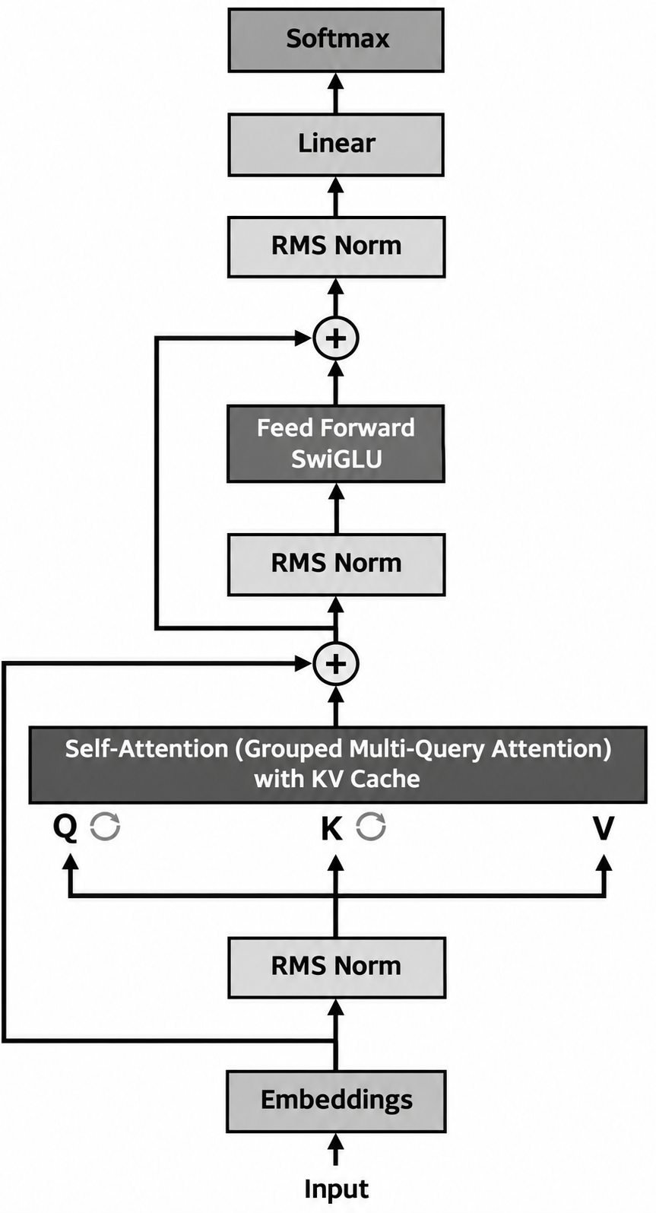
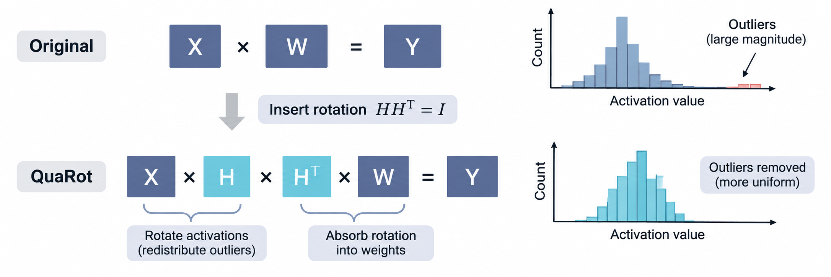
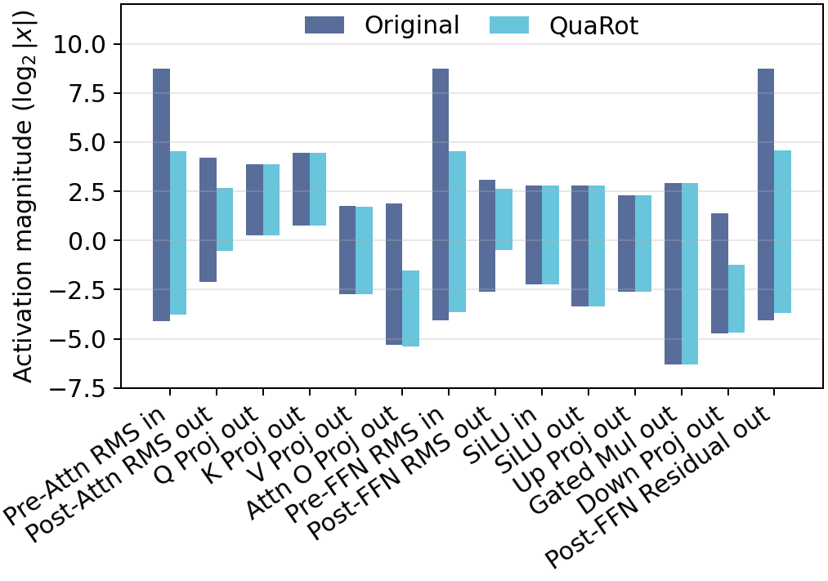
Outlier-Aware Rotation Makes Fixed-Point Processing Feasible
Walsh–Hadamard transform to distribute outliers across channels
No runtime weight-conversion overhead
Residual connections preserve outliers
← Reduced activation range
in Llama models
Outlier redistribution reduces the activation range required for fixed-point processing
4
Notes:
Let's begin with numerical representation. The main challenge comes from outliers in the residual stream.
[Click 1] A small number of unusually large activations can determine the required numerical range, even when most values are relatively small.
[Click 2] To redistribute these outliers, we adopt the Walsh-Hadamard rotation used in QuaRot. This transformation spreads the contribution of high-magnitude channels across dimensions, producing a more balanced range.
[Click 3] The corresponding inverse transformation is fused into adjacent weight matrices offline. So we obtain this range reduction without adding runtime weight-conversion operations.
[Click 4] As the measurements on the right show, the peak magnitudes decrease considerably at the most challenging points in the network.
[Click 5] This gives us a practical numerical foundation for implementing nonlinear functions in fixed point.

Slide 5
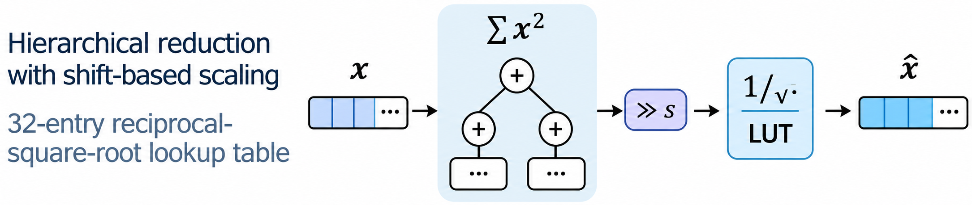
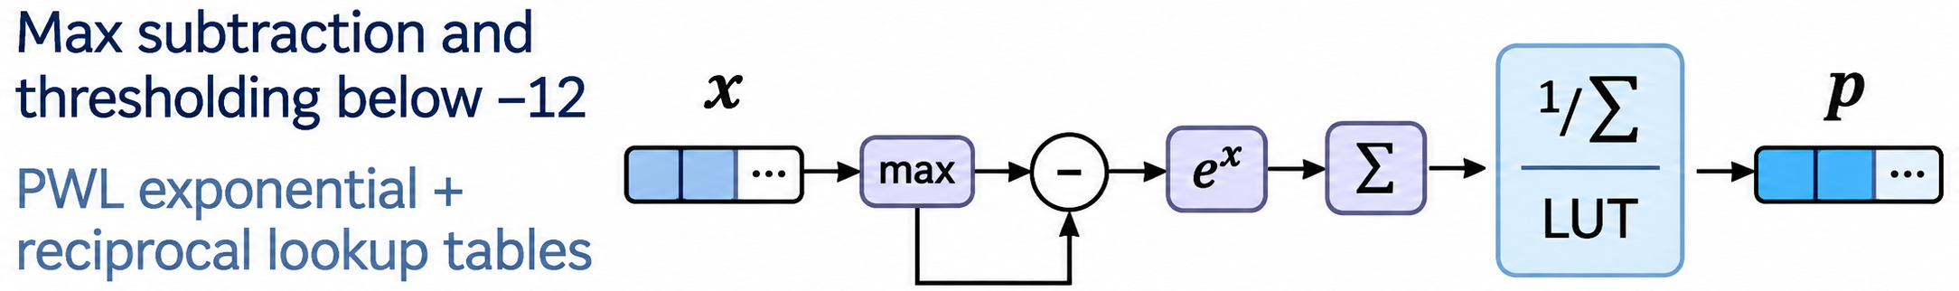
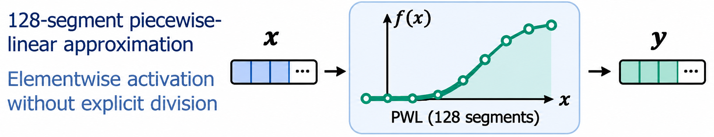
Operation-Specific Approximations Preserve Model Quality
Fixed-point nonlinear processing
Combined nonlinear approximation
Llama 3.2-1B
RMSNorm
WikiText-2 perplexity
9.9893 → 10.0114
Average zero-shot accuracy
60.99% → 61.22%
Softmax
Llama 3.1-8B
WikiText-2 perplexity
6.4649 → 6.4826
SiLU
Average zero-shot accuracy
69.66% → 69.42%
Function-specific nonlinear approximations preserve near-baseline model quality
5
Notes:
With the activation range under control, we can simplify the nonlinear functions themselves. Importantly, we tailor the approximation to each operation.
[Click 1] For RMSNorm, we use hierarchical reductions and shift-based scaling to manage intermediate values, together with a compact lookup table for the reciprocal square root.
[Click 2] For Softmax, we first subtract the maximum value for numerical stability. Then, thresholding and a piecewise-linear approximation simplify the exponential computation.
[Click 3] For SiLU, a piecewise-linear function implements the activation with a compact fixed-point datapath.
[Click 4] Now, the results on the right evaluate all three approximations together. On both the one-billion and eight-billion parameter models, WikiText-2 perplexity changes only marginally, while average zero-shot accuracy stays close to the FP16 baseline.
[Click 5] These results show that operation-specific simplifications can work together in an accurate, fixed-point inference path.

Slide 6
Next: Architecture and Hardware Design
RQ 1 | Can nonlinear functions use fixed-point arithmetic without material accuracy loss?
Algorithm
Solution 1 | Outlier-aware, accuracy-preserving fixed-point quantization
RQ 2 | How can nonlinear processing be integrated efficiently into a scalable architecture?
Architecture
Solution 2 | Reconfigurable nonlinear units and regularly interleaved functional slices
RQ 3 | How can computation and communication be orchestrated with low runtime overhead?
System
Solution 3 | Stationarity-aware mapping with predictable, deterministic dataflow
6
Notes:
Now that we have an efficient numerical path, let's turn to the architecture. How should we organize linear and nonlinear processing on the chip?

Slide 7
Why Interleave Linear and Nonlinear Processing?
Distributed per-core
OmniAcc: interleaved slices
Central nonlinear units
Local
Interleaved
Global
High locality, high replication cost
Localized sharing with regular placement
Reduced replication, longer communication
Nonlinear slice
7
Notes:
The placement of nonlinear hardware creates a trade-off between locality and resource sharing.
[Click 1] One option is to put nonlinear units inside every processing core. That provides short access paths, but it also replicates hardware, even though the demand for these functions changes across layers.
[Click 2] The other option is to centralize nonlinear processing. That reduces duplication, but intermediate data must travel farther through the fabric.
[Click 3] OmniAcc takes a middle path. We arrange linear and nonlinear cores in regularly interleaved slices, so nearby linear cores can share nearby nonlinear resources. This preserves local access while keeping the number of nonlinear units modest.

Slide 8

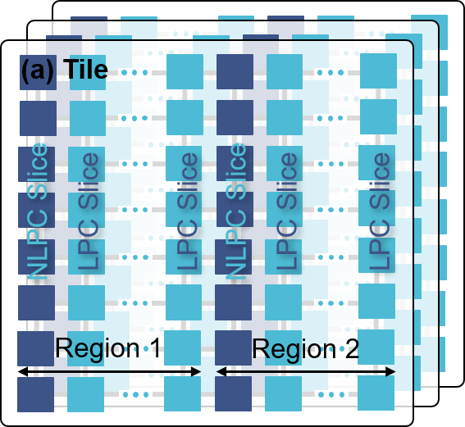
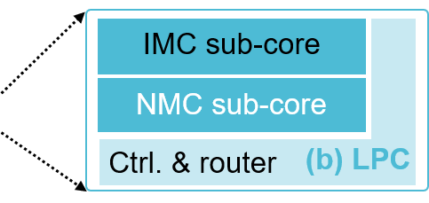
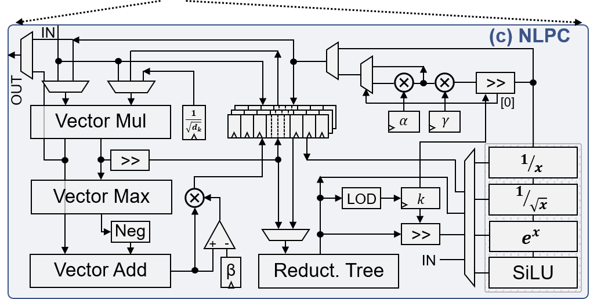
OmniAcc: Regularly Interleaved Compute Slices
Scalable processing tile array
Column-wise functional slices
Interleaved LPC & NLPC patterns
Linear processing core (LPC)
In-memory computing (IMC) → matrix multiplication with stationary weights
Near-memory computing (NMC) → dynamic-dynamic matrix multiplication
Nonlinear processing core (NLPC)
A local, reconfigurable fixed-point datapath supports RMSNorm, Softmax, and SiLU.
Router
and local reduction
Router-integrated adders aggregate partial results
8
Notes:
Here is how we build that organization.
[Click 1] OmniAcc is composed of repeated processing tiles, and each tile contains interleaved linear and nonlinear cores.
[Click 2] These column-wise slices are connected through a two-dimensional mesh, giving us a regular structure that can scale to larger systems.
[Click 3] Inside each linear processing core, or LPC, in-memory computing handles operations with static weights. Near-memory computing, or NMC, handles products between tensors that are generated at runtime.
[Click 4] Alongside the linear cores, the nonlinear processing core, or NLPC, provides reconfigurable fixed-point support for RMSNorm, Softmax, and SiLU.
[Click 5] Finally, adders integrated into the routers perform local reductions of partial results. Together, these components support both types of computation while keeping intermediate data close to its next consumer.

Slide 9
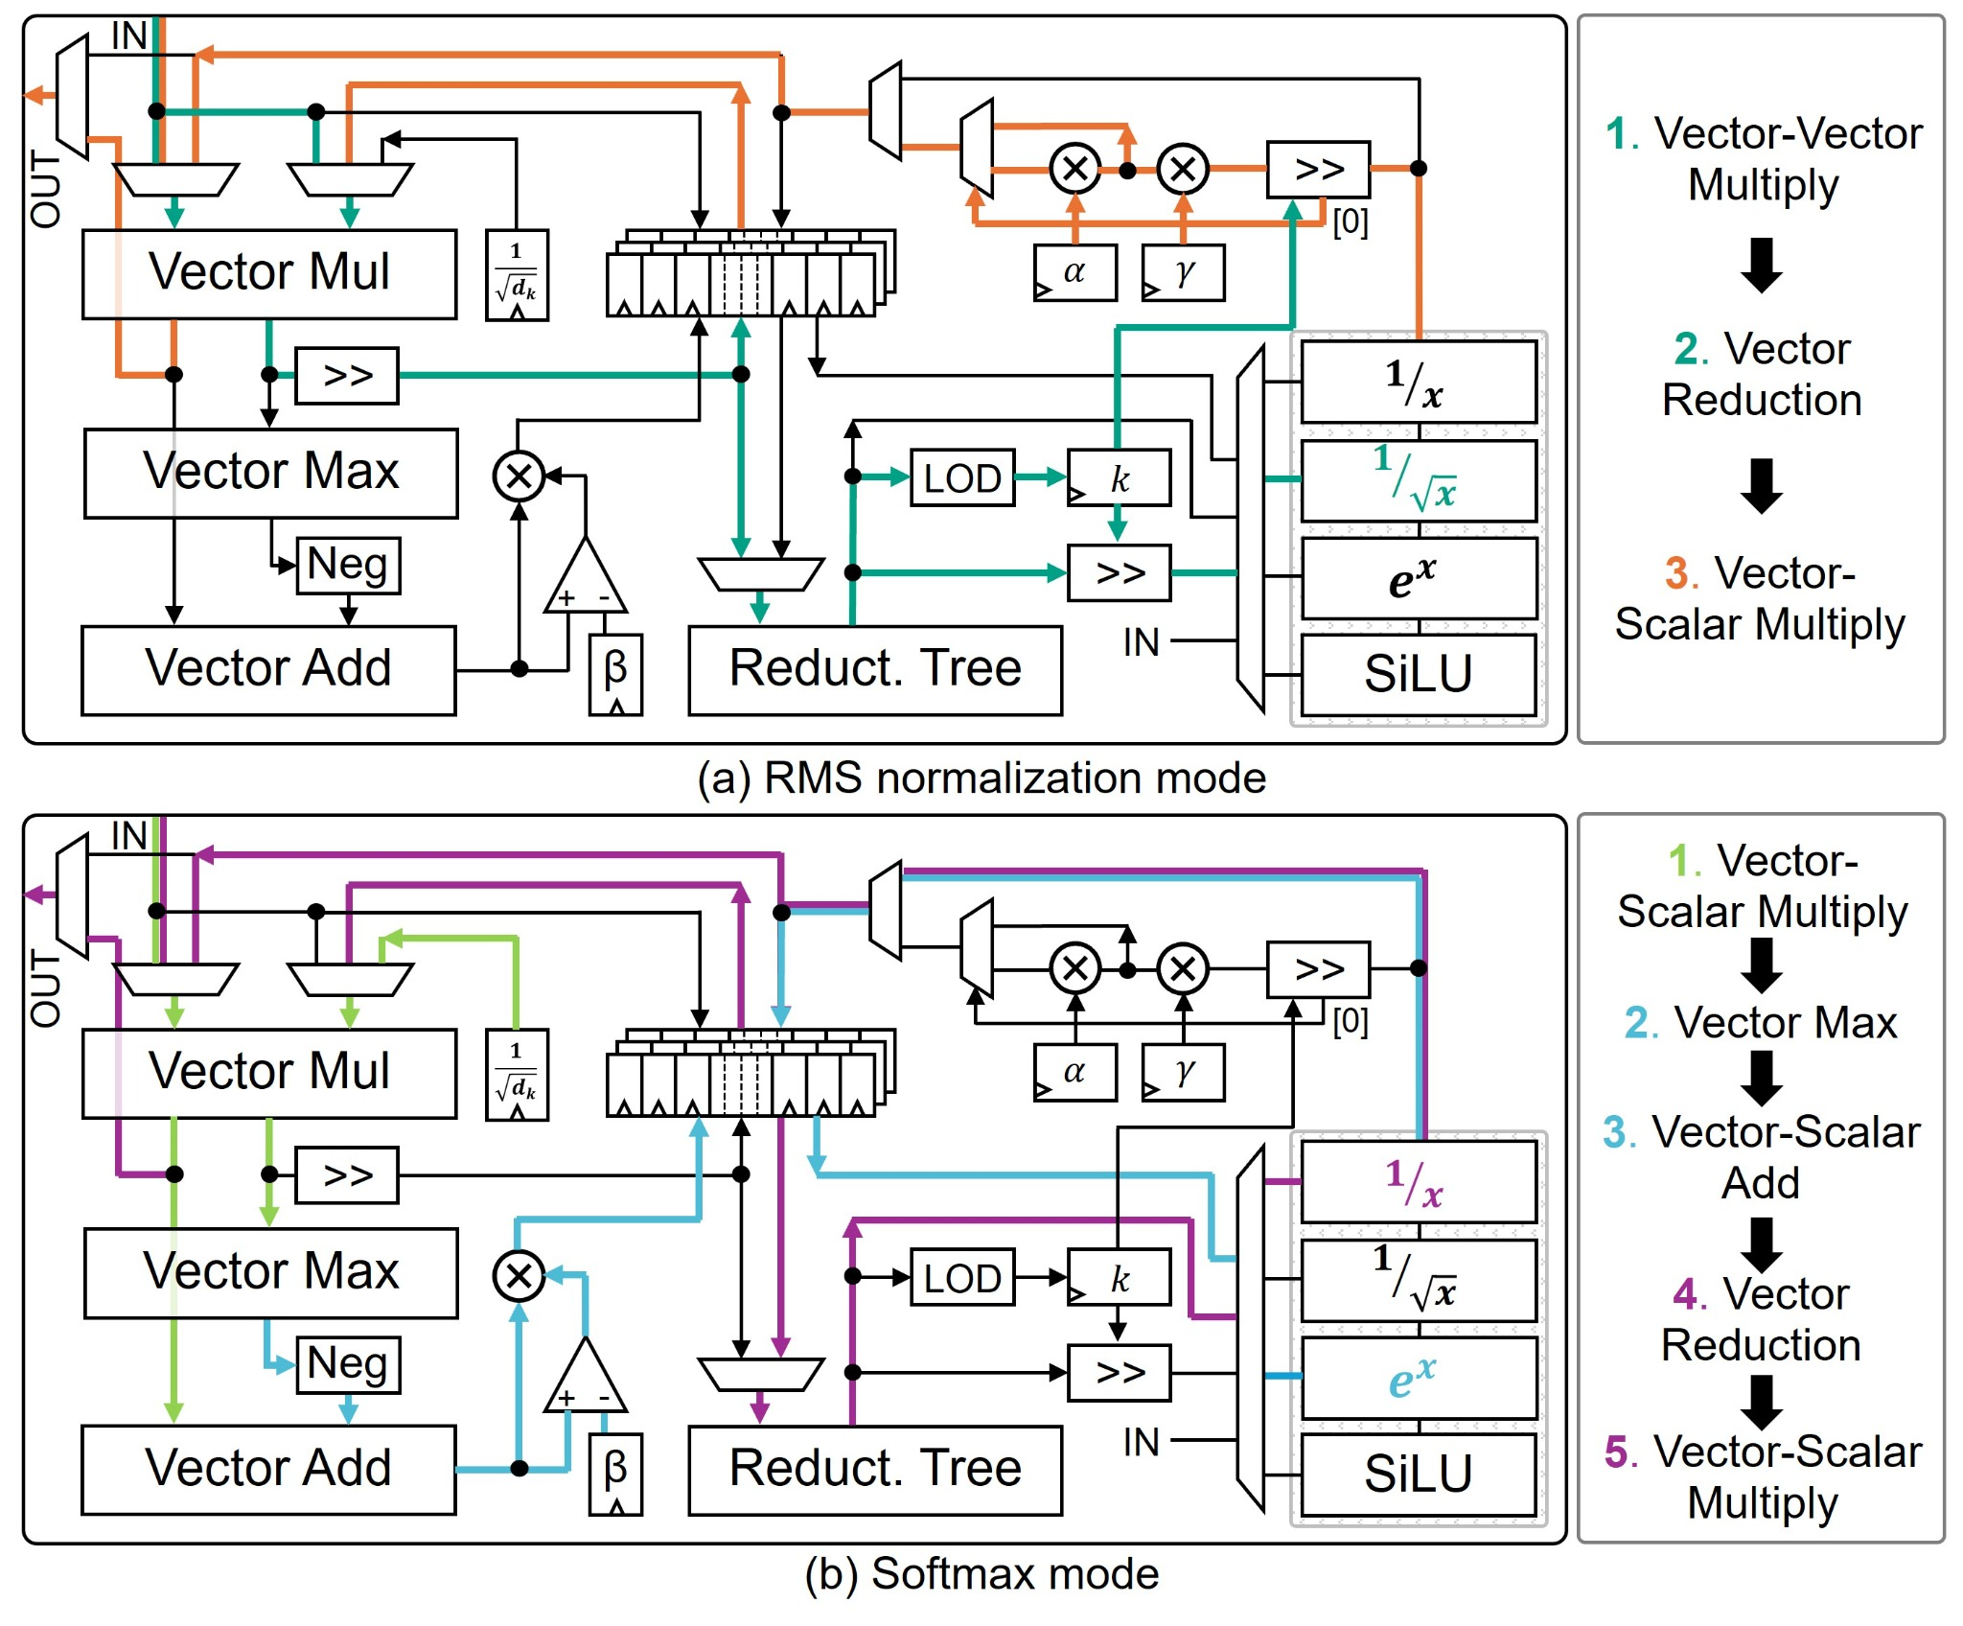
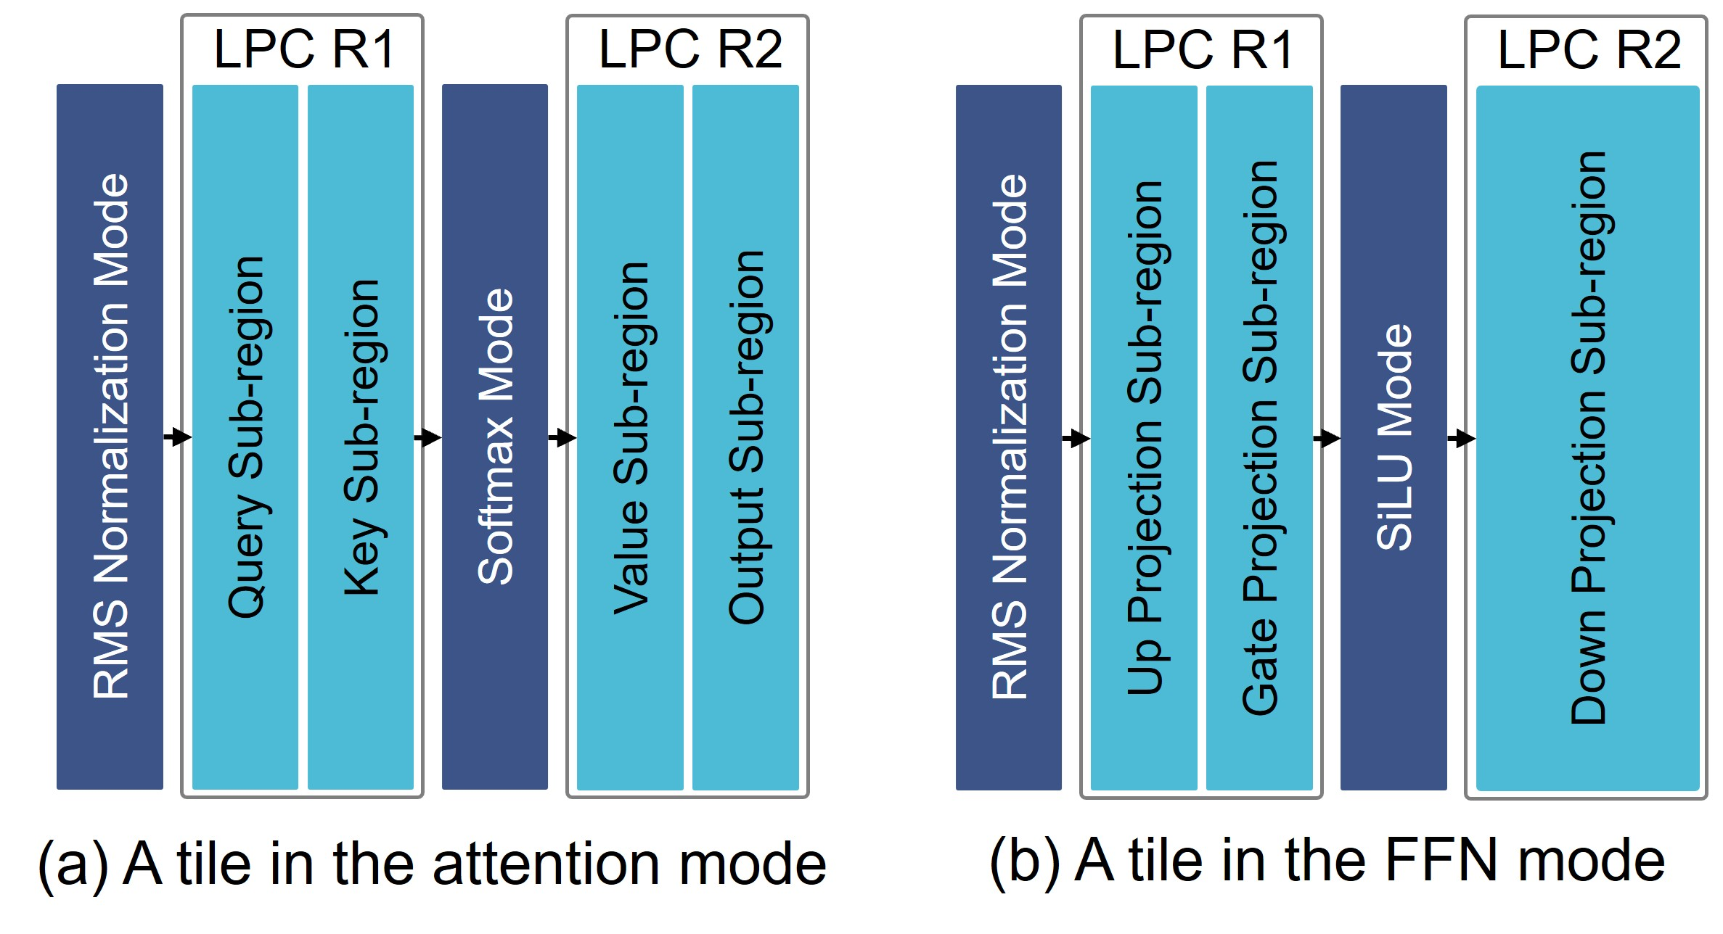
One Tile, Two Levels of Reconfiguration
Operation-level reconfiguration
Layer-level reconfiguration
RMSNorm mode
Attention mode
FFN mode
Softmax mode
Shared NLPC executes RMSNorm, Softmax, or SiLU through selectable datapaths
The same tile supports attention and FFN by changing its functional assignments
9
Notes:
A single OmniAcc tile is reconfigurable at two complementary levels.
[Click 1] At the operation level, the nonlinear core reuses vector arithmetic, reductions, scaling circuits, and lookup tables across functions. In the first configuration, these units implement RMSNorm.
[Click 2] In the second, much of the same hardware implements Softmax. SiLU uses a dedicated lookup-based path within the same nonlinear core.
[Click 3] This sharing makes fixed-point nonlinear processing compact.
[Click 4] At the layer level, we can also configure the tile for different parts of a Transformer. In attention mode, linear regions carry out the Q, K, V, and output projections, while nonlinear regions support normalization and Softmax.
[Click 5] In feed-forward mode, the same fabric executes the Up, Gate, and Down projections, together with normalization and SiLU.
[Click 6] The takeaway is that one physical fabric can efficiently serve both attention and feed-forward layers.

Slide 10
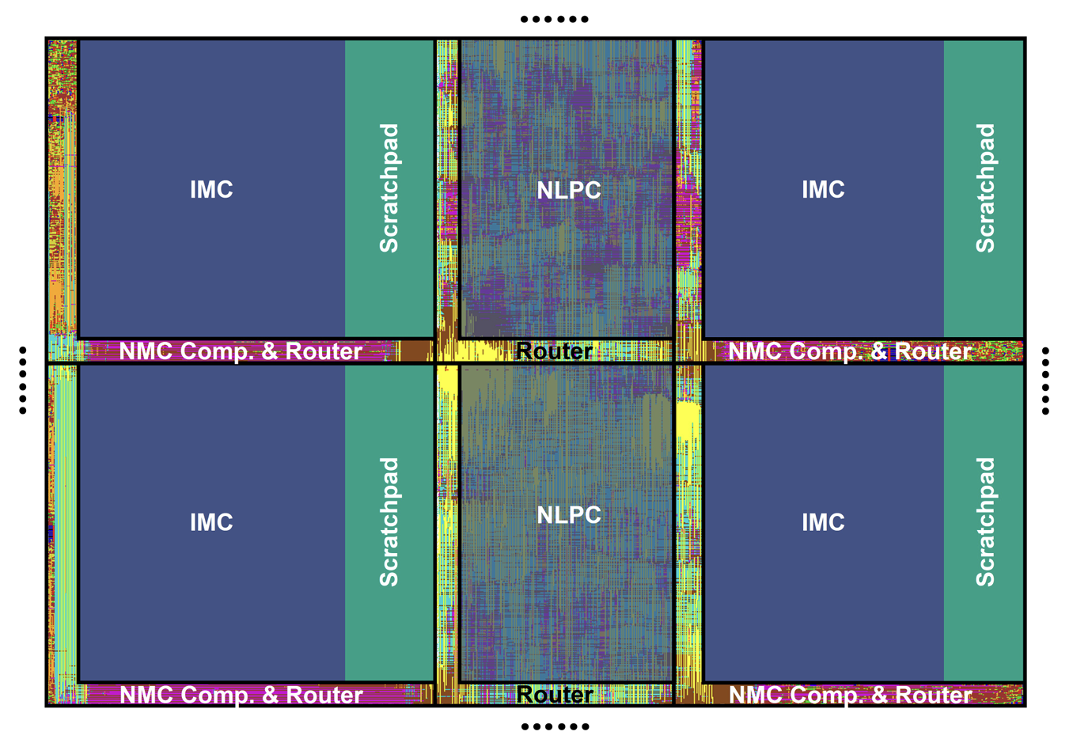
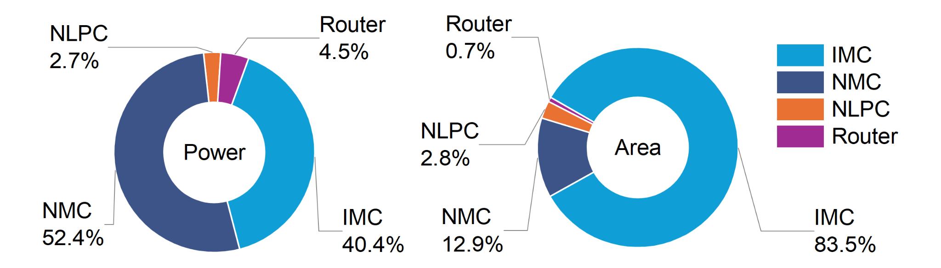
Physical Implementation and Resource Breakdown
NLPC accounts for 2.8% of area and 2.7% of power
10
Notes:
This physical layout shows how the linear units, local scratchpads, and nonlinear slices fit into a repeating structure. In our evaluated design, nonlinear processing cores contribute only two point eight percent of the total area and two point seven percent of the total power. These small shares allow us to distribute nonlinear capability across the architecture while maintaining a compact implementation.

Slide 11
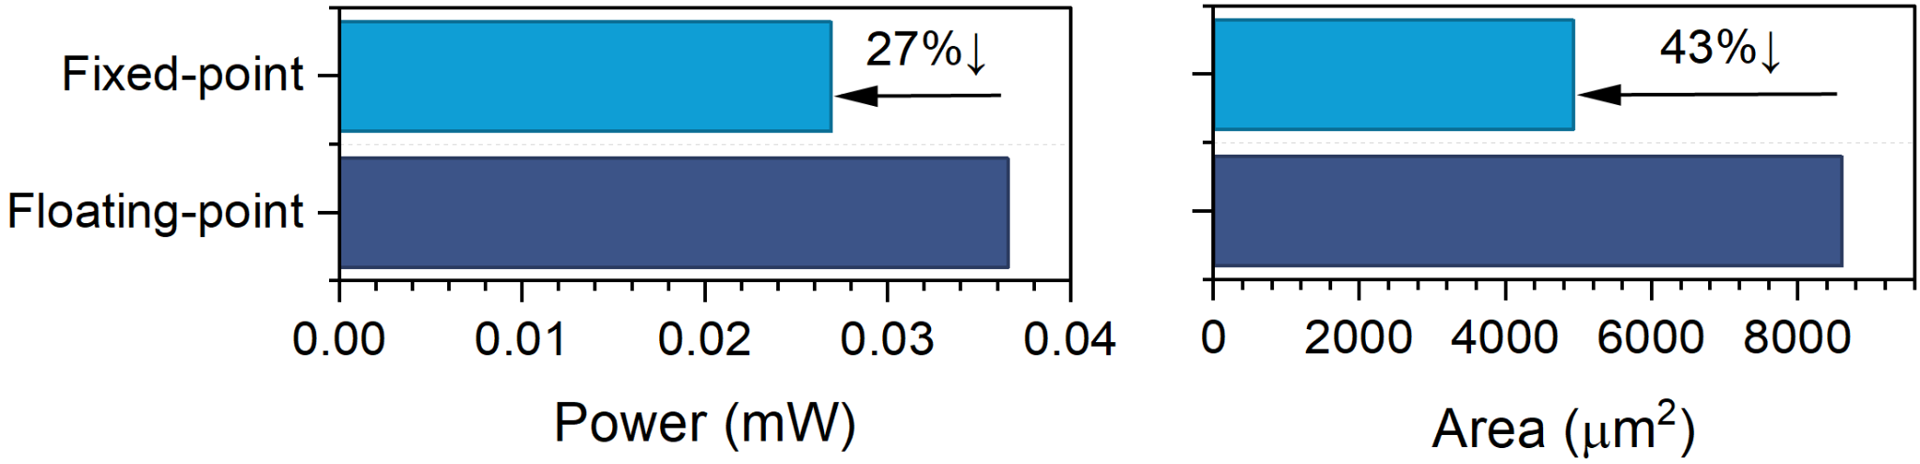
Fixed-Point NLPC Reduces Hardware Cost
27% lower power
43% lower area
Significant improvement compared with a floating-point NLPC implementation
11
Notes:
Fixed-point arithmetic is also important at the individual core level. Compared with a floating-point implementation, our nonlinear processing core reduces power by twenty-seven percent and area by forty-three percent. These savings make local nonlinear processing more practical, and they directly support the interleaved architecture we have just seen.

Slide 12
Next: Locality-Aware Orchestration
RQ 1 | Can nonlinear functions use fixed-point arithmetic without material accuracy loss?
Algorithm
Solution 1 | Outlier-aware, accuracy-preserving fixed-point quantization
RQ 2 | How can nonlinear processing be integrated efficiently into a scalable architecture?
Architecture
Solution 2 | Reconfigurable nonlinear units and regularly interleaved functional slices
RQ 3 | How can computation and communication be orchestrated with low runtime overhead?
System
Solution 3 | Stationarity-aware mapping with predictable, deterministic dataflow
12
Notes:
The final piece is orchestration. With linear and nonlinear resources distributed across the fabric, we want the mapping and dataflow to preserve locality throughout inference.

Slide 13
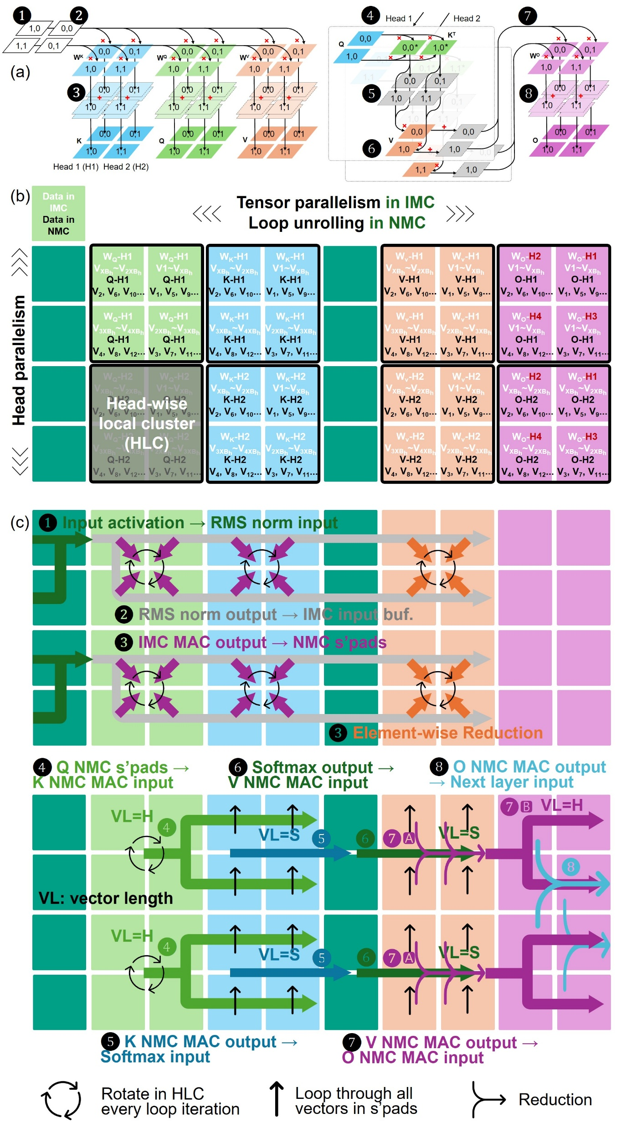
Locality-Aware Mapping and Fine-Grained Parallelism
Head parallelism
Assign attention heads to local clusters
Tensor parallelism in IMC
Loop unrolling in NMC
Tensor parallelism
Partition static weights across IMC arrays
W_{Q}-H1
V_{XBh}~V_{2XBh}
Q-H1
V₂, V₆, V₁₀...
W_{Q}-H1
V1~V_{XBh}
Q-H1
V₁, V₅, V₉...
W_{K}-H1
V_{XBh}~V_{2XBh}
K-H1
V₂, V₆, V₁₀...
W_{K}-H1
V1~V_{XBh}
K-H1
V₁, V₅, V₉...
W_{v}-H1
V_{XBh}~V_{2XBh}
V-H1
V₂, V₆, V₁₀...
W_{v}-H1
V1~V_{XBh}
V-H1
V₁, V₅, V₉...
W_{O}-H2
V1~V_{XBh}
O-H1
V₂, V₆, V₁₀...
W_{O}-H1
V1~V_{XBh}
O-H1
V₁, V₅, V₉...
W_{Q}-H1
V_{3XBh}~V_{4XBh}
Q-H1
V₄, V₈, V₁₂...
W_{Q}-H1
V_{2XBh}~V_{3XBh}
Q-H1
V₃, V₇, V₁₁...
W_{K}-H1
V_{3XBh}~V_{4XBh}
K-H1
V₄, V₈, V₁₂...
W_{K}-H1
V_{2XBh}~V_{3XBh}
K-H1
V₃, V₇, V₁₁...
W_{v}-H1
V_{3XBh}~V_{4XBh}
V-H1
V₄, V₈, V₁₂...
W_{v}-H1
V_{2XBh}~V_{3XBh}
V-H1
V₃, V₇, V₁₁...
W_{O}-H4
V1~V_{XBh}
O-H1
V₄, V₈, V₁₂...
W_{O}-H3
V1~V_{XBh}
O-H1
V₃, V₇, V₁₁...
Head parallelism
Loop unrolling
Unroll NMC computation and distribute dynamic tokens cyclically
W_{Q}-H2
V_{XBh}~V_{2XBh}
Q-H2
V₂, V₆, V₁₀...
W_{Q}-H2
V1~V_{XBh}
Q-H2
V₁, V₅, V₉...
W_{K}-H2
V_{XBh}~V_{2XBh}
K-H2
V₂, V₆, V₁₀...
W_{K}-H2
V1~V_{XBh}
K-H2
V₁, V₅, V₉...
W_{v}-H2
V_{XBh}~V_{2XBh}
V-H2
V₂, V₆, V₁₀...
W_{v}-H2
V1~V_{XBh}
V-H2
V₁, V₅, V₉...
W_{O}-H2
V_{XBh}~V_{2XBh}
O-H2
V₂, V₆, V₁₀...
W_{O}-H1
V_{XBh}~V_{2XBh}
O-H2
V₁, V₅, V₉...
W_{Q}-H2
V_{3XBh}~V_{4XBh}
Q-H2
V₄, V₈, V₁₂...
W_{Q}-H2
V_{2XBh}~V_{3XBh}
Q-H2
V₃, V₇, V₁₁...
W_{K}-H2
V_{3XBh}~V_{4XBh}
K-H2
V₄, V₈, V₁₂...
W_{K}-H2
V_{2XBh}~V_{3XBh}
K-H2
V₃, V₇, V₁₁...
W_{v}-H2
V_{3XBh}~V_{4XBh}
V-H2
V₄, V₈, V₁₂...
W_{v}-H2
V_{2XBh}~V_{3XBh}
V-H2
V₃, V₇, V₁₁...
W_{O}-H4
V_{XBh}~V_{2XBh}
O-H2
V₄, V₈, V₁₂...
W_{O}-H3
V_{XBh}~V_{2XBh}
O-H2
V₃, V₇, V₁₁...
Map static weights to IMC, dynamic activations to NMC, and reductions near their producers
13
Notes:
Our mapping strategy follows a simple principle: keep data close to the hardware that uses it.
[Click 1] We begin with head parallelism. Different attention heads are mapped to separate local clusters, limiting communication between heads.
[Click 2] This also keeps each head's weights and intermediate activations within a compact physical neighborhood.
[Click 3] Within a cluster, tensor parallelism partitions static weights across IMC arrays, so matrix operations can proceed in parallel.
[Click 4] The placement enables partial results to be reduced locally before they move to the next operation.
[Click 5] For dynamic tensor operations, NMC provides additional parallelism through loop unrolling.
[Click 6] Finally, we distribute token vectors cyclically across local scratchpads. This spreads the growing key-value cache across available memory resources and helps avoid hotspots during decoding. By combining these decisions, the mapping connects stationarity, fine-grained parallelism, and physical locality.

Slide 14
Deterministic Dataflow for Attention
❹ Q NMC s’pads → K NMC MAC input
❻ Softmax output → V NMC MAC input
❽ O NMC MAC output → Next layer input
❶ Input activation → RMS norm input
VL=H
❼🅱
VL=H
❹
VL=S
❼🅰
VL=S
❺
❻
❽
❷ RMS norm output → IMC input buf.
❸ IMC MAC output → NMC s’pads
VL=H
❹
VL=S
❻
❼🅰
VL=S
❺
❸ Element-wise Reduction
❺ K NMC MAC output → Softmax input
❼ V NMC MAC output → O NMC MAC input
Localized reductions and predetermined routes reduce dynamic control requirements
14
Notes:
Let me illustrate the resulting dataflow with the attention example on this slide.
[Clicks 1–2] First, the normalized input is delivered directly to the IMC input buffers, without an intermediate stop in a global buffer.
[Clicks 3–4] Next, partial results are reduced close to the cores that produce them. The results are then retained in neighboring NMC scratchpads, ready for reuse by the next operations.
[Clicks 5–7] During attention, computation proceeds within the clusters assigned to individual heads. The communication pattern follows the tensor dimensions and the mapping that we already know. This allows us to plan the movement of intermediate data in advance.
[Clicks 8–10] Finally, the output path follows the similar local reductions and dataflows. In this way, attention executes through predictable, locality-aware communication with lightweight runtime coordination.

Slide 15
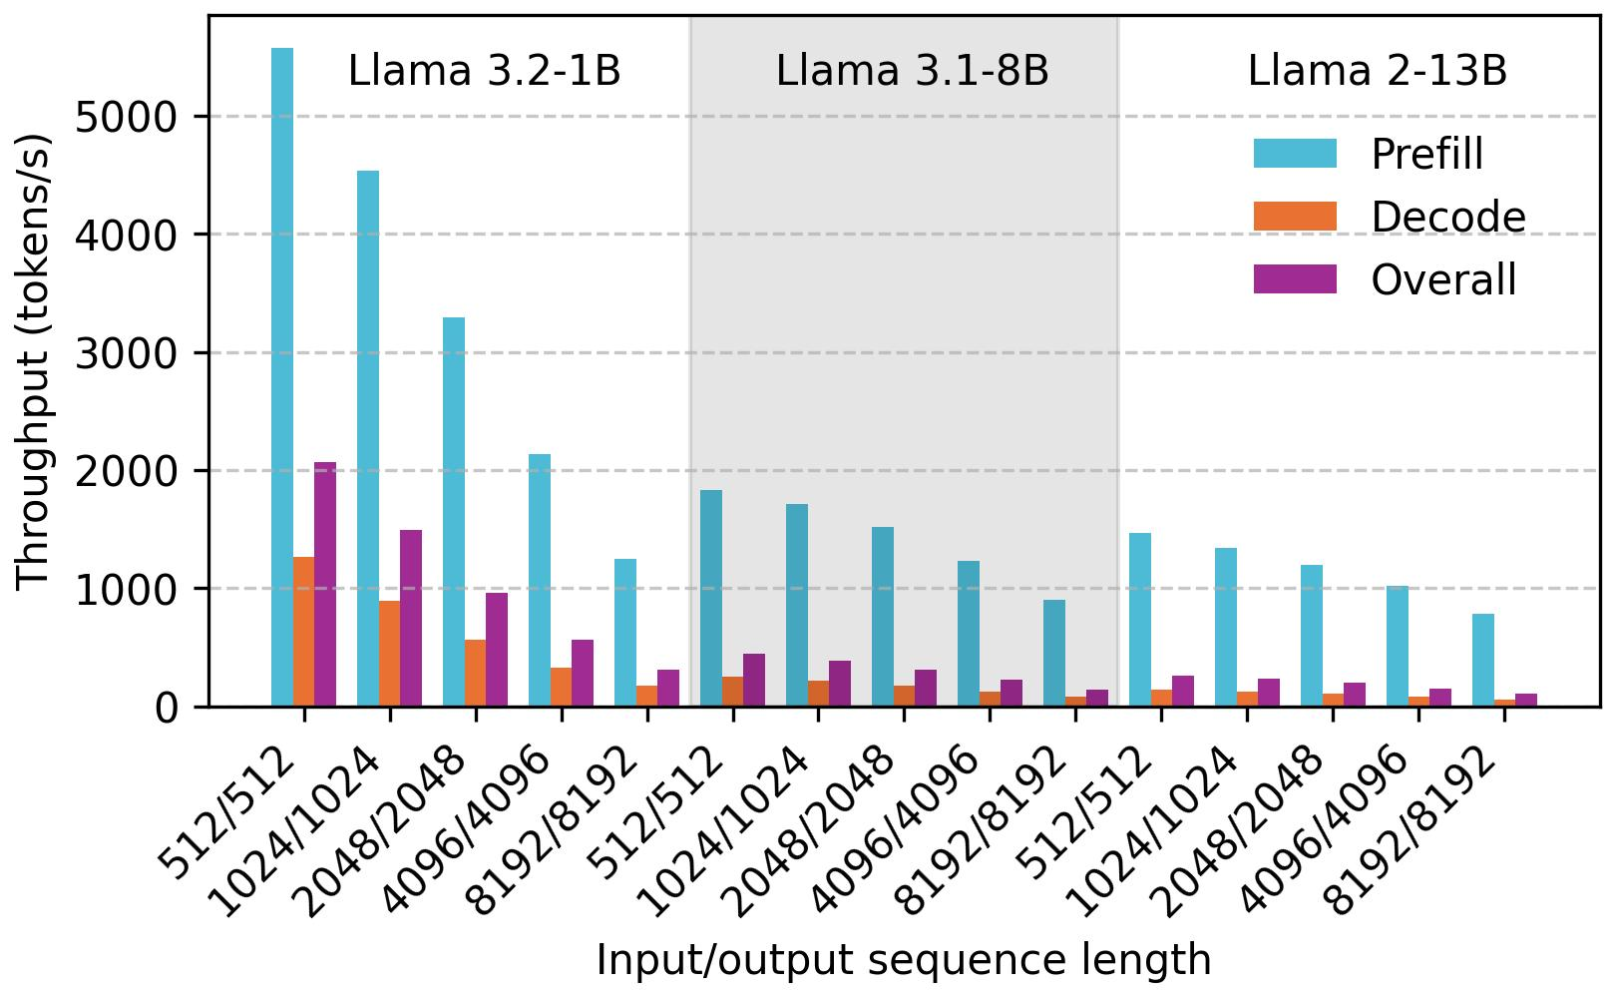
Throughput Scaling Across Models
2.8× lower TP with
8× larger model size
3.6× lower TP with
13× larger model
Prefill, decode, and overall throughput are evaluated for 1B, 8B, and 13B Llama models.
Throughput decreases less than proportionally as model size increases
15
Notes:
Now, let's look at the system-level evaluation. We measure prefill, decode, and overall throughput across three Llama model sizes, with different input and output lengths. These two phases show different behavior. Prefill benefits strongly from parallel matrix computation. Decode, on the other hand, becomes more sensitive to sequential execution and the growing runtime state. In the evaluated configurations, prefill throughput decreases by only about two point eight times when moving from the one-billion to the eight-billion parameter model, and by about three point six times from one billion to thirteen billion parameters. This indicates that the architecture can continue exploiting substantial parallelism as the model size increases.

Slide 16
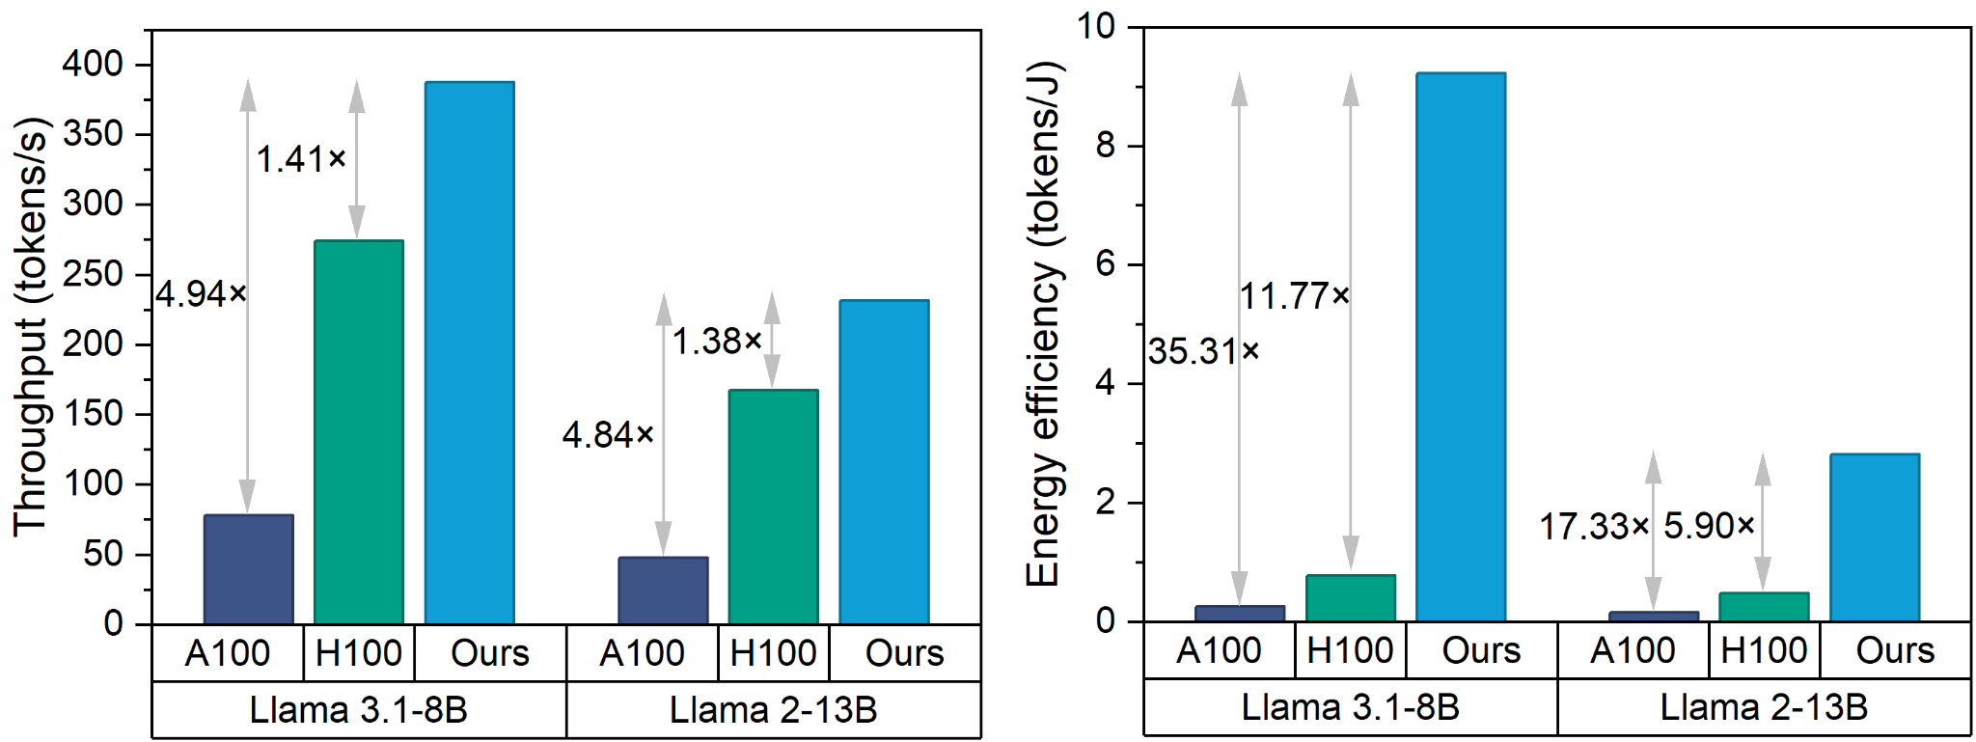
System-Level Energy Efficiency Compared with GPUs
17.33–35.31× vs. A100
5.90–11.77× vs. H100
OmniAcc achieves substantial energy-efficiency gains while maintaining competitive throughput
16
Notes:
Finally, we compare the modeled OmniAcc system against the NVIDIA A one hundred and H one hundred GPUs, using Llama three point one, eight billion, and Llama two, thirteen billion. In these evaluated workloads, OmniAcc achieves higher throughput, together with a particularly strong improvement in energy efficiency. The improvement comes from three complementary ideas: reducing data movement through distributed memory, simplifying nonlinear execution with a lightweight fixed-point datapath, and organizing communication around local, predictable transfers. Together, these choices improve efficiency across the full model.

Slide 17
Key Takeaways
Challenge: Nonlinear operations incur nontrivial overhead; accelerating matrix multiplication alone does not guarantee efficient full-model inference
Circuit: Outlier-aware, division-free nonlinear processing reduces NLPC power and area while preserving near-baseline model quality
Architecture: Interleaved linear and nonlinear slices support attention and FFN on the same scalable tile
Dataflow: Fine-grained parallelism and deterministic routing turn local compute into efficient full-model inference
17
Notes:
To conclude, efficient large language model inference benefits from co-design across algorithms, circuits, architecture, and system-level mapping.
[Click 1] First, our numerical and circuit techniques enable accurate, division-free nonlinear processing.
[Click 2] Second, the regularly interleaved architecture allows attention and feed-forward layers to share nearby linear and nonlinear resources.
[Click 3] And third, locality-aware mapping brings these components together through predictable dataflow and fine-grained parallelism. OmniAcc demonstrates how these cross-layer ideas can make memory-centric inference more efficient at the full-model level.

Slide 18
Thank you!
Questions & Discussion
Notes:
[On slide]
Thank you very much for your attention. I'd be happy to take your questions.

