Slide 1
Impact of Celebrity on consumers
Submitted by:-
Mohit Kumar (2017IMG-033)
Yash Agrawal (2017IMG-061)

Slide 2
Introduction
Consumer associate themselves with their ideals/ celebrities which in turn are associated with brand(s), so consumers begin liking the brand.
Consumers are provoked to buy the product.
Another side of coin: if brand is not satisfying the consumer, he may begin disliking the celebrity. Or if product delights the customer, he may begin liking the celebrity.
Some typical examples are:
Amitabh Bachhan for Ghari (“pehle istemal kare, fir vishwas kare”).
Shahrukh Khan for Byju’s (“keep learning”).
Salman Khan for Goldee masale (“Jaha bhi jaye, rishte banaye”).
Kiara Advani for Myntra (“that’s why we are the fashion expert”).
Ajay devgan for Vimal pan masala (“bolo jubaan kesari”).

Slide 3
Introduction
Celebrity Endorsed Advertising aims to give something new, creative and useful to get long term benefits of brand loyalty and image building of product and company by establishing an emotional relationship and persuasion for buying product.
Selecting a celebrity for product, also indicates that company wants to target a particular segment (which have some similar cultural and social values) and position itself as supreme in that category of product in mind, heart and spirit of consumers.
It brings positive involvement of consumers and so consumers learn more and are persuaded more rapidly about product advertised.
Endorsing right celebrity gives some authentication about quality of product. Status conscious people (who are everywhere) and fans are affected very much by celebrity endorsed ads.

Slide 4
History
Advertisement began in egypt, then greece and rome and then gradually in whole world
First outdoor advertisement was practiced by bill-boards etc. then gradually came newspaper, radio advertisement and now with advancement of technology, television advertisement;
In television ads, first there used to be only products, but consumers found researchers found that some advertisers over appreciated their product and as a result consumer was made fool.
As a result, slowly celebrities came in show, winning consumers trust, that the product is reliable.
Featuring celebrities on ads along with product and tagline, in order to gain maximum influence on customers is both an art and science (whether celebrity should be on left…), which is advancing at a lightning pace.

Slide 5

Adidas
Lionel Messi’s picture initially attracts the consumer, the intended audience being sports (especially football) enthusiasts.
The contrasting colours of the shoe and matching caption convey that it’s a shoe advertisement.
The shoe appears to be emitting sparks (representing fast performance)

Slide 6
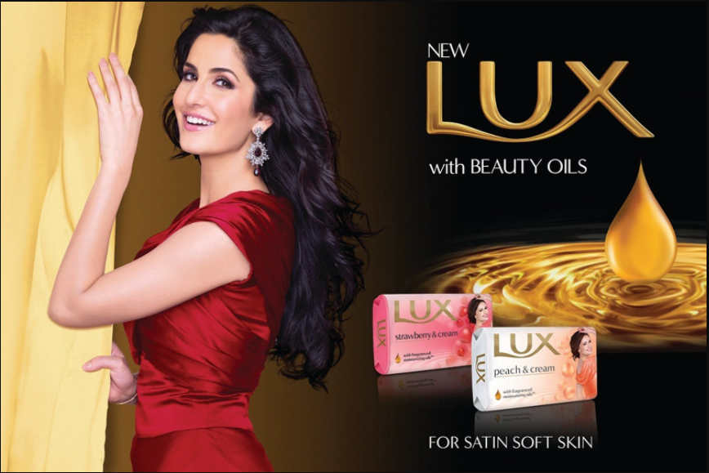
“Bs zara sa LUX”.
LUX involves more bollywood celebrity because is habituate to see LUX with young and fashionable celebrity

