Slide 1

MUSIC GENRE CLASSIFICATION USING CONVOLUTIONAL RECURRENT NEURAL NETWORKS
Noopur Srivastava
(Research Scholar)
noopurs@iiitm.ac.in
(Paper ID - 72)
Atal Bihari Vajpayee Indian Institute of Information Technology and Management, Gwalior

Slide 2
CONTENTS
Introduction
Research Work-Flow
Methodology
Experiments and Results
Conclusion
References
Noopur Srivastava
ABV IIITM Gwalior
2
/14

Slide 3
INTRODUCTION
Music Genre Classification is one of the toughest task, and it is highly demanded now a days.
It's Classification can be done manually by experts, which is very costly economically.
Basically, Music genre classification is the task of classifying
audio clips into well defined music genres.
GTZAN audio dataset was used, which is a benchmark dataset [5], and from this dataset, MFCC (Mel Frequency cepstral Coefficients) were extracted which are good representation of audio data.
Like image files, audio files too contain hierarchical structures. thus CNN can be introduced here.
The proposed model uses CRNN (CNN + GRU, CNN + LSTM), which is more accurate than state-of-the-art models based on CNN , K-NN, GNN etc.
3
3

Slide 4
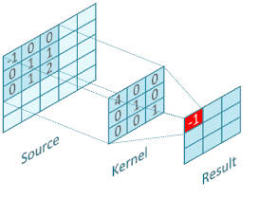
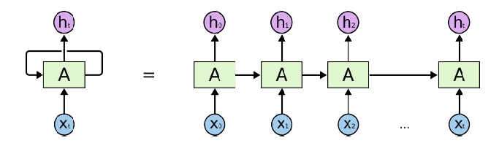
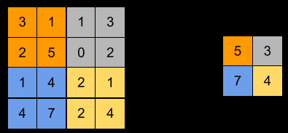
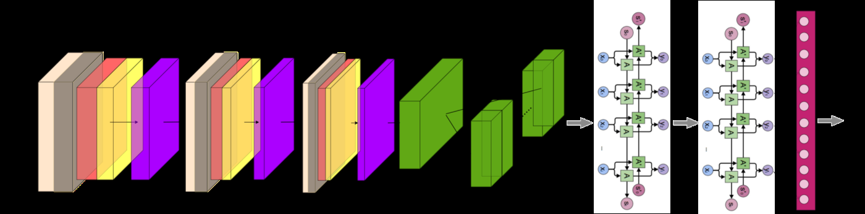
INTRODUCTION (CONTD…)
.
Fig. Convolution operation in CNN [2]
Fig. An unrolled loop in RNN [7].
Fig. Pooling operation in CNN [3]
Fig. Schematic representation of CRNN model [1]
4

Slide 5
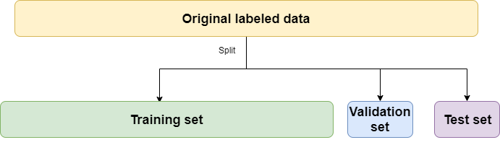
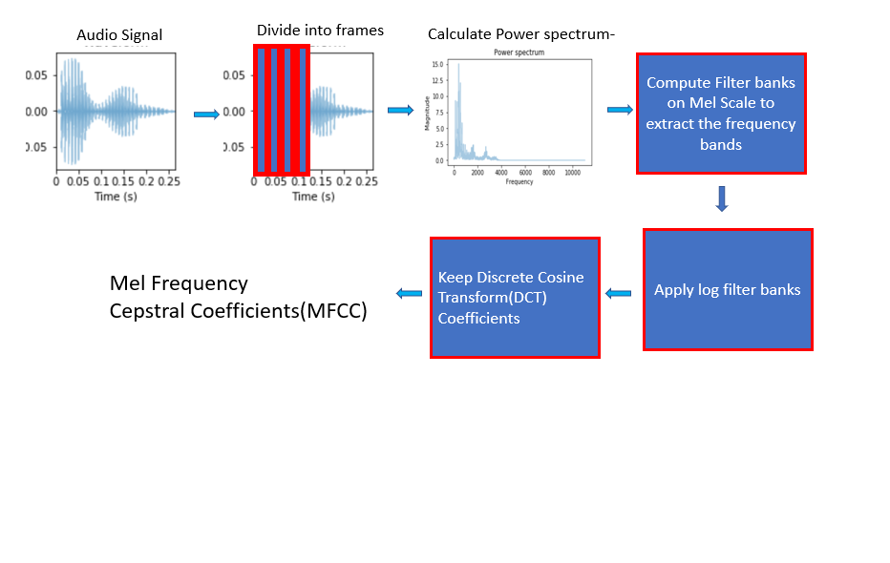
RESEARCH WORK-FLOW
GTZAN dataset is divided into training (80%) and testing subsets (20%).
Training subset is further divided into training and validation subsets.
CRNN model is trained using training and validation subsets (total 80%), then resultant model’s performance is evaluated on test subset (20%).
Inputs to CRNN model were MFCCs, which capture power spectrum of sound.
Fig. Schematic representation of splitting dataset [6].
Fig. MFCC derivation [3].
5

Slide 6
METHODOLOGY
Proposed Hypothesis:
  Convolutional Recurrent Neural Network model should utilize both spatial and temporal features and produce better results than Convolutional Neural Network model.
Dataset Description:
  GTZAN dataset, benchmark dataset for music genre classification was used.
  The GTZAN dataset provides us 100 music clips each with
30 sec duration for 10 genres each.
6

Slide 7
METHODOLOGY(CONTD…)
Mechanism and model:
  After processing the music clips, MFCCs with 23 coefficients was derived.
  Two CRNN models were implemented viz. CNN + GRU, CNN + LSTM, which take MFCCs as input.
  Dropout rate was set to 10%, to avoid overfitting in RNN layers.
  For 1st CRNN model, 2 GRU layers were used, whereas, for 2nd CRNN model, 2 RNN-LSTM layers were used.
  Reshape layer used for reshaping 3 dimensional CNN output as 2 dimensional input to RNN.
  To process the audio data and derive MFCC features, librosa was used, whereas, keras was used implement our model and train them.
7

Slide 8
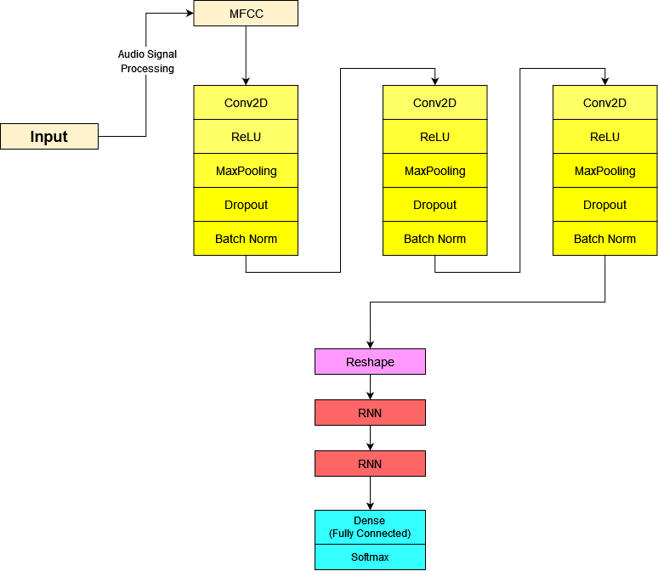
METHODOLOGY(CONTD…)
.
Fig. Architecture of CRNN model [7]

Slide 9
EXPERIMENTS AND RESULTS
Adam optimizer is used for controlling learning rate while training
Sparse categorical cross entropy is used as loss function while training.
Adam optimizer is an extension to stochastic gradient descent and it is based on the adaptive estimation of first order and second order moments.
Adam optimizer is a combination of RMSP and gradient descent with momentum algorithms.

Slide 10
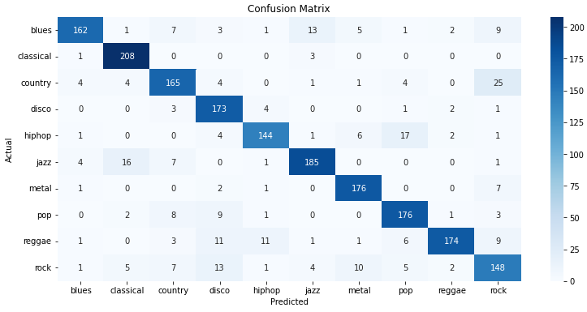
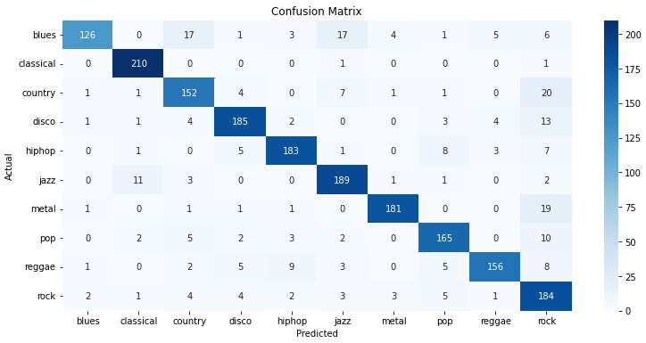
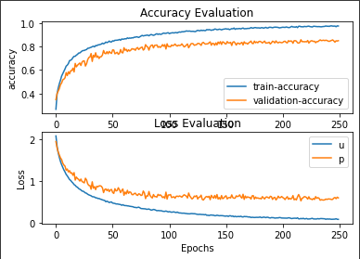
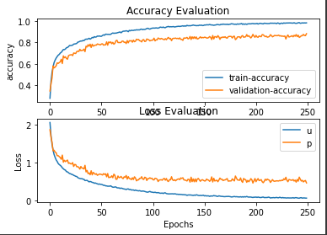
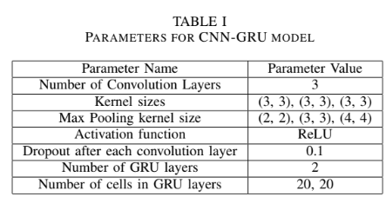
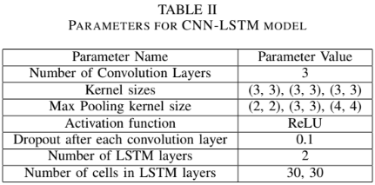
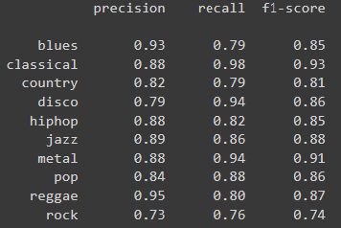
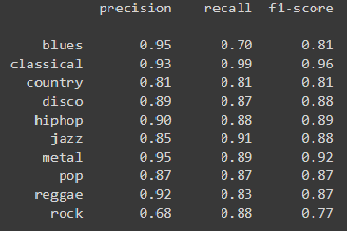
EXPERIMENTS AND RESULTS (CONTD…)
Experiment 1:
CNN-GRU model was trained and tested using
train and test subsets.
CNN-GRU model achieved an accuracy of 85.7%.
Fig. Confusion matrix for CNN-GRU model
TABLE III
PRECISION, RECALL AND F1 SCORES OF
CNN-GRU MODEL ON THE GENRES.
Fig. Training vs Validation plots for accuracies and losses for CNN-LSTM

Slide 11
EXPERIMENTS AND RESULTS (CONTD…)
Experiment 2:
CNN-LSTM model was trained and tested using
train and test subsets.
CNN-LSTM model achieved an accuracy of 87.5%.
Fig. Confusion matrix for CNN-LSTM model
TABLE IV
PRECISION, RECALL AND F1 SCORES OF
CNN-LSTM MODEL ON THE GENRES.
Fig. Training vs Validation plots for accuracies and losses for CNN-LSTM

Slide 12
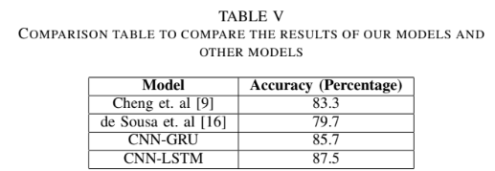
CONCLUSION
CRNN models was tested for the task of music genre classification to utilize both the hierarchical spatial features and the temporal relationships of the music data.
Both the CRNN models outperformed the CNN [9] model and yielded better testing accuracy on the GTZAN dataset.
Among the two CRNN models the CNN-LSTM model achieved better results than the CNN-GRU model.

Slide 13
FUTURE SCOPE
Model can be improved by using Graph Convolutional Networks and relationships and variations of different genres can be captured.
Better datasets and better features can be used to improve the model.

Slide 14
REFERENCES
[1] An approach towards convolutional recurrent neural networks, available:
https://towardsdatascience.com/an-approach-towards-convolutional-
recurrent-neural- networks-a2e6ce722b19
[2] Basic concepts of cnn, available: https://medium.com/s-a-a-s/dl-basic-
concept-of-cnn- 2ef4fc9b039b.
[3] Deep learning for audio classification, available:
https://medium.com/analytics- vidhya/deep-learning-audio-
Classification-fcbed546a2dd.
[4] Explaining pooling layers, available: https://androidkt.com/explain-
pooling-layers- max-pooling-average-pooling-global-average-pooling-
and-global-max-pooling/.
[5] Gtzan dataset, available: https://www.kaggle.com/datasets/andradaolteanu-
/gtzan- dataset-music-genre-classification.
[6] Test, train and validation split, available:
https://www.brainstobytes.com/test- training-and-validation-sets/.
[7] Keunwoo Choi, Gy orgy Fazekas, Mark Sandler, and Kyunghyun Cho.
Convolutional recurrent neural networks for music classification. In
2017 IEEE International Conference on Acoustics, Speech and Signal
Processing (ICASSP), pages 2392–2396, 2017.
[8] Yu-Huei Cheng, Pang-Ching Chang, and Che-Nan Kuo. Convolutional
neural networks approach for music genre classification. In 2020 Inter-
national Symposium on Computer, Consumer and Control (IS3C), pages
399–403, 2020

