Slide 1
PAPER PRESENTATION
ON
“A Neural Network based Diabetes Prediction on Imbalanced Data”
MASTER OF TECHNOLOGY
In
DATA SCIENCE
Name: Shivani Yadav
Roll no: 0002DS18MT04

Slide 2
INDEX
Introduction
Related works
Proposed Work
Methodology/Tools And Technology To Be Adopted
Experimental Results
Conclusion and future scope
References

Slide 3
ABSTRACT
As an extensively well-known chronic disease, diabetes is an illness that harms the body’s capability to process blood glucose. The proper treatment of diabetes could help a person live a long and normal life in general. It is necessary to detect the disease at an early stage. We focus our work on the performance of a machine-learning (ML) algorithm to identify the presence of diabetes on the PIMA Indian diabetes dataset (PIDD) which referenced from the University of California, Irvine (UCI) ML repository. Using ML, we know about the classification and prediction techniques. Further, diabetes became an attention seeker in the field of research due to the presence of imbalanced and missing data. Although many factors affect the performance of the algorithm, This research paper worked on the prediction technique for diabetes classification with outliers and missing values in data with class imbalance. Using an adaptive synthetic sampling method (ADASYN) and reduced the impact of class imbalance on the performance of the prediction model. Then, this algorithm improved the generalization using a feature selection technique and multilayer perceptron classifiers to make predictions and evaluations. Experimental results shows that this experiment obtained a better accuracy of 84% with a neural network model in comparison with the previous model.
Keywords Diabetes prediction . Machine Learning. Outliers . Artificial Neural Network . Adaptive synthetic sampling . Multilayer Perceptron

Slide 4
INTRODUCTION
Diabetes is the abbreviated version of full name diabetes mellitus. The term diabetes mellitus is derived from the Greek word diabetes which means siphon. The word ’siphon’ means to pass through and the Latin word Mellitus means sweet[1].
In the 17th century, diabetes mellitus also known as pissing evil [2]. Diabetes is one of the most chronic diseases in the world.
It was characterized by high blood sugar. It had become a fifth-ranked among various diseases for disease-related deaths [3].
Due to diabetes, other problems may arise like the increased risk of heart attacked and stroked, kidney failure, etc.
Diabetes disease had mainly three categories such as type 1 diabetes, type2 diabetes, and gestational diabetes [4]. Other categories of diabetes mellitus were diabetic retinopathy and diabetic neuropathy.
The PIMA Indian dataset (PIDD) [5] was used for the development of prediction models for classified data into diabetic or non-diabetic based on their symptoms and through the performance of various algorithms applied on this dataset.

Slide 5
Machine learning techniques had a massive perspective to improve the performance of the prediction model for diabetes. In terms of the development of the healthcare industry, they create a large amount of valuable data such as patient records, electronic medical history, the record of diagnosis, treatment data, etc.
Researchers had proved that the classification algorithms as support vector machine (SVM) [6], KNN [7], Naïve Bayes [8] and an ensemble of tree classifiers [9] [10], Logistic regression (LR) [11] etc. work better for many diseases with better results. This approach to ML techniques also indicates the improvement in the performance of the analysis.
In this work, various factors were under consideration to enhance performance. Firstly works to improve the quality of data for effective diabetes classification and applying feature selection. Then, it uses an oversampling method for improvement in the imbalanced class distribution in the dataset. It helps to solve the problem related to the unduly biased classification of major classes. The proposed algorithm was explained as the achievement of improved accuracy on PIDD, which performs better than the previous experiment.

Slide 6
RELATED WORKS
Various research works have been proposed for the classification of diabetes. These consider some features for the diagnosis and treatment of diabetes.
S. S. Dileep[12]works on the creation of an efficient model to compare various machine learning techniques using support vector machine (SVM), decision tree (DT), and Naïve Bayes (NB) to forecast the possibility of diabetes with maximum accuracy. They showed that the NB classifier performed best as compared to other methods with AUC 0. 809. They demonstrate that DT achieved higher accuracy in comparison with other techniques employed in this model.
The ML framework proposed [13], using linear discriminant analysis, quadratic discriminant analysis, NB, Gaussian process classification, AdaBoost (AB), logistic regression (LR), SVM, ANN, DT, and RF with dimension reduction and cross-validation method. They also worked on outlier rejection and filling missing values for boosting the performance of the ML model, where they chose AUC as a performance metric.
Authors in [14], they developed the five different models to predict diabetes using a linear kernel SVM (SVM-linear), radial basis kernel, KNN, ANN, multi- dimensionality reduction methods. They also employed a feature selection method to avoid biased selection of dominant features in the dataset. The Boruta wrapper algorithm used for feature engineering.

Slide 7
The deep learning technique [15] used to predict diabetes; they used a combination of a prevalent method from deep learning as long short term memory technique and convolution neural network method. Then, it compared with the performance of the MLP classifier to show the impact of the technique.
The artificial neural network (ANN) based classification model was proposed, in [16], they screened the PIDD data and worked with self-adaptive ANN. The neural network acclaimed by a cascading correlation (CC) algorithm. They demonstrated the CC with ANN helps to reduce the complexity of the neural network and also showed improvement in the performance of the technique.
The predictive modeling [17] used to analyze the performance of different ML techniques based on a 3 patient’s record to help doctors in the early detection and treatment of diabetic patients. They performed on the PIDD data using different algorithms like KNN, LR, and gradient boosting, SVM, RF, DT, and neural network. In this experiment, RF performed better on this dataset with 79% accuracy.
The proposed framework [18] performed the analysis of features in PIDD. Based on correlation values, they selected the optimal features from the dataset. They showed in their experiment, the feature selection method provided the best fit to the data in aspects of diabetic or non-diabetic patients’ records.

Slide 8
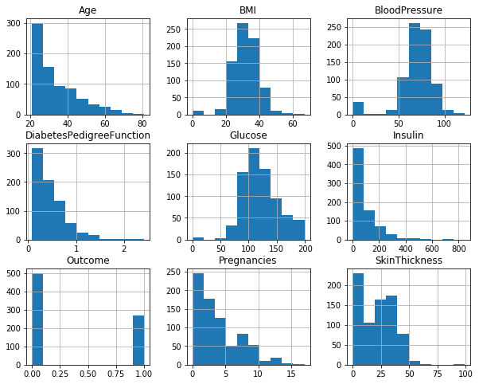
MATERIAL AND METHODOLOGY
Dataset
The proposed work performed using the PIMA Indian dataset taken from the UCI Repository [5].
Fig.1 Distribution of attributes in PIDD

Slide 9
Table 1 Description of PIDD
Attribute number | Attribute name | Description
1 | Pregnancies | Number of Times Pregnant
2 | Glucose | Plasma Glucose concentration
3 | Blood Pressure | Diastolic blood pressure(mm Hg)
4 | skin thickness | skinfold thickness(mm)
5 | Insulin | 2-hour serum insulin (mu U/ml)
6 | BMI | Body mass index function
7 | Diabetes pedigree function | Diabetes pedigree function
8 | Age | Age in years
9 | Outcome | Class Label (’0’ or ’1’)

Slide 10
TOOL USED
Python Python is an object-oriented, high-level programming language. Python supports packages to utilize code and the modularity of the programming. For this experiment, used python environment jupyter notebook on anaconda version 3.
Scikit-learn Scikit-learn is a preeminent library for machine learning in python.
Packages used in the experiment
Scikit-learn came filled with various features. Here some packages [19] were used in this experiment are as follows-
1. Numpy
2. Pandas
3. Matplotlib
4. Seaborn
5. Model Selection
6. Imbalanced-learn

Slide 11
PROPOSED FRAMEWORK
Step 1: Data Preprocessing
1.1 Handling Outlier
1.2 Missing Values
Step 2: Feature Scaling
Step 3: Feature Selection
Step 4: Oversampling Technique (ADASYN)
Step 5: Classifier(MLP)

Slide 12
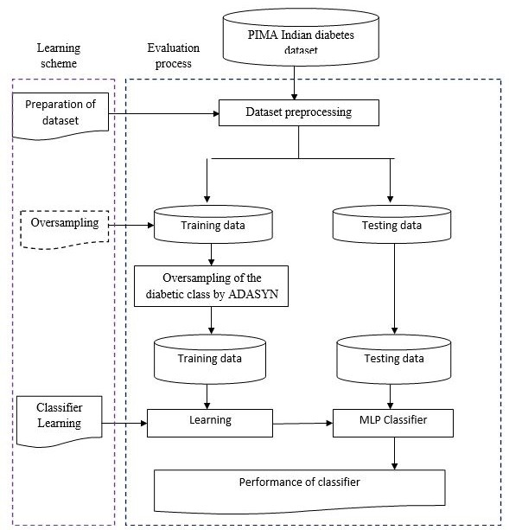
Fig.5 Block Diagram for Proposed Mechanism

Slide 13
EXPERIMENT RESULTS
For all experiments, we assigned 80 percent data for training purposes and 20 percent for testing purposes. The performance of the proposed model was evaluated as the average results obtained from the cross-validation (CV) technique. The accuracy of the classification task is to act as a performance indicator for the analysis of diabetes using ML techniques. Due to the presence of outliers, missing values, and imbalanced class distribution in PIDD, as a performance metric accuracy is not enough for this work. Thus, we need some points under considerations for the evaluation of the proposed algorithm is as follows-
Conduct classification using MLP classifier with and without detection of outliers and missing values imputation to interpret the improvement in performance after the processing of outliers and missing values.
Implement the classification task using MLP classifier with and without oversampling technique and feature selection to check the effectiveness of processing of class imbalance and standardization of features to analyze the likelihood of diabetes.
Evaluate the results against some evaluation metrics such as accuracy, recall, precision, f-measure.
The calculation of accuracy, precision, recall, f-measure is as below in Table 4.

Slide 14
Table 3 Results in Confusion matrix
Table 4 Results Comparison
Actual/ Predicted | Positive | Negative
POSITIVE | 91 | 16
NEGATIVE | 9 | 38
Methods | Accuracy | Precision | Recall | F- measure
SVM | 0.73 | 0.62 | 0.45 | 0.52
RF | 0.79 | 0.84 | 0.62 | 0.70
Pro- posed (k=5) | 0.84 | 0.91 | 0.85 | 0.88
We analyzed the results of the proposed algorithm with other benchmark algorithms in Table 4 from the following aspects. First of all, for the MLP adopted in this paper and proposed the Algorithm with the impact of the CV where, k indicates 5-fold or 10-fold CV
strategies, the proposed algorithm gives result based on the experiment [20] by the authors, there is no processing for the outliers, missing values, and oversampling technique for the dataset.
In our proposed work, we are working on these aspects and done oversampling to avoid the problem of the minority class. And also work for the feature selection method to improve the performance of the classification task.
In Fig. 6, the graphical representation shows the performance comparison between the experimental results for diabetes prediction.

Slide 15
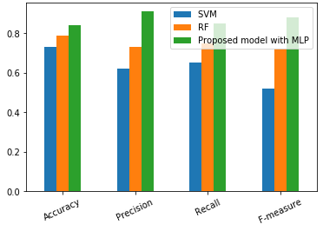
Fig.6 Graphs Represents Comparison of Results

Slide 16
CONCLUSION AND FUTURE SCOPE
In this study, we have proposed a model to classify the dataset and forecast the likelihood of diabetes. The classification method focuses on some problems regarding diabetes prediction. It is considered that the challenge is the presence of a missing value, outliers, and unbalance class distribution seen in the medical record.
The algorithm designed for working with the data preprocessing and classification steps. The reduction of the high dimensionality of the dataset enhances the quality of dataset with decreased class imbalance where preprocessing plays a significant role in robust and precise prediction for classifying the diabetes dataset.
The analysis of variance using an f-test boosts the correlation between features concerning the outcome label. The validity of the MLP classifier verified using the CV validation strategy. Due to the presence of class imbalance, performance metrics other than accuracy are also used as comprehensive indicators in this model.
Experimental results determine the effectiveness of the proposed work has 84% accuracy with 85% recall value. The comparison of results interpret that our proposed algorithm has outperformed the other benchmark algorithms in the experiments based on accuracy and other performance metrics of classifier.
In future, we hope to use this proposed algorithm for the analysis of other types of diseases with some extension and improvement in the algorithm for the classification task. This proposed framework can also be used to create a web application with a user-friendly interface.

Slide 17
References
M. C. Fitzmaurice, C, L. Allen, R.M. Barter. L. Bar- raged, A.Z. Butte, H.N. Brenner and T.M. Fleming.Global, regional, and national cancer occurrence, mor- tality, vanished many years of patient, many years patient remain alive with a disability, and adjusted living for 32 cancer patients with a disability, from the 1990s: a systematized analysis for the global im- plication of cancer study. col. 3(4) JAMA(2017)
K. Sumengalli, Gitika, S.B.R., and H.Ambharkar. A classifier based method for the earliest detection of diabetic or non-diabetic. In: 2016 International Con- ference on Control, Instrumentation, Communication, and Computational Technologies (ICCICCT). IEEE (2016)
American Diabetes Association. "Diagnosis and Clas- sification of Diabetes." Diabetes Care (May 2018)
C. Ambeeka and G. Dipak. A Survey on Medical Prognosis of Diabetes Using Machine Learning Meth- ods. Ⓧc Springer Nature (2019)
https://archive.ics.uci.edu/ml/dataset-PIMA-indian- datasets
At.el.Carerra, E.V.Gonzales, R... Automated detec- tion of diabetic retinopathy using support vector ma- chine. In: IEEE XXIV International Conference on Electronics, Electrical Engineering, and Computing (2017)
M. Sued, S. Lara, L. Abdurrahman, R. Almohaini, and T. Saba. Current Techniques for Diabetes Prediction: Review and Case Study. Applied. Science. (2019)
Md. F. Faisal, H. Ashaduzaman, Sharker, Iqbal. Per- formance Analysis of Machine Learning Techniques to Predict Diabetes. IEEE International Conference on Electrical, Computer and Communication Engi- neering(2019)
P.Shonar K.MaliniJaya, Diabetes Prediction Using Different ML Approaches.3rd International Confer- ence on Computing Methodologies and Communica- tion (ICCMC), (2019

Slide 18
10. D. Vigneshvaari, N. K. Komal, R.Ganesh, V, A. Gagan, Vikas, S. R. Machine Learning Tree Classifiers in Predicting Diabetes. 5th International Confer- ence on Advanced Computing Communication Sys- tems(2019)
11. Jurafsky, S. Denials H. Martin, A. James, Logistic regression: Speech and Language Processing(2019)
12. S.S.Dileep, S.Deepti. Prediction of Diabetes using Classification Algorithms. International Conference on Computational Intelligence and Data Science (IC- CIDS 2018)
13. M. Maniruzzaman, M. J. Rahman, M. Al- MehediHasan, H. S. Seri, M. M. Abedin, A. El-Baz, and J. S. Seri. Accurate diabetes risk stratification using machine learning: Role of missing value and outliers. J. Med. Syst., vol. 42, no. 5, p. 92,(May 2018).
14.H. Kaur and V. Kumari. Predictive modeling and analytics for diabetes was using a machine learning approach. Appl. Compute. Information. (Dec. 2018)
15. Dr. K. Pradhnya, B.Rahul: Analysis of Classifiers for Prediction of Type II Diabetes.In Proceedings of International Conference on Computing Control and Automation (ICCUBEA), IEEE(2018)
16. K.Rolikathi, R, RajaKumari, P, G. Prashant. Diagno- sis of Diabetes Using Cascade Correlation and ANN. Tenth International Conference on Advanced Com- puting (ICoAC). (2018)
17. G. Sapna, R. Vinnie Kumar, and K. P. Soman. Dia- betes detection using deep learning algorithms. ICT Express, vol. 4, no. 4, pp. 243– 246 (2018).
18. Sneha, N., and T. Gangil. Analysis of diabetes melli- tus for early prediction using optimal features selec- tion. Journal of Big Data 6 (1): 13,(2019)
19. Scikit- learns and related packages: https://scikit- learn.org/ stable/ modules
20. Yoho. Amani, Jm. Akhtar, Yesiltepe Misrad, R.Jawad. A decision support system for diabetes prediction using machine learning techniques and deep learning technique. IEEE. pp. 978-1-7281-3992(2019).

Slide 19
THANK YOU

