Slide 1
Task 1:
Malicious Ethereum Addresses Detection
Case Study for BMW Interview
Yichun Xie
21st Jun 2022
Notes:
Thank you today for attending this interview.
I’m currently writing my master’s thesis on software defect prediciton, and am appyyling for this role on data science intern for a starter of my career in Germany.
It’ s a great opportnuity for me to present my solution of the two tasks for you.
The first is about Malicious addresses detection on blockchian.
6:00-9:00第一部分补充图表和说明
9:00第二部分两页slides就行
改字体
提前更新一下代码
10:00 调试teams展示note，穿好衣服，练习几遍，再看几遍Qs

Slide 2
Content
Problem
01
Malicious Ethereum addresses Detection
Feature Engineering
02
Data Preprocessing, Feature Engineering, Exploratory Data Analysis
Modelling
03
Standard Machine Learning Models, Hyperparameter Optimization, Feature Importance
Solution & Discussion
04
Business Suggestions, Limitation
Notes:
In the following sections, I’m gonna go through introduction of the problem,
and together with the provided dataset.
Followed by the machine learning pipeline.
And in the end more about suggestions for the business.

Slide 3
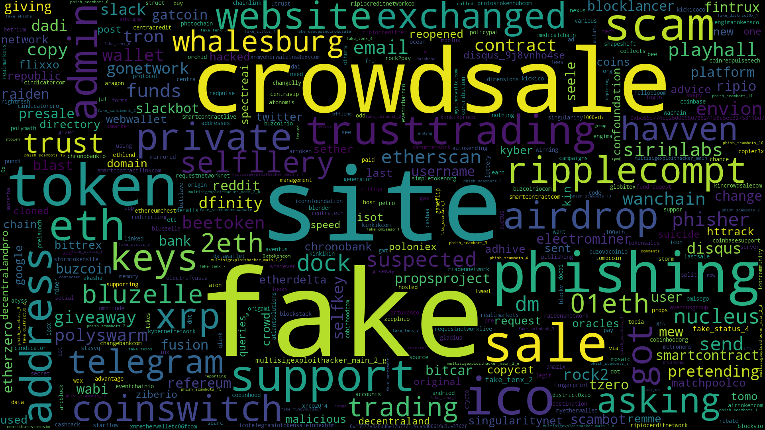
Notes:
So what is considered to be maliciousness in the blockchain?
This is the wordcloud extracted from the dataset of malicious addresses with comment explainning the reason why are they suspicious.
Among them, fake, site, crowdsale, phishing, scam, airdrop, telegram are among the top fequently occurred words related to the malicious activityes.

Slide 4
Malicious Activities
Phishing scam
Redirect users to imitation websites, ask them to reset their password or sent ETH.
Giveaway scam
Appear in many forms to ask users to send ETH to the provided wallet address, e.g., support giveaway..
Fake (crowdsale) website
Included in phishing scam and many other scams.
Social media hacks
Organizations and celebrities get hacked to post a cryptocurrency giveaway.
Fake Initial Coin Offering
Fake admin in ICOs, fake tokens
Airdrop scam
Airdrop an asset into your wallet and sending a scam website to claim the airdropped asset.
Notes:
https://ethereum.org/en/security/
This is inline with what have been reported on their official website about the common malicious activities.
Scammers are always looking for ways to take funds off others.
In the common phishing scam, they will re-direct users to fake websites to send ETH or install malwares.
In the giveaway scam, organizations and celebrities can possibly get hacked post a crypto giveaway, asking users to send ETH to the provided wallet address, transactions could happen within minutes.

Slide 5
Case Study Dataset
Task: To detect malicious addresses
Malicious Addresses with
Comments
Role: member of a Crypto startup
Malicious Transactions
Normal Transactions
Transactions with features:
address
from address, to address, contractAddress
input
timestamp
value
gas, gasPrice, cumulativeGasUsed
isError, txreceipt_status
blockNumber, hash, nounce, blockHash, transactionIndex
transactionIndex, confirmations
663 Addresses
268 Comments
From 2017-07-18 to 2020-11-17
551 Addresses
21961 Transactions
From 2017-05-20 to 2022-05-05
87 Addresses
30000 Transactions
From 2016-05-26 to 2022-06-08
-> ML Objective: Prediction of maliciousness
(Binary classification)
Notes:
For this case study, data has been provided regarding the malicicous addresses to

Slide 6
Machine learning Pipeline
Feature Engineering
Exploratory Data Analysis
Model Training
Prediction
Data Preprocessing
Data Formatting, Transformation
Select features, Create New Features
Plots
Standard machine Leaning models
Test Dataset
Distributions, Correlations
Feature importance
Data types,
Lowercase addresses,
Timestamp to time,
Gas Price from Gwei to Ethr.
Group and aggregate features
Training, Evaluation Metrics, Hyperparameter Optimization of selected models.
Notes:
Conducted pipelines with the data

Slide 7
Feature Engineering
Smart Contract
Address types and Transaction Types.
01
Transactions Sent and Received
02
Bi-directional graph.
Time
Temporal aspect.
03
Value
Amount of Ether in the transactions.
Gas Used and Price
04
.
05
Failed and Error Transactions
06

Slide 8
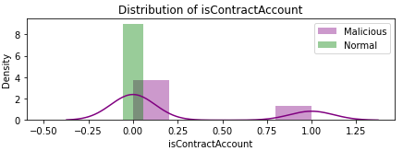
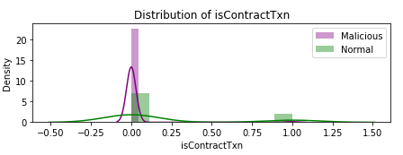
Exploratory Data Analysis
Account
Smart Contract (SC)
Externally Owned (EOA)
Many of malicious addresses are not SC accounts, SC accounts can be malicious.
Malicious EOA accounts tend not to run on smart contract.
Notes:
- The addresses are grouped into malicious and normal addresses, also for further model training. It shows that they have different patterns with the created features.
- As the nature of blockchain, if the address is smart contract address (SC), or externally owned addresses (EOA) is analyzed, and if the transaction is running on smart contract is also examined.
which shows that malicious addresses are mostly not contract account, they tend not to deploy or execute a smart contract either.

Slide 9
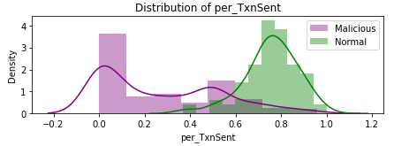
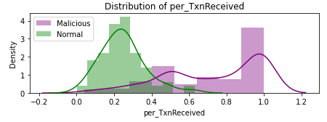
Exploratory Data Analysis
Transactions
Sent
Received
Malicious addresses have much more transactions received than sent, compared to normal addresses.
Notes:
The transactions are grouped into sent or received, as blockchain is a temporal bidirectional graph.
The percentage of transaction shows that malicious addresses have much more transactions received than sent, which makes sense because they are involved in financial activities.

Slide 10
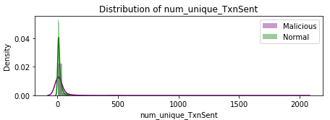
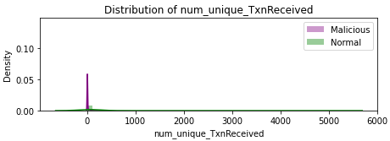
Exploratory Data Analysis
Unique Transactions
Sent
Received
Malicious addresses tend to send transactions to less unique addresses, but receive transactions from more unique addresses.

Slide 11
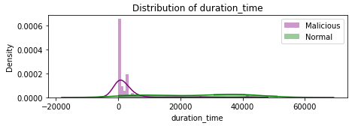
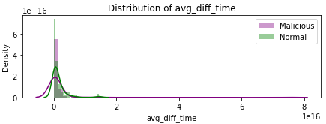
Exploratory Data Analysis
Time
Duration
Difference
Malicious activities last shorter and with short intervals.

Slide 12
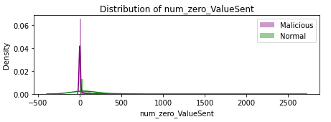
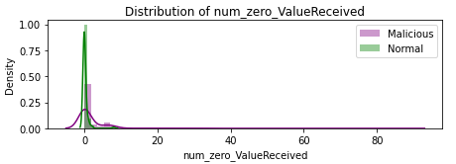
Exploratory Data Analysis
Value
Sent
Received
Malicious addresses send more zero value transactions, normal addresses receive more.
Notes:
- Values included in malicious transactions are in much smaller amount and are more centralized compared to normal transactions which has a more sparse distribution.

Slide 13
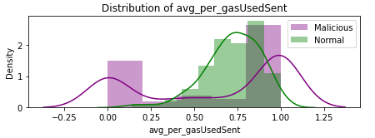
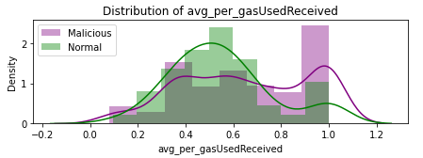
Exploratory Data Analysis
Average Percentage Gas
Sent
Received
Malicious addresses tend to use the upper limit of the gas.

Slide 14
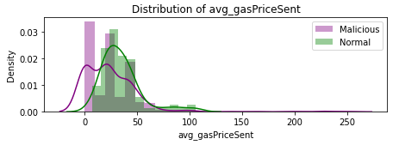
Exploratory Data Analysis
Average Gas Price
Sent
Received
Malicious addresses set the gas price to be lower when sending the transactions, but when they receive transactions, it’s much higher.

Slide 15
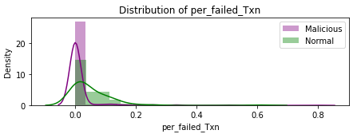
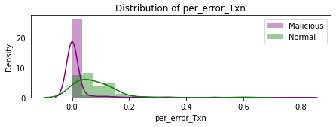
Exploratory Data Analysis
Transactions
Failure
Error
Malicious transactions are less likely to have error or fail.
Notes:
- Failure and error are much more common in transactions for malicious accounts.

Slide 16
Modelling
01
Dataset
02
Models
03
Training
04
Evaluation
Combine malicious and normal addresses,
Split into training and test dataset (80%),
Standard classification models
10 fold cross validation on the 80% training dataset.
Accuracy,
Precision,
Recall,
F1-score
06
Prediction
05
Optimization
With the 20% dataset.
Hyperparameter tuning for Random Forest and XGboost
Notes:
Logistic Regression,
Support Vector Machine, K-Nearest-Neighbors, Random Forrest,
XGBoost

Slide 17
Performance
 | val_ accuracy | val_ precision | val_ recall | val_ f1 | test_ accuracy | test_ precision | test_ recall | test_ f1
Logistic Regression | 0.858824 | 0.955820 | 0.880354 | 0.914815 | 0.875000 | 0.942857 | 0.908257 | 0.925234
SVM | 0.872549 | 0.873333 | 0.997727 | 0.931354 | 0.851562 | 0.851562 | 1.000000 | 0.919831
KNN | 0.888235 | 0.923547 | 0.950253 | 0.936462 | 0.859375 | 0.902655 | 0.935780 | 0.918919
Random Forest | 0.968627 | 0.975648 | 0.988737 | 0.982070 | 0.945312 | 0.955357 | 0.981651 | 0.968326
XGBoost | 0.966667 | 0.973478 | 0.988687 | 0.980974 | 0.945312 | 0.963636 | 0.972477 | 0.968037
Random Forrest and XGBoost outperform other models.
-> Hyperparameter tuning
_> Confusion Matrix: TP=107, TN=15, FP=4, FN=2

Slide 18
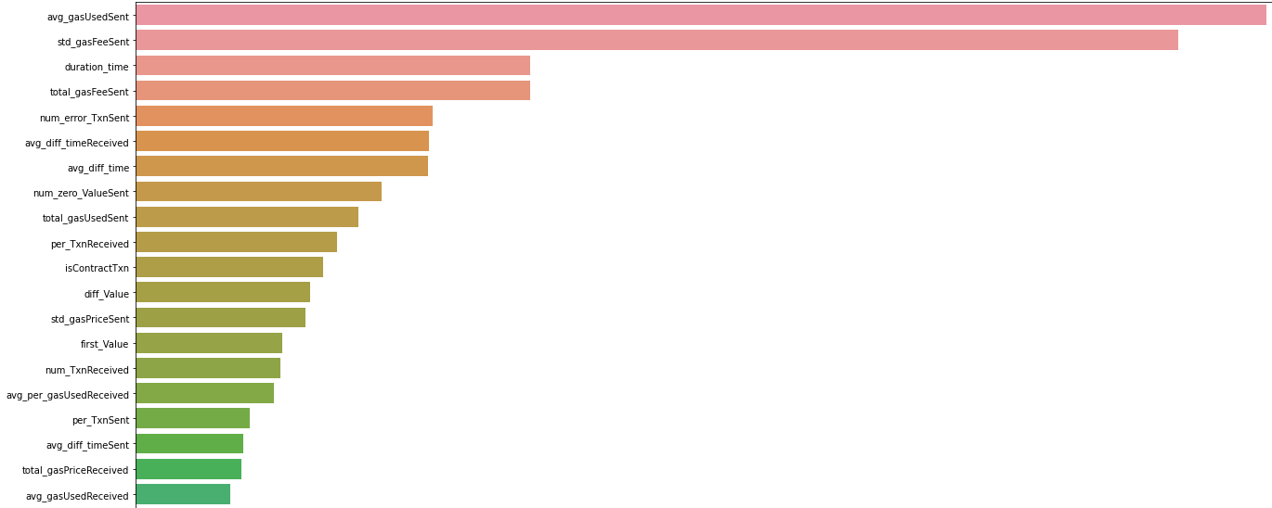
Feature Importance

Slide 19
Solution & Discussion
Time
Vulnerabilities of Smart Contract
Smart Contract
Value
Failure and Error
Phishing Scams
Transactions Sent and Received
Detection of Abnormal Value
Gas

Slide 20
Task 2
Bad Suppliers Detection

Slide 21
Bad Suppliers Detection
Supply Chain for a Food Company
Anomaly Detection
Historical Data
External
Effects
Reliability
Limitation
Time
Amount
Quantity
Construct features of good suppliers, manifest larger errors for bad suppliers.
Supplier
Location
Time
Item
Amount of items
Item Price
Returned amount
Class imbalance, majority of suppliers are good, abnormal behaviors are unpredictable.
Weather, Transport, Global Pandemic…
Notes:
1) The process / methodology / model
For the detection of bad suppliers in a food company, the historical supply, and delivery data are required for the problem. The model's output is supplier reliability score, which could be affected by the delayed delivery, less amount of products delivered than required, amount of the wrong items delivered, amount of poor quality of the item delivered, and the return of items due to wrong delivery or poor quality. As most deliveries meet the standards, and most suppliers are chosen are good suppliers, they should have similar patterns and higher reliability, while bad suppliers have more abnormal deliveries.
The state-of-the-art anomaly detection models can be applied, e.g., Autoencoder, which is trained to reconstruct features of good suppliers, will manifest larger reconstruction errors for bad suppliers.
A supplier is labeled as the bad supplier with the comparison of the score predicted by the model and a baseline of reliability score.
2) Data
The historical supply and delivery data which has the following features:
* supplier name
* location
* shipment mode
* scheduled delivery date
* recorded delivery date (delays)
* item brand
* item name
* required amount of item
* delivered amount of item (missing items)
* item price
* confirmed amount of item
* delivered amount of the wrong item
* returned amount of item (wrong items or items with poor quality))
3) Limits
The class imbalance problem could occur, as the majority of deliveries are good, and bad deliveries, and suppliers are the minority. Although anomaly detection models could be more effective than binary classification when dealing with unbalanced data, their stability still depends highly on the degree of imbalance.
The labeled historical data with qualified deliveries could be difficult to obtain, although a majority of suppliers are good suppliers.
External factors could affect the deliveries and could be further investigated as well, like the weather condition, the transport condition, and special events (e.g., festivals, pandemics, military situations).

Slide 22
THANK YOU

