Slide 1
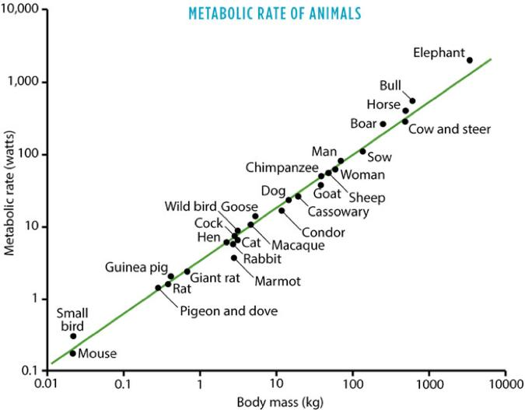
Kleiber’s law: Larger animals use more energy, but less energy per unit mass
Source: West, B.J. Systems 2, 89–118 (2014), Fig. 1; data from Schmidt-Nielsen (1984). CC BY 3.0.

Slide 2
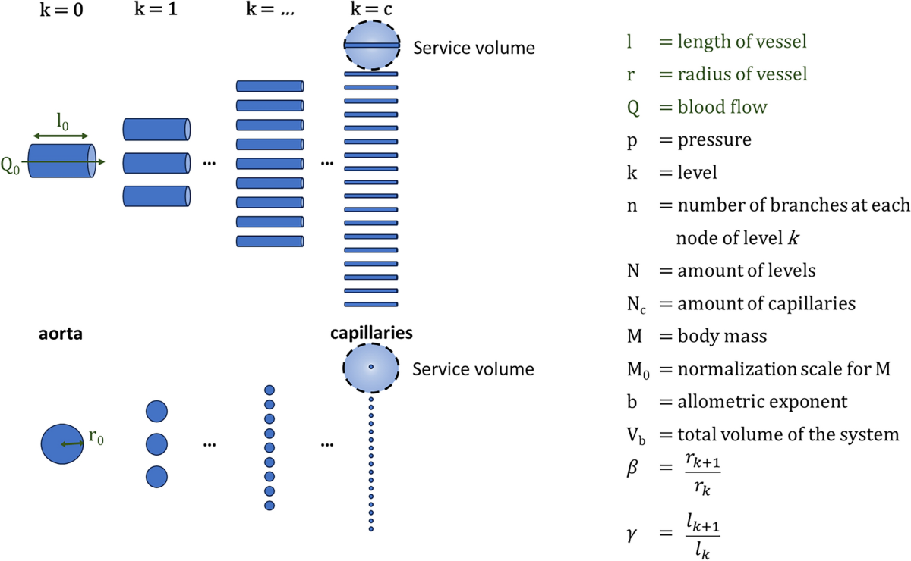
WBE theory: Optimized fractal networks may explain ¾ scaling law of Kleiber
West, Brown & Enquist (1997), Science 276:122–126.

Slide 3
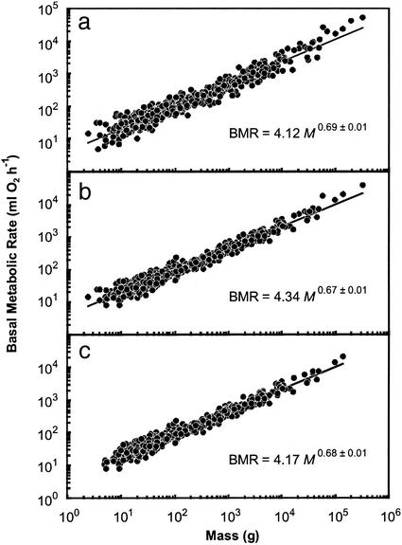
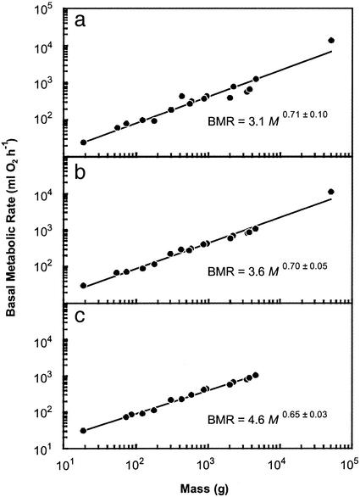
Empirical studies disagree over whether metabolic rate scales as 3/4 or 2/3
White & Seymour (2003), PNAS 100:4046–4049.

Slide 4
A yet-to-be-discovered physiological factor operates independently to ¼ allometric scaling
Uri Alon (2019) An Introduction to Systems Biology 2nd edition

