Slide 1

Insightful Pursuit Network Design & Setup Capstone Project Presentation by: Giselle E.

Slide 2

AGENDA
INTRODUCTION
IP Addressing Scheme & Network Segmentation
Network Design Overview
Services Provided On The Network
Routing and External Connectivity
Security Features
Ping, URL: www.company.com
Conclusion

Slide 3

The Network setup is for an enterprise called Insightful Pursuit, a missing person agency that specializes in locating and reuniting missing individuals with their families. The agency uses advanced technology and databases to assist in their search and communication efforts. Here's how the network setup might align with the agency's operations: Devices: 5 employee workstations (PCs\ laptops), 3 Smartphones, 1 printer, 1 video conferencing device, 1 public web server, NS server, Syslog server. Networking equipment (routers, switches).

Slide 4
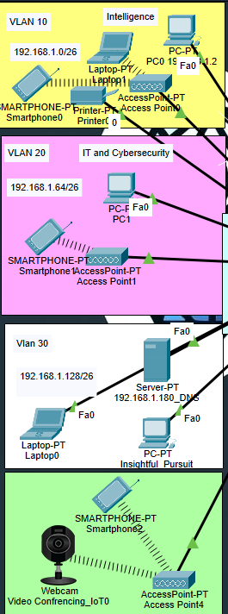
IP Addressing Scheme & Network Segmentation
The devices connect to the LAN both wired and wirelessly. The public web server has a wired connection.
One router and one switch to be used as well as a DNS server for the internal network. In the DMZ segment there is a switch, router, a sniffer, webserver and syslog server. One switch and a server with DNS and DHCP will be in the “internet” network.
IP addressing scheme for the internal network:
Intelligence Dept (Subnet 1, vlan10): 192.168.1.1 - 192.168.1.62
IT and Cybersecurity (Subnet 2, vlan20): 192.168.1.65 - 192.168.1.126
VLAN 30 (Subnet 3, vlan30): 192.168.1.129 - 192.168.1.190
DMZ network: 192.168.2.2 - 192.168.2.253
Subnetting is used to allocate IP addresses efficiently to each department and the DMZ zone. DHCP is configured to automatically assign IP addresses to host devices, simplifying network management.
Four network segments: three internal subnets and one DMZ network. The internal network segments and the DMZ network will be separated by routers.
The company connects to the Internet through a NAT router that connects the internal network and the DMZ network to the external network.

Slide 5
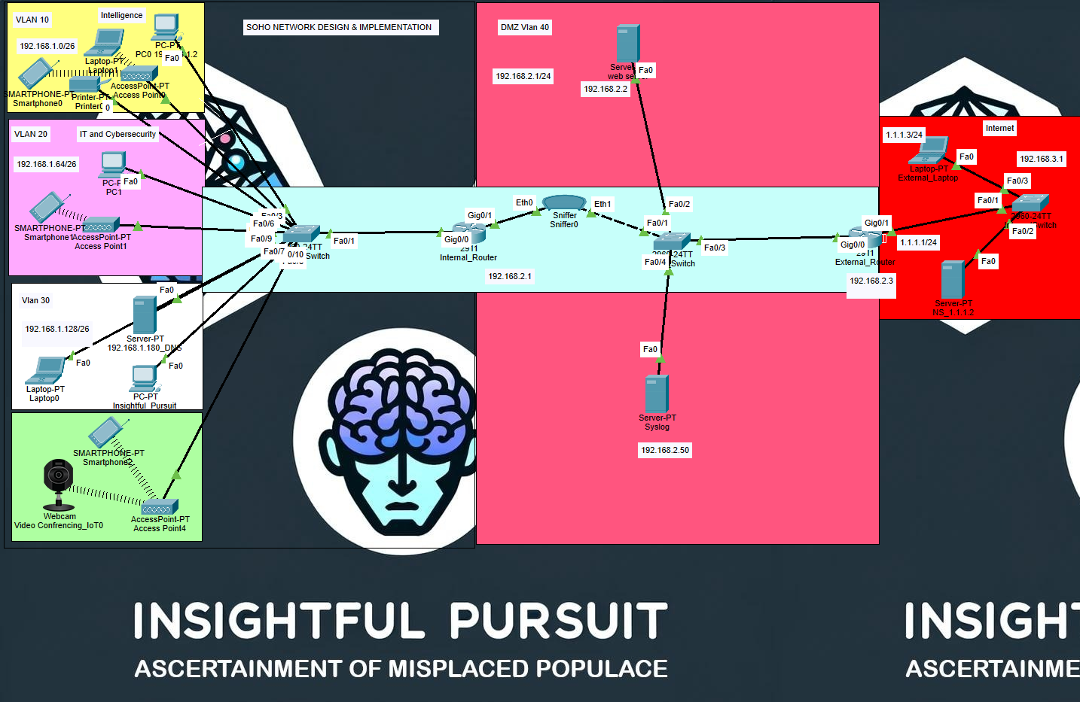
Network Design

Slide 6
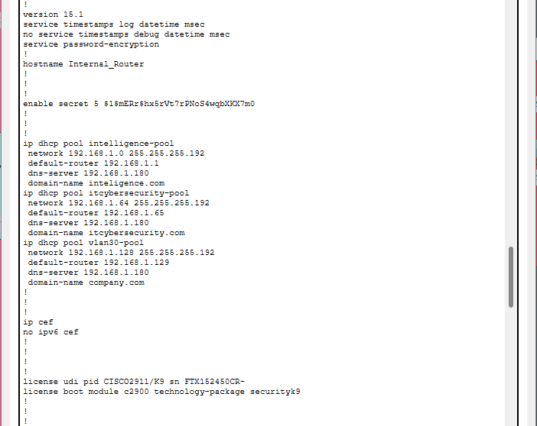
Services Provided On The Network
DHCP for automatic IP address assignment
DNS for domain name resolution: A DNS server has been configured to resolve domain names to IP addresses for both internal and external access.
Packet sniffing for network monitoring may be used to analyze network traffic for security and troubleshooting purposes

Slide 7
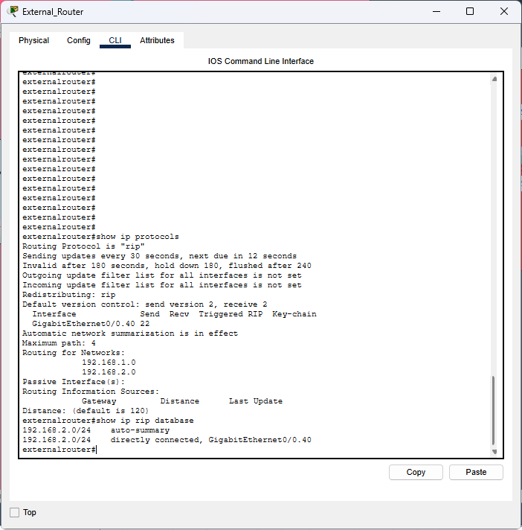
Routing and External Connectivity
Routing Information Protocol (RIP) is enabled for dynamic routing, allowing the internal router to exchange routing information with other RIP-enabled routers, including the external router.
The setup facilitates communication between the internal network, the DMZ, and the external network or the internet, ensuring connectivity for all network segments.

Slide 8
Security Features
An ACL named NAT_ACL is used to control which internal IP addresses can use NAT, providing an additional layer of security.
The `BLOCK_MALICIOUS` ACL blocks traffic from specific known malicious IP addresses, reducing the risk of attacks from these sources. The `ALLOW_ICMP_HTTP` ACL allows ICMP echo replies and HTTP traffic while blocking other types of traffic, limiting potential attack vectors.
CBAC is used to provide a stateful inspection on the HTTP traffic and log audit trails. This allows the router to detect and prevent unauthorized access and other security threats.
The IPS (`iosips`) monitors traffic for malicious patterns based on its active signature category (`ios_ips basic`) and takes action to block or alert on detected threats, providing real-time protection against attacks.
ACL
Access Control List
CBAC
Context-Based Access Control
IPS
Intrusion Prevention System

Slide 9
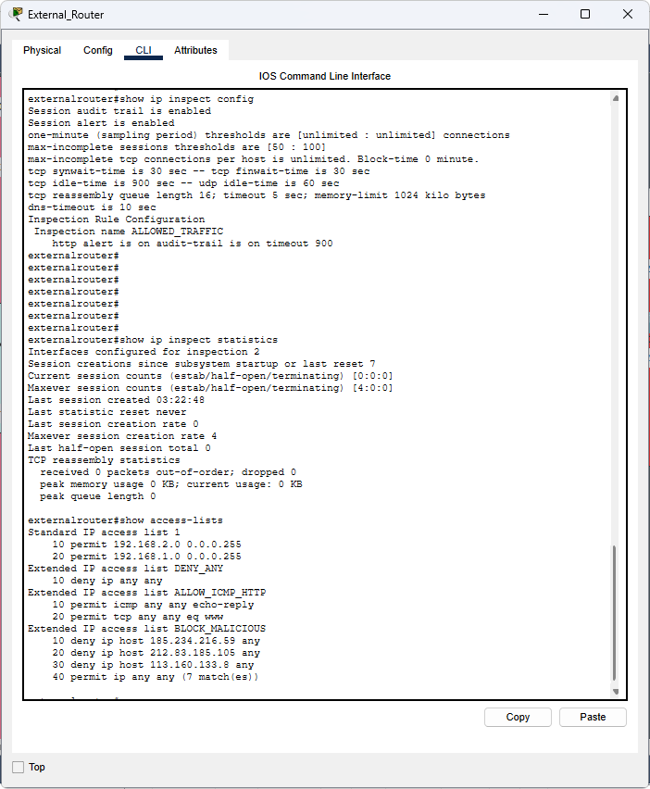
Security Features
Commands you can run for ACL: show access-list
Commands for CBAC: ip inspect config
Commands for IPS: show ip ips config
By combining IPS, CBAC, and ACLs, this configuration provides a multi-layered security approach to detect, prevent, and mitigate various types of attacks, including DDoS attacks, without significantly compromising network performance.

Slide 10
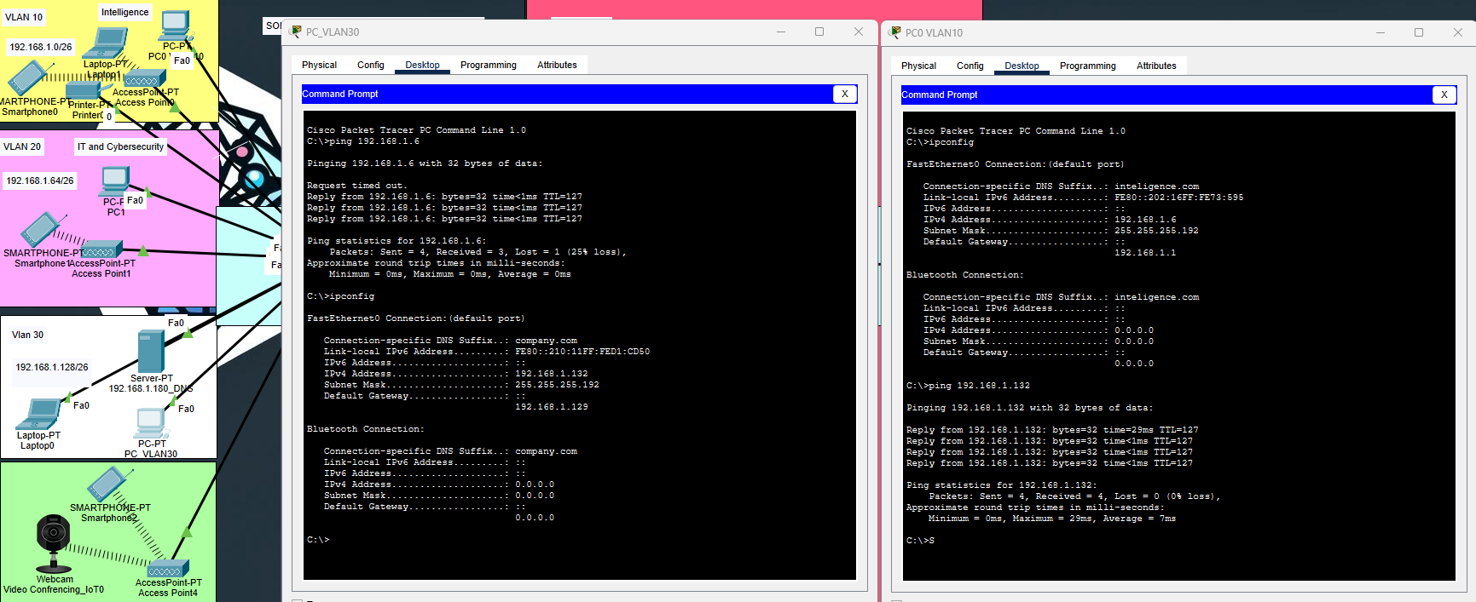
Ping

Slide 11
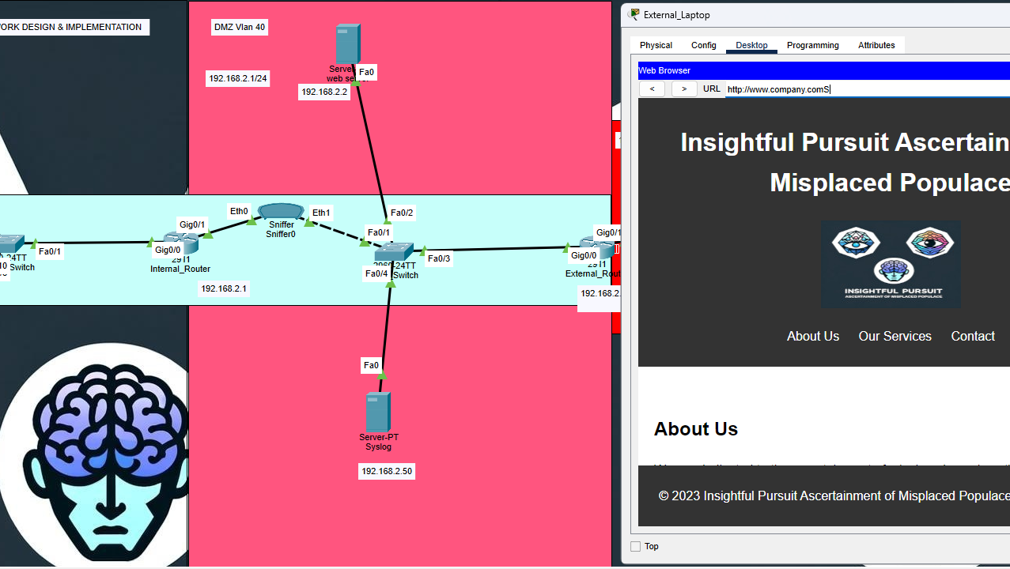
All devices can access the company’s webpage using the URL of http://www.company.com.

Slide 12
Conclusion
Insightful Pursuit's network has been meticulously designed to support the operational needs of a missing person agency, with a focus on security, efficiency, and scalability.
Security Measures: The implementation of ACLs, CBAC, and IPS ensures a robust security posture, protecting sensitive data and operations from cyber threats.

Slide 13

THANK YOU
Giselle E
502-555-0152
giselle@insightfulpursuit.com
www.company.com

Slide 14
Subnetting: Base network: 192.168.1.0 The number of departments required, or the number of subnets required = 3 No. Of subnets = 2^n (n = number of borrowed bits) (see 19 minutes) 2^n3==> n=2 Subnet: 255.255.255.0 New subnet mask: 255.255.255.192 (/26) Block size:64 (Subnet mask of 192 is a block size 64) Internal Network: Subnet 1, Intelligence Dept: Network ID: 192.168.1.0 Broadcast ID: 192.168.1.63 (-1 of next subnet 64) Host range: 192.168.1.1 - 192.168.1.62 (between network and broadcast id) Subnet 2 IT and Cybersecurity: Network ID:192.168.64 (block size 64 + pervious subnet 0) Broadcast ID: 192.168.1.127 Host range: 192.168.1.65 - 192.168.1.126 Subnet 3 Vlan30: Network ID: 192.168.1.128 (block size 64 + previous subnet .64) Broadcast ID: 192.168.1.191 (-1 + 64 +128) Host range: 192.168.1.129 - 192.168.1.190
Addendum

Slide 15
DMZ network: Network ID: 192.168.2.1 Host range: 192.168.2.2 - 192.168.2.253 Broadcast: 192.168.2.254 Subnet mask: 255.255.255.0 Wildcard mask: 0.0.0.255 DMZ switch's running configuration: 1. SSH Enabled: SSH version 2 is enabled for secure remote management. 2. Domain Name and Username: The domain name is set to `dmz.com`, and there is a user `admin` configured for SSH access. 3. Spanning-Tree Protocol: PVST (Per-VLAN Spanning Tree) is enabled, and PortFast is configured on multiple interfaces. 4. Port Security: Enabled on FastEthernet0/4 with a maximum of 2 MAC addresses allowed and the violation mode set to restrict. 5. Interfaces Configuration: Most interfaces are configured for access to VLAN 40, and several are shut down. PortFast is enabled on active interfaces to speed up the connection process for end devices. 6. VTY Lines: Configured for SSH access with local authentication. External network (internet): Network: 1.1.1.0 Host range: 1.1.1.1 to 1.1.1.254 Broadcast: 1.1.1.255 Subnet mask: 255.255.255.0 Wildcard mask: 0.0.0.255
Addendum

Slide 16
Here's an expanded description including details about the devices connected to each VLAN and the Internal Router: "Our Cisco switch, named InternalSwitch, plays a crucial role in our network infrastructure, ensuring secure and efficient communication among devices. The switch is running version 15.0 of the Cisco IOS software, with various features and configurations tailored to our organization's needs. VLAN Configuration: - VLAN 10: This VLAN is dedicated to our PC devices. FastEthernet ports 2, 3, and 4 are configured as access ports in VLAN 10, connecting our PCs to the network. Port 2 has port security enabled, allowing a maximum of 2 MAC addresses to connect. - VLAN 20: Devices such as laptops are assigned to VLAN 20. FastEthernet ports 5, 6, and 7 are configured as access ports in VLAN 20, providing connectivity for these devices. - VLAN 30: VLAN 30 is designated for devices requiring higher security, such as servers. FastEthernet ports 8, 9, and 10 are configured as access ports in VLAN 30, connecting these critical devices to the network. Internal Router Connectivity: The switch is connected to an InternalRouter, which serves as the gateway for our internal network. The InternalRouter, a Cisco 2911 router, facilitates communication between VLANs and provides access to external networks. The connection between InternalSwitch and InternalRouter is established through GigabitEthernet ports 0/1 and 0/2, respectively. Additional Configurations: - ARP inspection and DHCP snooping are enabled on VLANs 10, 20, and 30, protecting against ARP spoofing and unauthorized DHCP servers. - The switch is running PVST (Per-VLAN Spanning Tree) for loop prevention, with system-id extension enabled for improved interoperability. - Port security is implemented on select ports to limit the number of MAC addresses allowed, enhancing network security. - Password encryption is enabled for security, and a message of the day banner is displayed to inform users of unauthorized access restrictions.
Addendum

Slide 17
External Router Configuration: Security Perspective Intrusion Prevention System (IPS): IPS Rule (iosips): Monitors traffic for malicious patterns and takes action to block or alert on detected threats. Fail-Closed Mode: Ensures that if the IPS fails, all traffic is blocked to prevent potential security threats from slipping through. Context-Based Access Control (CBAC): HTTP Inspection: Inspects HTTP traffic for suspicious activity and dynamically opens and closes ports as needed for legitimate traffic. Access Control Lists (ACLs): BLOCK_MALICIOUS: Blocks traffic from specific known malicious IP addresses, reducing the risk of attacks from these sources. ALLOW_ICMP_HTTP: Allows ICMP echo replies and HTTP traffic while blocking other types of traffic, limiting potential attack vectors. DENY_ANY: Denies all traffic, providing a default security posture that only allows explicitly permitted traffic. Network Address Translation (NAT): Hides the internal network structure from potential attackers, adding a layer of obscurity to the network's security. Logging and Monitoring: Audit Trail: Logs CBAC events for monitoring and analysis. Syslog: Configured to log security events, providing visibility into potential security incidents. Secure Management: Password Encryption: Ensures that passwords are stored securely on the router. Enable Secret: Provides a secure method for accessing the router's privileged EXEC mode. Key Takeaways: The external router is configured with multiple security features to protect the network from various threats. IPS and CBAC provide real-time monitoring and control of traffic, while ACLs enforce access policies. NAT and logging contribute to the overall security posture by adding obscurity and visibility. Regular updates and monitoring are essential to maintain the effectiveness of these security measures.
Addendum

