Slide 1

SW Project
Darwin Zapata
N00170456

Slide 2
Introduction
Laravel
Bootstrap
GitHub Project
Design
Business – drone

Slide 3
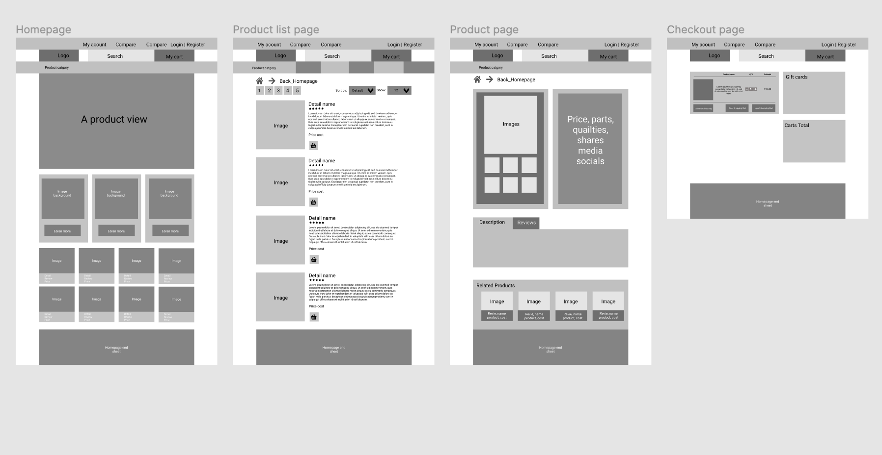
Design

Slide 4
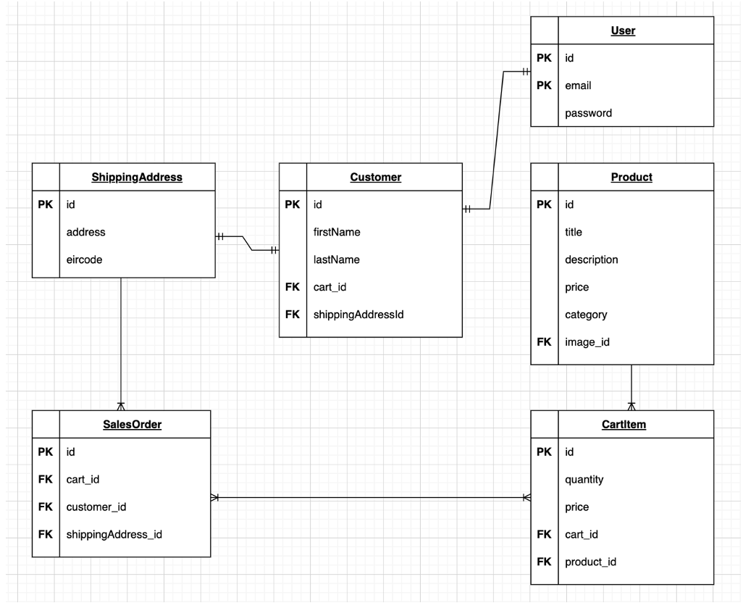
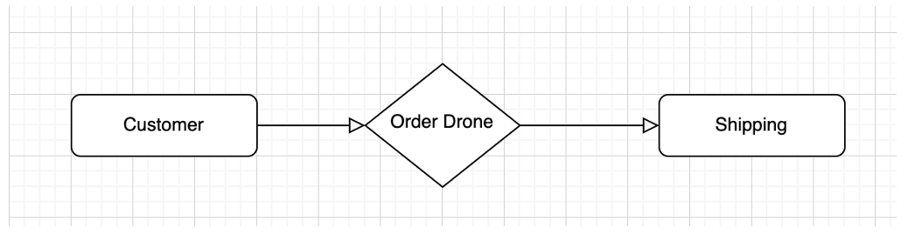
Database

Slide 5
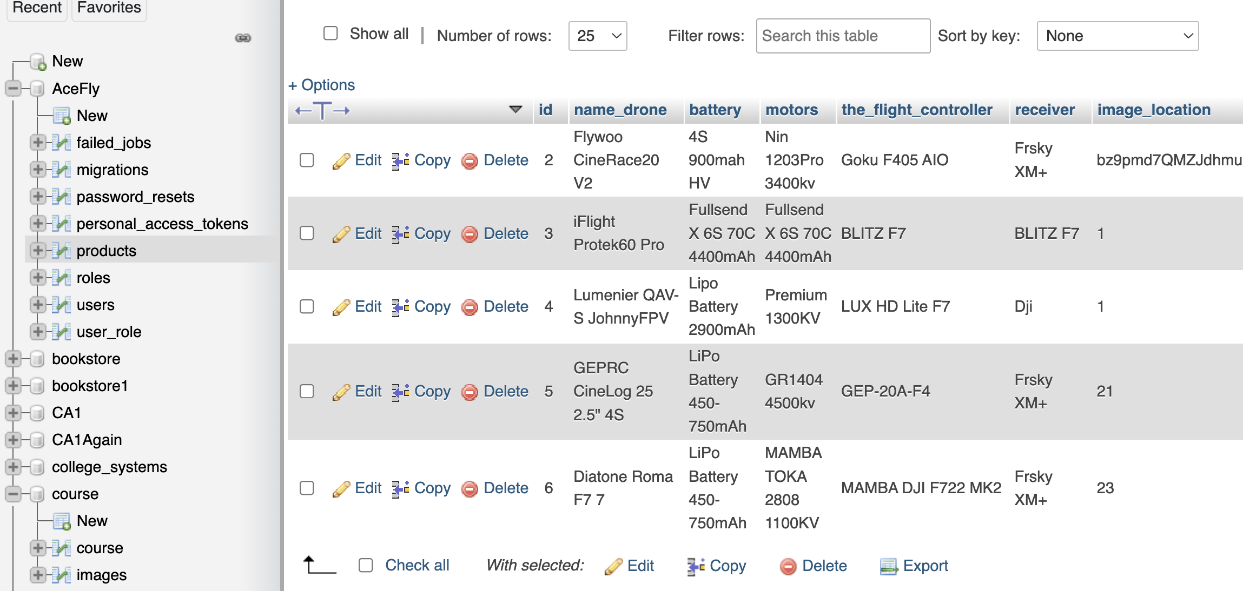
Development in php

Slide 6
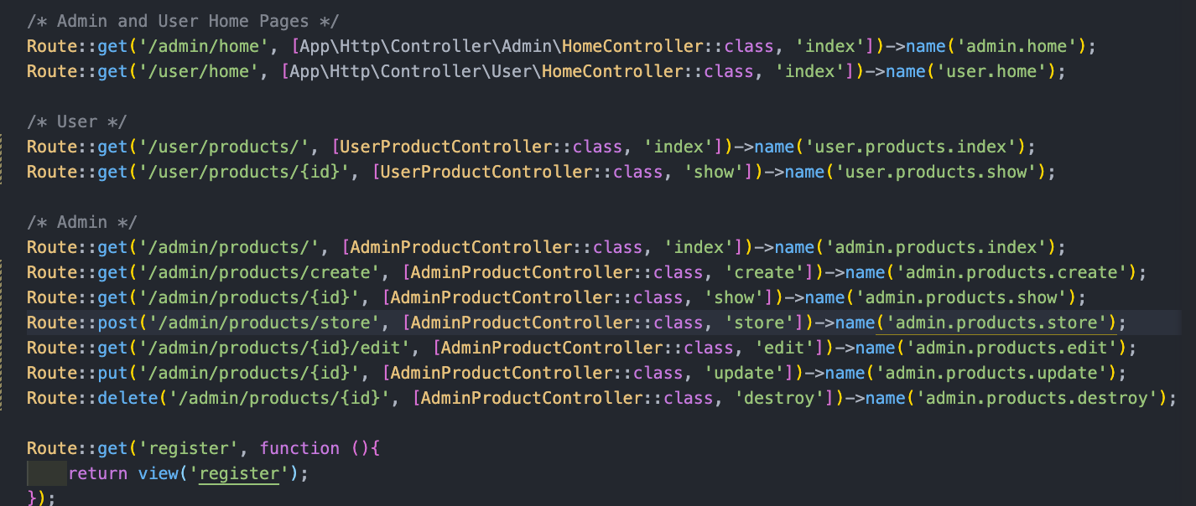
Development Laravel

Slide 7
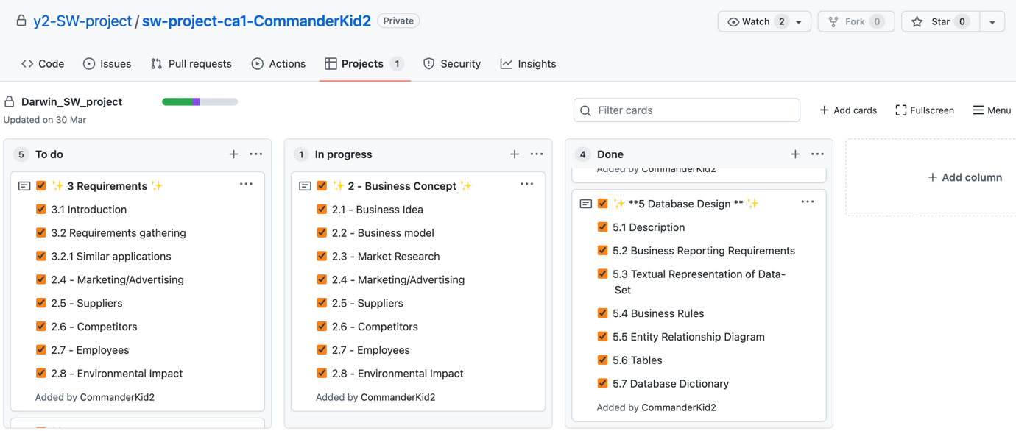
GitHub project

Slide 8
My own reflection
- My work had errors with Laravel which images and login
- Learned bootstrap which colours, boxes, icons
- Learned Laravel which route, web, controllers

